Slide 1
Overcoming Unconscious Bias in the Talent Acquisition Process
Lori Fuller
Sr. Human Resources Manager
UW System Human Resources
Wanda Manning
Human Resources Generalist
UW System Human Resources

Slide 2
Overview
UWSA’s Commitment to Inclusive Excellence
What is Unconscious Bias?
Types of Unconscious Bias
Impact of Diversity
Examples of Unconscious Bias
Controlling Unconscious Bias
Discussion

Slide 3
The University of Wisconsin System is an affirmative action/equal opportunity employer and actively seeks and encourages applications from women, minorities, and persons with disabilities.
REGENT POLICY 17-4
It is the policy of the University of Wisconsin System to adopt and support measures designed to prevent and eliminate discrimination against employees and prospective employees of the University of Wisconsin System on the basis of race, color, religion, sex, gender identity or expression, national origin, age, or physical handicap.

Slide 4
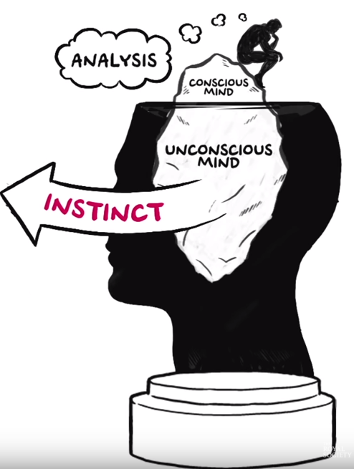
The Brain is Amazing
It can process vastly more information than the conscious mind by using shortcuts based on our background, cultural environment, and personal experiences to make instantaneous decisions about everything around us.
Automatic reactions and skills
Implicit knowledge
Instinct and intuition
The Royal Society (2015, November 17). Understanding Unconscious Bias [Video file]. Retrieved from https://youtu.be/dVp9Z5k0dEE

Slide 5
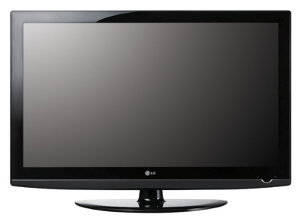
Equalityandinclusion (2015, September 17). What is Unconscious Bias? [Video File]. Retrieved from: https://youtu.be/rbe5D3Yh43o
Notes:
WHAT IS UNCONSCIOUS BIAS: https://www.youtube.com/watch?v=rbe5D3Yh43o

Slide 6
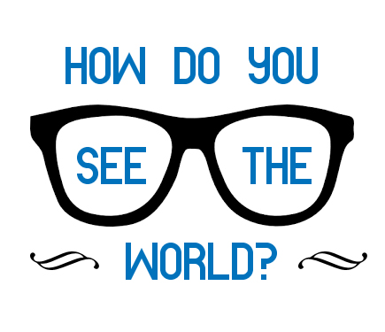
WHAT IS BIAS IN HIRING PRACTICES?
Tendencies to favor or prefer one person or group over another person or group for reasons unrelated to the actual job criteria.
WHAT IS UNCONSCIOUS BIAS?
Unconscious bias is a mental shortcut and results from almost automatic connections or decisions we make often without conscious consideration.
We don’t see things as they are,
we see things
as we are.
~Anais Nin

Slide 7
We all have unconscious bias.

Slide 8
The Father-Son Activity
SOLVE THE FOLLOWING PROBLEM:
A father and son were involved in a car accident in which the father was killed and the son was seriously injured. The father was pronounced dead at the scene of the accident and his body was taken to a local morgue. The son was taken by ambulance to a nearby hospital and was immediately wheeled into an emergency operating room. A surgeon was called. Upon arrival and seeing the patient, the attending surgeon exclaimed “Oh my God, it’s my son!” Explain how this can happen.
Pendry, Driscoll, & Field (2007).

Slide 9
As Humans, Our Tendency Is To Prefer To Be With People Who:
Look like us
Sound like us
Share our social background
Interests
Education
We are naturally drawn to people who have commonalities with us. We find comfort in what we know regardless of whether or not we believe this to be the right choice. This can manifest in a bias recruitment process and we can let the real talent slip through our fingers.
IncrediblePeopleAUS (2016, September 21). Unconscious Bias in Recruiting [Video file]. Retrieved from https://youtu.be/C-Dp372Jsj4

Slide 10
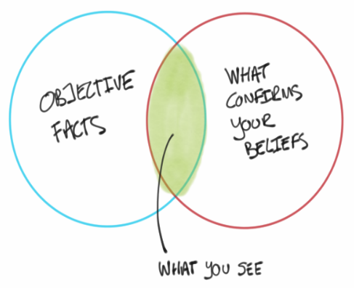
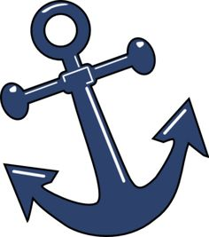
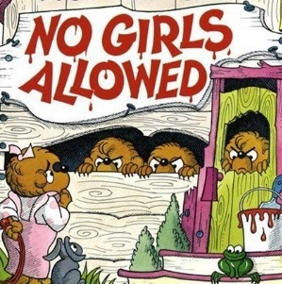
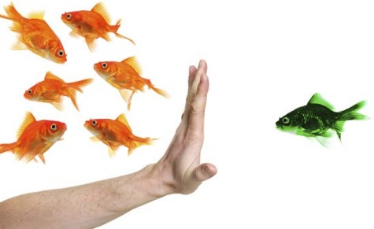
Types of Unconscious Bias
ANCHORING BIAS
Over-relying on the first piece of information obtained and using it as the baseline for comparison. For example, if the first applicant has an unusually high test score, it might set the bar higher than applicants with more normal scores.
CONFIRMATION BIAS
Involves favoring information that confirms previously existing beliefs or biases. For example, a hiring manager has a preference for hiring candidates who have graduated from a specific college or university.
HALO/HORN EFFECT
HALO: The tendency to judge others similarly on all traits, assuming that because someone is good or bad at one thing they will be equally good or bad at another. For example, during a search, if a candidate has strong education credentials the committee might conclude that he/she is also a strong leader.
HORN: The concept by which a person who is judged negatively on one aspect is automatically judged negatively on several other aspects without much evidence. Clearly, this is the opposite of the halo effect.
IN-GROUP BIAS
Makes us more comfortable with those who we unconsciously feel are like us and in our group. For example, search committee members who perceive commonalities with applicants are more likely to view them favorably.
STEREOTYPE BIAS
Attributing assumed or learned characteristics of a group to individual members of the group, whether or not they share the characteristic. For example, a search committee member judges a job candidate by their physical appearance.

Slide 11
Workplaces with Greater Diversity Report Greater:
Adaptability
Productivity
Profitability
More effective execution of strategy due to the broader variety of viewpoints and strengths that comes from the workforce
IncrediblePeopleAUS (2016, September 21). Unconscious Bias in Recruiting [Video file]. Retrieved from https://youtu.be/C-Dp372Jsj4

Slide 12
Examples of Unconscious Bias
Candidate address – long commute or lives in an undesirable location
Email address – crazymom666
The university attended
Social networks – stated political affiliations or religious affiliations
Phone interviews – tone, pitch, or accent
Appearance – clothes, hair style, tattoos
Gaps in employment – justified or a red flag?
Tolstoi-Miller, Gail (2017, May 4). Unconscious Bias: Stereotypical Hiring Practices [Video file]. Retrieved from https://youtu.be/QCFb4BiDDcE

Slide 13
Potential Blind Spots (Bias) in Candidate Selection
TESTING | INTERVIEWING | REFERENCES | PANEL INTERVIEW | RIGHT FIT-COMFORT
Method Used Fairness Languages Predictive Bias Measurement Bias | First Impression Negative Emphasis Halo/Horn Effect Cultural Noise Contract Effect | Confirmation Bias Gender Implications Bias in Self-Identification Functional Bias | Panel Member Selection Documentation Observation / Analysts Cultural / Gender Biases | Expectation of Assimilation Subjective Vs. Objective Criteria Standardization Introspection

Slide 14
Tips to control for Unconscious Bias
Replace your self-image as an objective person with recognition and acceptance that you are subject to the influence of bias and assumptions
Insist on a diverse search committee
Increase the representation of women and minorities in the applicant pool
Develop well-defined, objective evaluation criteria prior to reviewing applications
Prioritize evaluation criteria prior to evaluating applicants
Check yourself and each other in counter-stereotype imaging to reduce the influence of unconscious assumptions (i.e. imagine an astronaut, engineer, CEO who is also a woman)
Spend sufficient time evaluating each applicant; minimize distractions

Slide 15
Media Partners [2017, September 12]. How to Overcome Unconscious Bias [Video file]. Retrieved from: https://youtu.be/vytOEbWvVjc

Slide 16
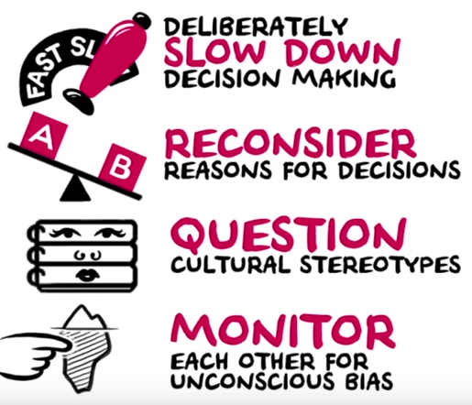
We can’t cure unconscious bias, but with self-awareness we can address it.
The Royal Society (2015, November 17). Understanding Unconscious Bias [Video file]. Retrieved from https://youtu.be/dVp9Z5k0dEE

Slide 17
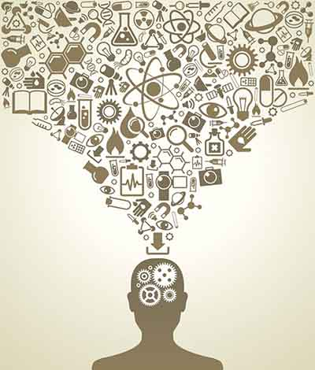
Discussion
Be honest with yourself. It’s okay to have biases – we all do. It doesn’t make you any less of a person. What’s important is that you control them and actively look for ways to expand and revise your views. Be open to change.
Recognize how your assumptions can influence your decisions and make a conscientious effort to overcome your assumptions.
Change your outlook to prevent bias. Everyone should aim to assess others more positively – to give credit where it’s due and not magnify shortcomings.

Slide 18
Summary
Everyone has Biases
Recognize your Biases
Question what you Think you Know – Change your Viewpoint
Understand how your Biases Affect your Decision-Making
Focus on what is Important

Slide 19
Resources
Project Implicit: https://implicit.harvard.edu/implicit/selectatest.html
Project Implicit Test: https://implicit.harvard.edu/implicit/takeatest.html
KIRWAN INSTITITE: http://kirwaninstitute.osu.edu/researchandstrategicinitiatives/implicit-bias-review/
Emtrain (2016, May 19) What is Unconscious Bias? [Video File]. Retrieved from: https://youtu.be/R95bU9Z7afQ
Marshall E-Learning Consultancy (2017, May 12). How We Make Decisions and How Unconscious Bias Affects Judgement [Video File]. Retrieved from: https://youtu.be/dlwkvB0Diz4
Equalityandinclusion (2015, September 17). What is Unconscious Bias? [Video File]. Retrieved from: https://youtu.be/rbe5D3Yh43o
Litmos Heroes ( 2016, October 28). Unconscious Bias – Leadership and Management [Video File]. Retrieved from: https://youtu.be/dloCJq8shZE
PwC (2017, June 23). Blind Spots: Challenge Assumptions [Video File] Retrieved from: https://youtu.be/BFcjfqmVah8
Media Partners (2017, September 13). Unconscious Bias Test [Video file]. Retrieved from https://youtu.be/0veDFGo666s
Ali al-Yunani (2015, December 9). What Muslims Are Hiding From You. [Video file]. Retrieved from: https://youtu.be/OiKZpsu418k
Media Partners [2017, September 12]. How to Overcome Unconscious Bias [Video file]. Retrieved from: https://youtu.be/vytOEbWvVjc
The Royal Society (2015, November 17). Understanding Unconscious Bias [Video file]. Retrieved from https://youtu.be/dVp9Z5k0dEE
Grovo.com. Addressing Unconscious Bias with Modern Learning, Overcome Your Unconscious Bias. [Video File]. Retrieved from: https://www.grovo.com/lessons/overcome-your-unconscious-bias
TV 2 Denmark (2017, January 27). All That We Share [Video file]. Retrieved from: https://youtu.be/jD8tjhVO1Tc

