Slide 1
Research Participant Cash Advance Specialist Training
February 24, 2026

Slide 2
Agenda
Spend Authorization Functionality Overview
Spend Authorization with Cash Advances for Research Participant Approvals
Cash Advance balances are due 30 days past the end date of the Spend Authorization with the Cash Advance
Find Cash Advances and Find Spend Authorizations (UW) Reports
Understanding Expense Advance Repayment Specialist Role (EARS) vs Research Participant Cash Advance Specialist (RPCAS) role
Ready for Go Live?
Open Questions

Slide 3
Spend Authorization Overview
Some campuses require Spend Authorizations for travel, for most it is optional
Spend Authorizations must be used for all cash advance requests
Spend Authorizations also are used for Policy Exceptions, Official Functions and Gift Card Approvals
You will only be in the approval chain for Spend Authorizations that have a Business Purpose of Cash Advance for Research Participants
Your role is to evaluate if the cash advance is appropriate, and best practice is to look to see if the employee has other cash advances that are overdue
Make sure the “Cash Advance Requested” box is selected
If it is not selected you will need to send back with instructions to employee to check the box (you are not able to check the box on the employee’s behalf)
It will have to through approval chain again, but it is best practice to have employee confirm the cash advance
Functionality does allow you to send back to the Driver Worktag Manager and they can select the Cash Advance Requested box

Slide 4
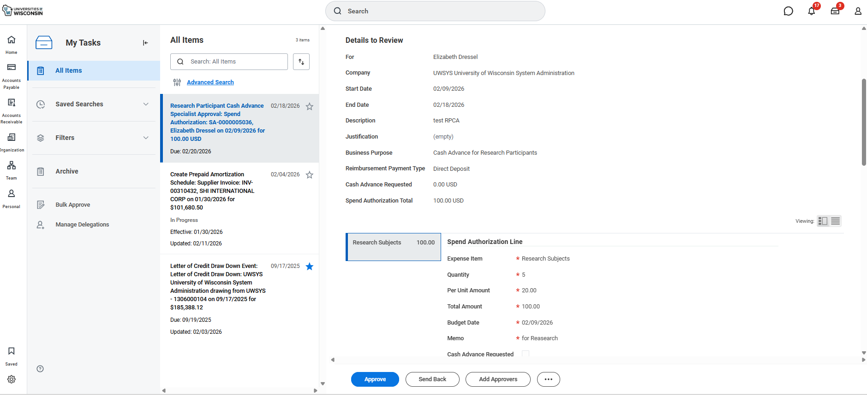
How Approval Will Look – My Tasks

Slide 5
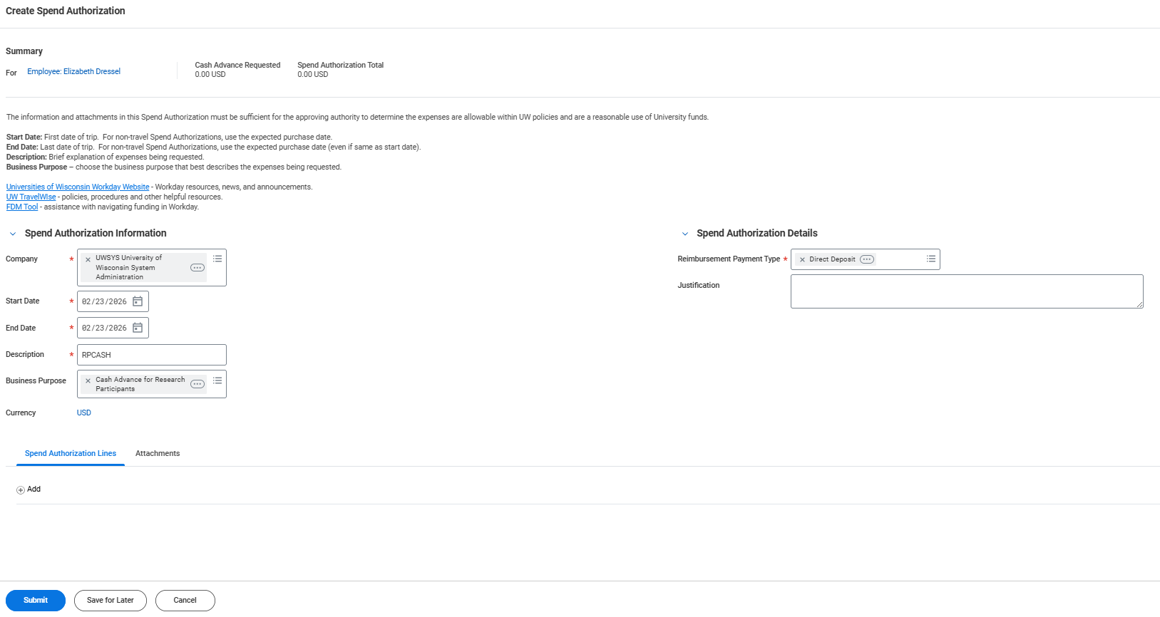
Spend Authorization Overview – View of Spend Authorization (screen 1 of 3)

Slide 6
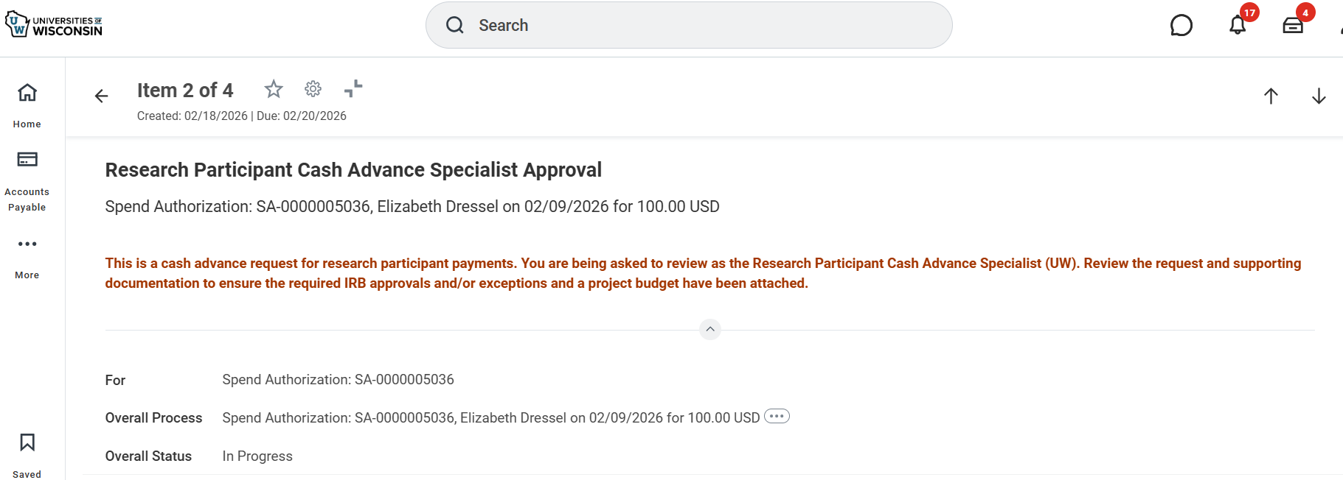
Spend Authorization Overview – View of Spend Authorization (screen 2of 3)

Slide 7
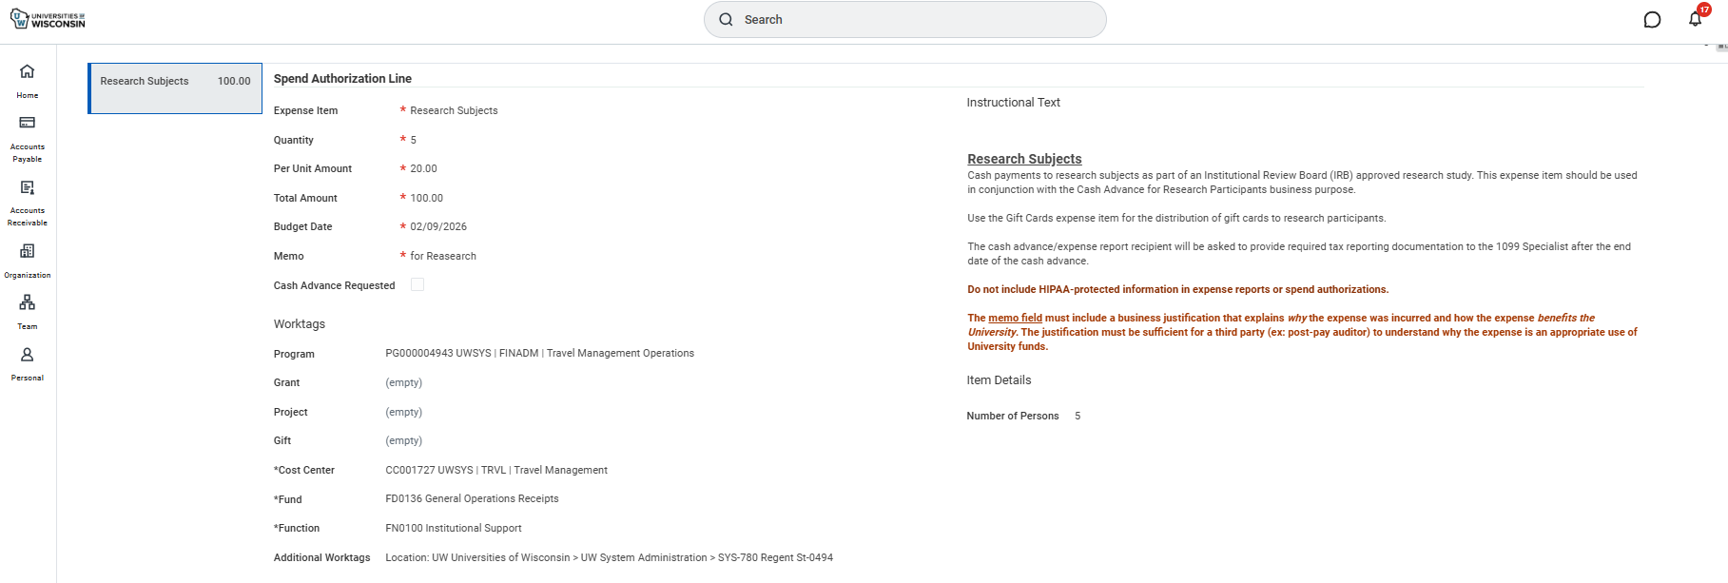
Spend Authorization Overview – View of Spend Authorization (screen 3 of 3) Look for the Cash Advance Requested Check Mark, Does this Language Work on Expense iTEm?

Slide 8
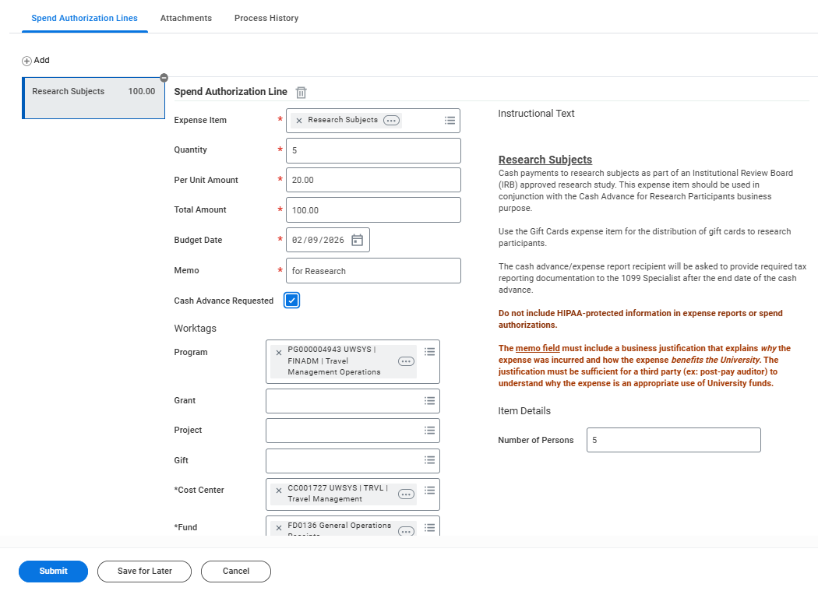
Employee Will Go in and Select the Box and Submit and go through appropriate Approvals

Slide 9
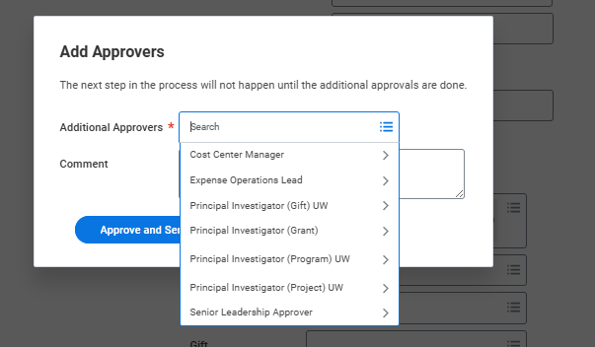
Option to Add Approvers
Here is the list of roles you are able to Ad Hoc the Spend Authorization to should you need to (most likely scenario the PI for the Grant)

Slide 10
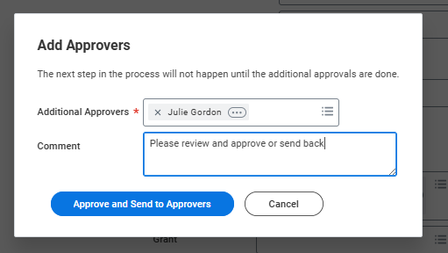
Reminders
Only the Driver Worktag Manager is reviewing the request and you (RPCAS) for any Research Participant Cash Advances
It is up to you to determine if you need to ad hoc additional approvers in
Not all Worktags will have a PI option (especially true of Programs, and Projects)
If you do Add Approvers, you are approving
(and also requiring this other approver to approve or send back)

Slide 11
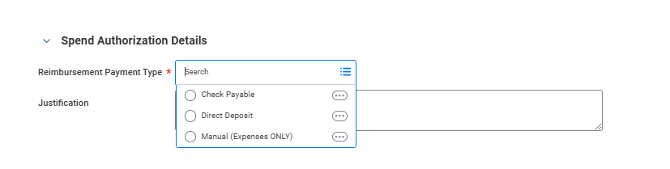
Cash Advance Payment options
Payments will default to direct deposit and will be deposited typically within 2 days after final approval
Checks can be requested at the header level of the Spend Authorization by selecting “Check Payable”
Manual is wire payments made internationally

Slide 12
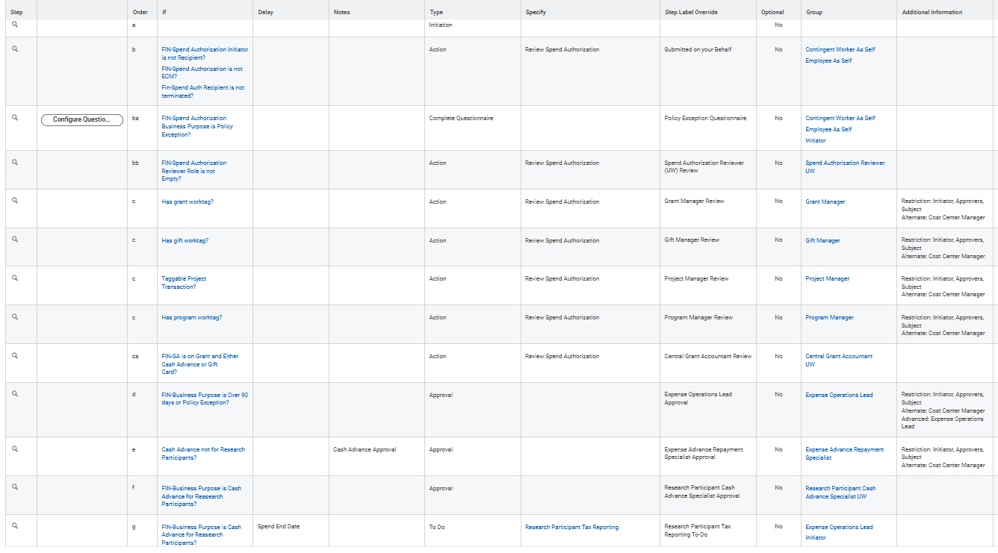

Slide 13
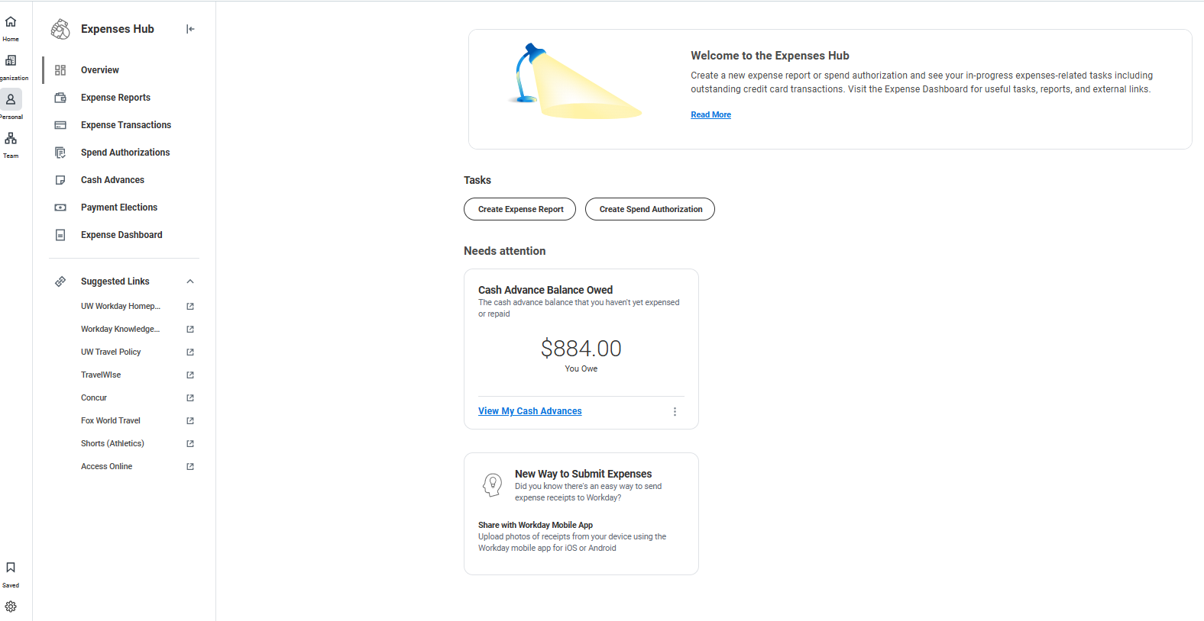
After Approval of Cash Advance
Employees will see “Cash Advance Balance Owed” card in Expense Hub and can “View My Cash Advances”

Slide 14
After Approval of Cash Advance
The Expense Operations Lead and the Initiator of the RP Cash Advance will get a “To Do” step to send any tax information to the 1099 Specialist if needed (the end date in the header)
This “To Do” fires even if the requestor did not check “Cash Advance Requested”
RPCAS will also get the approval step even if CAR is not checked (reminder to please make sure it is checked)
UWA is working on potentially rolling out guidance on any tolerances/thresholds, for now the we have built in a “To Do” step is sent as a reminder that it may be needed after the cash advance for Research Participants is approved
We have left this language generic, added UW Madison link, rest of campuses nothing is set yet

Slide 15
Unused Cash Advances
Employees are required to pay back the UW within 30 days of the End Date they entered in the Spend Authorization
Workday atomically generate a receivable from the employee when they link the Spend Authorization the Expense Report and mark the Spend Authorization as the “final” expense report reconciling the Spend Authorization/Cash advance
Employees will be asked on how they wish to pay the University back
The EARS role will handle any payroll deductions or marking any repayments to the Bursars office on any outstanding/unused cash advances
EARS has the right and responsibility to ensure compliance to the 30 day rule and can ask payroll to deduct money from payroll as needed

Slide 16
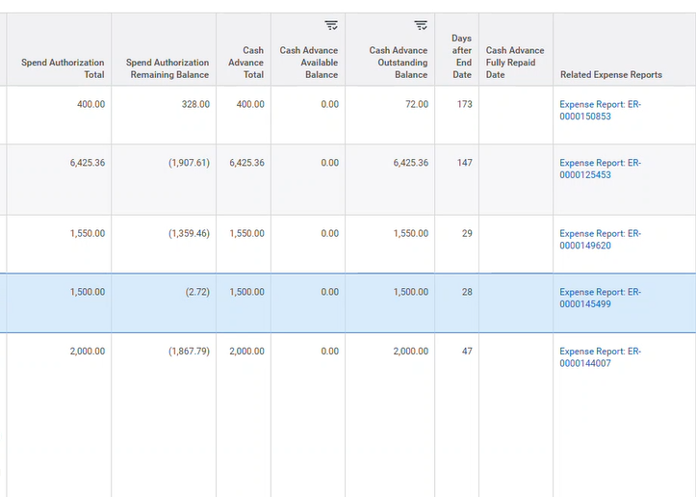
Reports – Demo
Use Find Cash Advances
Find Spend Authorizations (UW)
Cash Advance Available Balance - is reduced by in process Expense Reports
Cash Advance Outstanding Balance is not reduced by in process Expense Reports

Slide 17
Overview of EARS role vs RPCAS Role
Separate Word doc, PDF on Workflow and Excel on Workflow
Make sure to coordinate with the EARS on any past due outstanding cash advances and repayments

Slide 18
Wrap UP
Do you feel ready for go live this week?
What else is needed from Expenses?
Job Aids are being updated, hoping for March for completion with all of the changes across Expenses/Spend Authorizations
Questions

Slide 19
Thank YOU!

