Slide 1
Workday Expenses Open House with expense Data Entry Specialist Emphasis
April 2026

Slide 2
Agenda
Spend Authorization Functionality Overview
Policy & 90 Day Exceptions
Expense Report Functionality Overview
New Expense Report Reviewer Role (optional) - NEW
Potential Upcoming Changes:
Fly America Act Compliance Form
New Expense Items (International Airfare vs Domestic Airfare)
Non-Resident Alien Process
Submitting for Pre-Hire or Candidate vs External Committee Member
Open Questions

Slide 3
Spend Authorization Overview – Changes Highlighted
Some campuses require Spend Authorizations for travel, for most it is optional
Spend Authorizations must be used for all cash advance requests
Spend Authorizations also are used for Policy Exceptions, Official Functions and Gift Card Approvals
UW Madison will be rolling out in July of 2026
We have added a new Spend Authorization type, that have a Business Purpose of Cash Advance for Research Participants
The Central Grant Accountant reviews Cash Advance or Gift Card business purpose/expense items on Grants
Ad hoc to more roles (PI Grants/PI Programs/PI Project/PI Gifts, Senior Leadership Approver)
We have updated Policy & 90-Day Exceptions (Spend Auth Only) to require a completed questionnaire after the Spend Authorization is submitted

Slide 4
Spend Authorization for Policy Exceptions
If an EDES enters the Spend Authorization for the Policy Exception on behalf of another employee, it will route for the employee to approve
After employee approves, the Policy Exception questionnaire is sent to both the EDES and the employee
After either the EDES or employee completes, it will then route to driver worktag managers and the Expense Operation Lead for approval
EDES and employee both receive a notification once the Spend Authorization is complete (and can then be attached to an Expense Report)
UW Madison will be rolling this out in July 2026
All other campuses are currently using

Slide 5
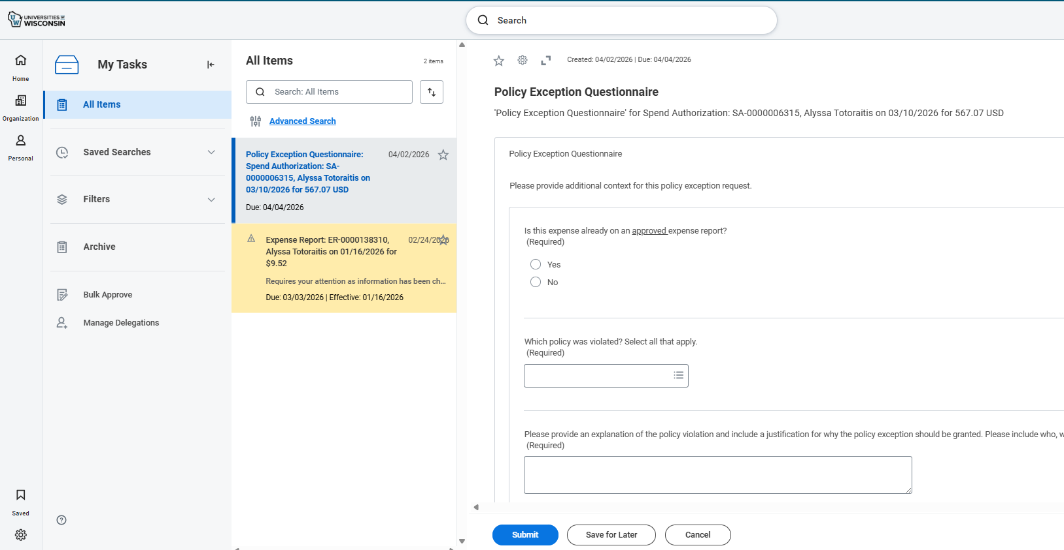
How Spend Authorization Will Look for Policy Exceptions

Slide 6
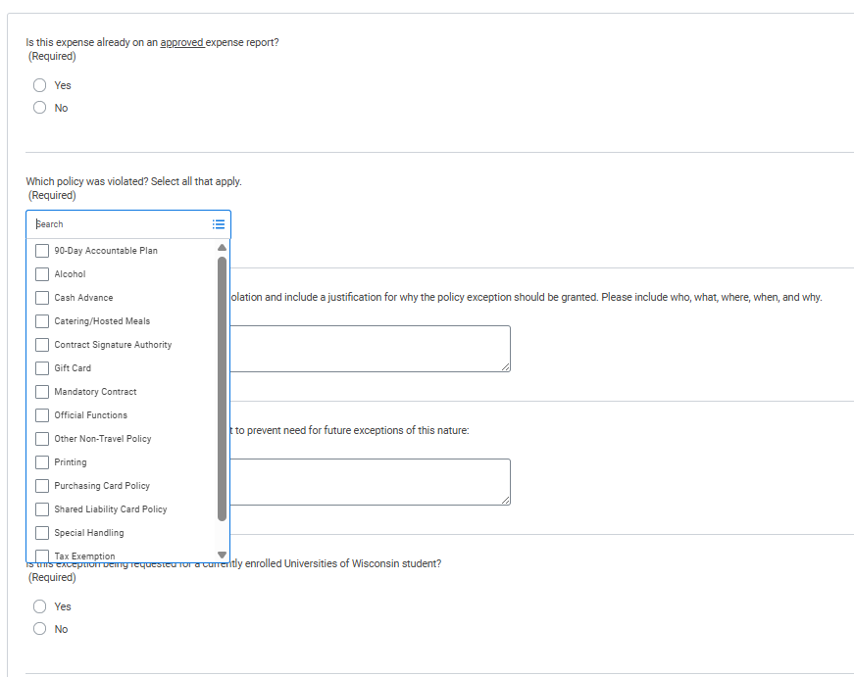
How Spend Authorization Will Look for Policy Exceptions
Which policy was violated is a multi-select field with Travel Policy being the last on this list (not shown)

Slide 7
Research Participant Cash Advances
This process in Spend Authorizations are open for all campuses
Works like other Cash Advances, except this will route to the Research Participant Cash Advance Specialist role as well as Driver Worktag Managers
Must be reconciled within 30 days of the “End Date” at the header level of the Spend Authorization

Slide 8
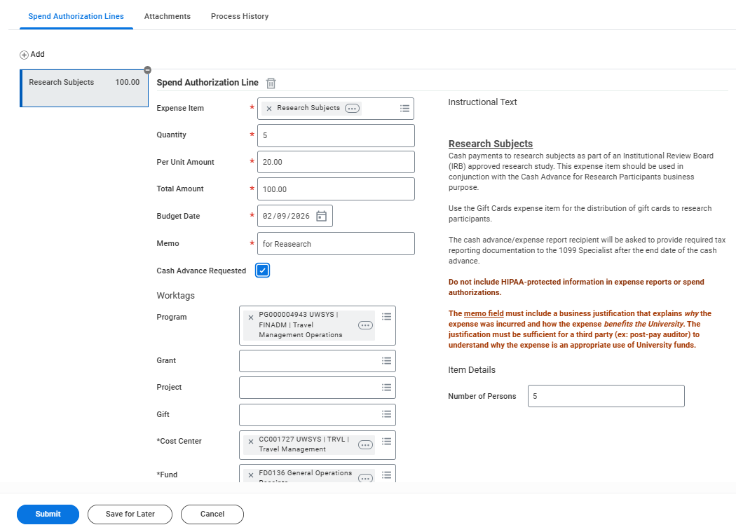
Employee Will Go in and Select the Box and Submit and go through appropriate Approvals

Slide 9
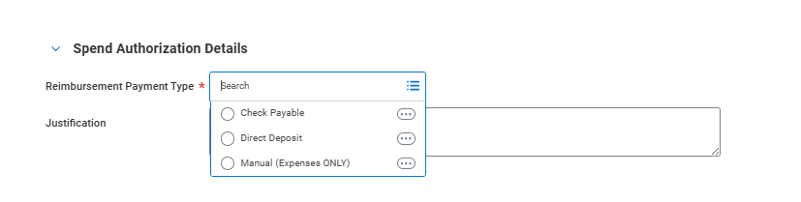
Cash Advance Payment options
Payments will default to direct deposit and will be deposited typically within 2 days after final approval
Checks can be requested at the header level of the Spend Authorization by selecting “Check Payable”
Manual is wire payments made internationally

Slide 10
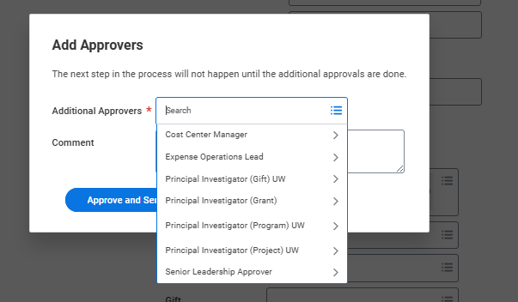
Option to Add Approvers
Here is the list of roles approvers are able to Ad Hoc the Spend Authorization to should they need to (most likely scenario the PI for the Grant funding)

Slide 11
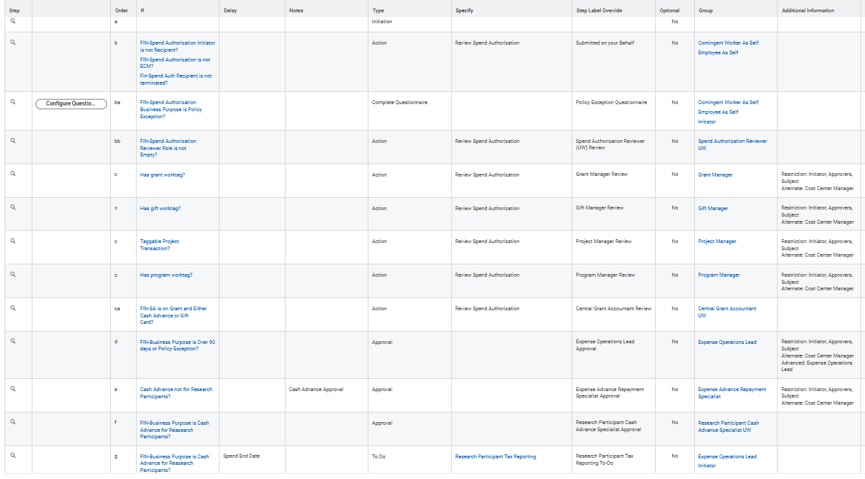

Slide 12
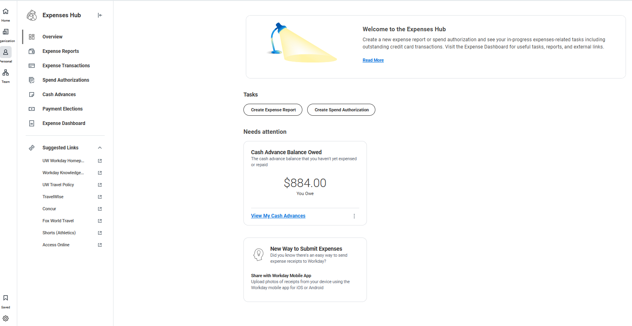
After Approval of Cash Advance
Employees will see “Cash Advance Balance Owed” card in Expense Hub and can “View My Cash Advances”

Slide 13
Unused Cash Advances
Employees are required to pay back the UW within 30 days of the End Date they entered in the Spend Authorization
Workday atomically generate a receivable from the employee when they link the Spend Authorization the Expense Report and mark the Spend Authorization as the “final” expense report reconciling the Spend Authorization/Cash advance
Employees will be asked on how they wish to pay the University back
The EARS role will handle any payroll deductions or marking any repayments to the Bursars office on any outstanding/unused cash advances
EARS has the right and responsibility to ensure compliance to the 30 day rule and can ask payroll to deduct money from payroll as needed

Slide 14
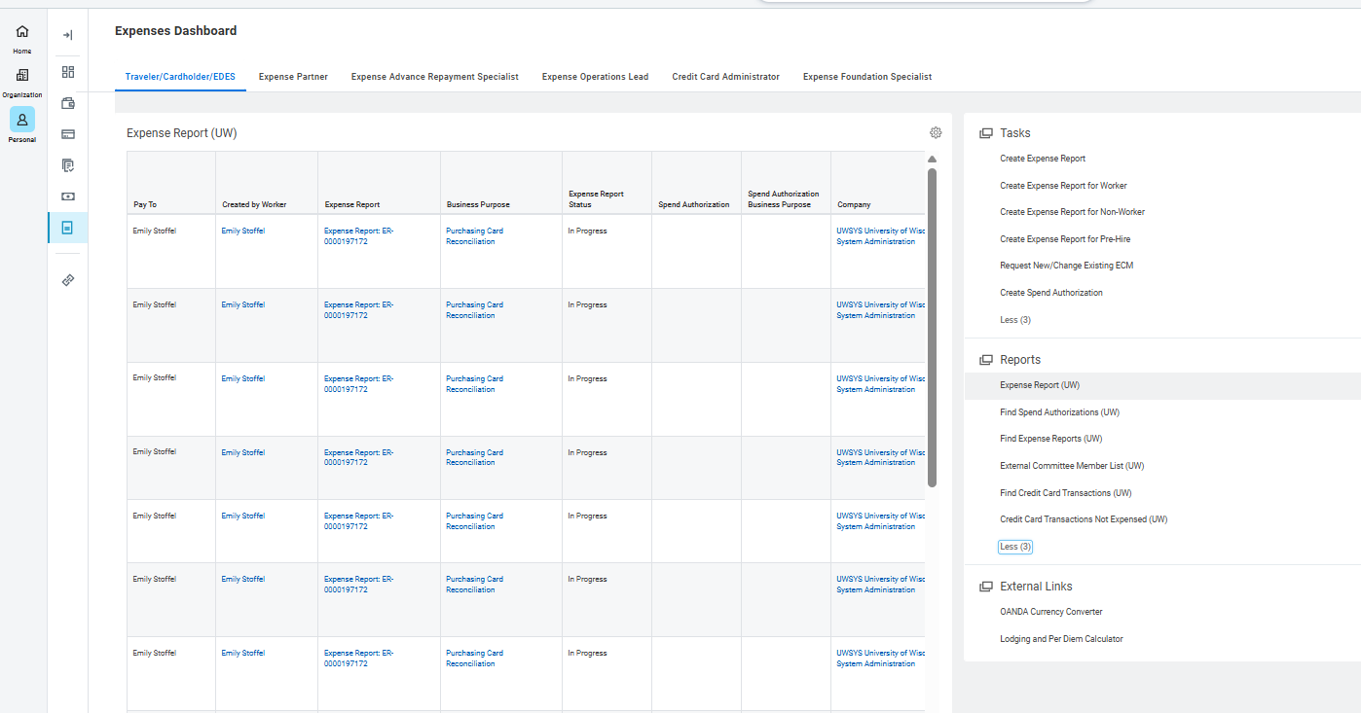
Dashboard in Expenses Hub
Use Dashboard find Tasks and Reports and External Links
Expense Report (UW) has additional information

Slide 15
Overview of External Committee Member (ECM)
Run report – External Committee Member List (UW) first to see if the ECM already exists (
Submit to create ECM by using “Create Request”
Request type: External Committee Member
Complete information (Name, Address, Contact information – either phone or email)
See if it is completed by going to your notifications (bell icon)

Slide 16
Potential Future changes – Pain points
Looking into use of ECMs vs Candidate/Pre-Hire
Use ECM when in doubt
Working with HR on Non-Resident Alien document review process
Fly America Act – will require an exception form if a non US Flag Carrier is used for international airfare on Federal Funds, rolling out in May 2026
https://www.wisconsin.edu/travel/planning/international/fly-america-act-and-open-skies-agreements/

Slide 17
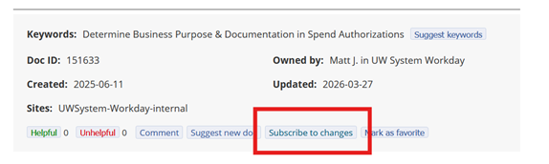
Wrap UP
Subscribe to Workday changes -
https://www.wisconsin.edu/workday/2026/03/02/new-subscribe-to-workday-updates-for-your-functional-area/
Subscribe to changes on Job Aids
Review What’s New: System Updates
Questions

Slide 18
Thank YOU!

