Slide 1


Travel Policy Training
October 28, 2025

Slide 2

Presenter
Emily Stoffel Regional Travel Manager emily.stoffel@wisconsin.edu 608-263-1040

Slide 3
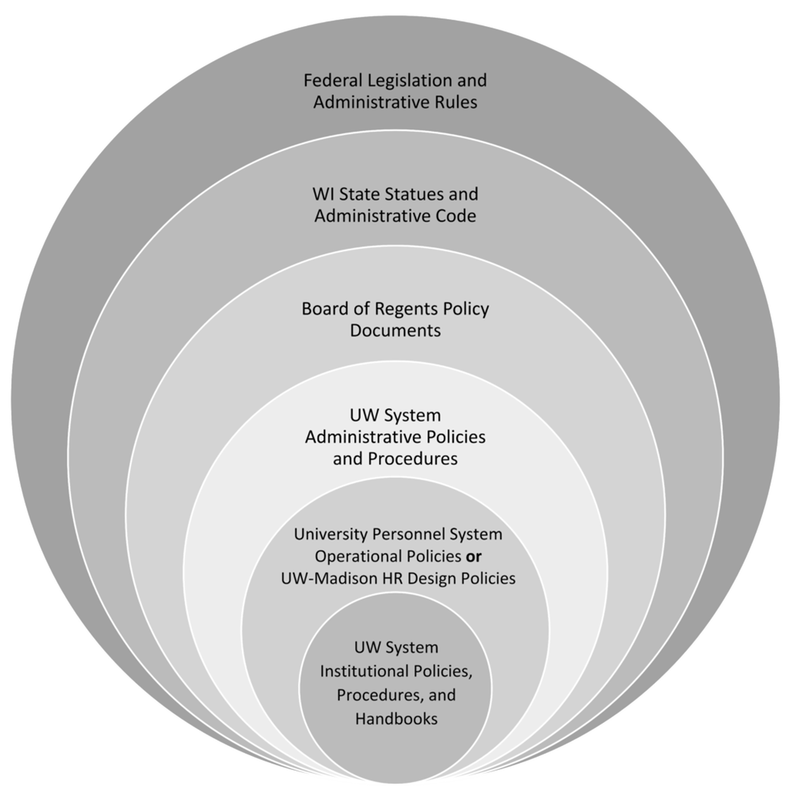
The more restrictive policy takes precedence
Always check with your supervisor/dept for specific travel policies

Slide 4
Tax Exemption
Purchases made in WI must be tax exempt (lodging in WI, WI based car rentals, WI hosted meals, etc.)​
Concur/Travel Agencies do NOT handle tax exemption. It is up to the traveler to ensure hotels are tax exempt​
Recommend travelers carry tax exempt wallet card​. Business office has wallet cards
Some other states honor tax exemption. Visit TravelWIse for more info​

Slide 5
Travel Authorizations
Provost requires them for folks in Academic Affairs
Other, non-Academic Affairs depts may require TA’s
Check with department for specifics (may or may not be done in Workday)

Slide 6
Paying for Travel
Personal Funds
Personal funds may always be used for travel
Reimbursement is done via expense report in Workday
Shared Liability Card
Not really used at UWL
Formerly Corporate card
University issued liability card only for travel
Cardholder must ensure prompt payment or late fees after 60 days
Purchasing Card
University issued credit card
Automatically paid
Reconciled within 60 days via expense report in Workday

Slide 7


Travel Agencies
UW has managed travel program = most UW travel MUST be booked using the approved travel agency
Individual Travel
Fox World Travel – work with an agent via phone or email
$31.50/domestic air ticket
$41.50/international air ticket
No service fees for hotel or car-only bookings
Recommended for complex international bookings, same-day travel, etc.
M-F 7a-7:30p standard hours; after hours calls incur service fees
Group Travel (10+ tickets) = Fox World Travel
Athletics Travel = Shorts Travel

Slide 8

Concur
Website managed by Fox World Travel to book hotel, car, air online
$6/air ticket (domestic & international)
No service fees for hotel or car-only bookings
All employees have a Concur profile
Chat with live agents
No longer required to register
Every active employee is automatically set up with a Concur profile
Legal name is populated from Workday. Ensure your name in Concur matches your legal travel document. Allow 2-3 days to correct in Concur
Concur Login

Slide 9
Airfare
Must ALWAYS be booked with a travel agency or in Concur
CANNOT be booked on third-party website (Expedia, Travelocity, etc.) or directly with airlines
Seat assignment fees are allowed but cannot be for cabin upgrades/class change
Allow baggage fees
Valid cost comparisons are required when:
Adding personal stops to trip (ex., Conference in Denver but flying from MSP to DEN to San Diego for personal reasons and back to MSP)
Layovers longer than one night
Departing from/returning to airport outside of WI or more than 100 mi from the WI border for personal reasons (including from voluntary remote work location)
Travel Policy: Airfare

Slide 10
Lodging
Reimbursement allowed up to nightly max rate for location
Nightly max rate found in Per Diem Calculator
If the city is not listed, use county
Exceptions to nightly max:
Designated conference hotels (get proof such as screenshot)
Overage due to taxes and fees (not applicable in WI)
No hotels available under nightly max rate (must have proof from Concur or Fox)
Can book in Concur, with travel agency, directly with hotel, or through conference booking link
Third party site bookings NOT allowed
Tax Exemption
Always tax exempt in WI
Other states have some tax exemption
Check TravelWIse for list
Travel Policy: Lodging
Per Diem Calculator

Slide 11
Ground Transportaion
Driver Authorizations
Required for all drivers on UW business
Must be completed prior to travel
Required for rental vehicles, personal vehicles, & fleet vehicles
Options
Rental Vehicles
Fleet Vehicles
Personal Vehicles
Driver Authorization

Slide 12



Rental Vehicles
Must utilize Enterprise/National or Hertz contracts​
Best practice is to reserve in Concur or with travel agency to ensure UW contracts are applied​
Rent Compact/Standard/Intermediate vehicle classes​
UW reimburses cost of rental vehicle and gas
Do NOT take any add-on services (GPS, satellite radio, car seats)​
Toll passes/packages are an allowable expense​
CDW and LDW insurances are included in domestic business rentals​
International rentals require careful review. Visit TravelWIse for more info​
Travel Policy: Vehicle Rental
Notes:
Madison airport has Enterprise and Hertz; Enterprise in La Crosse

Slide 13
Personal Vehicles
Travelers who utilize a personal vehicle for business travel are eligible for mileage reimbursement​
Mileage reimbursement covers all costs related to operation of vehicle including service, maintenance, insurance, depreciation, and gas​
MapQuest or Google Maps are used to determine most direct route​
As of July 1, 2025, turndown rate is no longer utilized
​Reimbursement rate = $0.70/mile
Fleet Vehicle Information
https://www.uwlax.edu/facilities-management/university-central-fleet/
Travel Policy: Vehicle Rental
Notes:
New remote work agreement might have impact on mileage reimbursement

Slide 14
Meal & Incidental Per Diem
Meal & Incidental per diems are paid when there is an overnight stay​
Per diem rates are paid directly to the individual traveler AFTER travel​
Rates vary based on location and provided meals. Provided meals are deducted from reimbursement. No longer deducting for first/last day
​A $5 incidental cost is included in the per diem rate for things like tips, travel costs to restaurants, etc.​ Incidental is built into meal percentages not calculated separately
Use the Per Diem Calculator to determine reimbursable amount​
No receipts are required for per diem reimbursement​
Day trip meals are reimbursed if there is no overnight stay - $15 taxable​
Travel Policy: Meals

Slide 15
Travel WIse & Per Diem Calculator

Slide 16
Fox World Portal

Slide 17
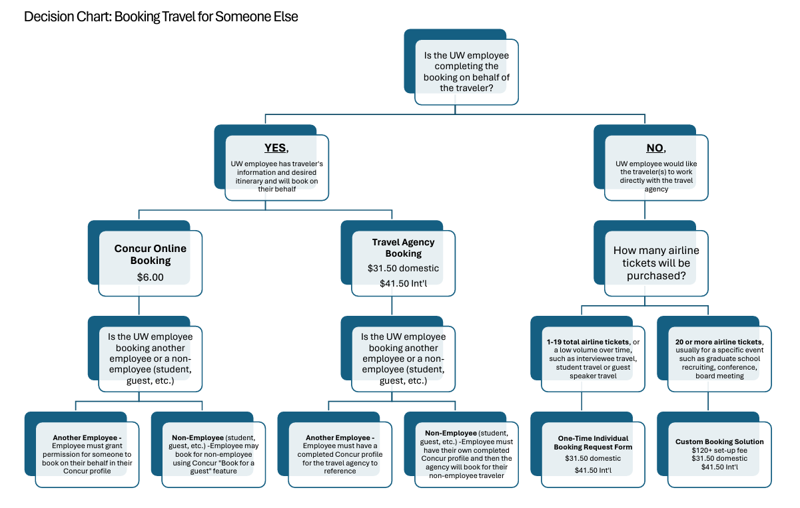
Booking for Others
Booking for Others
Notes:
Training is geared toward individual travelers; anyone traveling on University Business

Slide 18
Unused Airfare Tickets
When tickets get cancelled, a credit goes on file under the traveler’s name
Each airline handles unused tickets differently
Credits may be eligible for name changes (allowing someone else to use the credit), refunds, etc.
Reference Unused Ticket Credit Guide for more info
When part of a credit is utilized (ex. Changing flights results in cost difference) these are referred to as MCO’s. They have less flexibility

Slide 19
Resources
UW TravelWIse
UWL Travel Page
Concur Login and Registration
Fox World Portal
Per Diem Calculator
Workday Login
Booking for Others TravelWIse Page

