Slide 1
UWEC Travel training part 1: policy
AUGUST 25, 2025

Slide 2

Topics:
Paying for Travel
Travel Agencies
Airfare
Hotel
Car Rental
Ground Transport
Meal Per Diems
Per Diem Calculator
Concur Walkthrough
Resources
Presenter: Emily Stoffel
Regional Travel Manager
Emily.Stoffel@wisconsin.edu
608-263-1040

Slide 3
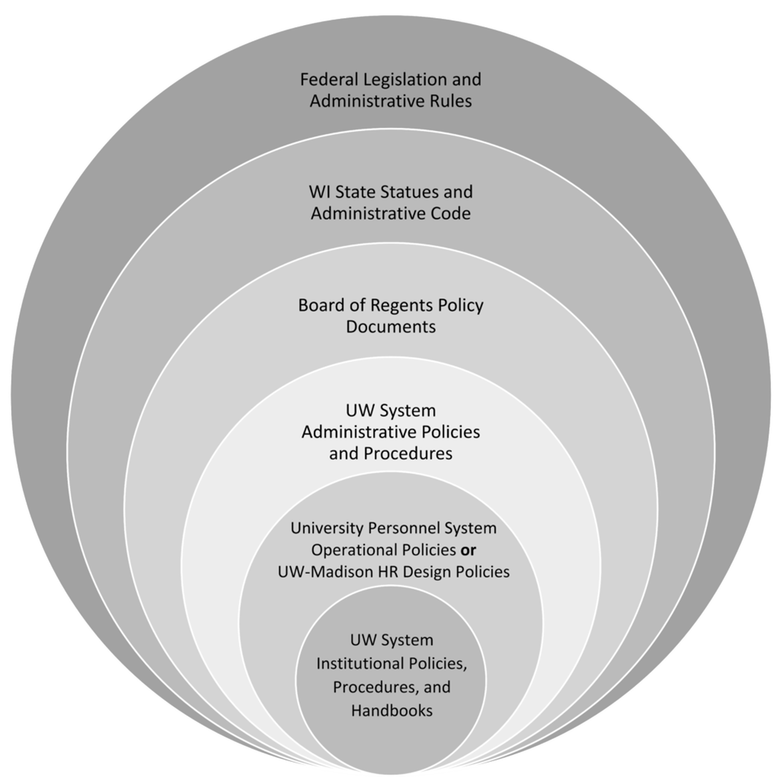
The more restrictive policy takes precedence
Always check with your supervisor/dept for specific travel policies

Slide 4
Paying for travel
Travel is allowed on P-Cards
University-issued credit card
Automatically paid
Reconciled within 60 days via expense report in Workday
Personal Funds
Shared Liability Card
Purchasing Card
Personal funds may always be used to pay for travel
Reimbursement is done through an expense report in Workday
Formerly Corporate Card
University-issued liability credit card only for travel = cardholder’s responsibility to pay within 60 days, or late fees are assessed
Card is paid via expense report in Workday

Slide 5
Receipt requirements when paid with…
Personal Funds or Shared Liability Card
Purchasing Card
Receipts required for every purchase
Do not use Pcard for meals included in the per diem or gas when using a personal vehicle
Receipts are required for purchases over $50
Receipts are not required for mileage or per diem reimbursements

Slide 6



Travel agencies
UW has a managed travel program = most university travel MUST be booked using the approved travel agency
Individual Travel
  Fox World Travel – work with an agent via phone or email
    $31.50/domestic air ticket
    $41.50/international air ticket
    No service fees for hotel or car-only bookings
    Recommended for complex international bookings, same-day travel, etc.
    M-F 7a-7:30p standard hours; after hours calls incur service fees
  Concur – website to book hotel, car, air online
    $6/air ticket (domestic & international)
    No service fees for hotel or car-only bookings
    All employees have a Concur profile
    Name in Concur is from Workday; ensure LEGAL name is correct and complete to match ID’s used for travel
Group Travel (10+ Tickets) = Fox World Travel
Athletics Travel = Shorts Travel

Slide 7

Airfare
Must ALWAYS be booked with a travel agency or in Concur
CANNOT be booked on third-party website (Expedia, Travelocity, etc.) or directly with airlines
Seat assignment fees are allowed but cannot be for cabin upgrades/class change; can sometimes be booked by agents but can also be booked directly with airline
Allow baggage fees
Valid cost comparisons are required when:
  Adding personal stops to trip (ex., Conference in Denver but flying from MSP to DEN to San Diego for personal reasons and back to MSP)
  Layovers longer than one night
  Departing from/returning to airport outside of WI or more than 100 mi from the WI border for personal reasons (including from voluntary remote work location)

Slide 8

Lodging
Can book in Concur, with travel agency, or direct with hotel
No third-party bookings allowed (Ex. Expedia, booking.com, etc.)
Reimbursement is allowed up to maximum nightly rate for location
  Per Diem Calculator shows rates
  If city is not listed, use county
  Exceptions to nightly max:
    Designated conference hotels
    Overaged due to taxes and fees (not applicable in WI)
    No hotels available under max rate (proof required)
Tax Exemption
  Always tax exempt in WI
  Other states have some tax exemption.
  Check TravelWIse for list

Slide 9


Ground Transportation
Driver Authorizations
  Required for all drivers on university business
  Must be completed prior to travel
  Required for rental vehicles, personal vehicles, fleet vehicles
Options
  Rental Vehicles
  Personal Vehicles
UWEC Driver Authorization Page

Slide 10



Rental vehicles
Must utilize Enterprise/National or Hertz contracts
Book in Concur or directly with vendor (must ensure contract is applied)
Use rentals when it is the most cost-effective means of transport
Rent Compact/Standard/Intermediate vehicle classes
UW reimburses cost of rental vehicle and gas
Do NOT take any add-on services
Personal booking codes can be found on TravelWIse

Slide 11
Personal Vehicles
Reimburse mileage at Standard rate ($0.70/mile)
Only mileage is reimbursable (gas is not reimbursed separately)
Maps and receipts do not need to be included for reimbursement
Workday expense reports calculate mileage automatically based on location information

Slide 12

Meal & Incidental Per Diem
Per Diem rates
  Reimbursement paid directly to the employee AFTER travel
  Vary based on location and number of meals needed
  No longer deducting for first/last day; only deducting for meals provided
Incidentals are no longer calculated separately. If you claim all meals were provided, you will receive $0 for that day
Not recommended to pay for meals with Shared Liability Card; but, if you do, make sure to pay these card charges with personal funds
No receipts required for per diem
Day Trip - $15 taxable
Per Diem Calculator

Slide 13
Employee Checklist
Resources
UWEC Travel Page
UW System TravelWIse
Per Diem Calculator
Concur
Workday
Ensure name on Concur account is correct
Apply for UW card product/s if desired
  Purchasing Card
  Shared Liability Card
Complete a driver authorization
Travel Manager Emily Stoffel
Emily.stoffel@wisconsin.edu
608-263-1040

Slide 14
Thank you!

