Slide 1
Expense Data entry specialist training
THURSDAY, OCTOBER 9, 2025
Notes:
Tina – Intros & Housekeeping

Slide 2
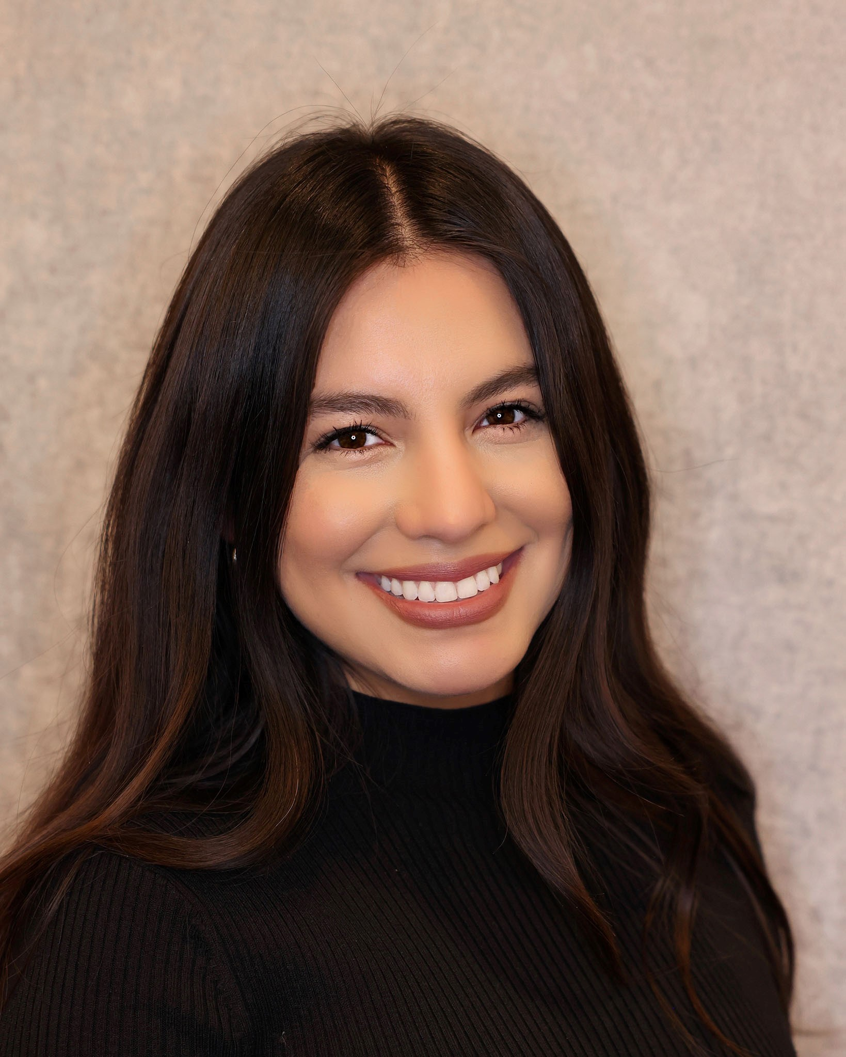
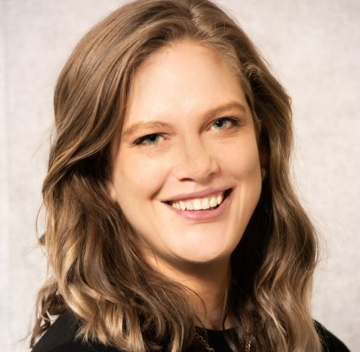
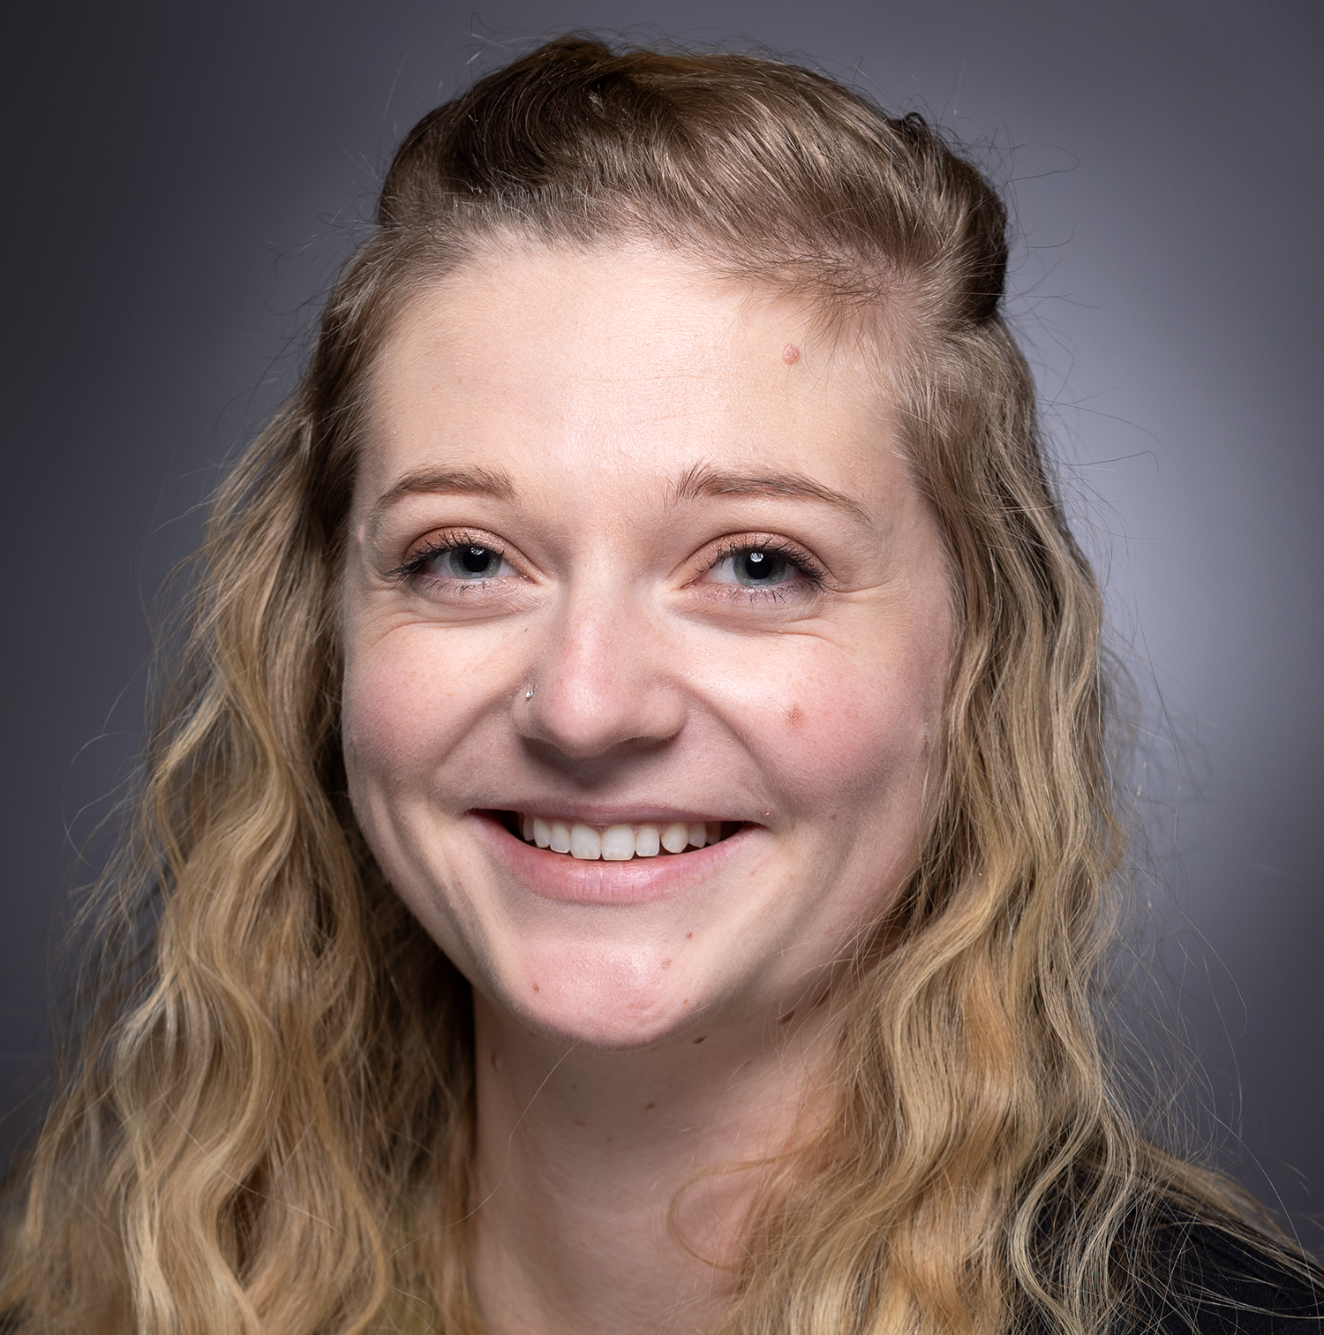
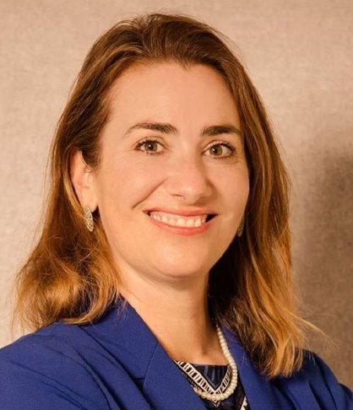
Uw travel team introductions
Elizabeth Dressel
ATP Expenses Design Team Co-Lead & Director of Travel
Alma Ramirez
Regional Travel Manager Supporting UW-Whitewater, UW-River Falls, & UWSA
Alyssa Totoraitis
Regional Travel Manager Supporting UW-Milwaukee & UW-Parkside
Tina Chorlton
Regional Travel Manager Supporting UW-Platteville
Emily Stoffel
Regional Travel Manager Supporting UW-Eau Claire, UW-La Crosse, & UW-Stout
Notes:
Tina – Intros & Housekeeping

Slide 3
SECURITY ROLE
Expense Data Entry Specialist = Security Role
  Allows you to create expense reports & spend authorizations for others (Workers, Non-Workers) within company
  Allows you to request External Committee Members within company
  EDES can support entire company, no longer assigned to specific people
How to tell if you have the role
  Search for Create Expense Report for Worker in search bar
How to request it
  Send request email to GetHelpUW@support.wisconsin.edu
What you can't do
  Employee has to Approve/Submit expense report, can't submit on behalf of active employees
Notes:
Tina

Slide 4
EXTERNAL COMMITTEE MEMBERS
What is an ECM?
  Non-employee profile which allows guests, students, etc. to be reimbursed via an expense report
How to Request
  Task in Workday = Create Request
  Choose External Committee Member from list
  Requires First Name, Last Name, Mailing Address, and Phone Number or Email
International Documents
  Additional documentation may be required for international guests
  Work with local HR with questions
Timeline for Approval
  24 hours
Should I use an ECM for a candidate?
  If you know the specific role name, you do not need to create an ECM for candidates
  If you don't know the role, you can create an ECM for a candidate
  Relocation stipends are no longer paid via expenses
    Prior to employment, paid via Misc Payment
    After employment, paid via payroll
Notes:
Tina – pause for questions after
https://kb.wisconsin.edu/workday/internal/144703
https://kb.wisconsin.edu/workday/internal/144704

Slide 5
CREATING SPEND AUTHORIZATION
Could be used for Cash Advance, Travel Authorization, and/or Policy and 90 Day Exceptions
How to Request
  Search for Tasks in Workday search bar. Tasks are:
    Create Spend Authorization for Worker
    Create Spend Authorization for Non-Worker (students, guests, candidates)
Create Spend Auth & Cash Advance Request KB
Notes:
Alyssa

Slide 6
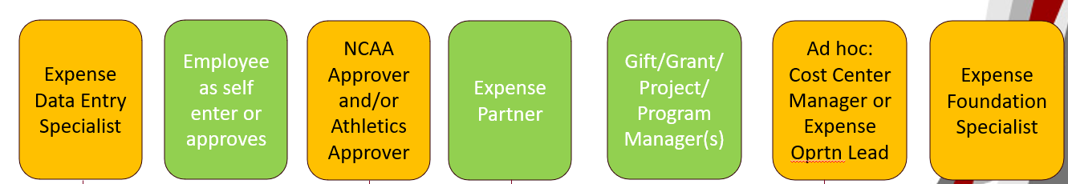
CREATE EXPENSE REPORT FOR...
How to Create
  Search for Tasks via Workday search bar
Different Tasks
  Create Expense Report for Worker
    Used for active and terminated employees
  Create Expense Report for Non-Workers
    Used for students, candidates, guests
    Able to change Reimbursement Method
      Manual = WIRE for international guests going to international bank
      Defaults to Check – suitable for most reimbursements
Status on Pre-Hires
Expect delays on approvals
Notes:
Alyssa- create expense report for pre-hire is in Workday but should not ever be used at this point; students always come in as pre-hires so it gets a bit confusing as students cannot be reimbursed that way

Slide 7
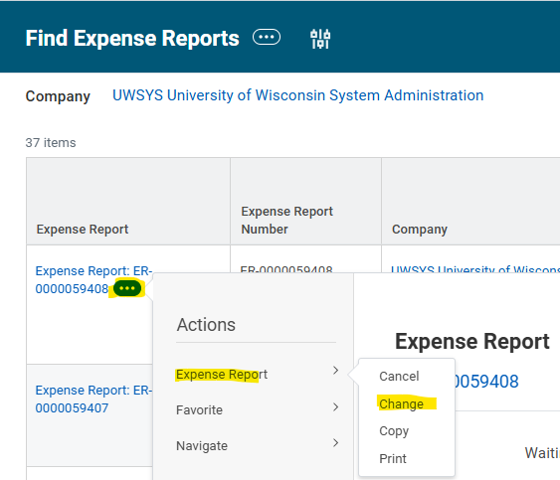
MAKING CHANGES AFTER SUBMISSION
How to find expense reports for others and make changes
  Search Workday search bar for "Find Expense Report" or Expense Reports (UW)
  Enter your search parameters (company, employee name, ER number)
  In report, select three dots after report name, hover over Expense Report, click Change
Editing is available up until the final approval; employee or EDES can withdraw the report and make changes
After withdrawing report, restarts approval process
Auditors can make small changes (adding attachments, updating receipt date) - email GetHelpUW@support.wisconsin.edu with report number and any changes
Notes:
Alyssa - Audit should not be making major changes to report

Slide 8
REASSIGN Purchasing CARD TRANSACTIONS
Search Workday search bar for "Reassign Expense Credit Card Transactions"
Can be used to reassign your P Card purchases to another employee
Still cardholder's responsibility to ensure card is reconciled on time
Use Case: paid for another employee's airfare. The employee has multiple funding sources, and the cardholder is unsure of the funding. Employee is then able to add to their own report and reconcile to the correct funding.
Reassigning PCard Transactions KB
Notes:
Alyssa – pause for questions

Slide 9
HELPFUL REPORTS
Find Expense Reports
  Search by Company, Traveler, ER number
Expense Reports (UW)
  Search by Company, Funding, Traveler
Find Spend Authorizations
  Search by Company, Traveler, SA number
Find Credit Card Transactions (UW)
  Search by Company, Credit Card, Cardholder
  Shows all transactions with ER number and status
My Requests
  Search for your requests (card changes, ECM requests, etc.)
Finding roles on campus = PROFILE > Job > Support Roles
Notes:
Emily

Slide 10
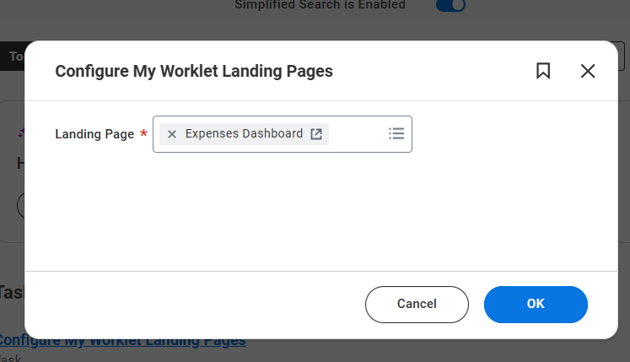
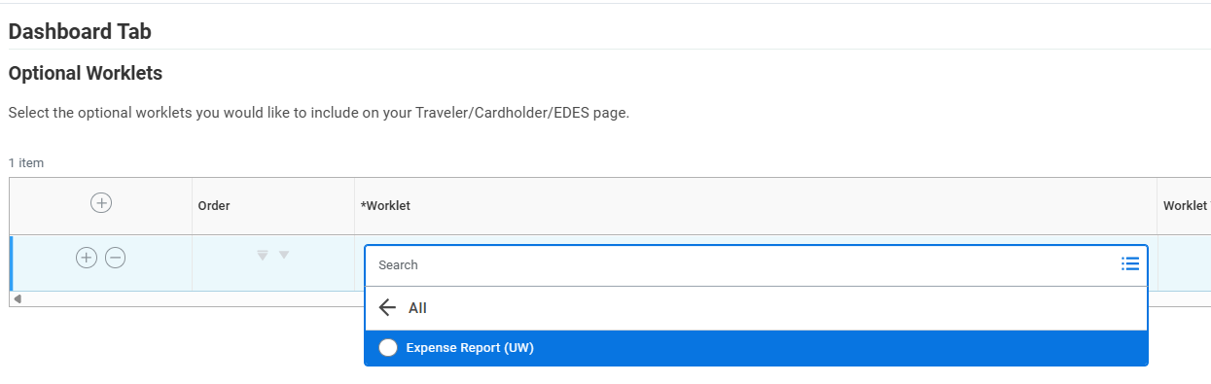
EXPENSE REPORTS UW WORKLET
Can add Expense Reports (UW) report as a Worklet to the Expense Dashboard. This prompts report with your set parameters to run
Search Workday for Configure My Worklet Landing Pages. Select Expenses Dashboard. Select Search > All > Expense Report (UW)
Use the gear icon in the top right to configure your report settings
Notes:
Emily

Slide 11
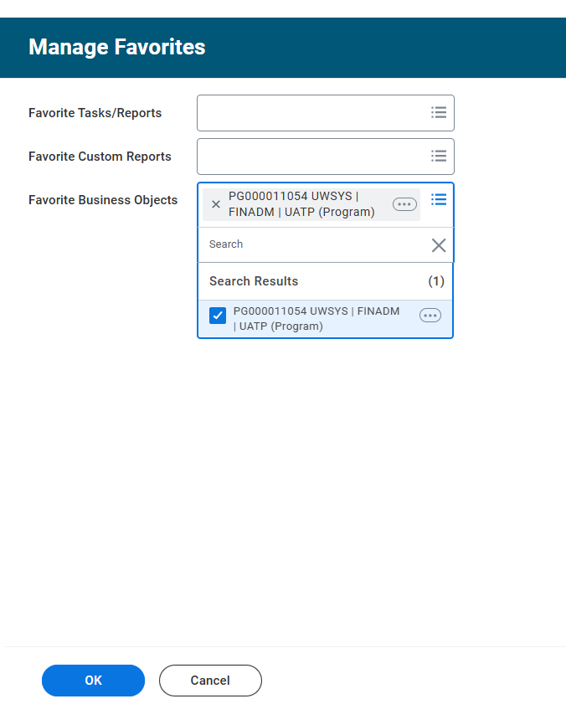
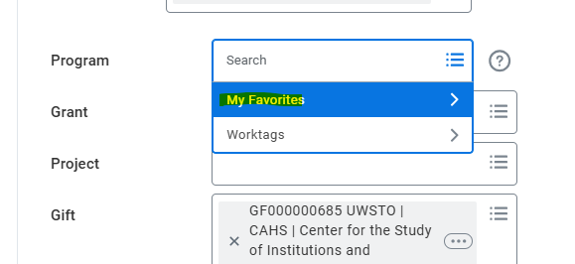
FAVORITES
Task = Manage Favorites
To add a specific funding to your favorites, enter it in Favorite Business Objects
Funding will then show up in Favorites
Notes:
Emily

Slide 12
Questions & Workday Demo
Notes:
Emily

Slide 13
resources
UW TravelWIse – policy and procedures
Workday Expenses Resources
UW Policy: General Travel and Expense Policy
Per Diem Calculator
Concur
Notes:
Emily

