Slide 1
Expenses in Workday
August 21, 2025

Slide 2


Presenter: Emily Stoffel
Regional Travel Manager
Emily.Stoffel@wisconsin.edu
Topics:
Review Paying for Travel
Review Receipts
UW Card Products
Credits in Workday
Personal Items in Workday
Workday Demo

Slide 3
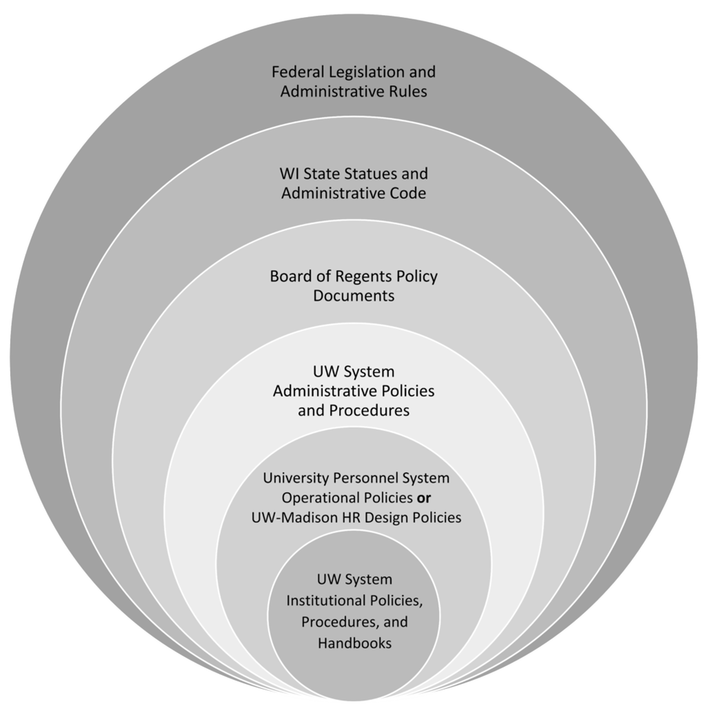
The more restrictive policy takes precedence
Always check with your supervisor/dept for specific travel policies

Slide 4
Paying for Travel
Personal Funds
Shared Liability Card
Purchasing Card
Travel is allowed on P-Cards
University-issued credit card
Automatically paid
Reconciled within 60 days via expense report in Workday
Personal funds may always be used to pay for travel
Reimbursement is done through an expense report in Workday
Formerly Corporate Card
University-issued liability credit card only for travel = cardholder’s responsibility to pay within 60 days, or late fees are assessed
Card is paid via expense report in Workday

Slide 5
Receipt requirements when paid with…
Purchasing Card
Personal Funds or Shared Liability Card
Receipts required for every purchase
Do not use Pcard for meals included in the per diem or gas when using a personal vehicle
Receipts are required for purchases over $50
Receipts are not required for mileage or per diem reimbursements

Slide 6
University Card Products
UW Credit Cards (Shared Liability and Purchasing Cards) are managed by Shared Services
Apply for cards and request changes in Workday
All UW card products are reconciled via the expense report system in Workday
Shared Liability Cards MUST be paid within 60 days to avoid late fees. Late fees are non-reimbursable and must be marked personal

Slide 7
Card Products in Workday
Shared Liability and Purchasing card transactions are automatically loaded into Workday 2-3 days after they post to US Bank
Transactions can take a long time to post to US Bank. Check Access Online if you are unsure
All card transactions must be submitted via an expense report within 60 days
The ONLY way to claim/reconcile a card transaction is to wait for it to appear in Workday and pull it into an expense report
Employees can not “create” credit card transactions in Workday
All expense items that are added from scratch are automatically designated as paid out-of-pocket and reimbursed to the employee (ie. We no longer need to designate how things were paid)

Slide 8
Credits in Workday
All Shared Liability and Pcard transactions will show up in Workday including credits or negatives
Negative credit card transactions can only be brought into an expense report when there are positive charges to offset it. The overall Company Paid amount cannot be negative.
If you are concerned about not having charges to offset a negative transaction, work with the credit card team at UW Shared Services

Slide 9
Personal Items in Workday
Items marked personal in Workday are NON-REIMBURSABLE/PAYABLE
Out-of-pocket items marked personal are not reimbursed to the employee (should rarely be used)
Shared Liability items marked personal are not paid to the card. The employee is responsible for paying US Bank if needed
Purchasing Card items marked personal are owed to the UW by the employee. The employee can elect to have the amount deducted from their paycheck or an upcoming expense report, or can choose to write a check to the University
ONLY mark items personal if you are sure they should not be paid or reimbursed

Slide 10
Spend Authorizations in Workday
Spend Authorizations are a task similar to an expense report in Workday
They are used for a variety of things through the UW
UW Stout is only using them for exception requests
UW Stout is NOT using them for cash advances or travel authorizations
Only worry about these if someone tells you to complete one or if you are asked to do a policy exception

Slide 11
Workday Demo

Slide 12
Resources
UW Stout Travel Page
UW System TravelWIse
Per Diem Calculator
Concur
Travel Manager Emily Stoffel
Emily.Stoffel@wisconsin.edu
608-263-1040
Workday Resources
Workday Login
Workday Knowledge Base
Wisc2 Workday Practice Tenant
FDM Mapping Crosswalk
Workday Help Tool

Slide 13
Tips
Manage Favorites
  Lets you save a different Worktag to your “default” list in Expenses
  Search for Manage Favorites, enter Program/Grant/Gift/Project in the Favorite Business Objects
  Only available to Financial roles currently; requesting to have it open to all employees
Expense Reports (UW) Worklet
  Lets you easily see expense reports in your Expenses Dashboard
  Click on Menu > Expenses Hub > Expenses Dashboard
  Click on Gear in top right
  Click the Plus button in the Configure Worklets pop up
  Click the Worklet text box field and click Add
  Choose Expense Report (UW) from the list
  This will prompt this report to run every time you go to your Expenses Dashboard. You can add filters to the report
My Requests
  To see your requests submitted through the Create Request task, search for My Requests in the searchbar

