Slide 1

Workday Expense
The Parkside Way
July 31, 2025

Slide 2
Agenda
Travel Policy Changes - July 2025
Workday Expense
  Workday Expense Roles
  Workday Expense Terminology
  Workday Functionality vs. SFS
Workday Resources
Open Q&A

Slide 3
Questions
What is your familiarity with Workday Expense?
What will you use it for?
Do you create expense reports for others?
Do you create expense reports for non-employees?
Are you involved with candidate recruitment?
Do you have experience in the SFS system?
What do you hope to get out of this session?

Slide 4
Travel Policy Updates
Effective July 2025

Slide 5
New Travel Policy Overview
New Travel Policy effective July 1, 2025
Consolidated several travel policies into one policy
Uses Workday terminology to provide clear direction within policy
Universities of Wisconsin Travel and Expense Policy

Slide 6
Policy Change: Business/Hosted Meals
Type of Meal | Continental United States | All Other Locations (including international)
Breakfast | $28 | $35
Lunch | $31 | $40
Dinner | $46 | $60
Refreshment Break | $14 | $20
Condensed to remove non-essential verbiage
Updated Meal Maximums to align with inflation
Removed Wisconsin specific rates
Updated policy name
Universities of Wisconsin Business Meals and Events

Slide 7
Travel Policy Changes, cont.
No receipts are required for personal card or shared liability card transactions under $50
No First/Last day deductions, incidental included in meals
Certain restrictions removed such as payment of rental car gas through the rental car agency
  More responsibility on cost center manager
  Allows flexibility for non-employees when policies are not followed

Slide 8
Workday Expense

Slide 9
What is Workday Expense?
Workday Expenses is used for:
  reimbursement of out-of-pocket transactions
  reconciliation of ALL UW card transactions (Purchase Card and Shared Liability Card)
Workday Expenses replaces current state e-Reimbursement and P-Card Module

Slide 10
What is different in Workday vs. SFS
Funding Information
Exception Requests
Missing Receipts
Alternates
Non-Employee Reimbursements
Travel Authorizations**
Reconciling Card Transactions
Foundation Account Charges

Slide 11
Expense Terms to Know
Spend Authorization
External Committee Member
Shared Liability Card
KB
https://www.wisconsin.edu/workday/glossary/

Slide 12
Workday Expense Terminology
Spend Authorization: Submitted by an employee to get approval for financial support of travel expenses. This is typically an optional step before an expense report is created, however spend authorizations are required when requesting a cash advance, for policy exceptions, and/or for 90-day expense reports.

Slide 13
Expense Roles in Workday
Expense Operations Lead | An ad-hoc approver who has authority to review exceptions in expense reports
Expense Data Entry Specialist | The Expense Data Entry Specialist has the ability to Create Expense Reports on behalf of other Workers.
Expense Advance Repayment Specialist (EARS) | Approval Cash Advances, oversee all payments back to UW and report taxes to HR
Expense Partner (Central Audit Group) | Approval role specific to the Expenses workflow. After an expense report is submitted and fits a certain group of criteria (ex: over X amount of dollars), this group can make changes to an expense report and can add an ad-hoc approver. The report is then sent on or sent back to the user to make required changes.

Slide 14
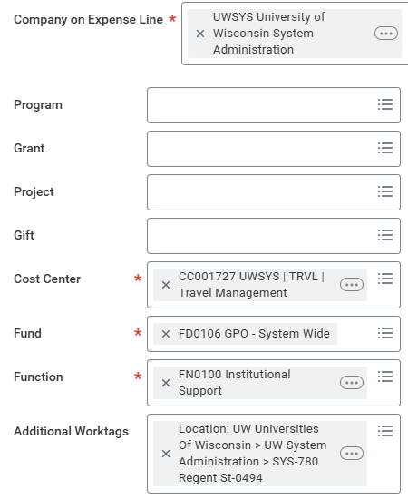
Funding Information
Future: Company/Program/Grant/Project/Gift
Current: Unit/Dept/Fund/Program/Project
For help finding the Workday funding that correlates to SFS funding – use the FDM Mapping Tool.
Home - ATP FDM Mapper

Slide 15
Spend Authorizations

Slide 16

New Requirement – Pre Trip Authorization via Spend Authorization
Effective with Workday go-live: All University of Wisconsin - Parkside staff must complete a Spend Authorization in Workday prior to incurring any travel-related expense.

Slide 17
Spend Authorization Process
Prior to travel, complete a spend authorization via Workday Expense. Include any anticipated travel expenses.
Spend Authorization is routed to Cost Center Manager for approval
  After approval, completed spend authorizations can be viewed in Expense Dashboard

Slide 18
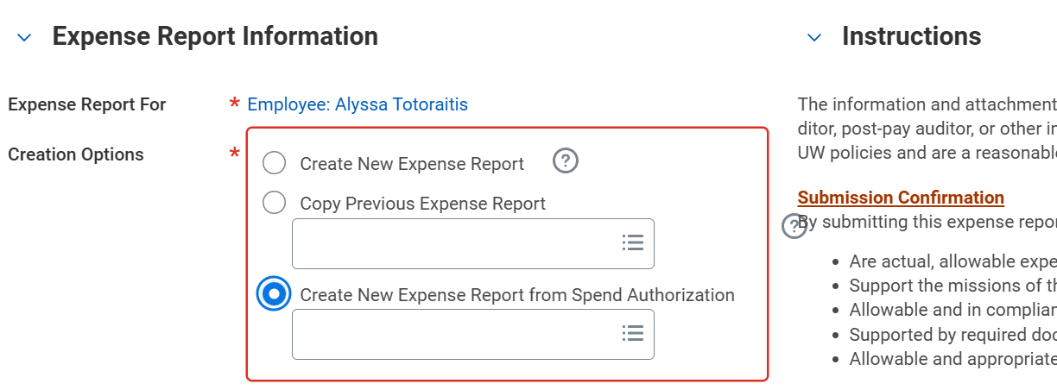
Spend Authorization Process
After travel has completed, create a new expense report from approved spend authorization

Slide 19
Spend Authorizations
If you have reoccurring local travel, spend authorizations can be completed on a per-semester basis.
  The same spend authorization for all trips during the semester.
  While creating the final expense report linked to that spend authorization, check the ‘Final Expense Report for Spend Authorization’ checkbox.
Spend Authorizations can be retroactively linked to an expense report while the expense report is still in the approval process

Slide 20
Expense Reports

Slide 21
Expense Report Type
Previous State (SFS)
Current State (Workday)
One expense report type used for all types of travelers (students, employees, candidates, non-employees)
Different “Create Expense Report” options based on type of traveler
Prompts:
  Create Expense Report for Worker
  Create Expense Report for Non-Worker
  Create Expense Report for Pre-Hire

Slide 22
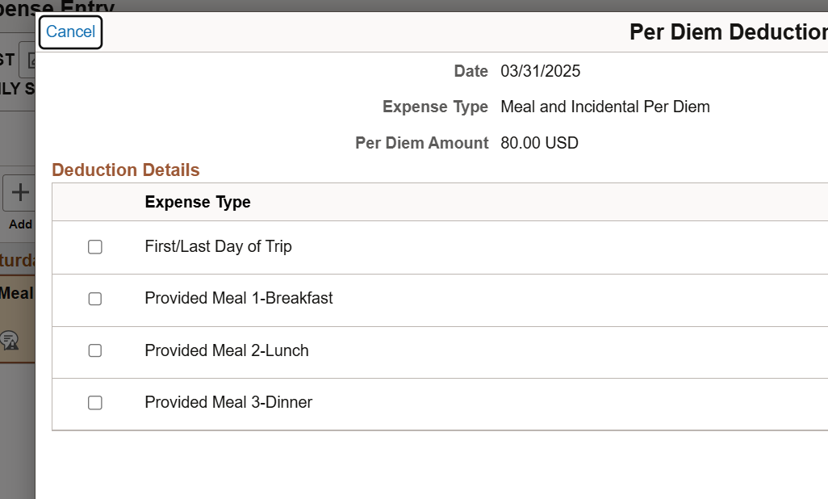
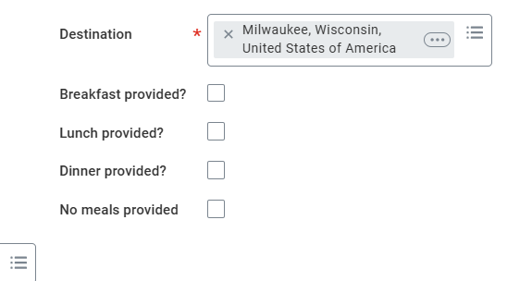
Meal & Incidental Per Diems
Current State
Future State (Workday)
Deductions for First/Last day of the trip
Must add each day separately
$5 incidental built into per diem
  If you deduct all your meals, still left with $5 for that day
No First/Last day
Can add multiple days at once
Incidentals are included in meal calculations
  If you deduct all your meals, you are left with $0

Slide 23
Non-Employee Expense Reports
Current
New
Non-Employee (Student, Speaker, etc.)
Non-Employee (Interview Candidate)
External Committee Member
Pre-Hire

Slide 24
Non-Employee Profiles
Current State
Future State (Workday)
Form is completed in SFS
No email or phone number required
Travel Team sets up a non-employee profile
Alternate is manually added
Any employee can request non-empl ID’s
Called External Committee Members (ECM)
Form is completed in Workday
Email or phone number is required
Shared Services team will set up ECM
can automatically use any ECM
Only Expense Data Entry Specialists can request ECM’s

Slide 25
Candidate Travel
Current State
Future State (Workday)
Arrangers must request a non-employee ID be created for each non-employee candidate
Expense reports are created under the non-employee ID
Candidates will have profiles created automatically through the recruitment process
No separate non-employee ID required
International candidates can be reimbursed for travel expenses through the expense report system

Slide 26
Exception Requests
Current State
Exception forms are processed through BP Logix
Used for any policy exceptions including missing receipts
Supervisor, Dean/Director, Travel Manager, & CBO all review and sign
Expenses over 90 days are taxable

Slide 27
Missing Receipt Process
Future State (Workday)
Receipts are not required for personal card or Shared Liability Card transactions under $50
Receipts are ALWAYS required for purchasing card transactions

Slide 28
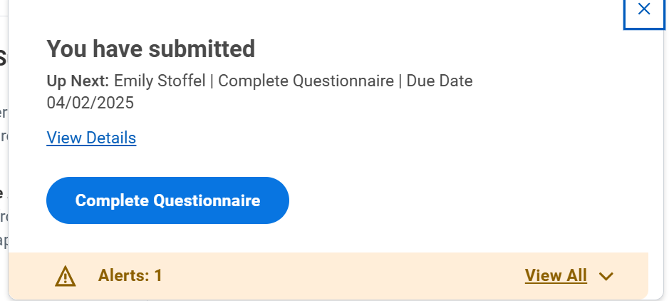
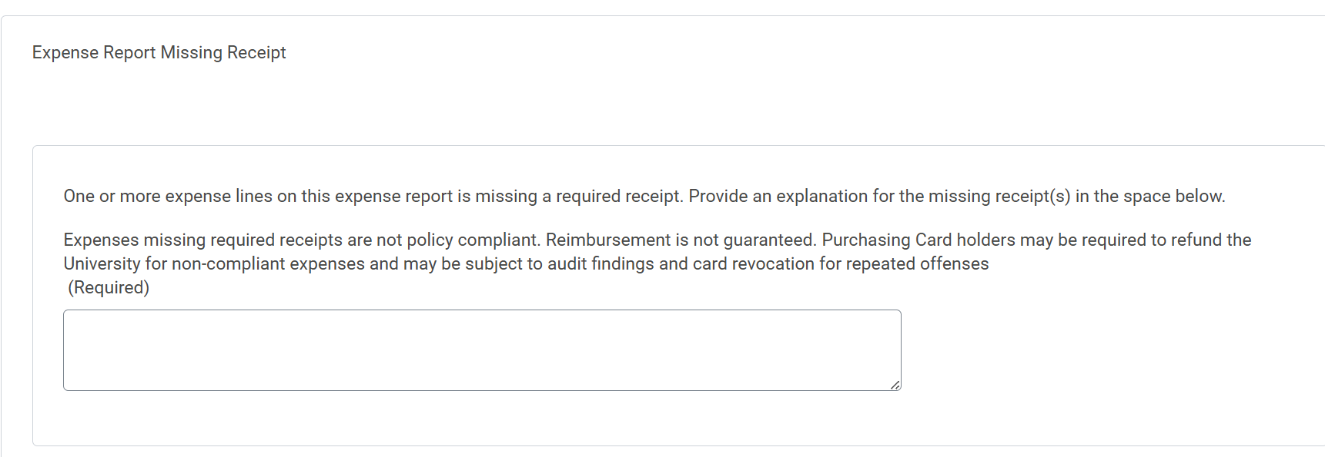
Missing Receipt Process
Future State (Workday)
Utilized when traveler is missing a receipt
If a traveler submits an expense report that is missing a required receipt, they will receive a pop up after submission
Reviewed in the expense report approval process

Slide 29
Credit Card Changes

Slide 30
Credit Card Terminology
Current
Future
Travel Card, Corporate Card
P-Card, Purchasing Card
Shared Liability Card
P-Card, Purchasing Card (no change)

Slide 31
Credit Card Products
Purchasing Card (P-card) | UW Corporate Card (Shared Liability) | Personal Credit Card
Primarily used for supplies, equipment, and travel University responsible for paying balance Personal purchases not allowed. Employee follow Pcard rules (bid process and thresholds, serial purchasing, restricted and contracted vendors, receipt requirements) Will be closed if not used for 9 months | Primarily used for individual travel Helpful for splitting personal/UW funded expenses when traveling (meals) Employee responsible for paying balance Remains open for 22 months between transactions Helpful with International Travel | Can be used for travel-related purchases (air/car/hotel/group meals) No guarantee of reimbursement, employee responsible for getting budget owner approval in advance as per the travel policy (risk not getting paid)
Resource: Card Reconciliation in Workday

Slide 32
Credit Card Products
Previous State
New State (Workday)
P-Card Transactions reconciled through SFS
Employees could “create” corporate card transactions in the expense system by selecting “Corporate Card” as Reimbursement Method
Employees did not have to use the transactions that come into their wallet and can delete these transactions
P-Card Transactions will be reconciled through the Expenses Hub
Corporate card and P-Card transactions will load automatically
Employees cannot “create” card transactions and must wait until they load in Workday to reconcile
Employees MUST use the transactions that load as they cannot be deleted

Slide 33
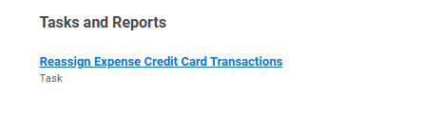

Credit Card New Functionality
Purchasing Cards can be reassigned to other employees to reconcile.
Task is called – Reassign Expense Credit Card Transactions
If you have CTS/Ghost Card (UW Parkside Athletics) and have the role of a CTS Card Custodian – assigned at a company (campus level) the task is – Assign Central Travel Card Transactions

Slide 34
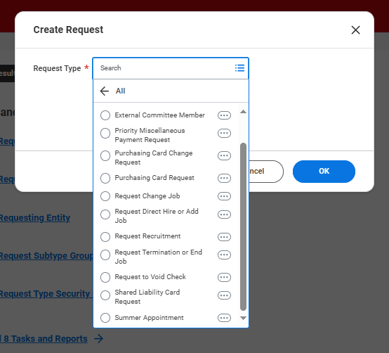
Credit Card Support
UWSA - Shared Services will be handling the administration of credit cards for all campuses other than Madison.
This includes increasing limits, canceling card, ensuring compliance to policies
Requests such as purchase card limit limit increases, or card cancellation requests can be done by submitting a “Create Request” in Workday

Slide 35
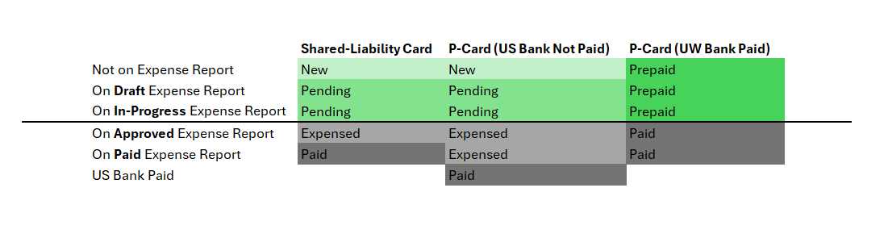
Card Transaction Statuses in Workday
Create an Expense Report

Slide 36
Relocation Payment Method
Current State
Future State (Workday)
Relocation payments are made through the e-reimbursement system
Estimated tax is withheld from payment
Encouraged to be paid after start date, but can be paid up to 30 days in advance of employee’s relocation date
Relocation payments will NOT be made through the e-reimbursement system
Encouraged to be paid after start date, but can be paid up to 30 days in advance of employee’s relocation date
Payments made after employee start date are done through Payroll to allow appropriate taxation at time of payment
Payments before employee start date are done through Miscellaneous Payment Request and will not have 30% tax withheld

Slide 37
Practice: Create an Expense Report
Log into Workday
Locate Expenses Hub
Start a New Expense Report for yourself
  Add a Meal/Incidental Per Diem
  Add a lodging expense
  What common scenarios do you encounter when entering expenses in the current system? Discussion
  KB: Create an Expense Report

Slide 38
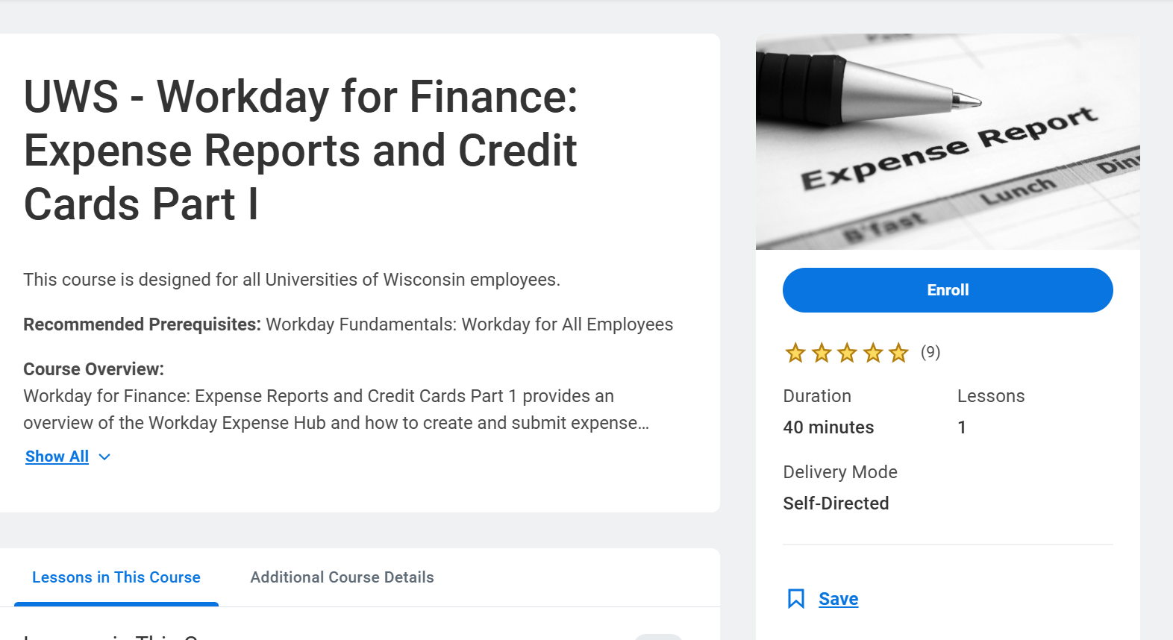
Workday Learning
Recommended Courses
Booking Travel
Expense Reports and Credit Cards (Part 1 and Part 2)
Shared Liability Cards
Resource: https://kb.wisconsin.edu/workday/internal/144890

