Slide 1
UWEC Travel training part 2: Expenses
AUGUST 26, 2025

Slide 2

Topics:
Paying for Travel
Receipts
UW Card Products
Credits in Workday
Personal Items in Workday
Workday Demo
Resources
Presenter: Emily Stoffel
Regional Travel Manager
Emily.Stoffel@wisconsin.edu
608-263-1040

Slide 3
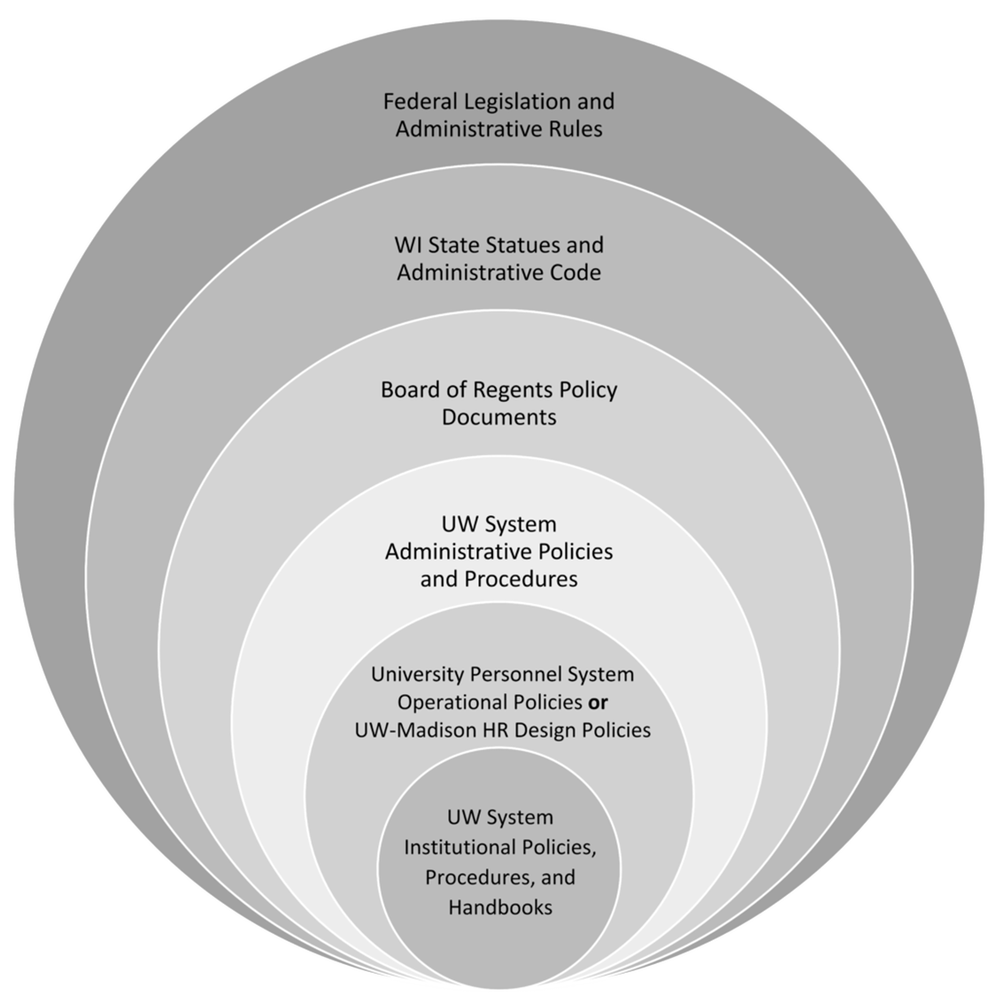
The more restrictive policy takes precedence
Always check with your supervisor/dept for specific travel policies

Slide 4
Paying for travel
Travel is allowed on P-Cards
University-issued credit card
Automatically paid
Reconciled within 60 days via expense report in Workday
Personal Funds
Shared Liability Card
Purchasing Card
Personal funds may always be used to pay for travel
Reimbursement is done through an expense report in Workday
Formerly Corporate Card
University-issued liability credit card only for travel = cardholder’s responsibility to pay within 60 days, or late fees are assessed
Card is paid via expense report in Workday

Slide 5
Receipt requirements when paid with…
Personal Funds or Shared Liability Card
Purchasing Card
Receipts required for every purchase
Do not use Pcard for meals included in the per diem or gas when using a personal vehicle
Receipts are required for purchases over $50
Receipts are not required for mileage or per diem reimbursements

Slide 6
University card products
UW Credit Cards (Shared Liability and Purchasing Cards) are managed by Shared Services
Apply for cards and request changes in Workday
All UW card products are reconciled via the expense report system in Workday
Shared Liability Cards MUST be paid within 60 days to avoid late fees. Late fees are non-reimbursable and must be marked personal

Slide 7
Cards in workday
Shared Liability & Purchasing Card transactions are automatically loaded into Workday 2-3 days after they post to US Bank
Transactions can take a long time to post to US Bank. Check Access Online to be sure
All card transactions must be submitted via an expense report within 60 days
ONLY way to claim/reconcile a card transaction is to wait for it to appear in Workday and pull it into an expense report
Employees can not “create” credit card transactions in Workday
All expense items that are added from scratch are automatically designated as paid out-of-pocket and reimbursed to the employee
  WE NO LONGER NEED TO DESIGNATE HOW THINGS WERE PAID

Slide 8
Credits in Workday
All Shared Liability and Pcard transactions will show up in Workday including credits or negatives
Negative credit card transactions can only be brought into an expense report when there are positive charges to offset it. The overall Company Paid amount cannot be negative.
If you are concerned about not having charges to offset a negative transaction, work with the credit card team at UW Shared Services

Slide 9
Personal items in Workday
Items marked personal in Workday are NON-REIMBURSABLE/PAYABLE
Out-of-pocket items marked personal are not reimbursed to the employee (should rarely be used)
Shared Liability items marked personal are not paid to the card. The employee is responsible for paying US Bank if needed
Purchasing Card items marked personal are owed to the UW by the employee. The employee can elect to have the amount deducted from their paycheck or an upcoming expense report, or can choose to write a check to the University
ONLY mark items personal if you are sure they should not be paid or reimbursed

Slide 10
Spend authorizations
Spend Authorizations are like an expense report in Workday
They are used for a variety of things throughout the UW
UWEC is using them for:
  Travel Authorizations – pre-approval of travel expenses; only required by some departments so check with your supervisor
  Cash Advances – request money paid to employee who then hands out usually for per diems
  Exception Requests – completed after travel for policy and 90 day exceptions (only complete if you are told to)

Slide 11
Workday Demo

Slide 12
Workday resources
Resources
UWEC Travel Page
UW System TravelWIse
Per Diem Calculator
Concur
Workday
Workday Login
Workday Knowledge Base
Wisc2 Workday Practice Tenant
FDM Mapping Crosswalk
Workday Help Tool
Travel Manager Emily Stoffel
Emily.stoffel@wisconsin.edu
608-263-1040

