Slide 1


GROUP BLOCK SERVICES
September 30th, 2025

Slide 2
Welcome
Liz Dressel, Director of Travel Management Services
Review of Group Block Services
Kayla Kitchner, Client Solutions Manager
Wanda Burdick, Director, Business Travel Operations
Q&A
AGENDA

Slide 3

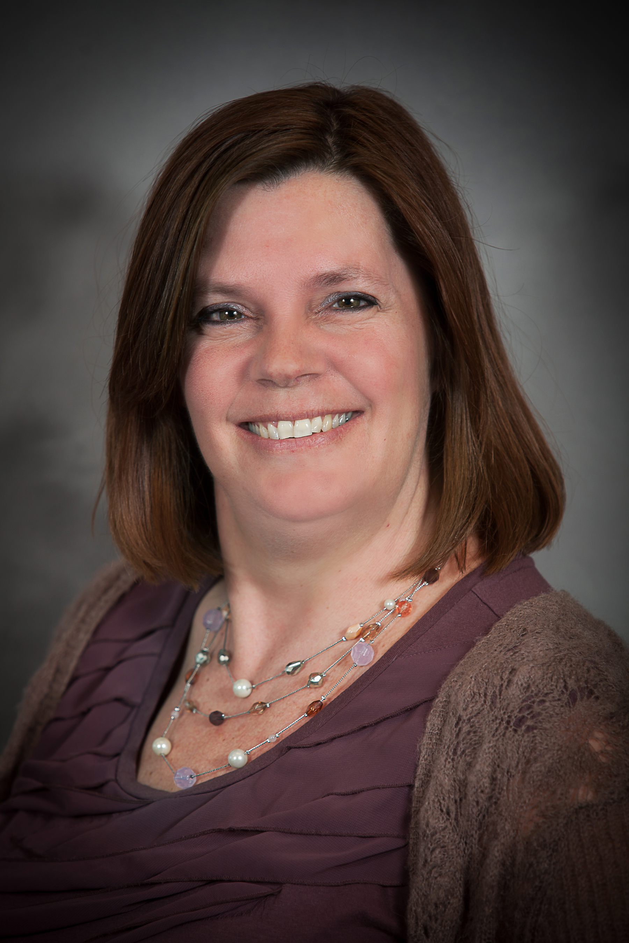
GROUP BLOCK CONTACT INFORMATION
Phone
608-710-4172, prompt 4
844-630-3853 (toll free)
E-Mail
foxgroupblock@foxworldtravel.com
Group block specialists are available from 7:30am-5:00pm, Monday-Friday
Fox Group Block Specialists
Robin Abel Paula Schultz
Notes:
Specify Robin and Paula solely work on group block.

Slide 4
WHAT IS A GROUP BLOCK?
Reserving 10 or more seats on one airline where all travelers have the same itinerary
Notes:
How is group block different from group air, hotel blocks, etc.
Setting expectations
this is not an afternoon process
this does take time and effort on both sides
Once quotes are received, prompt responses are necessary

Slide 5
WHAT IS NOT A GROUP BLOCK?
Group Air
Fox’s Group Air service is designed for groups of 10 or more travelers heading to the same destination for a meeting or event. Each traveler can book their tickets individually while adhering to your group's travel policy.
Hotel blocks
Ground transportation
Notes:
Group Air can be requested through the Portal, same as group block

Slide 6

FULL-SERVICE MEETING SOLUTIONS WITH FOX MEETINGS & INCENTIVES
Hotel blocks
Sourcing and negotiations
Ground transportation
Sourcing and negotiations
Registration, website and app development
Dedicated program manager
On-site support
E-Mail
Meetings-incentives@foxworldtravel.com
Notes:
Hotel sourcing /Ground Transportation
$100 sourcing fee
5 hotel quotes/ 3 ground quotes (if applicable)
Cvent sourcing, Booking.com, hostels, GDS and Airbnb (per UW’s agreement)
Expected Timeline: 3-5 business days
Other services requested
Meeting space, Events, meals
$100 sourcing fee

Slide 7






ADVANTAGES OF A GROUP BLOCK
All travelers will be on the same flight
Allows coordinators to finalize the group numbers up until contract deadlines without penalty
Guaranteed base pricing for the entire group*
Deferred ticketing with a minimal deposit**
Single form of payment
Name changes
Notes:
Why do we do a group block vs individual tickets?
Airlines only allow certain amount of seats at each price point. Group blocks guarantee pricing for whole group at same price.
“Why is my group block price higher than what I see online?”
*Airline taxes will vary and are not guaranteed until ticketing date)
International taxes may be higher than base fare
**Deposits could be waived with Fox’s preferred status with some carriers

Slide 8



LIMITATIONS OF A GROUP BLOCK
Deviations from the group may be limited or not allowed
Seats cannot be chosen and are assigned by the airline
Frequent flier status may not be taken into consideration and miles may not be credited
Online check in may not be allowed
Airlines require single form of payment
Baggage fees may apply and are paid at time of check in
Notes:
When booking a group block, it is assumed all travelers will be on the same itinerary. Deviations may not be allowed after ticketing. If traveler knows they will be leaving early/late, it is best to book that person separately.
How do we provide information about check in? Provided during final ticketing
When is form of payment communicated from Robin/Paula to group leader? Do quotes include deposit payment information? At time of contracting, deposit and FOP information is provided.
If carrier does ticketing, one form of payment is required. If Fox can execute ticketing, we can use multiple forms of payment.

Slide 9

HOW IS MY GROUP BLOCK PRICED?
Notes:
Airlines only allow certain amounts of seats at each price point. Group blocks guarantee pricing for whole group at same price.
“Why is my group block price higher than what I see online?”

Slide 10
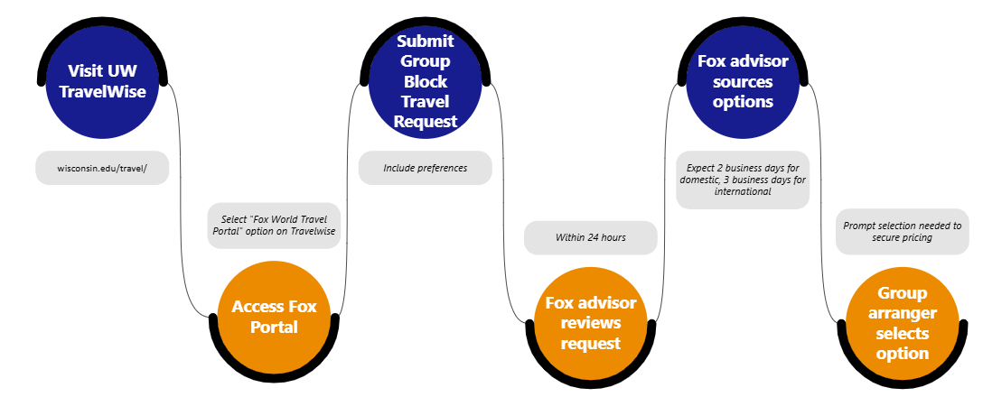
HOW TO GET STARTED
Notes:
Setting expectations
this is not an afternoon process
this does take time and effort on both sides
Once quotes are received, prompt responses are necessary

Slide 11
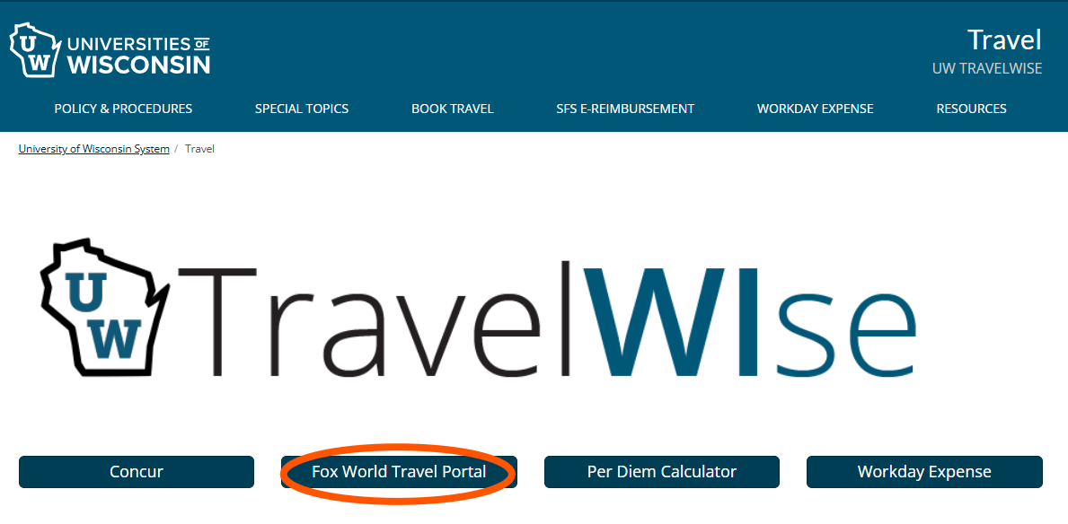
HOW TO GET STARTED
Notes:
Best practices
-reach out less than 11 months in advance, but a minimum of six months. Peak travel dates can be sourced earlier than 6 months in advance.
-provide as much detail as possible in your request

Slide 12
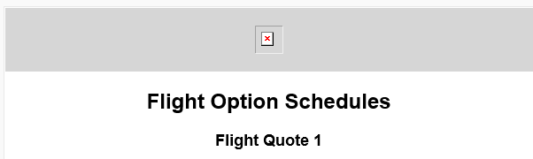

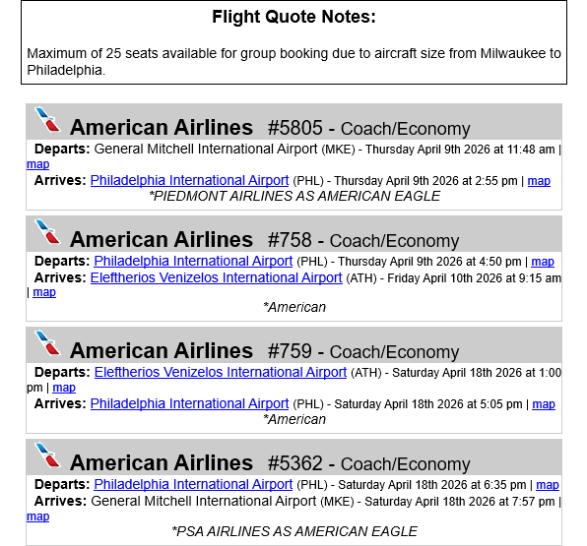
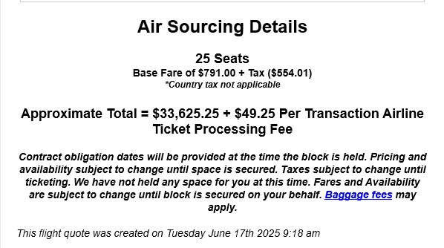
SOURCING QUOTE

Slide 13
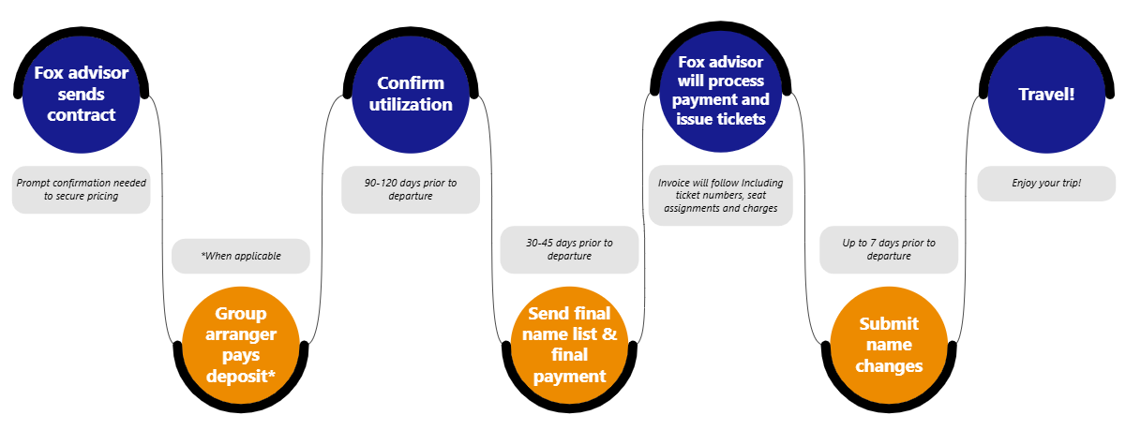
SECURED GROUP BLOCK, NOW WHAT?
Notes:
Deposit – 11months-45 days prior to departure
UW travel arranger confirms schedule
Fox advisor secures contract with airline
Deposit payment is required within 1-3 days
FOX line of credit to secure space and waive the deposits for UA,DL,AA,LH,AS
All other airlines payment type varies, from check, ACH and/or credit card
Utilization 120-90 days prior to departure
Reminder notifications sent
Contact customer to confirm # of seats
Now under penalty, if reducing seats
Work schedule changes
Check pricing
Ticketing 45-30 Days Prior to departure
Travel arranger will provide name list 3-5 days prior to ticketing deadline
Fox advisor will reprice block, compare to current GDS price
Provide name list to airline, Review details for accuracy
Wait for ticketing instructions from airline. Issue tickets
Assign seats
Send e-invoice with ticket numbers and pricing to customer
Work schedule changes
Name changes
Some airlines allow for name changes at minimal cost (True)
Below are the policies for the 4 major US carriers.
United , Delta , American and Southwest
Free name changes up to 7 day prior to travel. Only 1 name change allowed per ticket (True)
All other carriers – please verify with agent as policies vary by carrier. (True) NOTE: Name change policy is stated under Airline Contract, as it provided to Fox, for the customer to review and sign.
Email notifications Group block due date reminders 14, 10 and 5 days prior

Slide 14
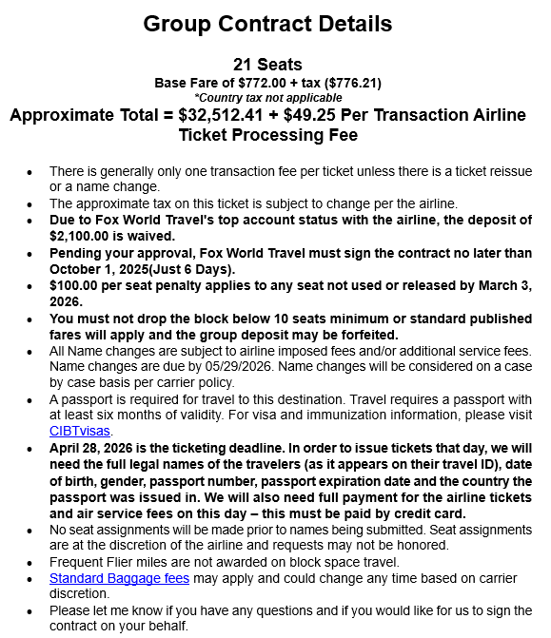
CONFIRMED CONTRACT
Deposit amount
Some airlines require a deposit to be paid at the time of securing your contract.
Contract acceptance date
This is the date Fox must return a signed contract to secure your seats. Respond back to Fox as soon as possible to allow us time to confirm with the airline.
Utilization date
This is the last day to reduce the number of seats you are holding in your block. Reducing seats after this date will result in fees.
Ticketing deadline
This is the last day to issue tickets, but Fox can issue sooner with a complete name list and form of payment, if desired.
Name change deadline
Name changes must be completed a minimum of 7 days in advance of departure. Only one name change is allowed per ticket.
Notes:
Read agreement thoroughly to avoid surprises. Your FGB team will remind you of important deadlines.

Slide 15
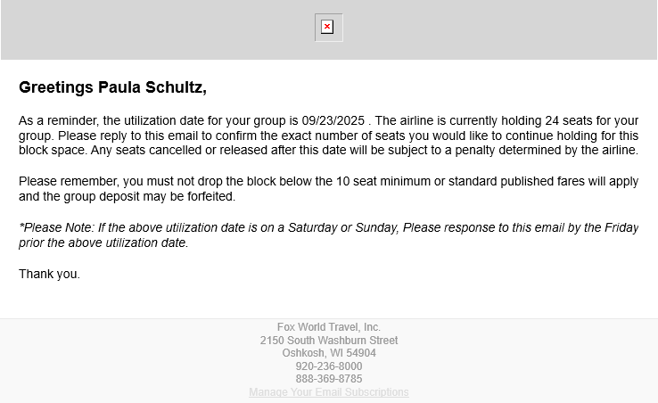
UTILIZATION DATE REMINDER

Slide 16
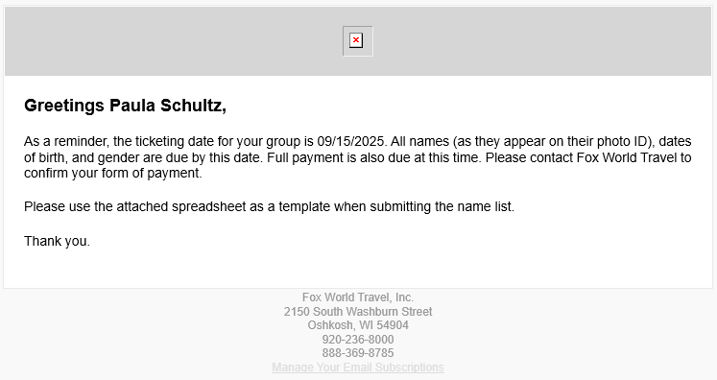
TICKETING DATE REMINDER
Notes:
Post ticketing cancellations, discuss options for unused ticket

Slide 17
YOU SHOULD KNOW…
Filling out your group travel request form in as much detail as possible helps our Group Block agents provide the most applicable flight options.
Requesting a group block should be done 6-11 months in advance.
Group leaders should be aware of which travelers in their group are experienced travelers in the case of a travel disruption.
Group blocks are very complex and are a contractual agreement between your group and the airline. As such, the airline can change the contract requirements from one group to the next.
Carriers will not allow block space on all routes, and some will only allow group space to take up a certain percentage of the plane.
Excess baggage rules apply, similarly to individual travel.
How and when you pay for baggage will vary by airline, airport, or traveler status. Fox may not always be able to advise you of your trips baggage policies before check in.
If traveling internationally, a Fox agent may ask about your travelers' dietary restrictions and meal preferences.
If traveling internationally, it is possible and likely your taxes will be more expensive than your base airfare.
Notes:
Deposit – 11months-45 days prior to departure
UW travel arranger confirms schedule
Fox advisor secures contract with airline
Deposit payment is required within 1-3 days
FOX line of credit to secure space and waive the deposits for UA,DL,AA,LH,AS
All other airlines payment type varies, from check, ACH and/or credit card
Utilization 120-90 days prior to departure
Reminder notifications sent
Contact customer to confirm # of seats
Now under penalty, if reducing seats
Work schedule changes
Check pricing
Ticketing 45-30 Days Prior to departure
Travel arranger will provide name list 3-5 days prior to ticketing deadline
Fox advisor will reprice block, compare to current GDS price
Provide name list to airline, Review details for accuracy
Wait for ticketing instructions from airline. Issue tickets
Assign seats
Send e-invoice with ticket numbers and pricing to customer
Work schedule changes
Name changes
Some airlines allow for name changes at minimal cost (True)
Below are the policies for the 4 major US carriers.
United , Delta , American and Southwest
Free name changes up to 7 day prior to travel. Only 1 name change allowed per ticket (True)
All other carriers – please verify with agent as policies vary by carrier. (True) NOTE: Name change policy is stated under Airline Contract, as it provided to Fox, for the customer to review and sign.
Email notifications Group block due date reminders 14, 10 and 5 days prior

Slide 18
FOX COMMUNICATIONS: WHO GET’S WHAT?
Flight Options
Group leader
Campus Travel Manager
Air Contract
Group Leader
Campus Travel Manager
Utilization Date/Ticketing Date Reminders
Group Leader
Campus Travel Manager
Invoice/Itinerary
Group Leader
Campus Travel Manager
Travel Alerts
Group Leader
Campus Travel Manager
Primary traveler noted on name list (could be same as Group Leader)
Notes:
Email location receives x, y, z doc (separate slide)

Slide 19
FOX SUPPORT
TEAM SHARED INBOX
All communication is via shared email box, foxgroupblock@foxworldtravel.com, for streamlined support for all customer and vendor communications.
AFTER HOURS SUPPORT
Available 24/7/365 for group blocks via phone
After hours agents are trained twice annually on group block services
After hours have access to group block shared box for airline communication
TRAVEL ALERTS
GROUP LEVEL
Altitude flight alerts
Flight monitoring alerts for schedule changes, delay notifications, gate changes
Group leader will receive 1 email notification pre-trip to sign up for alerts
If opt out has been selected, they will need to notify FOX re-activate
CAMPUS TRAVEL MANAGER
Travel alerts, several per day
Any type of travel disruption event, ie road closed to airport, flooding, hotel fire, earthquake
Notes:
Post ticketing cancellations, discuss options for unused ticket
Email location receives x, y, z doc (separate slide)

Slide 20
What can Fox do to help?
What pain points do you experience?
Where do you find difficulty in the process?
What problem could we solve for?

Slide 21

Q & a

Slide 22

Thank you!

