Slide 1

Travel Information Session
Spring 2023

Slide 2

State of Travel Industry – What to expect
Longer hold times with agencies as the industry tries to catch up with increased demands.
Longer TSA lines
Arrive at the airport early and be prepared for long lines
Reconfirm your flight!
Higher airfare
More Self-service options being offered (and encouraged)
  Use of Concur for booking
  Use of Travel Inc Hub for personal invoice retrieval
Utilizing Campus Travel Manager for assistance with policy, planning and booking questions.
Notes:
Since COVID – The Travel Industry has changed. So we put this slide to explain what you may see differently.

Slide 3
UW-Platteville Travel Updates
Domestic Travel is allowed and may be booked in our booking channels
International travel requires approval from the International Programs Office
Travel Management Contact
  UW System Travel Office
  uwstraveloffice@uwsa.edu
  Phone: 414-345-7553

Slide 4
UW-Platteville Travel Updates
Current UW Platt COVID-19 Travel Booking Restrictions:
  The university ended its domestic travel freeze effective Feb 28th. University-sponsored travel should follow CDC domestic travel guidelines based upon your vaccination status.
  UW Platt’s travel freeze remains in place for international travel and is subject to review on a case-by-case basis for compliance with CDC guidelines for international travel. Please contact the International Programs Office for approval
  Concur is open for booking domestic travel. Users can see international flight information but are restricted from booking.

Slide 5
Managed Travel Program Goals
Provide Duty of Care and Travel Risk Management for students, faculty and staff who travel on University business
Obtain best prices through consolidated spend
Act as an intermediary with vendors to ensure a smooth travel experience
Notes:
With Travel Inc, the University is getting an enhanced duty of care. The University has a moral and legal responsibility to ensure that employees and students health, well-being and safety while they are on the clock, and that includes during travel for work. This is one of the biggest reasons that we have a managed travel program. Covid-19 is a perfect example. When travel bans started coming in we had to quickly and efficiently get in touch with all of our travelers to make sure they knew what was going on and assist in any way necessary to get them home.

Slide 6
Travel Program Overview
All travel is booked through designated Agencies
Concur is an online booking tool that is managed by Travel Incorporated
Travelers have the option to book with a UW specific consultant or by using Concur

Slide 7
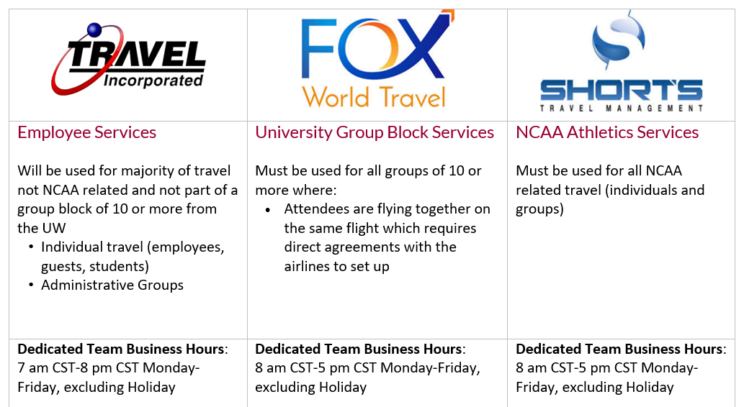
Links to information for:
Travel Incorporated
Fox World Travel
Shorts Travel Management

Slide 8


Policy Highlights - Air
Must be booked with Designated Agency or in Concur to receive payment/reimbursement
  Booking with third party sites, such as Expedia.com, or directly on airline site is not reimbursable
Preferred vendors are Delta, American Airlines, United, Southwest
  Other airlines are allowed to be booked
Airfare must be paid with the ghost card
  Traveler or arranger must fill out the Direct Charge Airfare form
  The form can also be found on the UW-Platteville travel page on TravelWIse
Basic Economy fares are not shown on Concur. Must be requested in order to book that fare class
Airline
Direct

Slide 9
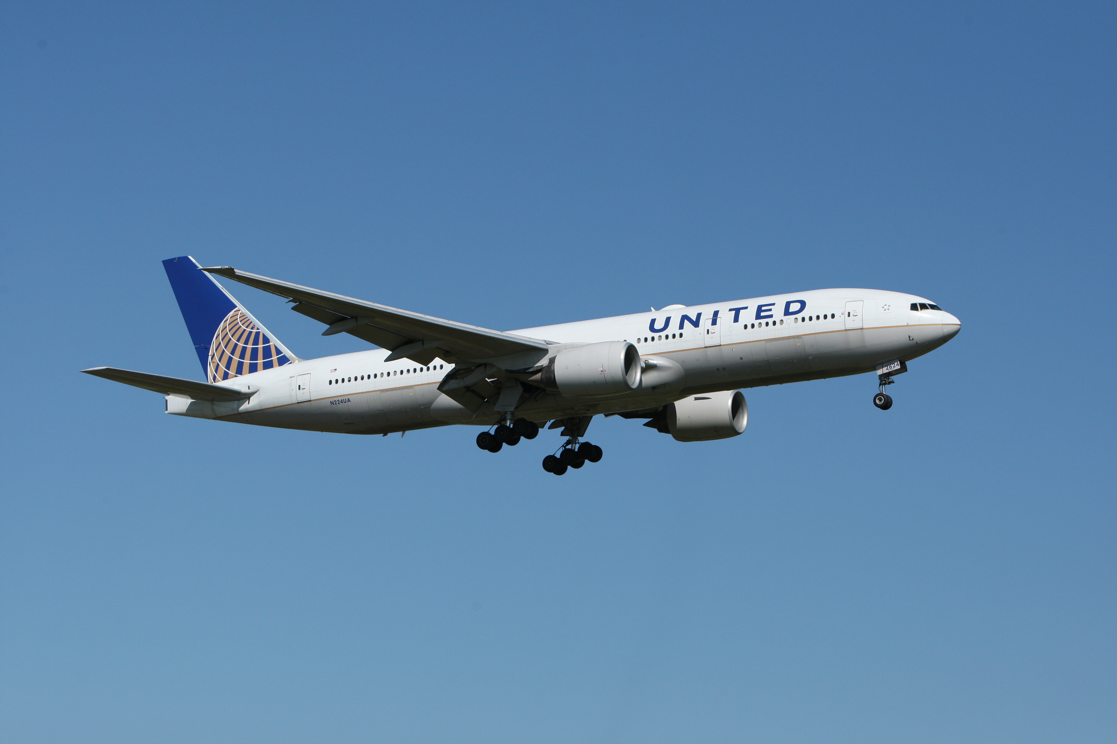
Policy Highlights - Air
Notable Travel Policy Exceptions:
  Flights with 8+ hours of consecutive airtime are eligible for Premium Economy seats
  Inter-Country flights purchased outside of the U.S. are exempt from Travel Inc. purchase mandate

Slide 10
Policy Highlights - Hotel
Best Practice: booked with a Travel Inc consultant or in Concur
  Conference hotels are an exception and can be booked directly with the conference hotel at the rate that the conference dictates.
  Group bookings can be booked with designated agency or work directly with hotel
Rates must be below the rate maximum, based on per-person
  Verify max rate for your location via Lodging and Per Diem Calculator
Ghost card is for air fare only. Not to be used for hotels
Preferred hotels should be used whenever available
As of July 2020, policy allows Airbnb bookings.

Slide 11
Policy Highlights - Ground
Must be an authorized driver through Risk Management to drive on University Business
Car Rental Contracts:
  First Choice - Enterprise/National - Big10 contract
  Second Choice - Hertz
  Book with a Travel Inc. Consultant or in Concur
  Never accept extras such as fuel service, GPS, Roadside Assistance, etc. These are not reimbursable
  Traveler is expected to refuel car prior to return –receipts required
  Preferred is to book standard, able to book up to full size SUV if needed (as of July 2020)

Slide 12
Administrative Groups
The Administrative Group process allows a host department to easily manage all department specific travel needs for students, guests or employees. The process allows the group administrator to either:
  Securely use the UW Platt ghost card on file with Travel Inc for agent reservations or;
  To set up the group for individual bill, where each traveler provides a personal credit card at the time of booking.

Slide 13
Administrative Groups
Setting Up an Admin Group - Department arrangers must provide the following information and use the Travel Incorporated UW Group Reservation Request Form to submit the information.
  Travel dates/times can be pre-defined (this is not required if not yet known)
  Fare allowance
  Approval requirements
  If you want the card on file to be used for hotel guarantee (hold reservations for traveler’s own payment at check-out)
  List of authorized users that are eligible to have their charges paid for via the card on file. This list may be modified as needed.
Once this process is complete, Travel Incorporated will provide the Administrative Group Code and contact information that must be given to and referenced by travelers or coordinators when booking under the established Administrative Group.
Important Note: Be advised that it will take up to 48 business hours to have the group set up internally. Not advised if travel needs to take place within 20 days

Slide 14
Mileage Reimbursement
When driving your personal vehicle for University-sponsored business, you will be reimbursed for mileage. MapQuest or Google Maps are the official tools for determining the most direct route. The following rates apply:
Less than 100 miles roundtrip - Standard Rate
  On/after 7/1/22: $0.625 per mile
If trip is over 100 miles, a fleet vehicle should be used
  https://uwplatt.sharepoint.com/sites/AdministrativeServices/FacilitiesManagement/SitePages/Car-Fleet.aspx
  Provide fleet non-availability slip if no fleet vehicle is available
  Exception – Trips to an airport (can’t park fleet vehicles at the airport)
More than 100 miles roundtrip without using fleet - Turndown Rate (Employees and Students)
  On/after 7/1/22: $0.405 per mile

Slide 15
Individual Meal Per Diems
Per Diem is an allowance provided for individual meals and incidentals. No receipts required
  The amount varies by location
  This is provided for any overnight travel
  Important to include conference documentation in expense reporting to document provided meals
Day Trip Allowance is $15 (taxable) and provided for day trips
  No receipts required

Slide 16
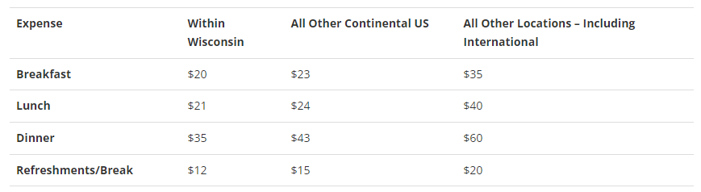
Hosted Meals
Conferences
Seminars
Retreats/Workshops
Training Sessions
Academic Colloquiums
Receptions
Orientations
Hospitality or hosted meals between University hosts and job interview candidates or recruits
A Candidate Hosted Meal Payment Form must be completed and attached to the TER if hosting a candidate
*Maximum of three employees per hosted candidate meal.

Slide 17
Tax Exemption
Wisconsin
  The Wisconsin sales and use tax provides an exemption from payment of state, county, and local tax.
  Travelers seeking Wisconsin sales tax exemption for business lodging, meals, and vehicle rentals should present the Department of Revenue approved tax-exempt wallet card (obtain your card from your institution’s business office)
Other States
  University of Wisconsin System may have various Sales and Use Tax Exemptions when making purchases other states. Review the TravelWIse site for more details.
*If you are unable to receive exception, make note of reason why on expense report

Slide 18

Real ID
Wisconsin DMV issues REAL ID compliant products (marked with a star) in accordance with the federal Real ID Act of 2005.
If you plan to fly within the U.S., visit a military base or other federal buildings, the Department of Homeland Security will require identification that is REAL ID compliant (or show another acceptable form of identification, such as a passport) beginning May 7, 2025.

Slide 19

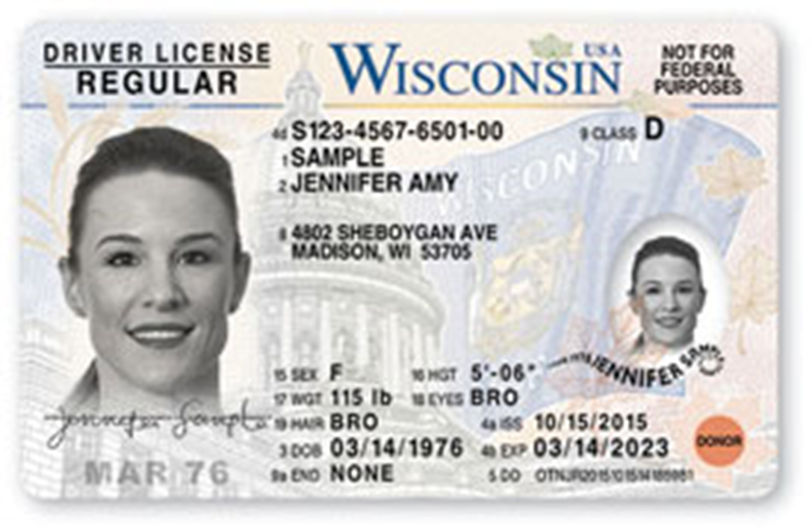
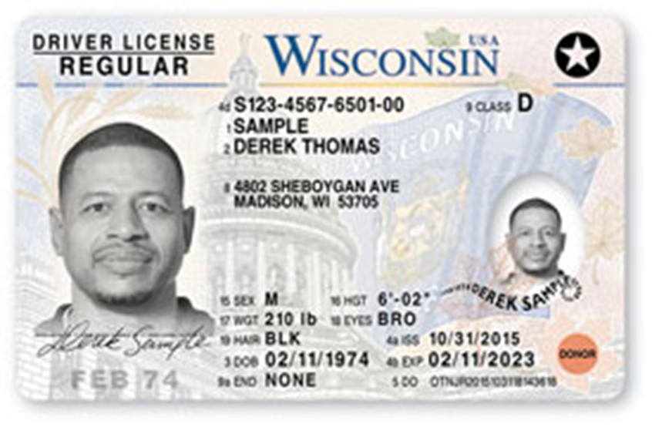
Real ID
Compliant
Not Compliant

Slide 20
Links
UW TravelWIse Website
E-Reimbursement Login
Policies (where to find)
UW Platt travel website
Travel News – Newsletter Sign Up
Current COVID travel restrictions for UW Platt
Concur Login & Demo
Per Diem Calculator

Slide 21

Thank you!

