Slide 1
Travel Information Session
Fall 2022

Slide 2
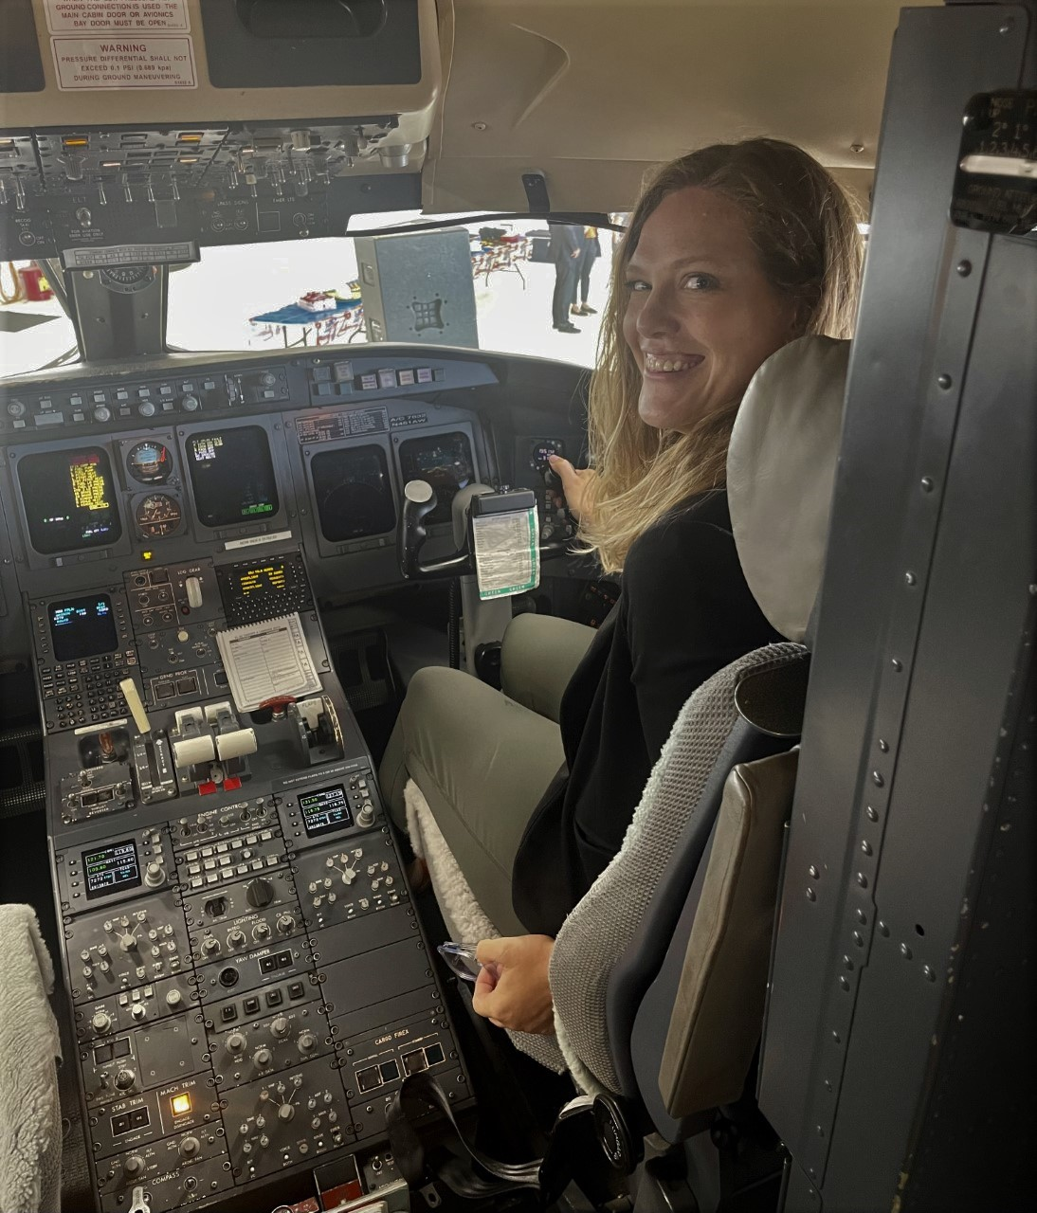
Alyssa Totoraitis
Regional Travel Manager
amahn@uwsa.edu
Wisconsin.edu/travel/uwm

Slide 3
Agenda
Travel Services Introduction
State of the Industry
Travel Policy Updates/Changes
  Preferred Hotels for 2023-2025
Ways to book travel
Combining business and personal travel

Slide 4

Travel Services
Provides trainings on travel policy
  Air bookings
  Car rentals/mileage
  hosted meals, and events
  Relocation
  individual meals
  Lodging
  Tax Exemption
Provides Concur training and administration
Liaison between Travel Agency, Preferred Hotels, Preferred Air Carriers
Provides University Guidance on best practices for group bookings
Resource for department administrators to provide training materials or sessions

Slide 5
State of the Industry
Post Pandemic Travel, UW and Elsewhere

Slide 6

What’s Happening In Travel
8% Air, 10% Hotel, 8% Hotel increases into 2023 industrywide
Supply chain issues and increasing supplier costs are the main culprit
  Ex. Enterprise is paying more for vehicles due to the continuing chip shortage
  Employment Issues continue
  - Pilot shortage, pilots in high demand leading to fewer flight options and higher costs for flights
  -Hotels have very high turnover and are largely staffed by industry “newbies”

Slide 7
Other Disruptions
Travel Incorporated UW Call Stats
Week | # of answered Calls (Designated Team) | # of offered calls (Designated team) | # of Calls (After Hours) | Average Hold Time | % answered 30 sec or less )
09/19/22-09/23/22 | 360 | 439 | 7 | 4 min and 30 seconds | 45%
09/12/22-09/16/22 | 352 | 443 | 3 | 7 mins | 35%
09/06/22-09/09/22 | 262 | 294 | 2 | 3 mins 55 sec | 58%
08/29/22-09/02/22 | 280 | 328 | 1 | 2 min 58 sec | 56%
08/22/22-08/26/22 | 264 | 287 | 2 | 2 min 27 sec | 68%
Hold times with Travel Management Company could continue to be long –call early or use other contact methods
Airlines are cutting service to smaller, regional airports
Car rentals are still in high demand, book early to ensure you get a car
Industry experts expect 2025 to be the next “normal” year

Slide 8
Travel Policy and Procedures
Updates in 2022-23

Slide 9
UW Travel Policy (2020 vs. 2022)
What’s the Same?
  Air bookings mandatory in Concur/Agency
  Hotel Maximum Rates apply to all bookings (except conference)
  Enterprise/National are car rental contracts
What is different?
Airbnb is allowed
Prepayment on hotels/deposit is now allowed
Hotels do not need to be booked in Concur
(2023) Relocation will be all stipend, no direct cost repayment

Slide 10
Milwaukee Preferred Hotels 2023-2025
Knickerbocker on the Lake | 1028 E JUNEAU AVE |  | "State Rate" (equal to $95 for Milwaukee, Racine and Waukesha counties and $90 for all other counties)
Hyatt Regency Milwaukee | 333 West Kilbourn Ave |  | "State Rate" (equal to $95 for Milwaukee, Racine and Waukesha counties and $90 for all other counties)
Hyatt Place Milwaukee Downtown | 800 W Juneau Avenue | "State Rate" (equal to $95 for Milwaukee, Racine and Waukesha counties and $90 for all other counties)
Holiday Inn Milwaukee Riverfront | 4700 N. Port Washington Road |  | "State Rate" (equal to $95 for Milwaukee, Racine and Waukesha counties and $90 for all other counties)
Radisson Hotel Milwaukee West | 2303 North Mayfair Road |  | "State Rate" (equal to $95 for Milwaukee, Racine and Waukesha counties and $90 for all other counties)
Drury Plaza Hotel Milwaukee Downtown | 700 N Water St. | Other Rate | 109
Cambria Hotel Milwaukee Downtown | 503 N Plankinton Ave | "State Rate" (equal to $95 for Milwaukee, Racine and Waukesha counties and $90 for all other counties)
Countryinns&suite Milwaukee Airport | 6200 south 13th street |  | Other Rate | 95
Hilton Milwaukee City Center | 509 W Wisconsin Avenue |  | "State Rate" (equal to $95 for Milwaukee, Racine and Waukesha counties and $90 for all other counties),Federal GSA Rate (varies by city)
Saint Kate - The Arts hotel | 139 E Kilbourn Avenue |  | "State Rate" (equal to $95 for Milwaukee, Racine and Waukesha counties and $90 for all other counties),Federal GSA Rate (varies by city)
The Pfister Hotel | 424 E Wisconsin Avenue |  | "State Rate" (equal to $95 for Milwaukee, Racine and Waukesha counties and $90 for all other counties),Federal GSA Rate (varies by city)
Guaranteed State Rate or Federal Rate through end of 2025
Direct hotel contact/relationship in case of issues
Familiar with UWM policies and tax exemption procedures

Slide 11
Ways to Book Travel

Slide 12
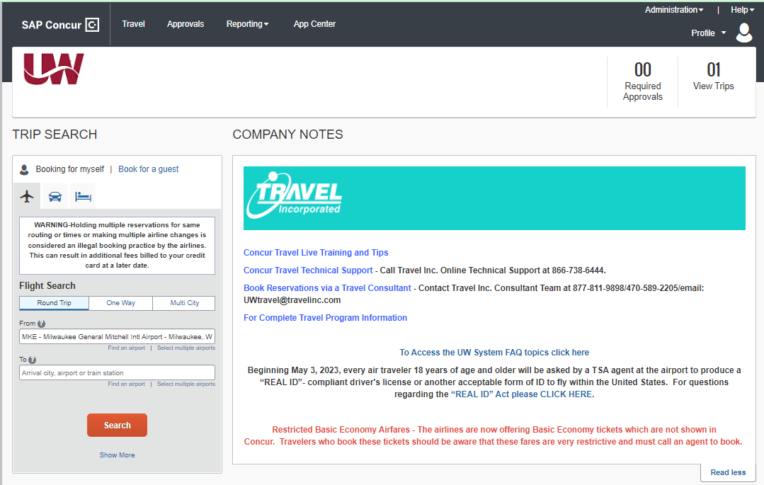
Ways to Book Travel - Concur
Individual Travel Only
Registration is unique from other UWM/UW System applications (Register Here)
Air/Car and Hotel can be purchased and are ticketed by a Travel Incorporated Agent
Many UW System Policies are programmed into the application

Slide 13



Ways to Book Travel - Contact an Agent
Each agency has a dedicated agent team to assist UW Travelers
Travel Incorporated – Individual Travel, Shorts Travel- NCAA Athletics, Fox World Travel – Groups of 10 or more
More information:
https://www.wisconsin.edu/travel/booking/

Slide 14
Travel Incorporated Contact Methods
Need a bit more support with your booking? Working with a consultant is recommended for those:
  Booking complex international flights
  Booking next day/same day air travel
  Uncomfortable with online booking
  Who prefer to speak to an individual or are
  Booking airfare with a companion
470) 589-2205 or Toll Free at (877) 811-9898.
Reservation Request Form
  The intent of the form is to ensure all essential information needed to make a reservation is provided to the travel agent at the point of contact.

Slide 15
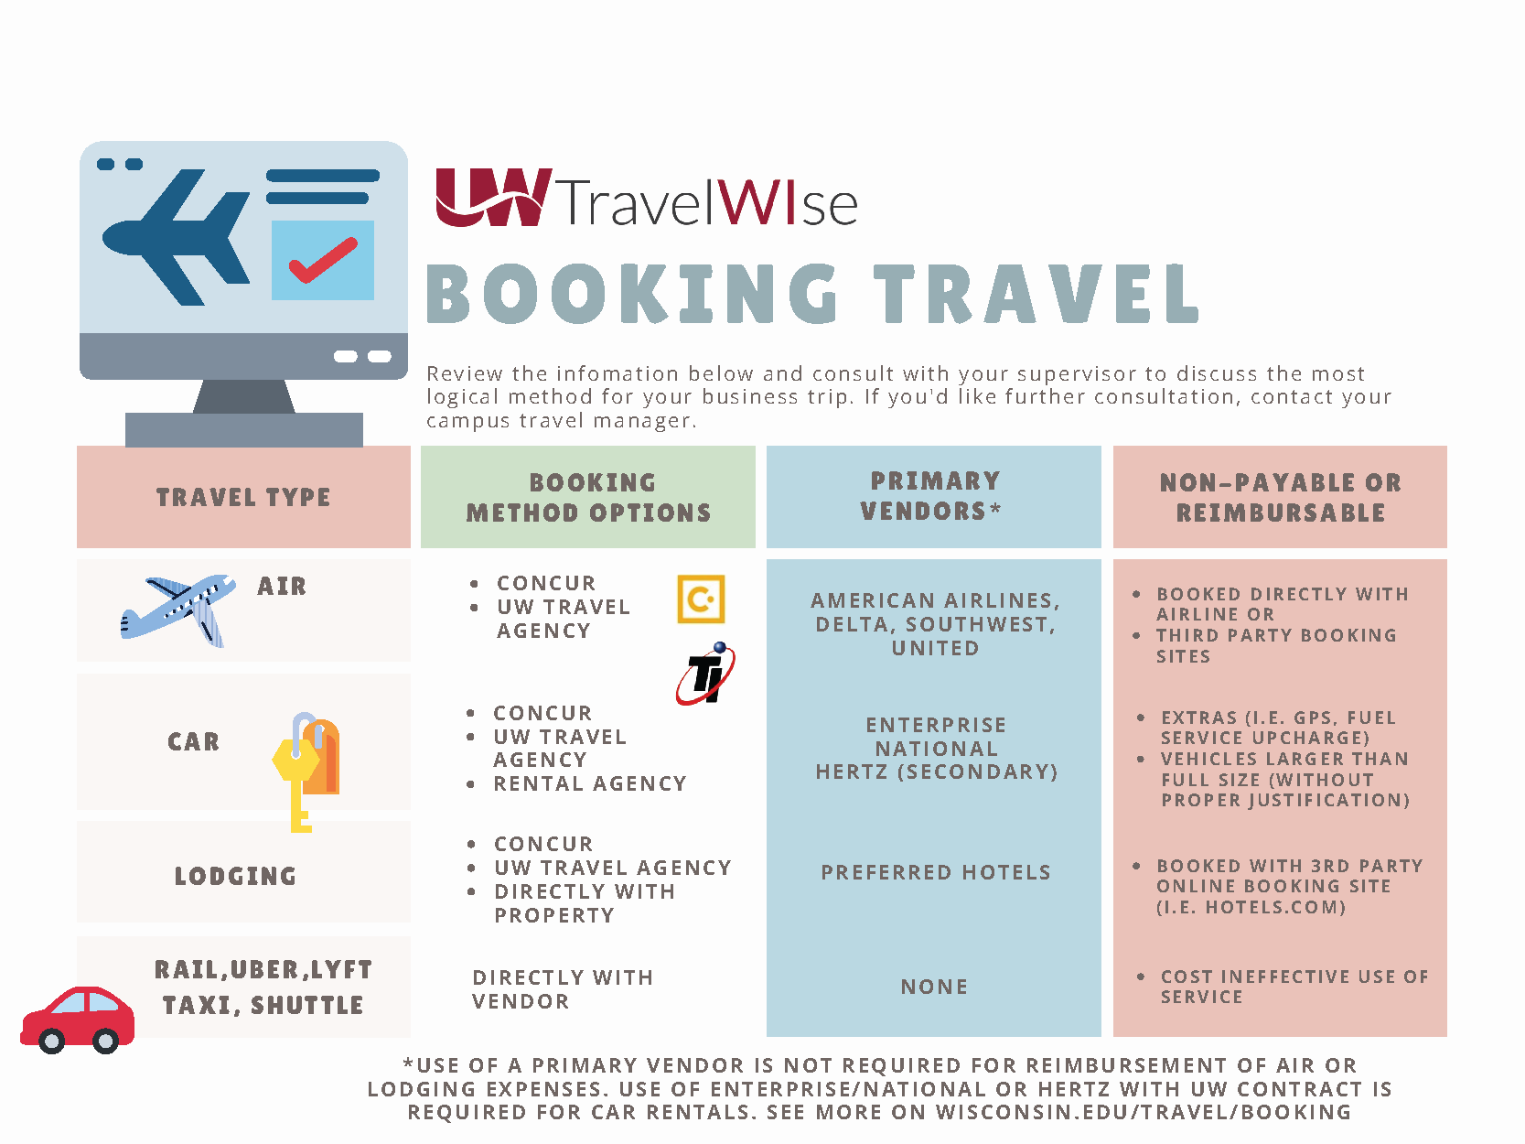

Slide 16
Comparing Search Results: Expedia/Orbitz vs. Concur

Slide 17
Concur vs. Consumer Third Party Agencies
Concur
Expedia Group
Literal Time Periods driven towards business travelers with strict schedules
Does not show more restrictive flights options such as basic economy fares
Real time fares
Dedicated support and airline priority due to UW System Contracts with Major Airlines (Delta, United, Southwest, American)
Liberal results no matter what dates you put in to show lowest price
Primarily offers Basic Economy fares and offers regular fares as an upgrade
Caches data, not real time and price may change from search to booking
Generic support and no status with airline

Slide 18
Combining Business and Personal Travel

Slide 19
Combining Business and Personal Travel
After discussing with your supervisor, you may opt to add personal travel days on the beginning or end of your business trip. The University will only pay for costs associated with university sponsored travel.
Visit our Adding Personal Travel to your Business Trip page to determine what’s needed if you’re adding personal travel to university business.
Additionally, please see this sample cost comparison. A cost comparison must be done at the time of booking and then included with your TER (Travel Expense Report).

Slide 20
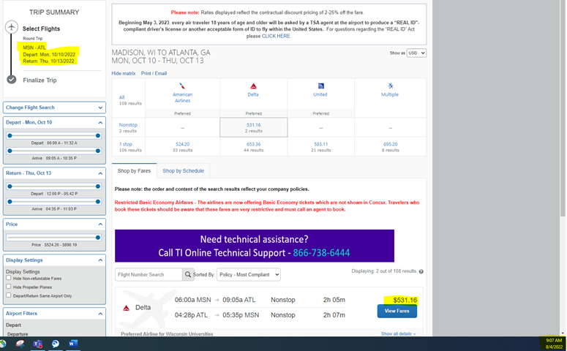
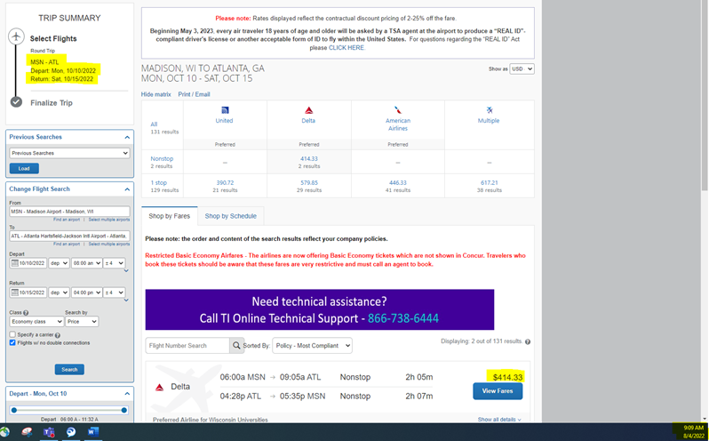

Slide 21

Thank you for your time!
Questions?

