Slide 1
Travel Town Hall
Fall 2021

Slide 2
Agenda
Current State of Travel Restrictions
Travel Approval Procedures
Trip Booking Guidance
Payment Method for UWM Sponsored Airfare
Car and Lodging Booking
Misc. Updates
Q&A

Slide 3
Current State of Travel and Approval Processes

Slide 4
Domestic and International Travel
Effective July 1, Domestic Travel may be booked without Risk Management approval.
Travelers should remain fiscally conservative and examine travel need prior to obtaining pre-trip authorizations
International Travel remains restricted. Requests may be submitted via an exception form, found on the International Policy.
  Users cannot book international travel via Concur, must work with a travel consultant

Slide 5
Travel and Misc. Expense Approval (TMEA)
Effective September 1, all UWM travelers will use the TMEA to request approval to travel.
  Letters and Sciences will continue to work with divisional business office, but does use the TMEA form
  All other divisions can obtain TMEA support via the Shared Services
Resources:
https://uwm.edu/shared-services/travel-procurement-pcard/tmea-form-process/
https://uwm.edu/shared-services/travel-procurement-pcard/
Contact Jarad Parker with questions regarding Shared Services

Slide 6
Booking Procedures

Slide 7
Airfare
Faculty/staff/students and guests will use Travel Incorporated to book airfare
  Athletics and Group Travel use Shorts Travel and Fox World Travel, respectively
  Tickets booked with Southwest, American, United or Delta:
    Will automatically be paid for with a UATP card (this card contains all air credits due to COVID cancellations) when booked with the agency or in Concur
    This is NOT a free ticket, the ticket must be expensed so that the appropriate funding can be charged
    Agency Fees will be paid for with the traveler’s credit card
    Resources:
    How to Expense a Ticket paid for by UATP Card
    Travel Agency Fees

Slide 8
More on UATP Cards…
One card for each airline. The agency has the card information and the traveler/arranger does not need to provide any card numbers or detail.
Not a permanent payment method. Once the value of the tickets are used up, normal payment procedures will resume.
If you plan to purchase a ticket that is not funded by UWM, contact Alyssa Totoraitis to obtain a UATP-Exempt code. Code is provided to the agency, and must be booked by calling a consultant
If you had a ticket that was booked with Fox World Travel and cancelled/unused due to COVID, it is no longer in your name and the ticket value was placed on the UATP card.
  Funds will be credited appropriately once UATP credits have been used

Slide 9
Hotel and Car Bookings

Slide 10
Hotel
Best practice remains to book with the travel agency (either by calling or booking in Concur)
  Concur programming shows lodging maximum on results screen. Bypass Per Diem information page when booking hotels in Concur.
Booking directly with the hotel is allowed if necessary and no approval is needed to do so
Many hotels have reduced services due to staffing issues, such as by request only housekeeping, reduced breakfast bars, etc.
UW Preferred Hotels can accommodate special requests and rate requirements, and should be used whenever available

Slide 11
Car Rentals
The Big 10 Enterprise Contract was renewed August 1, with a new contract number and rate changes for certain locations, and the removal of alumni and family as allowable renters under the personal use contract.
If you will need a vehicle for your trip, rent ASAP as the chip shortage has greatly impacted car rental availability
Resources:
Insurance Considerations (Renting vs. Personal)
Enterprise/National Big 10 Contract
Student Orgs – New Risk Management Policy outlining car usage

Slide 12
Other Updates

Slide 13
Other Updates
Lodging Policy now allows for usage of Airbnb, and full prepayment on lodging.
Day trip meal allowance ($15 and taxable) is allowed even if a meal is provided
Tax Exempt number has changed. Exchange your card at the UWM Business Office in Engelmann Hall

Slide 14
Updates Continued…
All Concur users now have the ability to book for a guest
  Employees should never be booked as guests. All employees should register for their own Concur profile
UW System Audit is experiencing a staffing shortage, and expense reports are currently delayed 3-4 weeks.
  Processes are being put into place to speed up the audit, but expect a longer than normal turn around time until further notice.

Slide 15
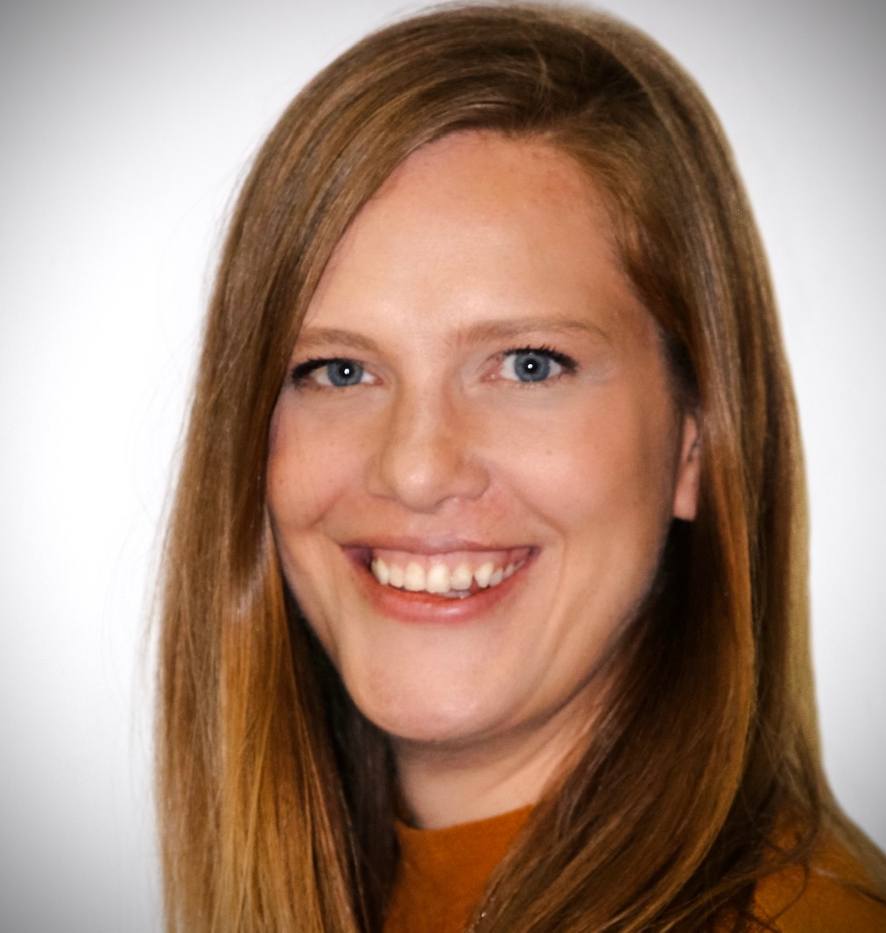
Questions
amahn@uwsa.edu
Wisconsin.edu/travel/uwm
https://www.wisconsin.edu/travel/support/travel-frequently-asked-questions/

