Slide 1


Candidate Travel Training
February 20, 2025

Slide 2
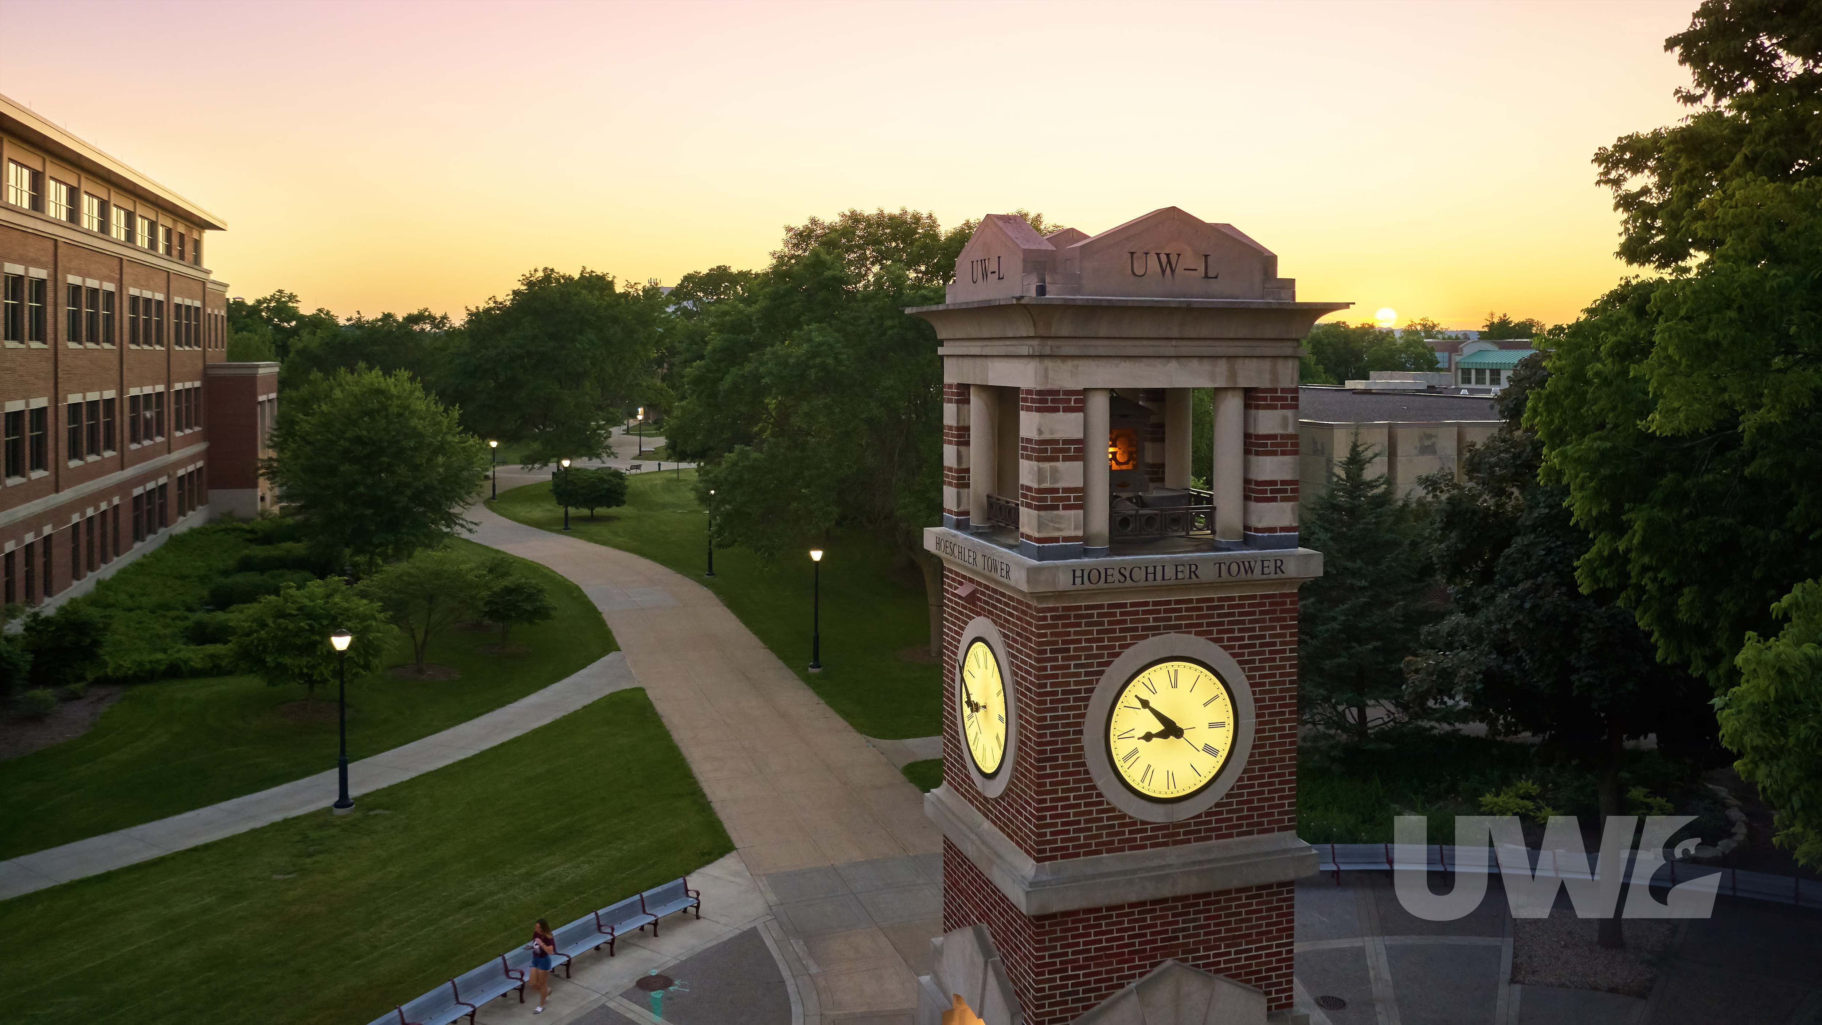
Presenter
Emily Stoffel
Regional Travel Manager
emily.stoffel@wisconsin.edu
608-263-1040

Slide 3
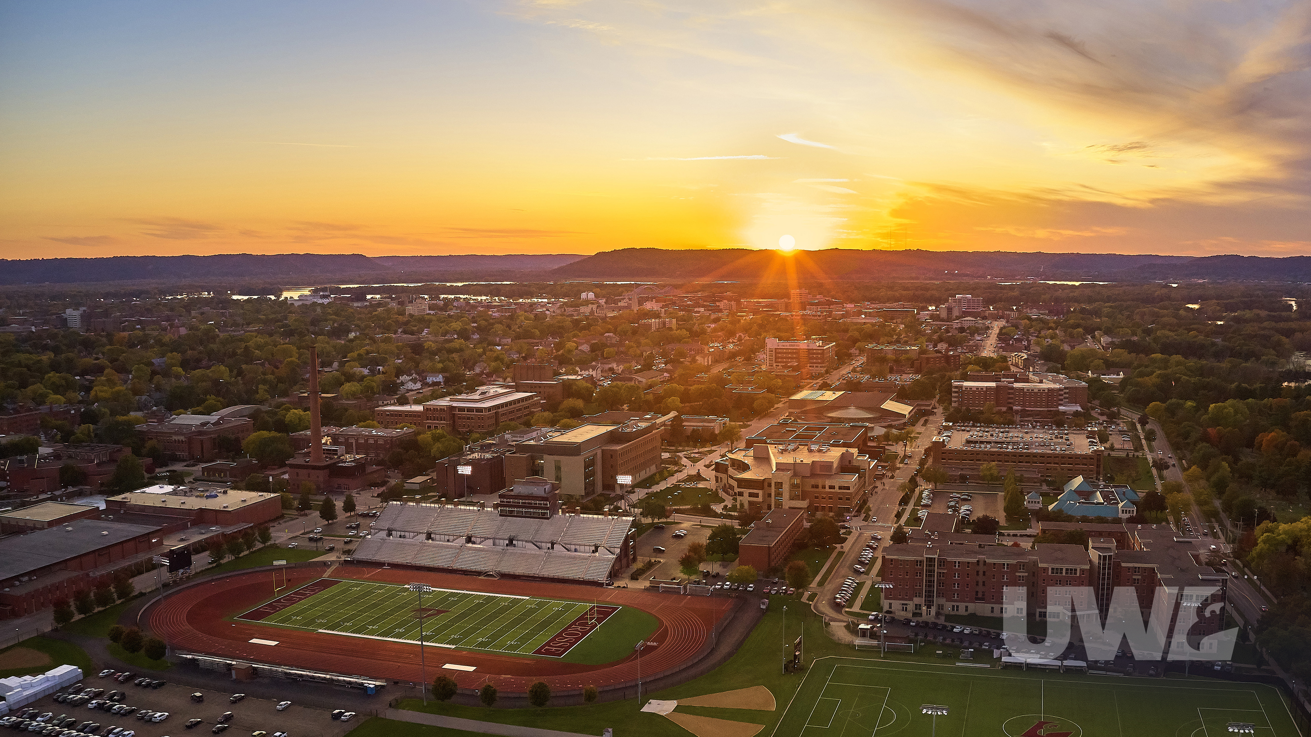
Agenda
Payment Methods
Non-Employee Profiles
Booking Options
One-Time Individual Booking Request Form
Airfare
Lodging
Car Rentals
Mileage
Shuttles
Meals
Resources

Slide 4
Today’s Online Session
This session is being recorded
Recording and PowerPoint will be available on UWL’s TravelWIse
Email with links will be sent to registrants
Informal in-the-moment questions & practical tips are welcome
When asking a question or sharing an experience, please introduce yourself

Slide 5

Workday is arriving July 1, 2025
Content of this presentation is meant to be referenced through June 30, 2025
  Big changes: travel policy, expense reimbursement
  Staying the same: Fox World Travel, booking methods
  Slides with the Workday icon in the top right indicate a change of process with Workday
Be on the look out for trainings and info sessions as July gets closer. Keep expense report cut off dates in mind for reimbursements

Slide 6
How you manage candidate travel matters. Why?
Anytime we use UW funding to pay or reimburse travel, all UW policies MUST be followed. Not following policy means the candidate does not receive reimbursement.
Providing clear instructions for candidates and timely processing of their reimbursements leaves a lasting positive impression of UW-La Crosse.

Slide 7
Payment Methods
Purchasing Card (P-Card)
Candidate’s Personal Funds
Recommended payment method
Used for airfare, lodging, car rental reservations, hosted meals, etc.
Cannot be used for meal per diem meals and mileage for personal vehicles
UWL PCard Page
Travel can always be paid using traveler’s personal funds
Personal funds must be used for gas, mileage, and meal per diems
Reimbursement is done through E-Reimbursement system after travel
Use a non-employee ID for guests and employee ID for current UW employees

Slide 8
You have two options for booking.
Department books on behalf of candidate
Candidate makes arrangements themselves following UW Policy
Dept. books for a guest in Concur or with a Fox World Travel agent or directly with hotel
Requires traveler's full legal name, date of birth, and gender
Dept. pays for/reserves travel using P-Card
Dept. complete OTIB form allowing candidate to book with Fox and make their own arrangements
  Option to enter Dept. P-Card or can choose for traveler to pay
Lodging, Groome, etc. arrangement can be made directly with vendor

Slide 9
One-Time Individual Booking Request Form (OTIB)
Normally, only travelers with a Concur profile can work with Fox
OTIB allows guests to book directly with Fox
Form found in Fox World Portal
Used for airfare, hotel, and car rentals
Requires traveler’s name, email, general travel dates
Coordinators MUST have Concur profile to complete access the Fox World Portal
Travel arranger completes form
Candidate receives an email with a code
Candidate calls Fox, provides code, and books travel
Travel arranger is emailed copy of itinerary and invoice

Slide 10
OTIB Form Demo

Slide 11
Airfare
MUST BE BOOKED WITH TRAVEL AGENCY!!!!!!!!!!!!!!!!!!!!!
Recommended booking method: complete OTIB and allow candidate to book with Fox World Travel
  Less work for arranger
  Allows candidate to control booking and get the details correct
  Avoids arranger having to gather personal information
  Can use P-Card or allow candidate to pay for with own credit card
Candidates traveling from international locations please contact travel manager
Travel Agency fees:
  Fox World Travel Domestic flight (fee if using OTIB): $31.50/ticket
  Fox World Travel Int’l flight (fee if using OTIB): $41.50/ticket
  Concur: $6/ticket

Slide 12
Driving vs Flying
Flying is considered most appropriate method of transportation for round trips over 1000 miles.
If traveler chooses to drive instead of fly and round trip mileage is over 1000 miles, a cost comparison is required.
Reimbursement is equal to the lesser cost
New Policy
Cost comparisons no longer required for adding personal days to travel
Still required if adding a stop or a leg to travel or returning to different location than starting location
https://www.wisconsin.edu/travel/planning/arriving-early-extending-your-stay-or-combining-business-and-personal-travel/

Slide 13
Cancellations
Non-refundable tickets will be booked by travel agency
When a cancellation is necessary, call Fox and have them cancel
A credit will be available under the traveler’s name with the airline for use on a future flight
If candidate paid and was not reimbursed, they can personally use this credit by calling Fox OR we can reimburse and use the value for a UW trip
If UW paid, credit can be utilized for another business trip or by someone else. Rules vary based on airline. Name changes are always an option, though sometimes have a fee
Unused Ticket Credit Guidance
If the airline cancels the flight, contact Fox World to reschedule. Should be issued refund from airline

Slide 14
Lodging
Recommended to book in Concur or directly with hotel; can be put on OTIB if also booking airfare
Must be at or below state rate: $110
Must contact hotel directly to process tax exemption and credit card authorization
  We should be tax exempt in WI
  Credit card authorizations allow non-traveler card (i.e. P-Card) to be charged. Traveler will still need to present card at check in.
Payment must be on PCard or direct bill to ensure tax exemption
  Hotels can deny tax exemption if payment method is not from UW

Slide 15
Cancellations
Regardless of booking method, call hotel and cancel
Cancellations must be done at least 24 hours in advance to avoid cancellation fees
If under 24 hours, ask if they will waive the fee. If not, it is allowable

Slide 16
Car Rentals
Must utilize UW contracts with National/Enterprise or Hertz
Recommended booking method: Use Concur book for a guest function and make reservation on P-Card; or OTIB if also booking airfare
Traveler has to pay for rental and present card at check-in
No add-ons such as car seats, GPS, etc are reimbursable
Reimburse rental cost and gas
Traveler must refuel vehicle prior to returning

Slide 17
Cancellations
Regardless of booking method, call car rental company to cancel if within 24 hours
Can cancel in Concur if over 24 hours from pick-up time

Slide 18
Mileage
Should be receiving standard mileage rate ($0.70)
It is the department’s decision what they choose to reimburse
Can reimburse from home to airport
Can reimburse 2 round trips for someone to drop them off at the airport if that is the most cost effective (compare mileage and parking costs)
UW employee candidates are treated like non-employees
  Standard mileage
  Can receive mileage from home
  Don’t have to be authorized drivers
  Need additional backup – reach out to Emily
If a UW-employee transports the traveler for any reason, the employee MUST be an authorized driver.

Slide 19
Shuttle
Department Arranges
Booking: Direct with Groome
Payment: P-Card
PRO TIP: Provide candidate Groom’s contact info in case of delay or flight changes
Traveler Arranges
Booking: Direct with Groome
Payment: traveler personal funds
Reimbursement: to traveler
Cancellations
Call Groome to cancel
No refunds issued, but will issue credit
If traveler paid and doesn’t think they will use credit, okay to reimburse

Slide 20
Helpful Tips
Ubers/Taxis are not always available. Be sure to communicate options to the traveler
Ensure there is an after-hours campus contact the day of travel
Receipts are typically needed for Uber/Taxi
Anyone driving a candidate must be an authorized driver

Slide 21
Meals
Hosted Meals
Meals while Traveling
Meals where a UW employee is paying for the traveler’s food
Requires approval
Be sure to follow up with Dining Services for meal tickets
Employee that pays would submit a TER
Tax exemption: ask; if unable to acquire, write that in the TER justification
UWL Food Page
Meal per diems for time candidate is in travel status and paid for their own food
Hosted meals count as provided meal and cannot be included in the meal per diem
Must be paid to candidate using non-employee profile. If airfare, hotels, and shuttles are all paid for by the department this may be the travelers only expense

Slide 22
Concur Book for a Guest Demo

Slide 23
Non-Employee Profile
NEAZC123 Sample non-employee ID
Used to reimburse non-UW employees (including students)
Request the non-employee profile set up in the reimbursement module. Expense tile > Request Non-Employee Emplid tile > Request Non-Employee Emplid
  Address is the place the check will be sent to. Please confirm with traveler
  Initial Expense Date is first date expenses are incurred. May be sooner than arrival date
  Alternate is the person who will create and submit the TER. This person cannot approve the TER
Approved and set up by UWS Travel team; take an overnight cycle to process
If the candidate is an employee at another UW System campus, they must complete the TER under their employee profile using CUSTOM FUNDING > UWLAC funding string

Slide 24
Non-Employee ID Demo

Slide 25
Expense Report Demo

Slide 26
Questions?

Slide 27
Before Visit
During Visit
After Visit
Travel Arrangements – Airfare, hotel, shuttle, car rental
Food Approval
Non-Employee Profile Request
Day before travel, check in with traveler
Collect Receipts
Ensure tax exemption/state rates when necessary
Communicate reimbursement process & timeline
  TER submitted within 1 week
  Approvals typically 2-3 weeks
  Check (external candidate), direct deposit (current employee) or wire (int’l candidate) within 4 weeks
Submit TER
Reconcile P-Card
Prior to arranging travel:
Have cancellation/rescheduling procedures in place
Confirm budget/funding string
Department contact & backup
Determine what will be paid for and who will pay (dept. or traveler)

Slide 28
Resources
Travel Manager:
Emily Stoffel
Emily.Stoffel@wisconsin.edu
608-263-1040
M-F 8-4:30
After-hours: 715-933-2376
Travel | UW TravelWIse
TravelWIse Guest Travel Page
E-Reimbursement Login
Concur Login
Fox World Portal
UWL Driver Auth Page
UWL PCard Page
UWL Food Approval Page

