Slide 1
UW Travel MANAGERS CONFERENCE
April 24-25, 2024
Eau Claire, WI

Slide 2
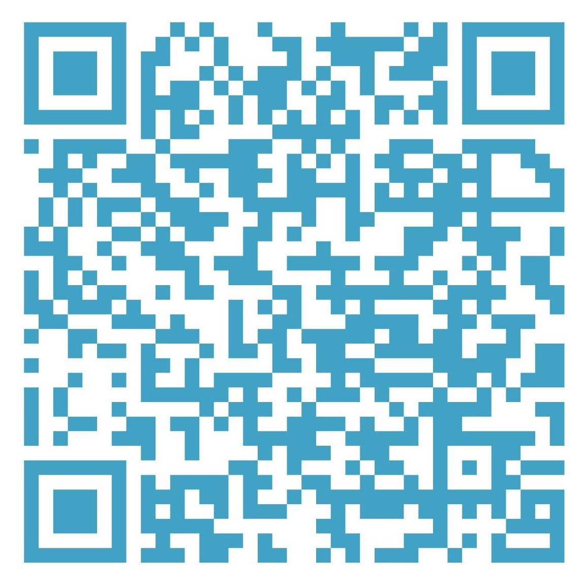
Welcome
Housekeeping items
  WIFI password → Thelismore
  (use Hilton Honors Lobby website to login)
  Restrooms are located outside of the conference room, across from the coat room. We will be having periodic breaks throughout the day.
  QR Code for Agenda and resources
  Reminder: Dinner is on your own. View nearby restaurant options via the QR code.
Notes:
Liz

Slide 3
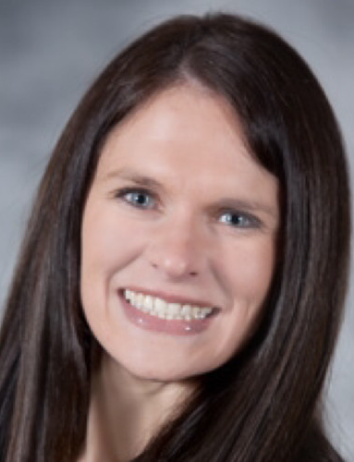
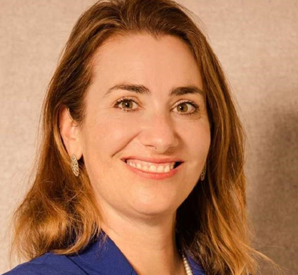

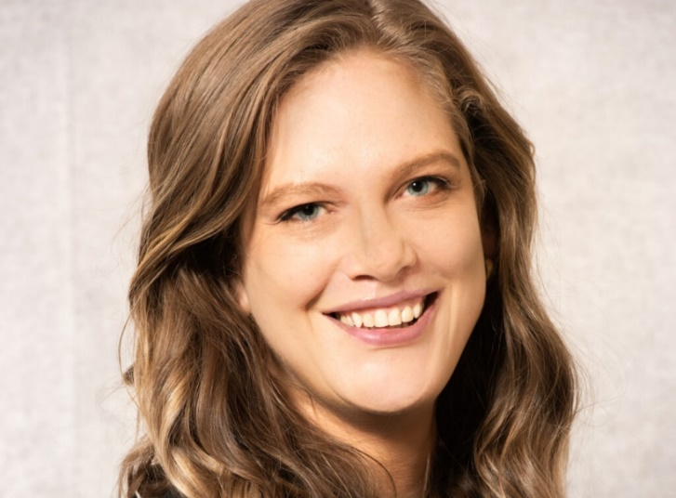
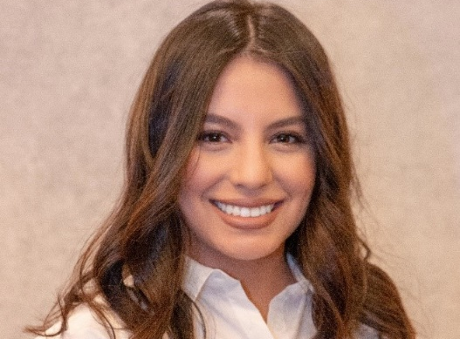
Introductions
Elizabeth Dressel - ATP Expenses Design Team Co-Lead & Co-Director of Travel
Becky Kopidlansky - Interim Co-Director of Travel
  Supporting UW-La Crosse and UW-Stout
Terry Wilson - Travel Manager, UW Madison
Alma Ramirez - Regional Travel Manager
  Supporting UW-Whitewater, UW-River Falls & UWSA
Alyssa Totoraitis - Regional Travel Manager
  Supporting UW-Milwaukee and UW-Parkside
Notes:
Liz
After our team introductions, the room can go around and do introductions.

Slide 4
Agenda
Wednesday, April 24​
10:00am - 10:10am - Welcome!​
10:10am - 11:20am - TMC Transition Topics​
11:20am - 11:30am - Break​
11:30am - 12:00pm - Sustainability​
12:00pm - 1:00pm - Lunch
    Lunch Discussion: Changes needed for UW policy​
1:00pm - 1:30pm - Welcome Fox World Travel!​
1:30pm - 2:45pm - Fox World Travel Presentation
2:45pm - 2:55pm - Break
2:55pm - 4:15pm - Fox presentation continued
4:15pm - 4:45pm – Kahoot Game
4:45pm - 5:00pm - Q&A and wrap-up day 1
*Dinner is on your own. Restaurant options provided via QR code.
Notes:
Liz

Slide 5
Agenda
Thursday, April 25
8:00am - 8:45am - Breakfast
8:45am - 10:00am - Workday Navigation/Credit Card Standardization/Expense Training Overview
10:00am - 10:15am - Break
10:15am - 11:30am - Workday Expenses (demo and walk through of Spend Auth)
11:30pm - 12:15pm - Working Lunch (Discussion on Workday Credit Card API & Workday/Fox integration​)
12:15pm - 12:30pm - Workday Expense Reports demo and walk through
1:30pm - 1:40pm - Break
1:40pm - 2:50pm - Workday Expense SME’s
2:50pm - 3:00pm - Wrap-up & Closing

Slide 6
UW Travel Team news
Shout out to UW-Stout, the newest campus to join the Regional Travel Manager Program.
Universities of Wisconsin Travel Team now supports 7 of our 13 campuses + UWSA.
As of Monday, April 22nd all uwsa.edu email addresses were updated to wisconsin.edu
  uwstraveloffice@uwsa.edu is now uwstraveloffice@wisconsin.edu
  Ann Brennan’s (Regional Travel Manager) last day at UW was April 10th
We will be posting our open position for a Regional Travel Manager soon!
  It will be posted as a 3-year project position
Notes:
Liz

Slide 7
Fox Transition – Focus of Today’s session
Travel bookings managed by our required contracted vendor, Travel Incorporated, will be transitioned to Fox World Travel on July 1, 2024
This is a result of leadership’s review and decision, based on feedback from travelers, arrangers, and administrators
Factors leading to the decision:
Quality of service to travelers and amount of feedback we received
Time to answer emails/phone calls
Agent team make up and transparency
Travel Inc has struggled to service/support many of UW's unique processes, resulting in a high number of complaints/issues
Agents not properly trained on booking complex international itineraries
We continue to get notified of major service issues weekly with Travel Inc, things are not “getting better”
Notes:
Liz

Slide 8
Review of Transition TIMELINE
Wednesday, June 26
Final day of booking in Concur with Travel Inc.
Thursday, June 27 – Monday, July 1
Concur unavailable
Thursday, June 27 – Sunday, June 30
Travel Inc. must be contacted for any immediate booking or support needs
Monday, July 1
Fox World Travel must be contacted for any immediate booking or support needs
Tuesday, July 2
Concur is available under the new Fox World Travel configuration
Notes:
Becky – address some of the questions that were asked during the Open House
1. Will fees be reduced during the time Concur is down? Since we have no option for Concur.

Slide 9
Fox Transition – Webinars/Trainings
March and April 2024: Travel Program Update (4 down, 1 left)
Overview of what is to come and high-level topics
The implementation process is underway with Fox World Travel
May and June 2024: New Non-Employee Booking Processes
Replacing Administrative Groups
Dedicated session for current Administrative group leaders
June 2024: Traveler Transition Readiness Sessions
Demo Fox-specific technology such as invoices, Fox Portal, past-date invoice retrieval, guest booking, flight monitoring, etc
July and August 2024: Open House/General Q&A Sessions
Review any post-go-live topics that were identified as pain-points or particularly meaningful to travelers and admins
Provide open-forum time for attendees to ask general questions or request demos on specific topics/technologies
Notes:
Becky – share feedback and questions from webinars. What are you hearing from travelers?
Talk about webinar issues with email migration.

Slide 10
Transition Specifics
  Encourage travelers to use open/unused ticket credits on file as soon as possible
    Round 1 of emails have been sent
    UW Travel Team will send out a 2nd round of emails in late May.
    Review of Open Ticket Guidance
  Travel occurring during the transition dates of June 26 – July 1
    Contact Travel Inc. if changes are needed through June 30th
    Contact Fox World Travel if changes are needed on or after July 1st
  Reservations booked with Travel Inc. before the July 1st transition date for travel on or after the July 1st Fox go-live date
    All confirmed bookings will be transferred to Fox World Travel on July 1st. No action is required by the traveler/arranger
    If any changes are required, Fox World Travel agents will have booking visibility and can assist
    Trip name will be visible in Concur, but itinerary may not be, all changes must go through a Fox World Travel agent
Notes:
Becky

Slide 11
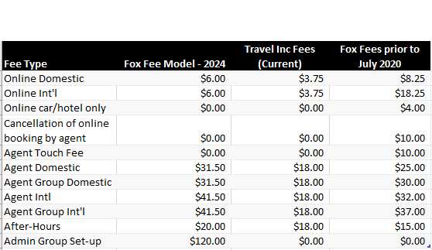
Service Fee changes
UW Overall (Systemwide) Transaction Type | % of Transactions
Online | 60.5%
Agent Domestic | 29%
Agent Int’l | 10.4%
Notes:
Alyssa
Update screenshot – remove 'proposed' and move Fox Fee Model to the first column. Add a red box

Slide 12
Fox Contact info & Wallet cards
Fox Employee Service/Individual Travel contact information:
Local: 608-710-4172
Toll Free: 844-630-3853
Email: UWtravel@foxworldtravel.com
Fox Group Block contact information:
Local: 920-933-4180
Email: foxgroupblock@foxworldtravel.com
*Phone/email will not be live until July 1st. Until then, there will be a recording that directs travelers to Travel Inc.
Notes:
Alyssa – suggest printing Wallet cards AND Tax Exempt Cards.
Becky to provide proof for printing. Each campus prints their own.

Slide 13
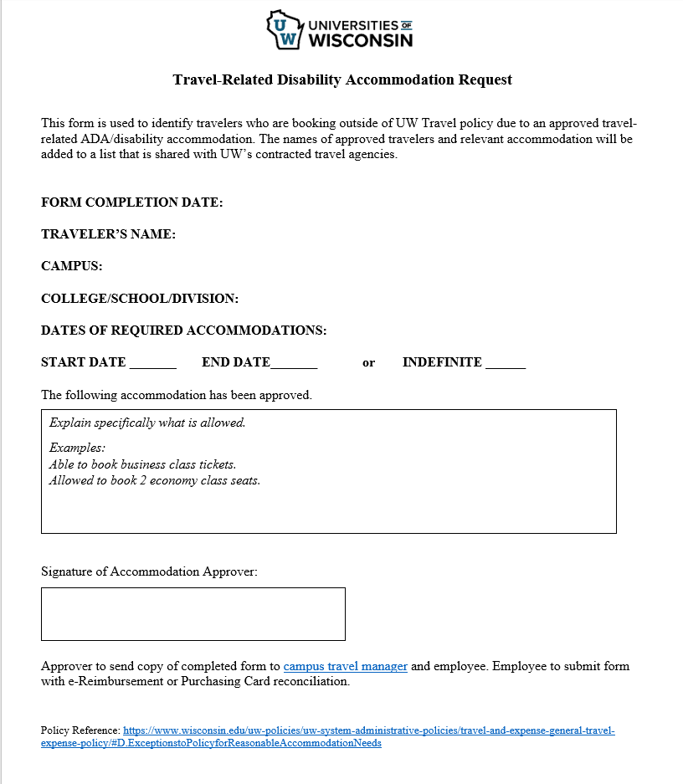
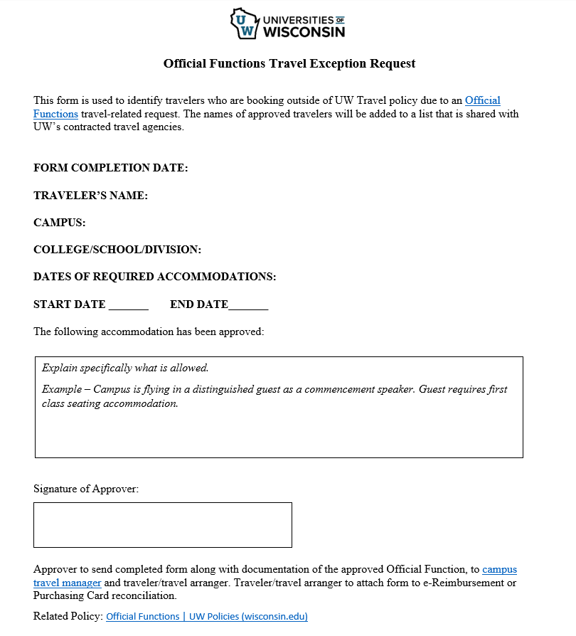
Overview of ADA & Official Functions Travel Accommodation Forms
Notes:
Alma

Slide 14
ADA Travel Request Process
Employee reaches out (to supervisor/to travel manager/etc.) to inquire about ADA travel accommodation
Employee is referred to campus ADA Coordinator
ADA Coordinator reviews request and determines if travel related accommodation is reasonable
If ADA Coordinator determines the employee is eligible for ADA Exception, the ADA Coordinator completes the form.
  A copy is sent to both the campus travel manager and the employee (to include with expense report or p-card reconciliation).
  Travel Manager shares form with UW travel team.
  UW travel team maintains master list and shares with contracted travel management company.
If ADA Coordinator determines the employee is not eligible for ADA Exception
  ADA Coordinator can recommend anything that is not covered by an ADA would follow the normal Travel Policy Exception Process or Official Functional Form (rarely for employees other than Chancellor/Executive Position link to Official Function Policy)
Notes:
Alma

Slide 15
Routing of Form
ADA Coordinator meets with employee to review exception request
Accommodation Approved
Accommodation Not Approved
ADA Coordinator completes form and sends copies to:
Campus Travel Manager
Saves for records
Sends to UW Travel Team
Employee
Attaches approved form to TER or P-Card reconciliation
UW Travel Team maintains master list and shares with agency
ADA Coordinator refers employee to Campus Travel Manager to review other options
Notes:
Alma

Slide 16
Next Steps
ADA Coordinator and Travel Managers for each campus to meet/align on rollout of form
ADA Coordinator/HR to consider if they keep these forms in the employee’s medical file
Travel Managers will be confirming with UW Travel office that they are ready for go live by June 15th
Notes:
Alma

Slide 17
Lunch Break

Slide 18
Introduction oF Fox Support Team
Wanda Burdick – Director of Operations
Kayla Kitchner – Client Solutions Manager
Kelly Kuebli – Operations Manager for University Agent Team
Notes:
Alyssa to introduce Fox Team and read bios

Slide 19


Universities of Wisconsin
Fox World Travel Reintroduction
April 24th, 2024
Notes:
1:20pm’ish – 2:20pm – Fox team presenting ( we can give this more time if need be and take time away from the later session)
New Non-profiled travel request form (screenshots is fine or a live demo like Mike showed us on Wednesday, even if we are still making changes)
Discussion on the Custom Booking solution and how that process will work (I know we haven’t really gotten that far with implementation yet so perhaps just a general overview?)
2:30pm – 4:15pm’ish Fox team presenting (unless you don’t think you’ll need/want this much time)
Kayla to Demos/samples/examples of:
Fox Invoice
Duty of Care (including Global watch processes, Fox Waivers, etc)
Fox Portal
Invoice retrieval
Etc.
Kelly to talk about the agent team
Give overview of the make of the agent team and how it’s going to be WAY better than what we have now. 😊
Example – emails can be routed to stay with the same agent start to finish
Chat functionality
Designated University team
Ability to select ‘domestic’ vs. int’l in the call in menu
Etc.

Slide 20
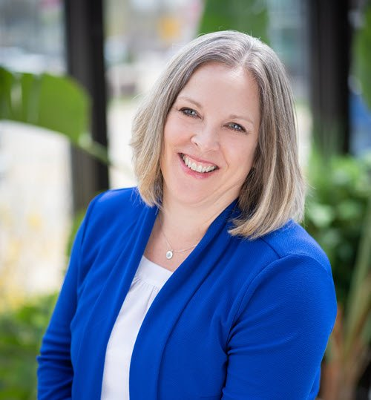
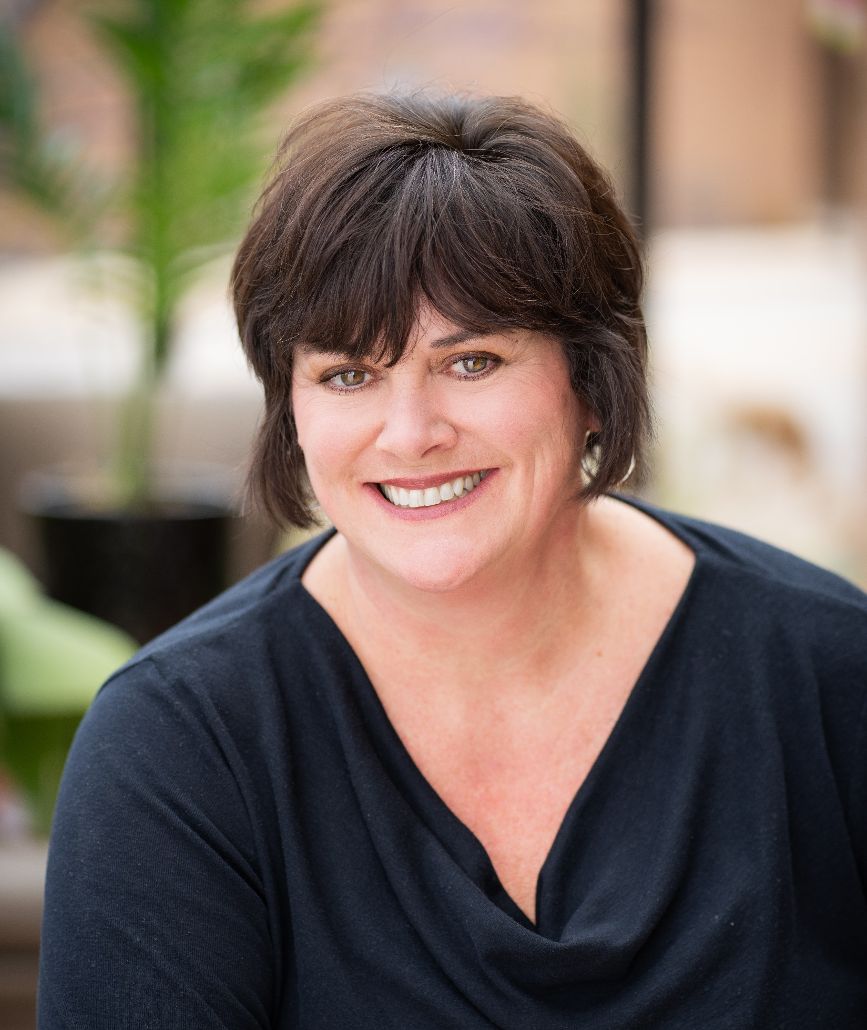
YOUR FOX TEAM
Wanda Burdick
Kelly Kuebli
Kayla Kitchner, GTP
Director of Operations,
Business Travel
Business Travel Operations Manager, Higher Education
Client Solutions Manager
Notes:
Alyssa to introduce and read bios

Slide 21
AGENDA
UNDERSTANDING UNIVERSITY TRAVEL
  Account Management
  Agent Services & Support
  Fox Portal
  Guest Travel Solutions
Notes:
Kelly: Agent Services & Support
Higher Ed Team
All agents trained on domestic and international
Global Watch
Business Hours/Phone Queue
Provide phone and email
Kayla: Account Management and Fox Portal
BREAK
Wanda: Guest Travel Solutions
Concur Guest Feature
Calling/Emailing Agent Team
Unprofiled Traveler Form
Custom Booking Solution (Admin Groups)

Slide 22





WHY FOX IS DIFFERENT
EXPECT
MORE
Travel management can feel like an island. In a sea of sameness, too many solutions, but nothing is the right fit. When tech stacks and innovations are everywhere, yet promises are left unmet, frustration swells and there is little choice but to settle.
But we DON’T.
We adamantly dig to understand what is valued.
We obsessively solve complex business issues.
We authentically serve each unique client.
We are boldly transparent in our approach.
CUSTOM SUCCESS
PROVEN VALUE
Our actions meet our words--and we prove it.
Unique obstacles are our opportunities.
TRUSTED PARTNER

Slide 23

Account management

Slide 24

Traveler experience

Slide 25
AGENT SERVICES & SUPPORT
Higher Education Team
Set Up
Staffing
Hours
Contact Information
Dedicated Phone
608-710-4172
844-630-3853 (toll free)
Dedicated E-Mail
UWTravel@FoxWorldTravel.com

Slide 26
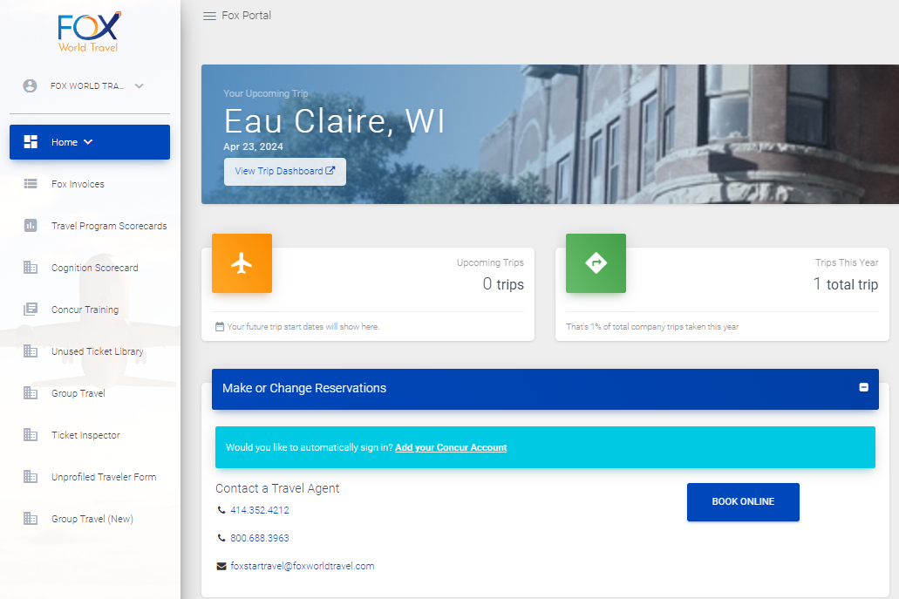
FOX PORTAL
Notes:
Getting screenshots
Break after this slide

Slide 27
Retirement of Administrative Groups
With the transition to Fox on July 1st, all current Administrative Groups will be discontinued.
  Decision to retire administrative groups and create 2 new processes for guest/non-employee travel
    Over 1,000 groups system-wide
    85% of all admin groups have less than 10 travelers
    Administrative burden
    Time consuming process for a small number of travelers per group
    Increase in fraudulent bookings
  New service fee model was created to minimize increases to Concur transactions and move fees to most labor-intensive reservations.
Notes:
Terry

Slide 28
Service Fee changes
UW Overall (Systemwide) Transaction Type | % of Transactions
Online | 60.5%
Agent Domestic | 29%
Agent Int’l | 10.4%
Notes:
Terry

Slide 29
Options for Booking Guest/Non-Profiled Travelers
There will be 4 options for booking guests, students and other non-employee travel. 2 of the options allow for the arranger to book on behalf of the guest and 2 of the options allow for the traveler to work directly with Fox.
Arranger books in Concur using ‘Book for a guest’ functionality
Arranger books on behalf of guest by calling Fox.
Traveler books directly with Fox after arranger authorizes booking through One-Time Individual Booking Request Form.
Traveler books directly with Fox after arranger establishes a Custom Booking Solution (CBS), formerly known as Administrative Group.
Notes:
BeckyFox

Slide 30
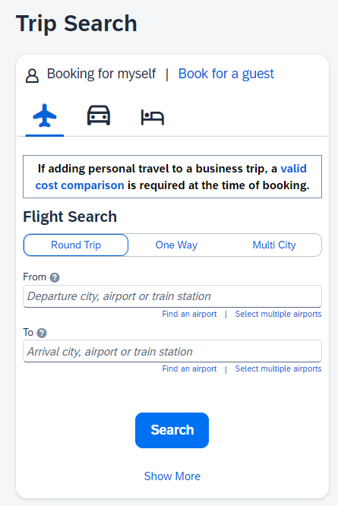
Options for Booking Guest/Non-Profiled Travelers
Arranger books in Concur using ‘Book for a guest’ functionality
  This functionality exists today with Travel Inc and is available to all employees with Concur profiles.
  Should be used when arranger wants to book online on behalf of the guest.
  This is the only option to book non-employee travel online.
  Arranger must collect and enter all information from the traveler, including full/legal name, DOB, gender, cell # and email, prior to making the booking.
  A credit card would have to be entered at the time of booking if not already stored in Arranger’s Concur profile.
Notes:
Bec

Slide 31
Options for Booking Guest/Non-Profiled Travelers
2. Arranger calls Fox to book on behalf of guest
  Arranger must have their own Concur profile to be able to call Fox to book.
  This method should be used when the arranger wants to book for the traveler and the traveler would not have any contact with Fox.
  Arranger must collect all information from the traveler, including full/legal name, DOB, gender, cell # and email, prior to calling Fox to book the trip.
  A credit card would have to be provided at the time of booking
  Email confirmation is sent to both arranger and traveler
Notes:
Becky

Slide 32
Options for Booking Guest/Non-Profiled Travelers
3. One-time Individual Booking Request
  Arranger completes request form to authorize Fox to work directly with Traveler.
  One of the two new processes created to replace Administrative Groups.
  Fox will review process shortly.
Notes:
Becky

Slide 33
Options for Booking Guest/Non-Profiled Travelers
4. Custom Booking Solution (CBS)
  Arranger completes request form to authorize Fox to work directly with Traveler.
  One of the 2 new processes to replace Administrative Group
  $120 set-up fee per group
  Fox to review process shortly.
Notes:
Becky
*Requires Group Air form to be completed by UW employee/group administrator

Slide 34
Afternoon Break

Slide 35
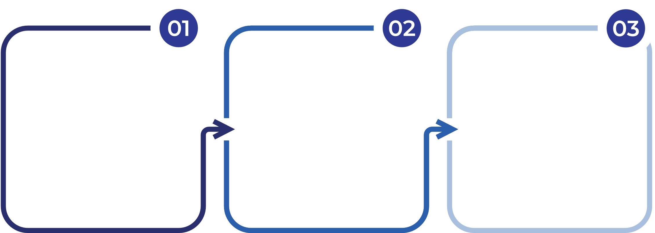

STANDARD GUEST TRAVEL SOLUTIONS
CONCUR GUEST BOOKING
Grant guest booking access to travel arrangers
Travel arranger gathers traveler information
Travel arranger completes reservation in Concur on behalf of traveler
AGENT GUEST BOOKING
Travel arranger collects traveler information
Profiled travel arranger contacts Fox agent with all details and payment information.
Agent completes booking

Slide 36
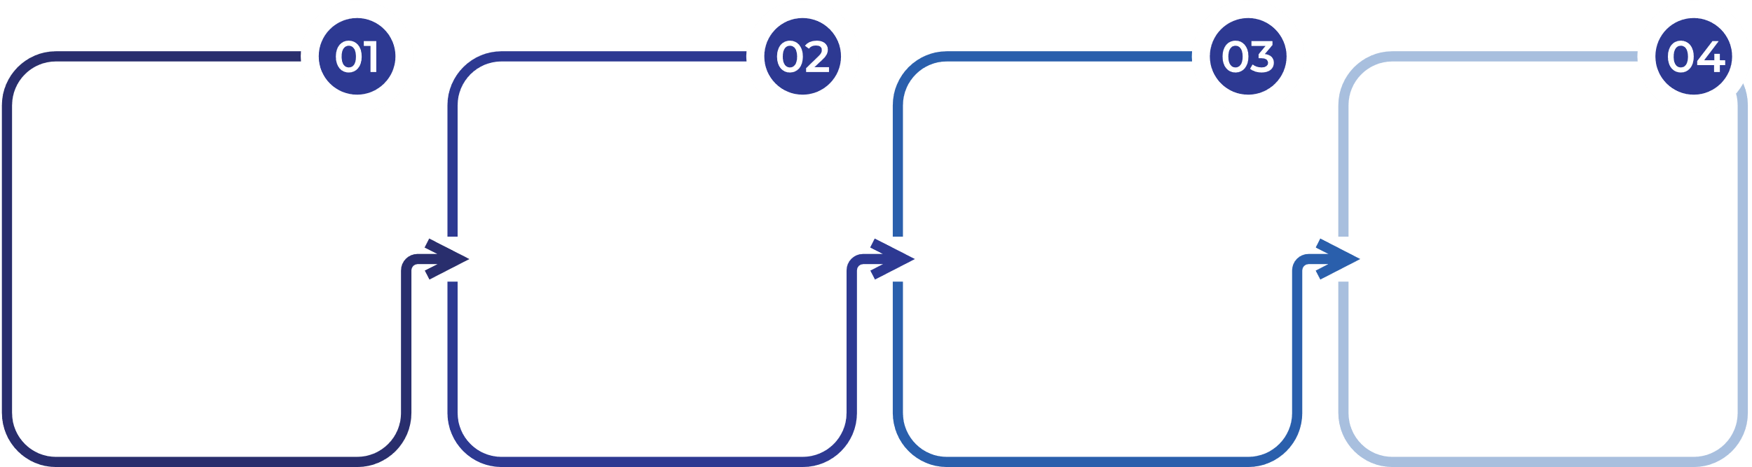
CUSTOM APPROVAL BOOKING SOLUTIONS
ONE-TIME INDIVIDUAL BOOKING REQUEST FORM
Travel arranger completes guest form with travel parameters
Guest traveler and agent team receives email confirmation
Traveler calls Fox and provides confirmation number
Agent completes booking
CUSTOM BOOKING SOLUTION
Travel arranger initiates group set up with Fox
Travel arranger establishes group parameters, dates, policy, etc.
Travelers contact Fox agents to complete bookings under group.
Notes:
Need to consolidate to four steps

Slide 37
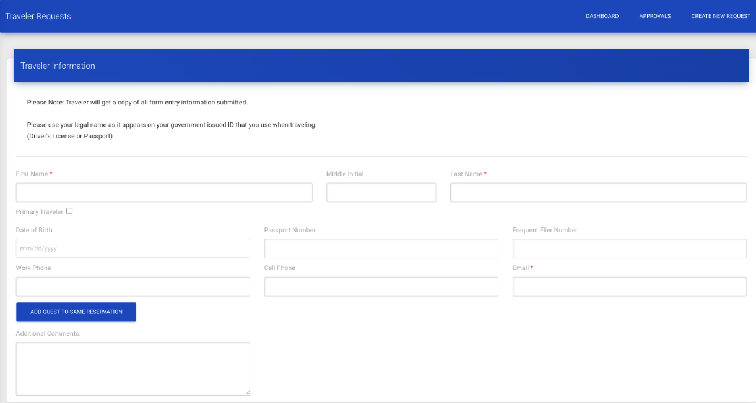
ONE-TIME INDIVIDUAL BOOKING REQUEST FORM
ONE-TIME INDIVIDUAL BOOKING REQUEST FORM
Minimal mandatory fields include first and last name and email.
Optional fields, including date of birth and frequent traveler numbers, allow for guests to provide their private information directly to the agent team for privacy.

Slide 38
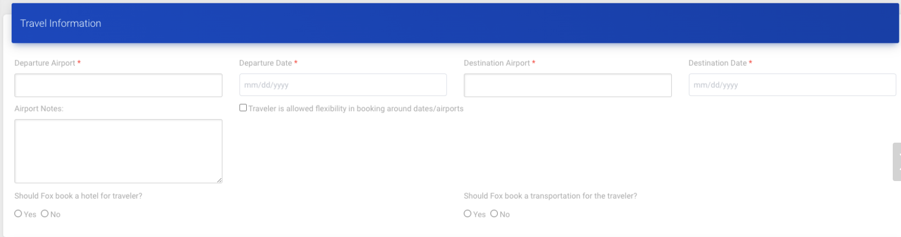
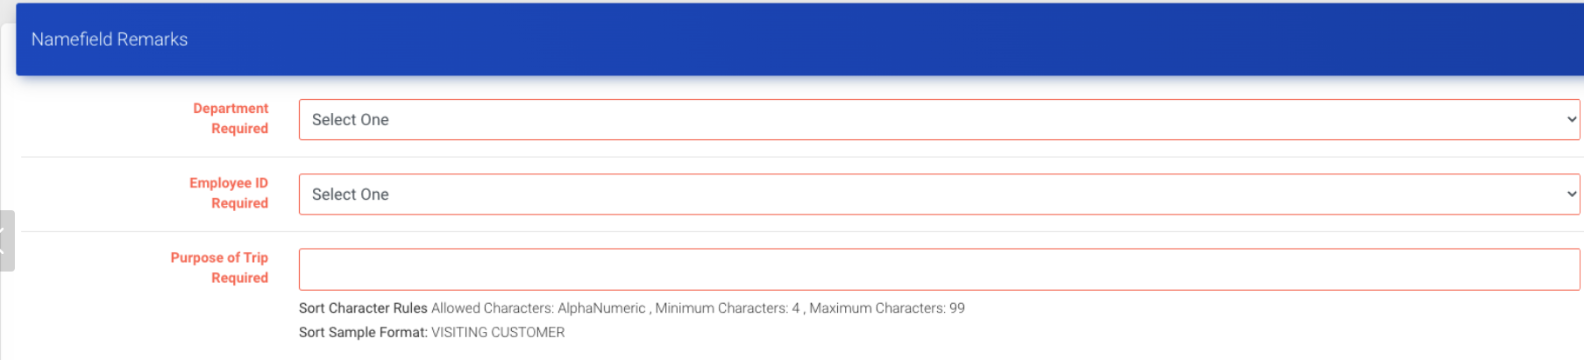
ONE-TIME INDIVIDUAL BOOKING REQUEST FORM
Parameters can be provided here.
Required fields will be provided here.

Slide 39
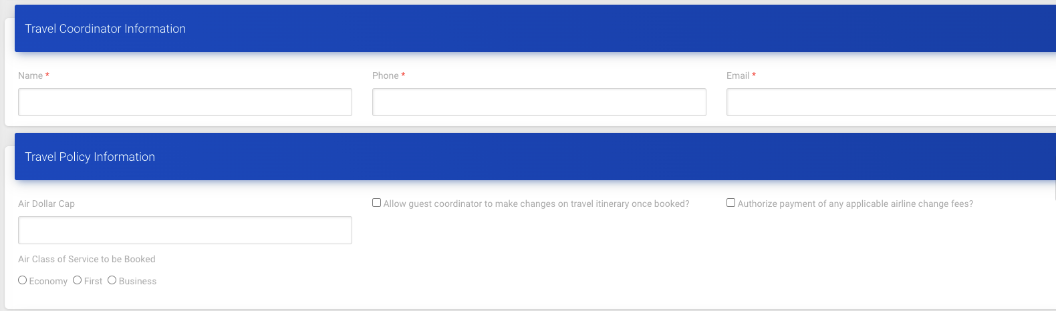
ONE-TIME INDIVIDUAL BOOKING REQUEST FORM
Travel requester information will be captured here. This will autofill with your information.
Additional policy information can be captured here, allowing you to change what is allowable per traveler.

Slide 40
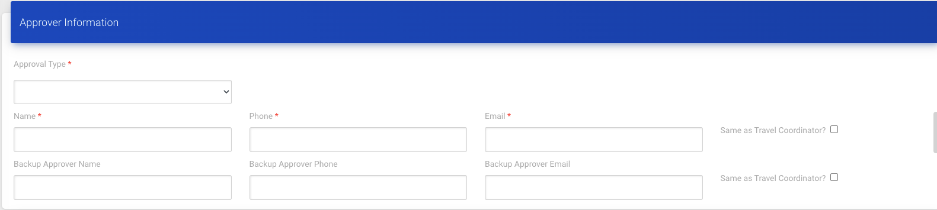
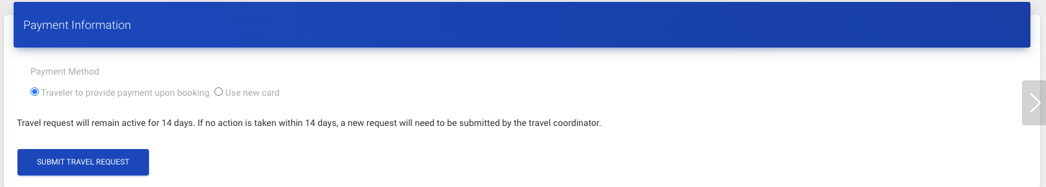
ONE-TIME INDIVIDUAL BOOKING REQUEST FORM
Optional approval information will be captured here. Additional approvers can be included to account for outages.
Payment information will be provided here. The form securely relays the card information to our booking system.

Slide 41
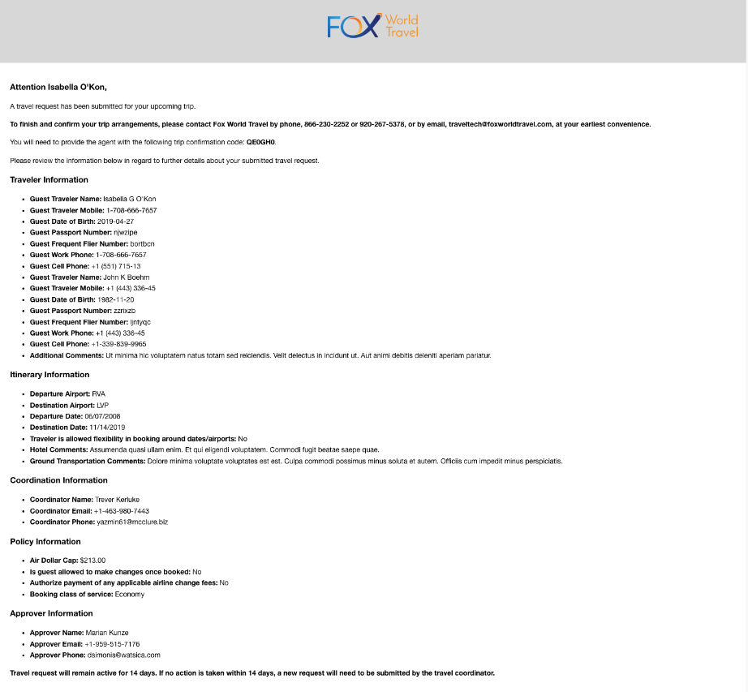
Travel Request Email
Following submission of the One-Time Individual Travel Request Form, an email will be sent to the requester and the traveler with the details of the request, as well as instructions for the traveler on next steps.

Slide 42
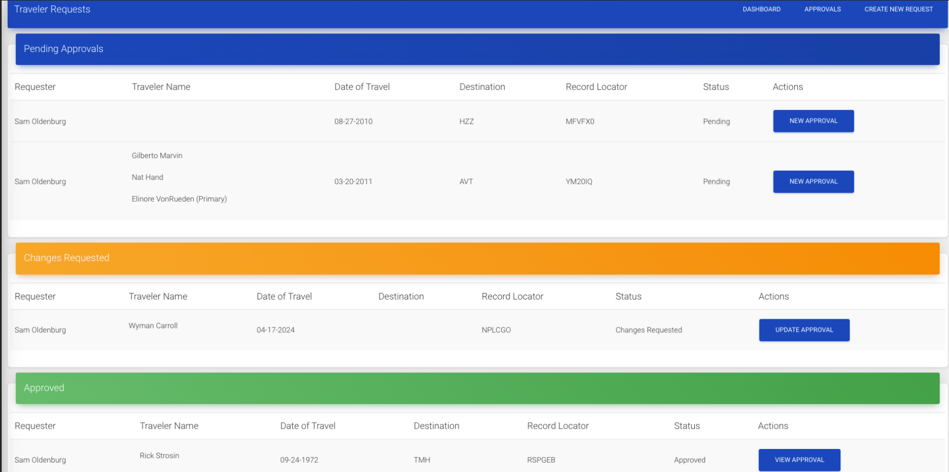
TRAVEL REQUEST DASHBOARD

Slide 43

Q & a

Slide 44


THANK YOU
LET’S SOAR, TOGETHER!

Slide 45
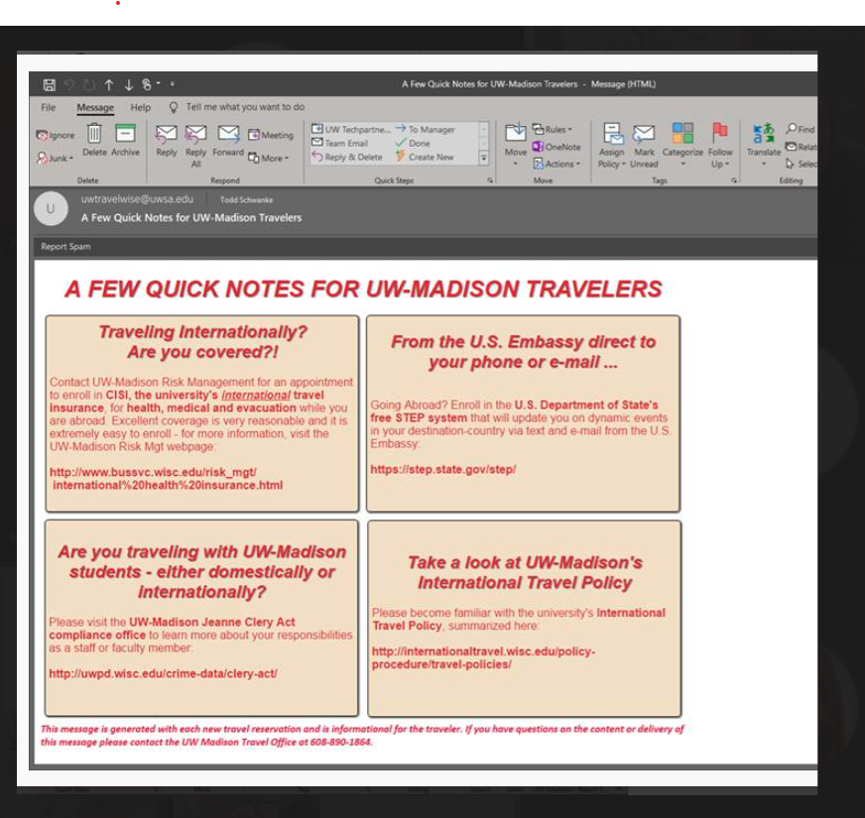
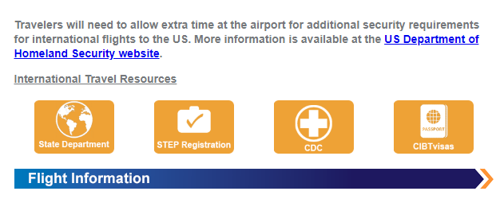
Fox Transition: Discussion ITEMS
1. Compliance Messages
  What are they?
  System-wide messages
    Combining business/personal travel
  Compliance Message options by campus
  Alternatives to Compliance Messaging
    Invoice messaging
  Pros/Cons
Notes:
Terry -Link to tax exempt forms??

Slide 46
Fox Transition: Discussion ITEMS
2. Unused ticket email reminders (sample on next slide)
  What are they?
    Email reminders alerting travelers of an expiring unused airline ticket/credits on file with Fox.
  Who are they sent to?
    Employees (profile travelers)
    Guests/Students (non profiled travelers)
  Pros/Cons
Notes:
Terry –
Do we need this slide? Verify with Fox on Friday
Chasity to send sample email and is checking if message is customizable.

Slide 47
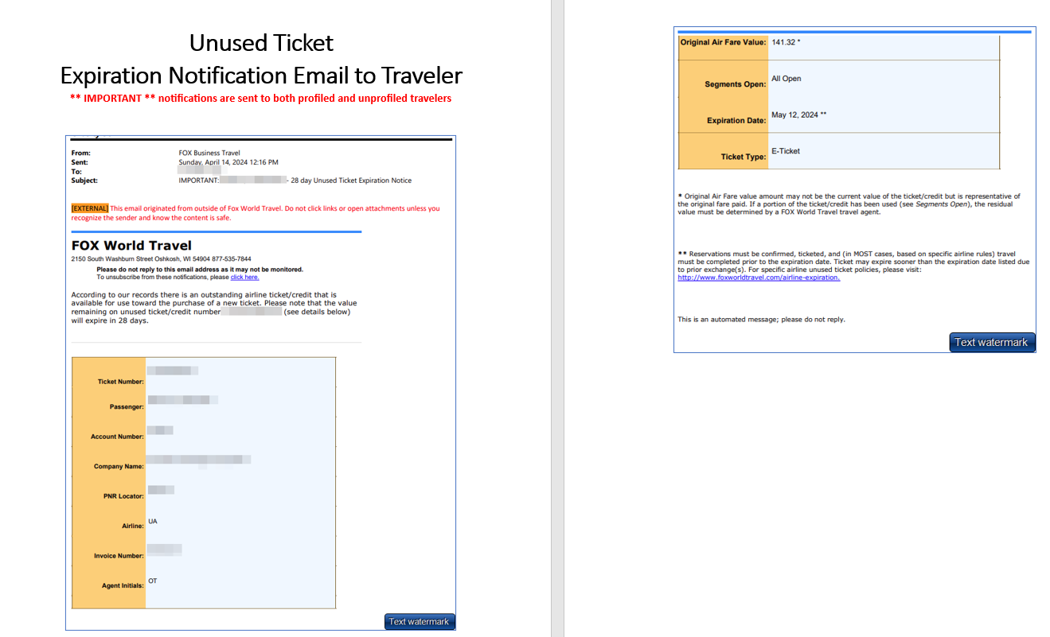

Slide 48
Fox Transition: Discussion items
3. Fox’s American NDC Early Adopter Program (we have opted in pending approval process follow-up)
  Allows access to American NDC fares
  Bookings may only be made through agents (not in Concur)
  Existing unused ticket credits cannot be used
  Flight/schedule limitations
    Return flight options may be limited based on what outbound flight is selected, potentially required multiple one-way tickets
    NDC tickets can only be exchanged for other NCD tickets, impacting change options
  AA may have to be contacted for support of NDC tickets, potentially impacting response time for travelers.
  Approval process may not be supported
    Fox to follow-up
  Schedule changes must be processed directly by American.
Notes:
Becky /Wanda – not yet available for any reservation that requires approval (CBP, One-time individual booking request)

Slide 49
Kahoot Game

Slide 50
Q & A
Day 1 Wrap-up

Slide 51
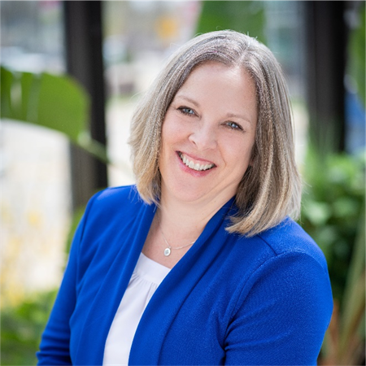
With over 25 years of experience in the travel industry, Wanda has established skills within operations, team development, problem solving, supporting best-in-class service deliverable and technology to enhance traveler experience. She originally started at Fox in 1997 but came back to the company in 2013.
At Fox, Wanda aligns with the business travel and Fox meeting & incentive division on strategic group air service delivery, along with consulting customers’ group air programs to find the best suitable products.
Wanda’s passion for continuous improvement helps Fox strive for success in the business travel industry. She has a strong focus on operational and technology solutions by evaluating opportunities, recommending solutions, and leading the change with implementation initiatives.
“Outside of work, I enjoy all four seasons; spring is the time for new growth and gardening. Summer walking, boating, and golfing. Fall means cool night and changing colors. Winter is for skiing and warm fires. Most of all, I love spending time with family and friends.”
Wanda Burdick
Director of Business Travel Operations
Notes:
Alyssa to read bios

Slide 52
Kayla works closely with clients to provide customized travel solutions that support, enhance, and expand their travel programs. Kayla's focus is on optimizing the overall traveler experience while maximizing savings for her clients' businesses. She uses her expertise in the travel industry to consult with clients and help them achieve their travel goals.
After nearly a decade of experience in the industry, Kayla joined Fox in 2023. She brings a fresh and dynamic approach to her clients and is ready to tackle any challenge. Kayla has a wealth of experience in the travel industry, having worked as a travel agent, account manager for university athletics, travel reporting and data analyst and corporate travel manager at a molecular diagnostics company. Kayla utilizes her vast knowledge and skills to improve travel programs while acknowledging that every client has distinct needs and that no two programs are alike. Her extensive experience has given her a thorough comprehension of the nuances related to compliance policies that impact travel.
Kayla firmly believes that data is a powerful tool that can be leveraged to find solutions to almost any problem. When she works with her clients, she starts by exploring the available data. After analyzing it, she uses the findings to support our proposed solutions and demonstrate their effectiveness. Conversely, if the data suggests that our approach is not working, she perceives it as an opportunity to go back to the drawing board and come up with a new plan.
Additionally, after obtaining her Global Travel Professional (GTP) certification, she is committed to staying up to date with the constantly evolving travel industry. Each new client presents an opportunity to expand her expertise.
“I thrive on relationships and love to be considered a part of my clients’ travel team. I have as much of an interest in getting your program where you want it to be as you do. We can work together to achieve your goals”.
Kayla Kitchner
Client Solutions Manager

Slide 53
Kelly’s Bio
Kelly Kuebli

