Slide 1
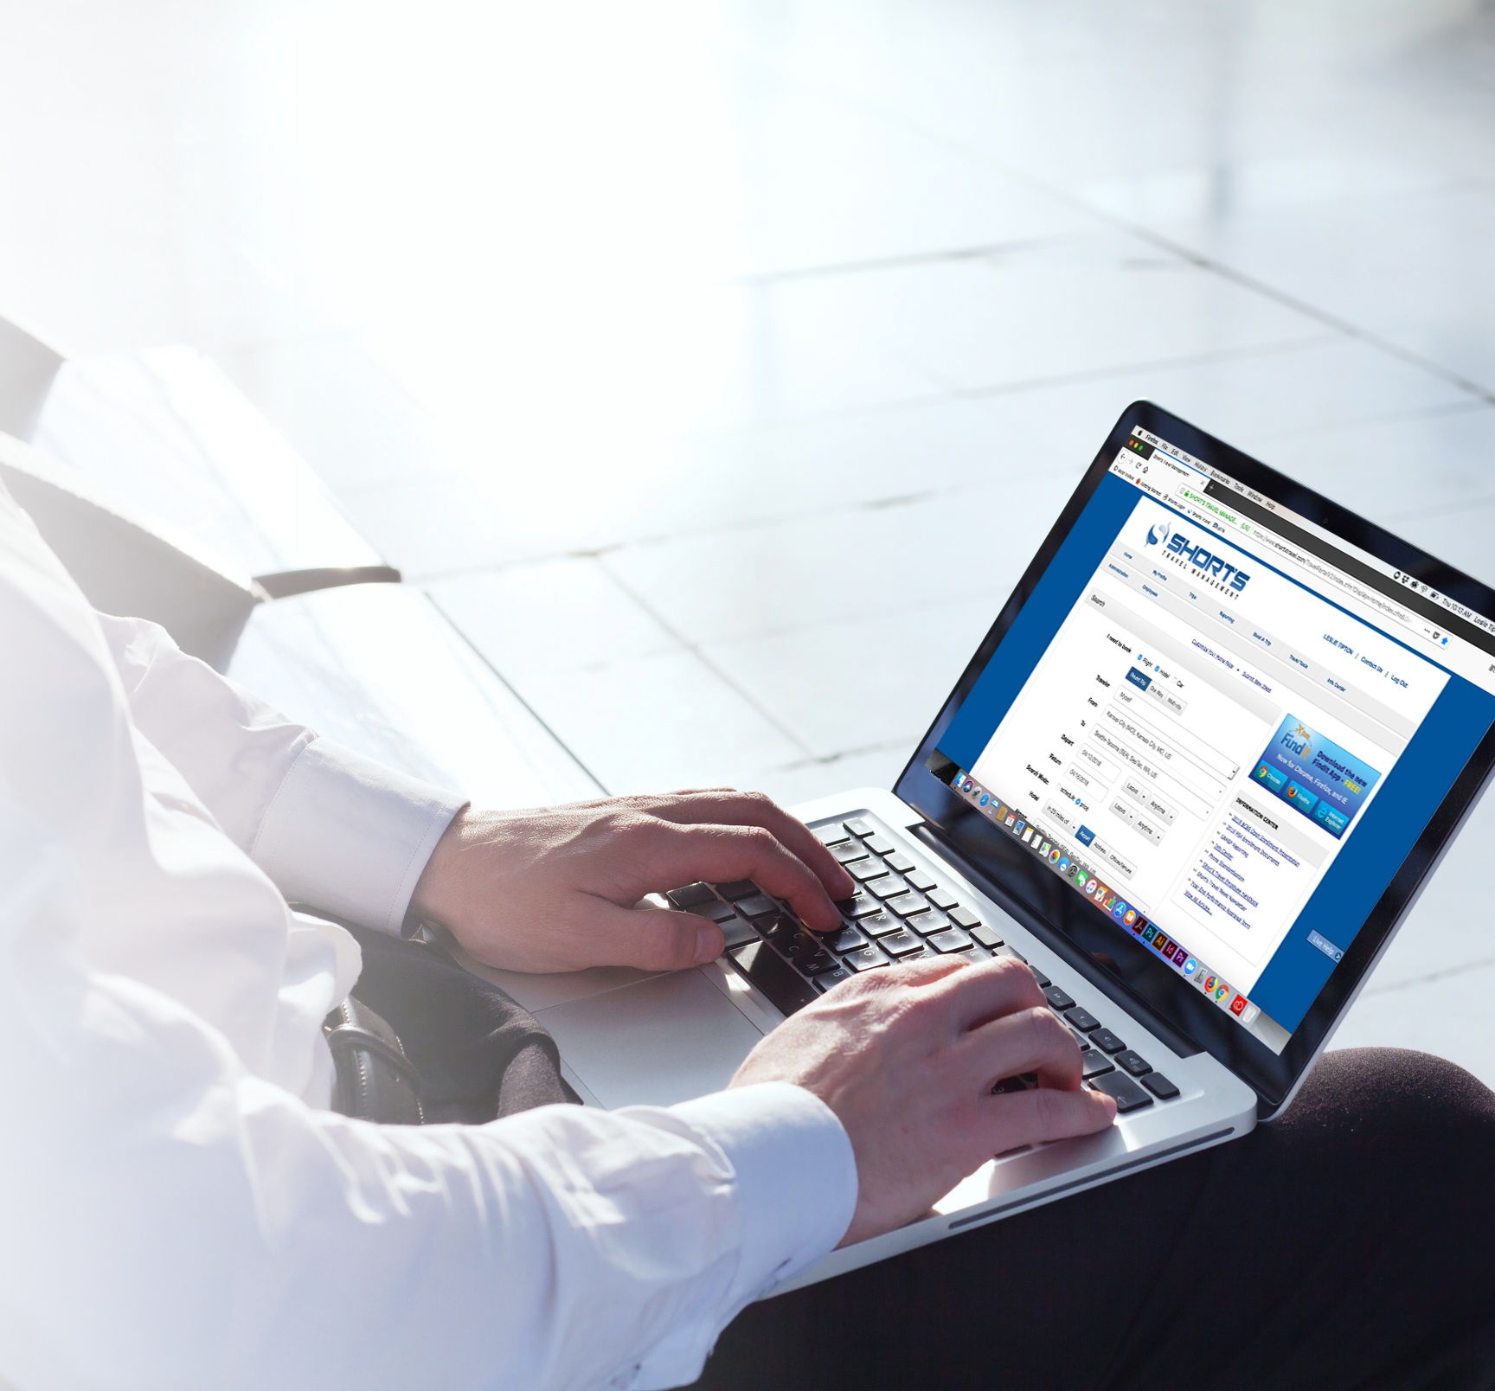

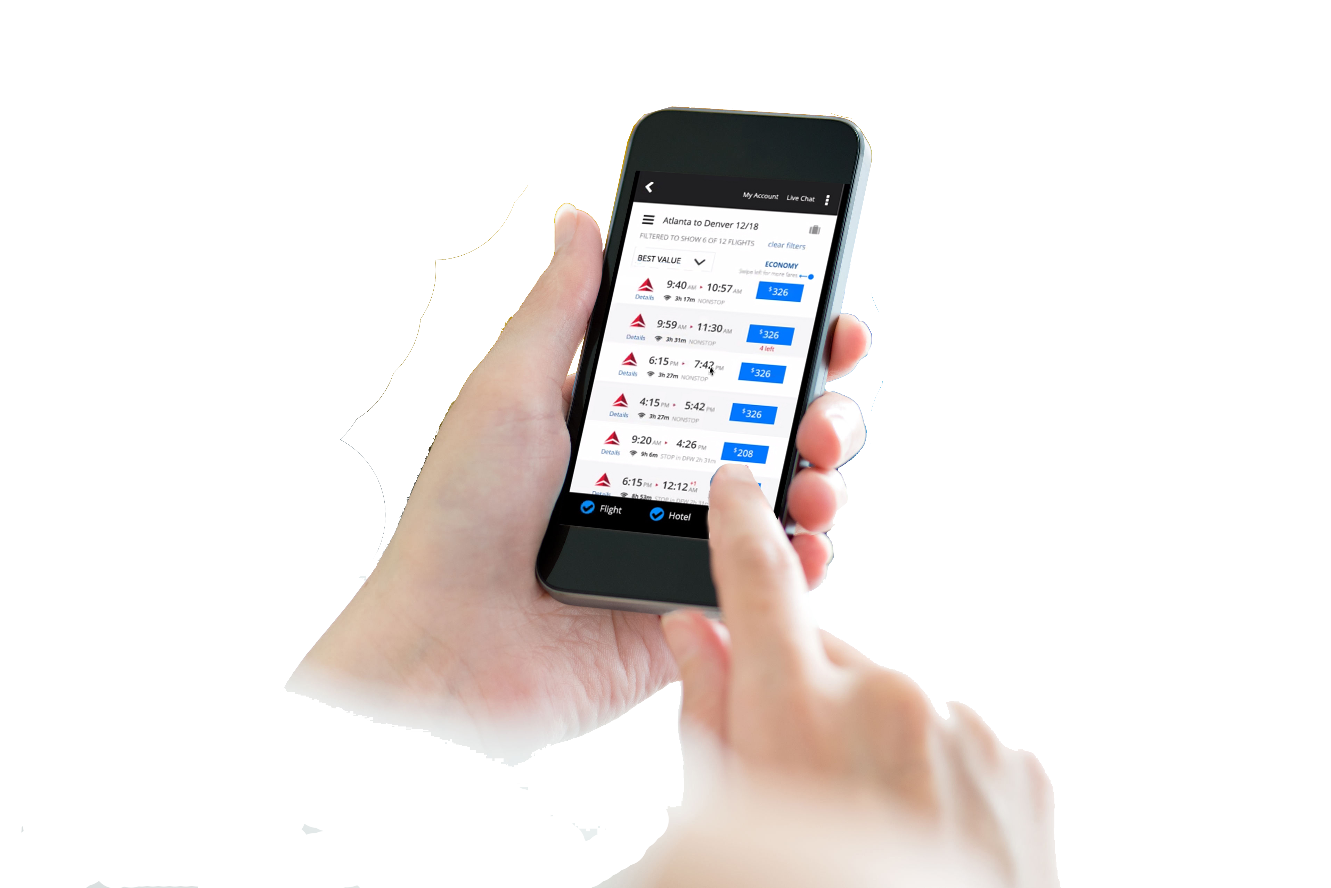

University of Wisconsin – River Falls
SHORT’S TRAVEL ONLINE (STO) PORTAL
Quick Reference Guide
To Enhance The Experience Of Getting There, Being There And Coming Home
Getting Started with Short’s Travel Management
The online travel portal provides travelers with instant access to travel information, itineraries, invoices, real time flight tracking, weather information, and online check-in.
Itineraries can be downloaded to your Outlook calendar and viewed on you smartphone. Itineraries can be automatically sent by e-mail to specified recipients.
Short’s Travel Management
1203 West Ridgeway Avenue
Waterloo, IA 50701
US: (888) 625-0209
www.shortstravel.com

Slide 2





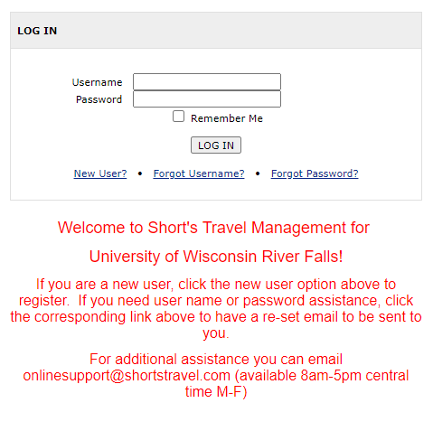


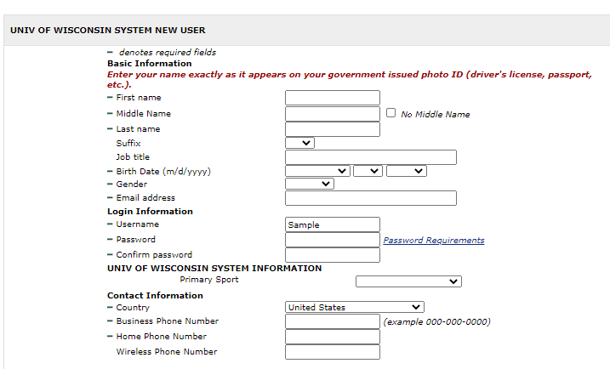

STEP 1 |  | STEP 2 |  | STEP 3
LOCATE THE APPROPRIATE PORTAL SITE UW River Falls https://www.shortstravel.com/falcons Navigate to the above domain: Select “New User” |  | COMPLETE THE REQUEST FOR A PROFILE Enter the following information for any fields not already completed: Legal Name Date of Birth Gender University Email Address Username (University Email Address) Password Primary Sport Contact Phone Numbers Select “Agree” for the Acknowledgment Once your request is submitted and approved by system, an introductory email will follow with additional instructions. Please note all profiles process for approval so there will be a slight delay. Create your profile at your earliest opportunity to allow time to complete before you travel. |  | CONTACT YOUR AGENTS FOR ALL TRAVEL ASSISTANCE Short’s Travel Management BUSINESS HOURS 8:00AM – 5:00PM CST M-F DEDICATED TOLL-FREE NUMBER (844) 814-3936 AFTER HOURS/ EMERGENCY (844) 814-3936 Answered 24/7 ADDRESS 1203 W. Ridgeway Ave. Waterloo, IA 50701 EMAIL uwsathletics@shortstravel.com

