Slide 1
E-Reimbursement Training
December 2022

Slide 2
Agenda
E-Reimbursement: Things to know
Creating Expense Report
General Information
Expense Entry
Payment Types
Travel Reductions
Demo

Slide 3
E-Reimbursement – Things to Know
E-Reimbursement resources on UW TravelWIse
All travel related expenses must be submitted by the traveler within 90 days after the trip completion date
If expense report is returned for any reason, it must be resubmitted within 90 days.
First/Last Day of Trip is 75% of the daily allowance
Provided meals are deducted from the per diem
Receipt Requirements

Slide 4
E-Reimbursement
Click here to log into the Expense portal

Slide 5
Creating Expense Reports
Walkthrough (this links back to UW Madison but it is a GREAT resource): https://businessservices.wisc.edu/travel-reimbursement/getting-reimbursed/how-to-create-modify-and-resubmit-an-expense-reimbursement-in-e-reimbursement/
Video tutorial and other reference documents: https://www.wisconsin.edu/travel/reimbursement/

Slide 6
General (Header) Information
Business Purpose: choose the best one that fits (Relocation must be correct)
Default Location = primary destination
Reference: where the destination is in relation to traveler’s headquarter city
Dates: do not include personal days
Attachments: all required receipts must be attached
Accounting Defaults: funding applied to entire report
Justification: traveler must enter at least one note explaining trip; additional notes can be added by traveler/alternate/approver/auditor

Slide 7
Expense Entry
Date: as shown on receipt
Expense Type: see “help” link for additional information
Description: required for some expense types
Reimbursement Method: see next slide.
Additional Information: varies based on expense type
Non-Reimbursable button: expense will not be reimbursed (typically not required to include these items)

Slide 8
Payment Types
Personal Funds – out of pocket expenses which will be reimbursed.
Ghost card (Central bill card for air only)
Prepaid Purchasing Card
Required to create an expense line item for P-Card purchases
UATP (UW Prepaid Air Card)
Left over funds from COVID cancelled flights. Funds have been depleted and no new airfare will be purchased using these funds.
Only use when following specific instructions

Slide 9
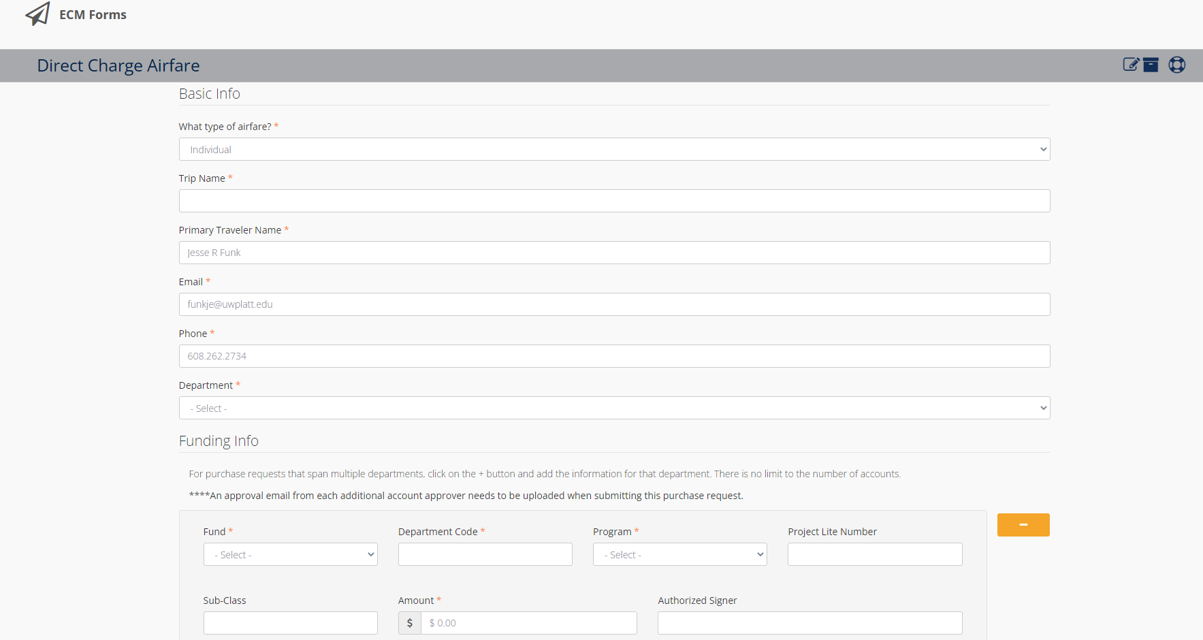
Ghost Card
Direct Charge Airfare form MUST be completed
https://dashboard.uwplatt.edu/ecm/forms/direct-charge-airfare

Slide 10
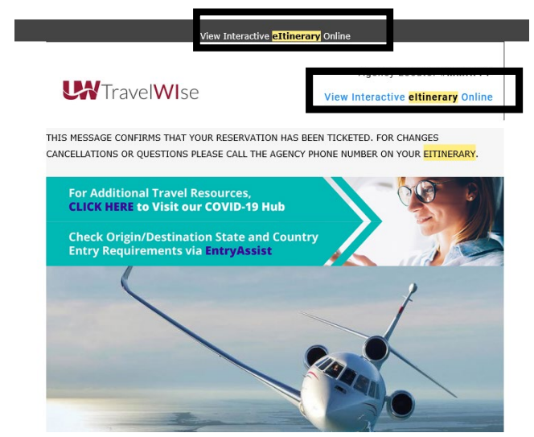
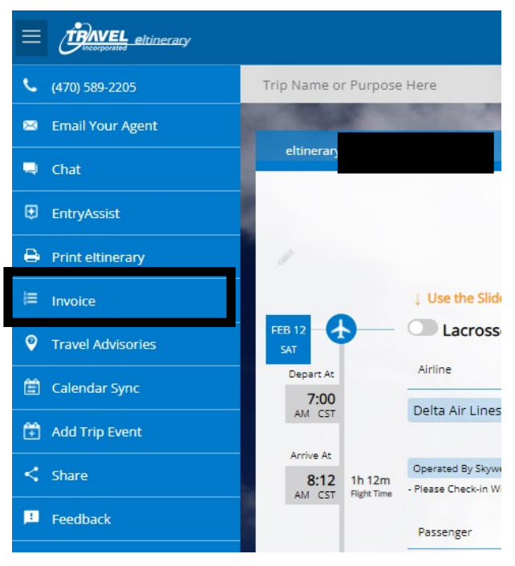
Invoice Retrieval from Travel, Inc
View Interactive eItinerary Online > Invoice

Slide 11
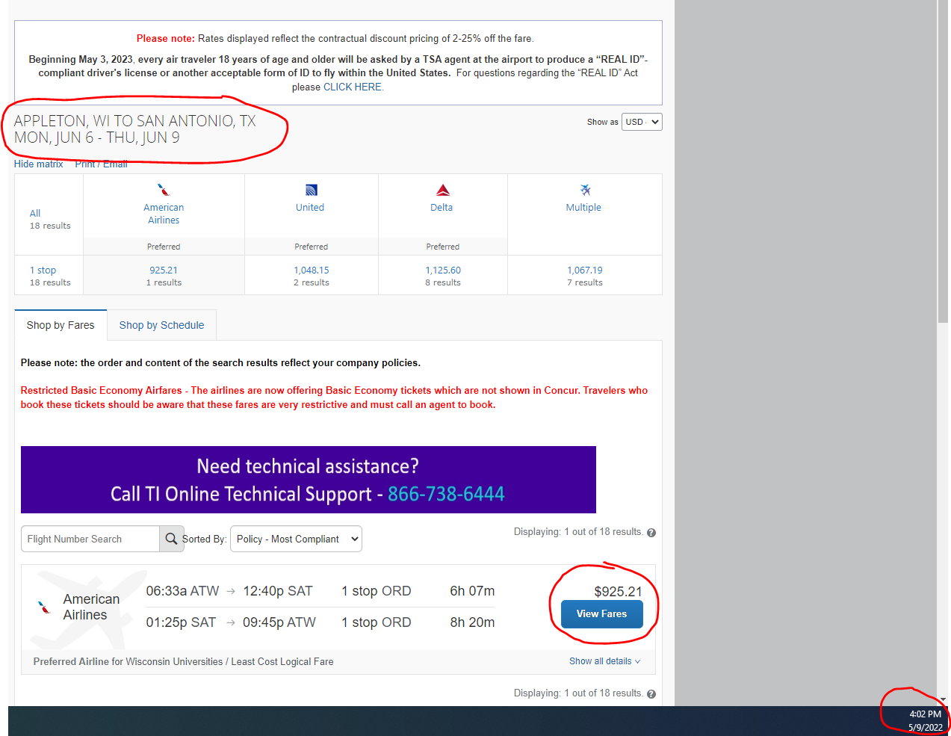
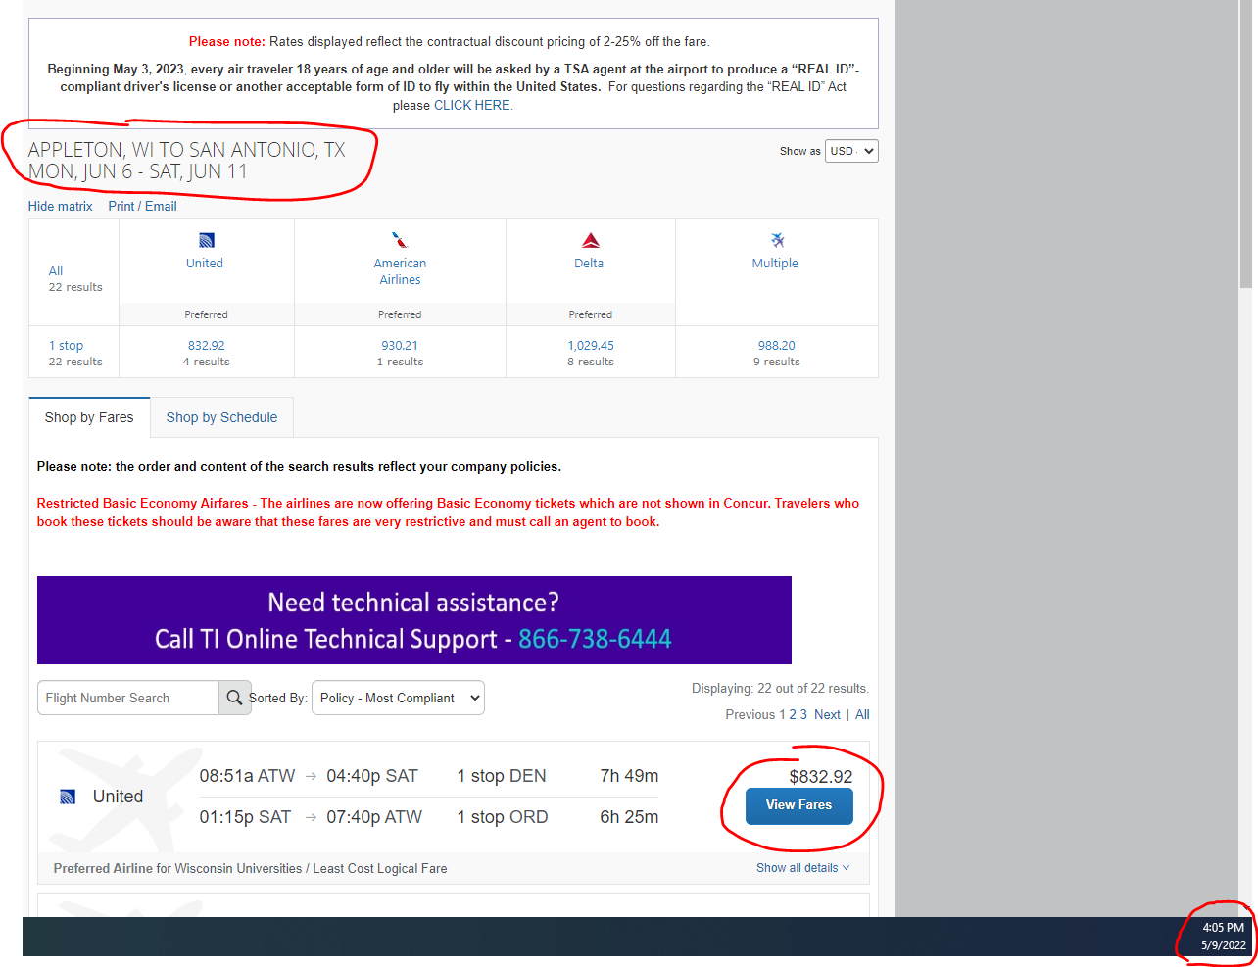
Business Combined with Leisure
Must provide a cost comparison for your TER

Slide 12
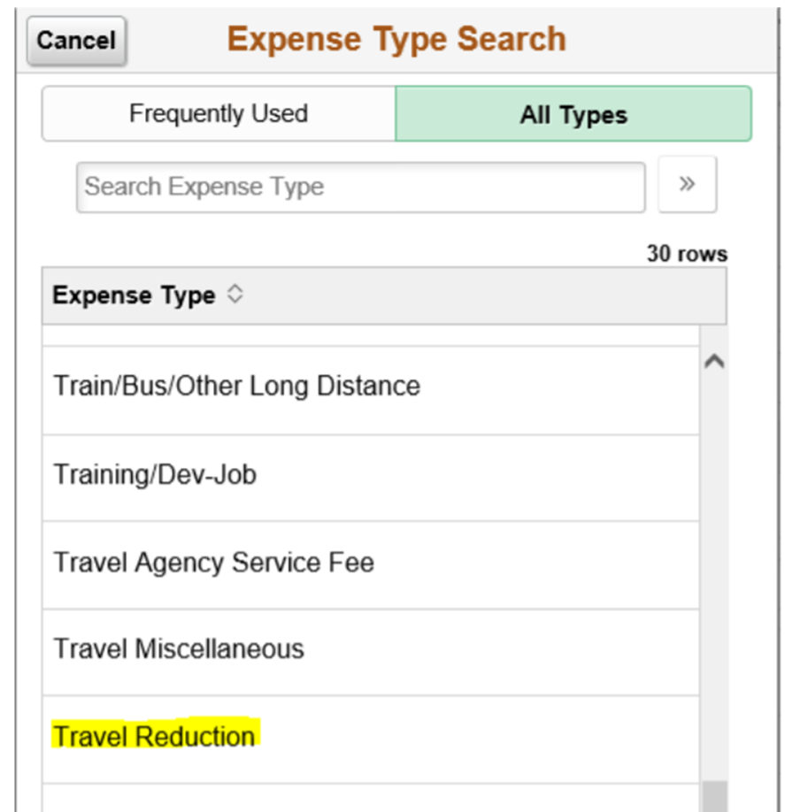
Travel Reductions
Common reasons to do travel reductions
Reduce to actual cost of meals rather than per diem
Grant or approval for only a specific amount of airfare. Traveler covers any overage.
Traveler to cover amount over hotel max rate
Reduce mileage reimbursement
Reduce overall reimbursement of entire expense
Include reasoning in justification
Notes:
Department may only cover a certain amount – but important to enter full amount in case $$ in case additional funds become available later.

Slide 13
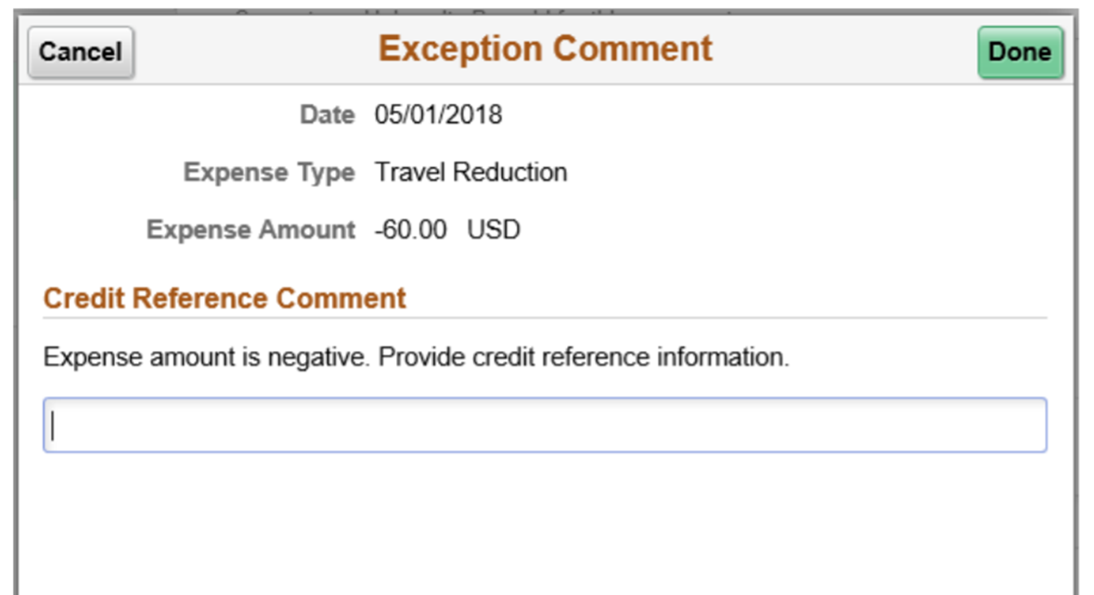
Travel Reductions
The screen/image shown below will be displayed when a negative amount is entered for an expense line. The message is to notify and confirm that the traveler acknowledges that their reimbursement will be reduced.
Travel Reduction help document

Slide 14
Thank you!

