Slide 1
UW Travel Manager Conference
April 12-13, 2023

Slide 2
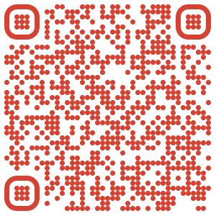
Agenda for Wednesday, April 12
10:15 – 10:30– Welcome & Overview of agenda (Liz Dressel)
Introduce self, campus, role (ex Controller, TM, Procurement, Audit)
10:30am – 11:15am Training Discussion (Alyssa Totoraitis)
Overview of current training offerings and resources
Ideas for future trainings
Review Administrator Training in Canvas
11:15- noon – Audit Presentation (Janelle Housley)
Noon - Lunch
12:25 – 1:25 – Working Lunch (Molly Berger & Erin Drachman)
Concur adoption
Evolution – reporting capabilities
Trip Insights w/invoice lookup
TI operations (consultants/staffing)
Administrative Groups discussion
1:35 – 2:35 - United Airlines Presentation (Sue Skoworn)
Industry overview
Discuss pilot shortage and flight cancellations
NDC
2:35 – 2:50 – New Expense Type (Student Lodging) and new Insurance Blanket Program (Liz Dressel)
2:50 – 3:25 Afternoon break
3:30 – 4:50 Kahoot and Roundtable discussions (Alyssa/Alma to lead and all to participate)
4:50 – Wrap-up & Dinner Logistics
Meet at 5:30 at Malarkey’s Pub & Townies Grill (N 3rd St – one block over)

Slide 3
UWSA Travel Department Welcomes You!!
  What a great week to come together!
  Let’s collaborate on how to make the travel program better and build understanding of current state and future state and stay engaged these two days together
  I’m expecting a fair amount of take aways (homework for the UWSA team) to help shape some of our calls going forward
  Feel free to speak up and participate and let’s make this fun ☺
  Please introduce yourself, your role, and how long you have been with UW

Slide 4
UW System
Training Overview
UW System – Travel Manager Conference
April 12 – 13, 2023
Notes:
Becky

Slide 5

Current Training Offerings
Canvas Travel Training Modules
  Travel Policy & How to book
  Admin Training (not live on Canvas yet)
UW TravelWIse Resources
Open House Webinar recordings
Monthly UW TravelWIse newsletter
Travel Inc Travel Hub

Slide 6

Ideas for Future Training Offerings
Additional Canvas Modules
  Athletics
  Group Blocks
  Expense
Standardized training for all campuses
  Hurdles to overcome in order to standardize
Expand Quarterly Open House offerings
UWSA Travel Team Virtual Office Hours
Other ideas? What would you like to see?

Slide 7

Questions and Answers

