Slide 1
Expenses Overview
Travel Manager Conference
Configuration as of
April 10, 2023

Slide 2
DISCLAIMER: Functionality Subject to Change
  Functionality shown and discussed reflects current development and is SUBJECT TO CHANGE.
  We are more than a year away from go-live. We are sharing more of a deeper dive look at Workday Expenses that we think Travel Managers, Credit Card Administrators, Expense Partners (Central Audit), various Procurement and Finance stakeholders will find relevant.
  We are hoping you flag to us anything we share that you find of concern, please ask questions and keep an open mind
  We are all on quite the transformation journey with this project!
  Special thanks to our amazing Expenses Focus Group, please stand up to be recognized for your volunteerism and dedication!

Slide 3
Agenda of Expenses Overview
Payment Elections
Guests/Committee Member Set Up
Finding and Knowing Funding
Roles and Workflow Overview
Mandatory Training
Pcards in Expenses
Spend Authorization Usage for Policy Compliance
Demo of Expense Report
Validations – Critical vs Warnings
Foundation
Key Takeaways
  Reporting and Dashboard, Discussion/Next Steps

Slide 4
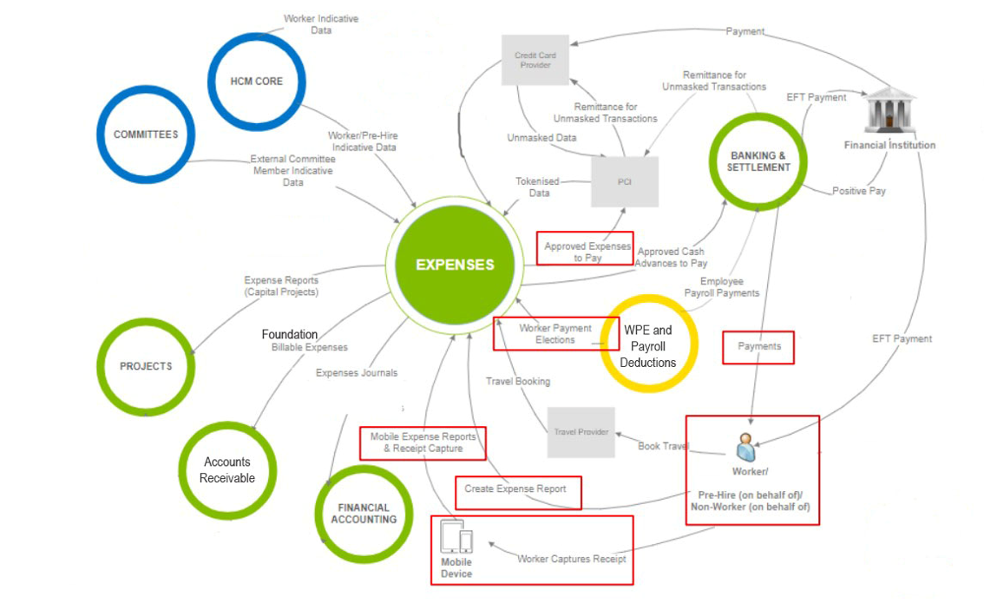
Expenses future state with Workday

Slide 5
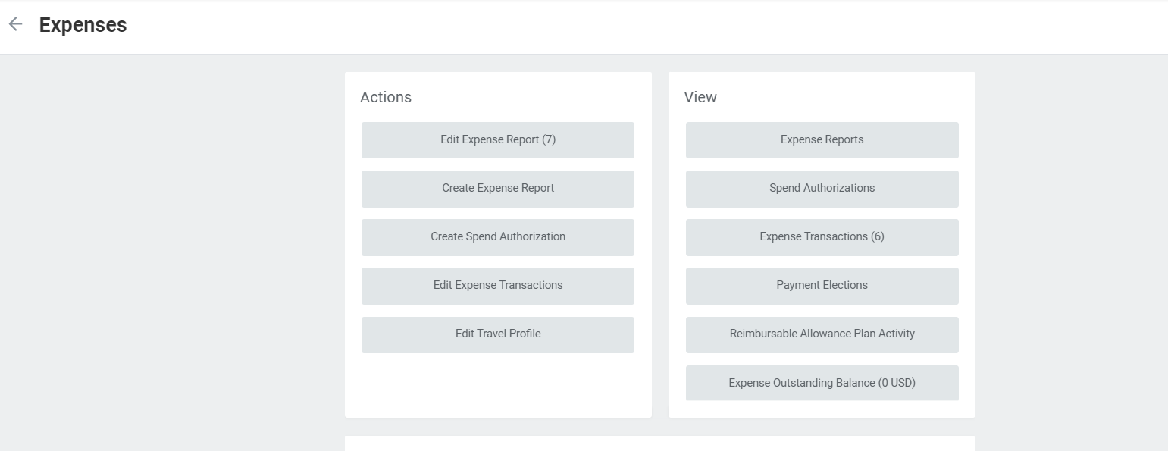
1. Payment Elections
In Workday, Payment Elections is included in the Expenses Worklet

Slide 6
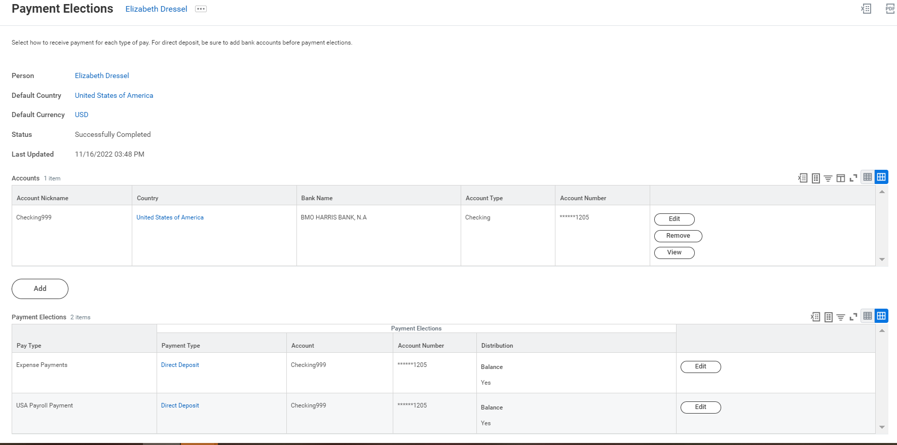
1. Payment Elections
In Workday is available in the Expenses Worklet

Slide 7
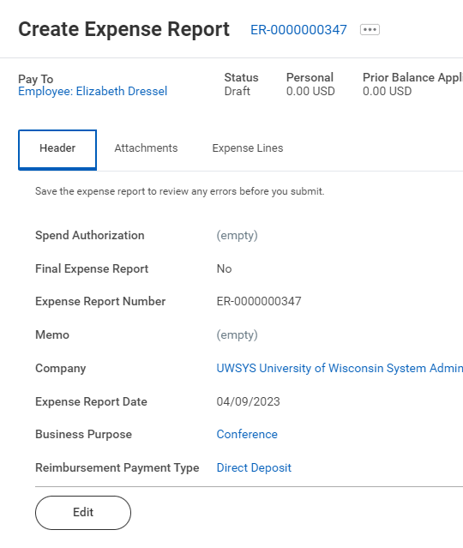
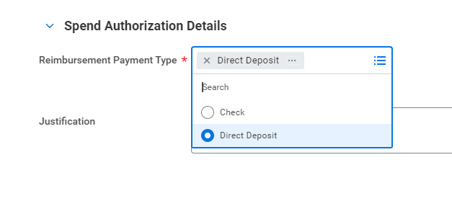
1. Payment Elections
Each Expense Report or Spend Authorization employees do have the option to select Check or Direct Deposit (Cash Advances will be requested completing a Spend Authorization).
It is hard to find where to change to check on the Expense Report, which is ideal, but want to point out it can be done

Slide 8
2. Expense Data Entry Specialist
Role assignment, not person-to-person assignment
Constrained by company
  Potentially cloning role to be constrained at a more narrow level
Can create and submit expense reports for employees and non-employees.
Mandatory training requirement
Replaces current state Alternate

Slide 9
Non-Employee Reimbursement
External Committee Member (ECM)
  Each campus and largest divisions at UWMSN and UWMIL are their own “committee”
  Ex: Invited speaker, research participant, visitor, etc.
  Candidate
    Initiated by HR
    Ex: Interview expenses
  Student
    Non-payrolled student travel and expenses
    Ex: Research fieldwork
Pre-Hire
  After hired but before start date
  Ex: House hunting expenses, travel prior to start date
Constricted by company

Slide 10

3. Finding Funding
Robyn Bolton’s team is leading the charge on creating a “Funding crosswalk tool” that will be available for folks to enter what the “old funding” string was and get the updated “Workday funding”
We expect this to be one of the most frequent questions from users
Will be required to reconcile all University Card charges, and all out of pocket expenses

Slide 11
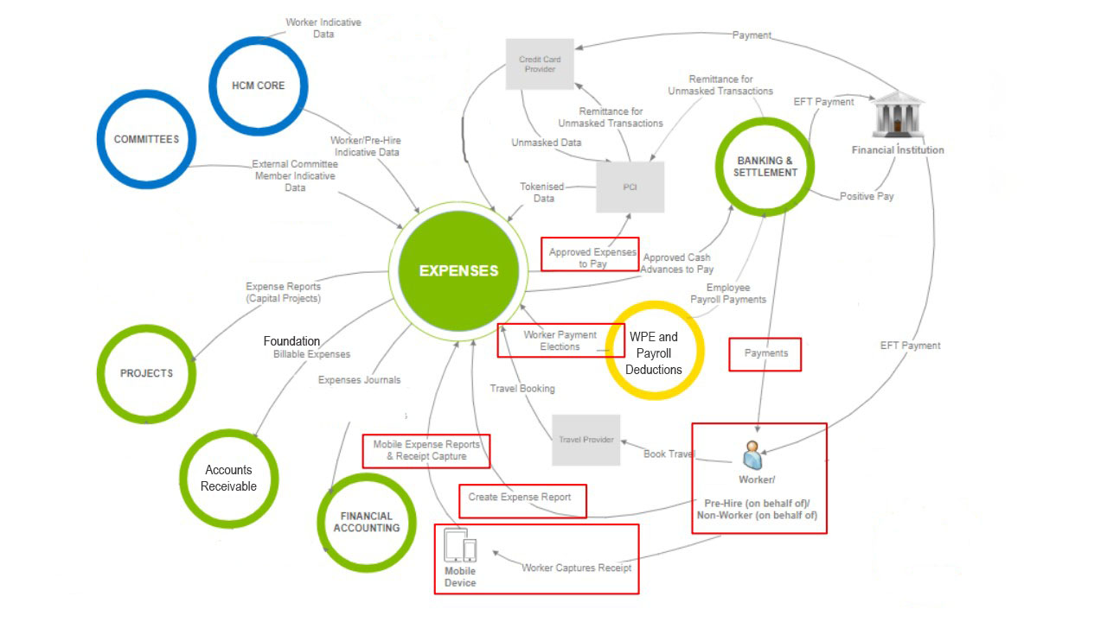
4. Expenses Roles and Workflow Overview
Campuses have not assigned roles, that work begins in May
Campuses have not yet received a list of what roles to assign yet (what is central versus campus level)
Background information on Expenses, there are two main business processes:
  Spend Authorization (similar to Travel Authorizations)
  Expense Report (includes Pcard products)

Slide 12
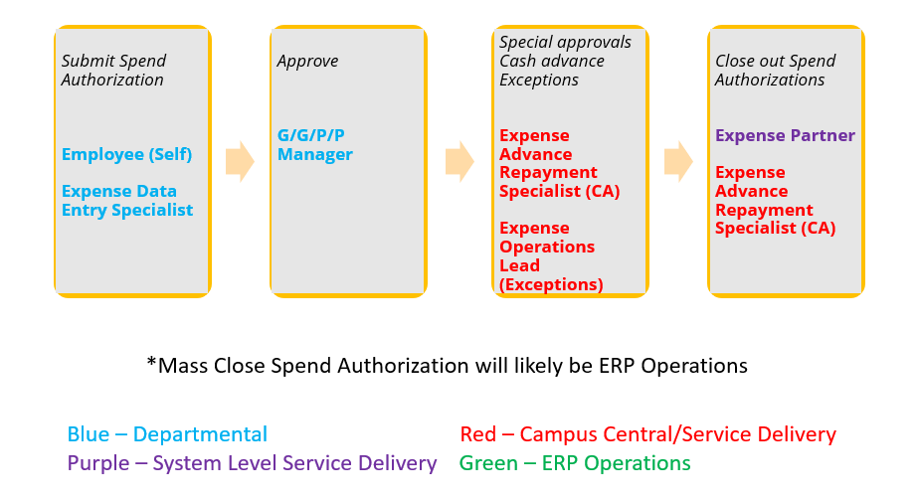
Spend Authorization- Process Overview and Security Roles​
Similar to current state Travel Authorization
  Not making this mandatory
Required for cash advances and policy exceptions (90 day, airfare booked direct)

Slide 13
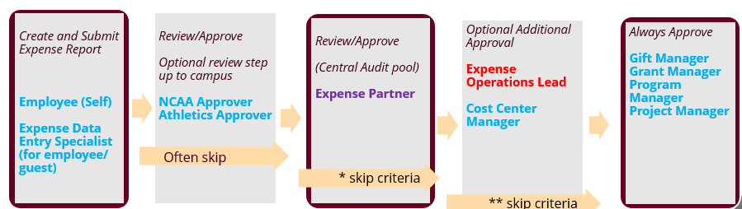
Expense Report- Process Overview with Security Roles
Out-of-pocket and all UW card expenses (all Corp Card/Purchase Card)
In general, expenses go to centralized approval first
  Looking at use of thresholds, and not requiring for most Purchase card reconciliations
Exception approver to approve spend authorization that will be referenced in expense report
Grant/Gift/Program/Project approval last
Ability to ad hoc approvers
Steps outlined in burgundy will be in most expense report events
*skip if under $X or Pcard Reconciliation
** skip in most cases unless ad hoc approval is requested/required
Alternate routing preventing approval for self (if G/G/P/P Manager will go to Cost Center Manager)

Slide 14
Expense Reimbursement- Common Security Roles
Expense Data Entry Specialist - The Expense Data Entry Specialist has the ability to Create Expense Reports on behalf of other workers and External Committee Members.
External Committee Member – Guest who gets reimbursed in Expenses.
Expense Partner - The Expense Partner has access to Review (and edit) Expense Reports and is generally part of the Expense Report Approval process. Similar to “Central Audit” function today.
Grant Manager - Primary manager for assigned grants. Typically assigned to administrative personnel. Access to grant spend analytics. Approval authority for financial business processes.
Gift Manager - Primary manager for assigned gifts. Access to gift spend analytics. Approval authority for financial business processes.
Project Manager - Primary manager for assigned projects. Access to project spend analytics. Approval authority for expense, requisition.
Program Manager - Primary manager for assigned programs. Access to program spend analytics. Approval authority for financial business processes.
Expense Operations Lead – Approval authority for expense business processes flagged as out of policy.

Slide 15
Expense Reimbursement- Additional Security Roles
Credit Card Transaction Administrator - Fix credit card transactions that are in error as well as Maintain airports, hotels, rental cars, etc.
Credit Card Administrator - Create and maintain all credit card setup data regardless of organization.
Travel Administrator - Unconstrained access to process travel booking records. No approval authority.
Expense Analyst - The Expense Analyst has access to View Expense Reports.
Expense Advance Repayment Specialist – Perform expense advance repayment functions for assigned companies. Examples include creating and editing cash advance repayments.
Finance Analyst – View all financial setup and operational data for assigned companies. No approval authority.
Committee Partner – Access to set up External Committee Members (guests) for reimbursements. The committee partner will be the role paired with Expense Data Entry Specialist to add/update External Committee Members.
Committee Administrator – Access to managing External Committees Members for Company.
Business Process Administrator – Access to reassign business processes that may be stuck or unassigned, or the employee it was assigned to is no longer an active employee.
NCAA Approver – Review and edit access. Request from UW Madison to have in approval for all Expenses
Athletics Approver - Review and edit access. Request from UW Madison to have in approval for all Expenses

Slide 16
5. Mandatory Training: Expenses
We have received approval to mandate training for:
  University cardholders (shared liability and Purchase card)
  Expense Data Entry Specialist
  Gift/Grant/Project/Program Manager
  Roles that have ability to approve transactions and Expense specific roles covered on prior slides
Training expected to begin March of 2024
*Employee as self if they are not a UW cardholder will not be required to complete training, Analyst roles will not require training (review reporting)

Slide 17
6. Card Products in Expenses
Purchasing Card and Joint-Liability card transactions are reconciled in the Expenses module
P-Card, Joint-Liability Card & Out-of-Pocket expenses can be on same expense report
  All follow the same approval path*
Expense Data Entry Specialist can access card transactions
*P-Card transactions more likely to pass central audit

Slide 18
Card Products in Expenses
Ability to reassign transactions (not required)
  Ex: I paid for your flight on my P-Card, you reconcile it on your ER
All transactions must be reconciled
  Purchasing Card transactions do not post to default funding
  Joint-Liability transactions cannot be added/removed from wallet (late fees, personal expenses)
Personal expenses
  Purchasing Card – generates an amount due back to University
  Joint-Liability Card – cardholder pays bank directly
60 Days

Slide 19
7. Spend Authorizations
Required for submission of Cash Advances
Potential use for policy-compliance measures:
  Policy exceptions
  Over-90-Day expenses
  Foundation
  Other pre-approval situations, including P-Card
One-to-many relationship
No central approval – G/G/P/P Manager are first approval
  Ability to ad hoc approvers into process

Slide 20
8. Expenses Demo

Slide 21

9. Validations - Critical (cannot submit)
Business Reason required with P-Card transactions
Credit Card late fees can only be used with Joint-Liability card
Certain Business Purposes are only allowable with SA’s
Driver worktag required
P-card Reconciliation business purpose only for P-Card expenses
Per diem not allowed with same-day travel
Personal items cannot use grant worktag
Receipt required
Project is closed
Inactive worktags
RA - Not allowed on grant
RA - Grant is closed

Slide 22

Validations - Warning (can submit)
Duplicate expense
Grant requires in-state/out-of-state/foreign worktag
Personal expense on Joint-Liability card
Personal expense on Purchasing Card
Expense is over 90 days
Should final spend authorization box be checked?
Hosted Meal requires more than 1 attendee
Preferred car rental agency – business reason required
RA – Award is in draft status
RA – Grant is ended

Slide 23
10. Foundation
Expenses reimbursed to employee or approved on P-Card, then billed to Foundation for reimbursement
Intended to allow for a single reimbursement for expenses requiring split payment
“UW Funding” vs. “Foundation Funding”
  UW Funding includes gift funding on deposit at University (ex: 233 funds)
  Foundation Funding is funds on deposit at the Foundation
  This process is for items to be charged to Foundation Funding
Not intended to replace all use of Foundation funds

Slide 24
Foundation
Expense Items
  Meals-Hosted/Event Food and Drink Overage (Foundation)
  Alcohol (Foundation)
  Other Business Meal/Event Expense (Foundation)
  Travel (Foundation)
  Non-Travel (Foundation)
Business Reason and Foundation account number required
Weekly* billing to Foundation through Workday AR Billing
  Expenses post to separate account which is cleared through billing process

Slide 25
Key Takeaways
Purchase Card transactions will need to be reconciled in Expenses
  Working with Service Delivery teams for Madison and System on future state
  If employee selects “Purchase card reconciliation, most of those expense reports will not be audited by Expense Partner
  Any combined expense reports (mix of Pcard and other card type expenses) will be audited by Expense Partner then G/G/P/P
Expenses module is not as customized or customizable as SFS. Great new functionality with mobile, reporting, audit trails, but not everything is going to be better. Overall, we think it will be ☺
Homework help – who can help us validate if athletics need additional approval?

Slide 26
Next Steps and Open Discussion
Working on Reporting:
  Custom reports
  Dashboard view
Credit Card Integration
  Planning on recording a demo on Pcards, was a common request following our CCS
Policy Exception workflow

Slide 27
Open Discussion
Known issues/Open items
  Antarctica, and a few other countries are not mapped
  Travel Reduction likely going away (just milage and meal per diem)
  Working with change management on training, open to travel and doing in person training, but have to think about how to cover mandatory training tracking. Right now we think Canvas will be main delivery for training.
  Changes to Travel Wise – New Per Diem calculator, Web pages within Workday will link to Travel Wise
  What questions do you have for us?

