Slide 1
Day 2 – Workday Expenses

Slide 2
Day 2 – Workday Expenses
8:00am-8:45am - Breakfast​
8:45am-10:00am – Workday Navigation and General Workday Intro
  Credit Card Standardization
  Expense Training Overview​ (Liz)
10:00am – 10:15am – Break​
10:15am-11:30am – Workday Expenses (demo and walk through of Spend Auth by Graig)
11:30pm-12:15pm – Working Lunch (Discussion on Workday Credit Card API & Per Diem and Workday/Fox integration​ by Liz)​
12:15pm – 1:30pm – Workday Expense Reports demo and walk through​ (Graig)
1:30pm – 1:40pm - Break​
1:40pm – 2:50pm - Workday Expense SME’s​ (Graig)
2:50pm – 3:00pm - Wrap-up & Closing (Liz)

Slide 3

Sneak Peek – Safe Harbor Statement
Everything we are showing you is subject to change during E2E 2 testing and UXT Testing
Design work complete, defects identified during testing prioritized
Expenses Team
We are here to help you learn and help prepare you for the future
Ask questions, have fun, after 3 more trainings it starts to sync in ☺
Graig Brooks – Expenses Team Design Co-Lead
Jane Rolfsmeyer – Business Analyst

Slide 4
Navigating Workday and Intro to Workday Terms/Concepts
For Expense Users

Slide 5
Workday Foundations
Business Processes
  Sequence: concurrent vs. consecutive
  Initiation
  Completion step
  Condition Rules
  Validations
  To Do Steps
Security and Security Roles
  What can a user do
  What can a user see
  What can a user change
Data
  Worker Profile
  Integrations
  Reports
  Dashboards

Slide 6
Workday Foundations for Expenses
Business Processes for Expenses
  Spend Authorization
  Expense Report
  Credit Card Questionnaires made into a BP
    Purchase Card Application
    Shared Liability Card Application
    Purchase Card Change
Security and Security Roles
  Finance Analyst (view only)
  Expense Advance Repayment Specialist (EARS)
  Expense Partners (Audit)
  Expense Data Entry Specialists
Data
  Worker Profile – Credit Card information
  Driver Authorization information
  Integrations populate Credit Card Information and Driver Authorization
  Reports – Report 47 (Wiser Replacement)
  Dashboards – Role Specific

Slide 7
Business Process
Configuration
BPs are configured “behind the scenes.” If your security role is part of the BP or the security associated with the BP, you have access to see the full BP (what steps have been completed, what’s in progress, and what’s outstanding)
Initiation is the first step of the BP
Condition and validation rules may be included in a BP
  Examples
    If a required field is not completed correctly, unable to submit the step
    You need to select an expense item
      You need to complete all required fields on an Expense Report

Slide 8
Business Process Steps (All Workday not just Expenses)
A few tips when navigating BP approval workflows
Submit = typically the first action once information is entered on the initiation step
Approval = can view previously entered information and approve
  BP will move to the next step or complete
Review = can edit data entered in a previous step + approve the step
Deny = denies the entire BP and the BP will end without completing…
Send Back = send back to a prior step so information can be reviewed or corrected
When on the task in your inbox, if you cancel or save for later, it will close out the task on the page, but it will remain in your inbox until completed.

Slide 9
Navigation Tips
Related Actions
How to Proxy
My Tasks

Slide 10
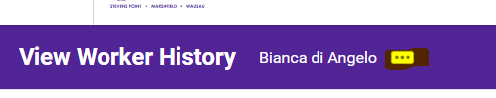
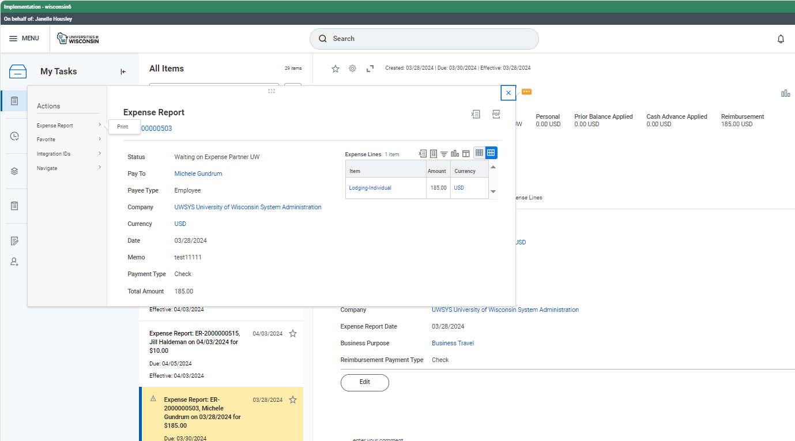
Related Actions (aka Twinkie Bar)
If you see a Related Actions twinkie next to a data element, click on it to access Actions or additional information associated with that item

Slide 11
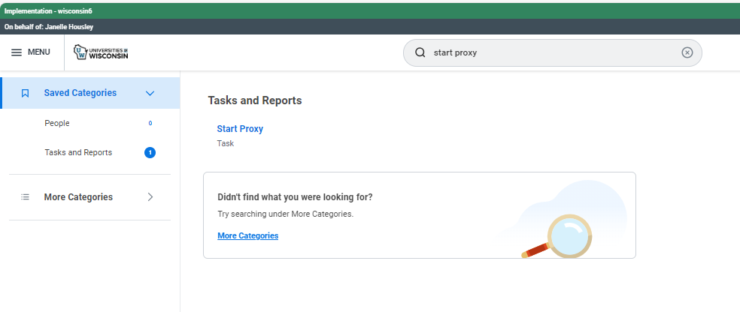
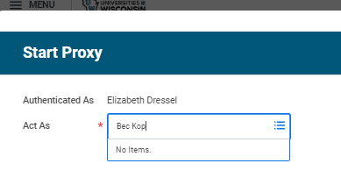
How to Proxy
Note this functionality only exists in these testing tenants (not in real life)
From the home screen enter Start Proxy from search bar
Then click the Start Proxy Task
Select user to Proxy in as (note you can’t proxy as ATP employee)

Slide 12
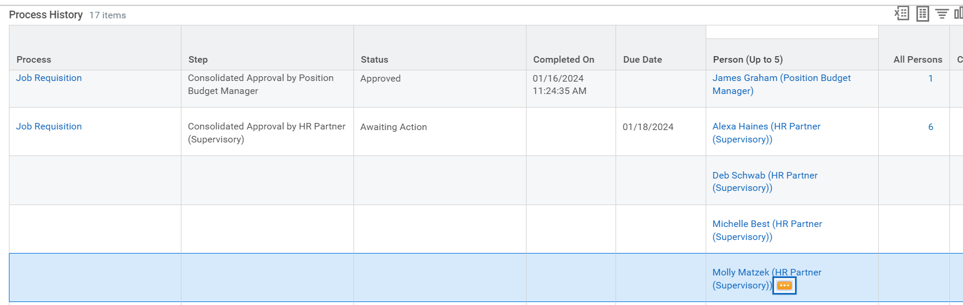
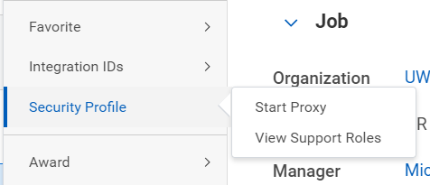
How to Proxy
From within a Workflow Approval
Go to the BP Process History to the Step with a status of Awaiting Action
Click on the twinkie next to the person who is next in line in the approval workflow and go to Security Profile > Start Proxy

Slide 13
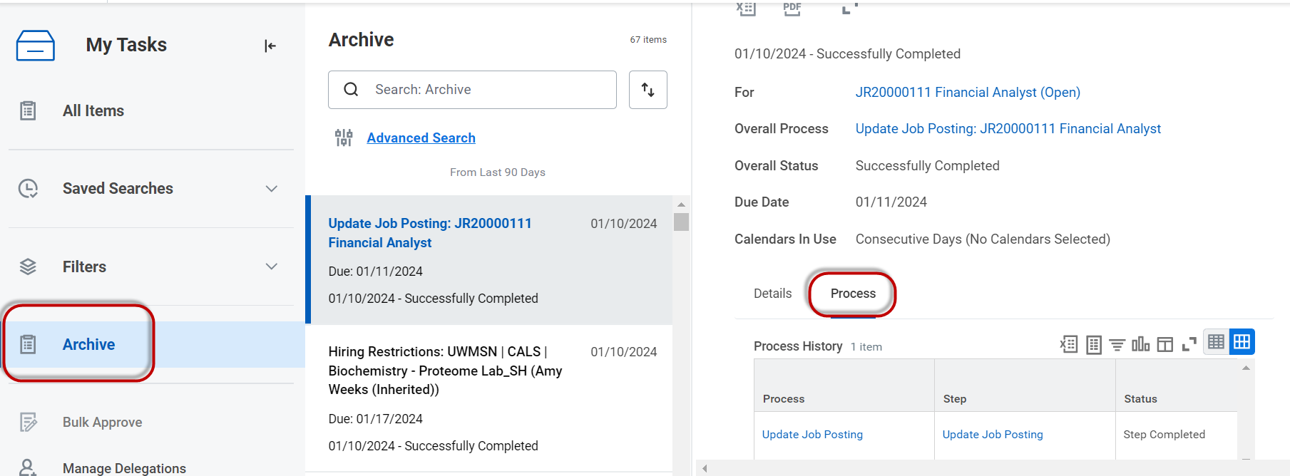
My Tasks – Archive
Viewing historical inbox tasks and BPs
Can view already completed task items in the Archive folder of your My Tasks inbox
  Details – of what was done
  Process – Overview of steps Submitted, Not Required, and Awaiting Action

Slide 14
Security

Slide 15
Security Groups
Collections of users who are granted access to securable items
Two ways a user is assigned:
  Assigning users to security groups directly. Example: Using user-based security groups
    Individual employees are identified as needing to perform certain functions and are assigned to the appropriate security group
    Not as common
  Deriving membership based on information about users. Example: Their role assignments or job details (Role Mapping)
    Employees identified by specific criteria are assigned, such as being a manager/supervisor, are assigned to the appropriate security group

Slide 16
Security Groups
Member access can be restricted by context types
  Unconstrained: Members can access all secured data instances
  Constrained: Members can access a subset of secured data instances
Security Groups are not Job Titles
Employees in the same position may have different security group assignments
Employees in different positions may have the same security group assignments
When employee leave the UW, most roles will be assigned to the “chair” not the person

Slide 17
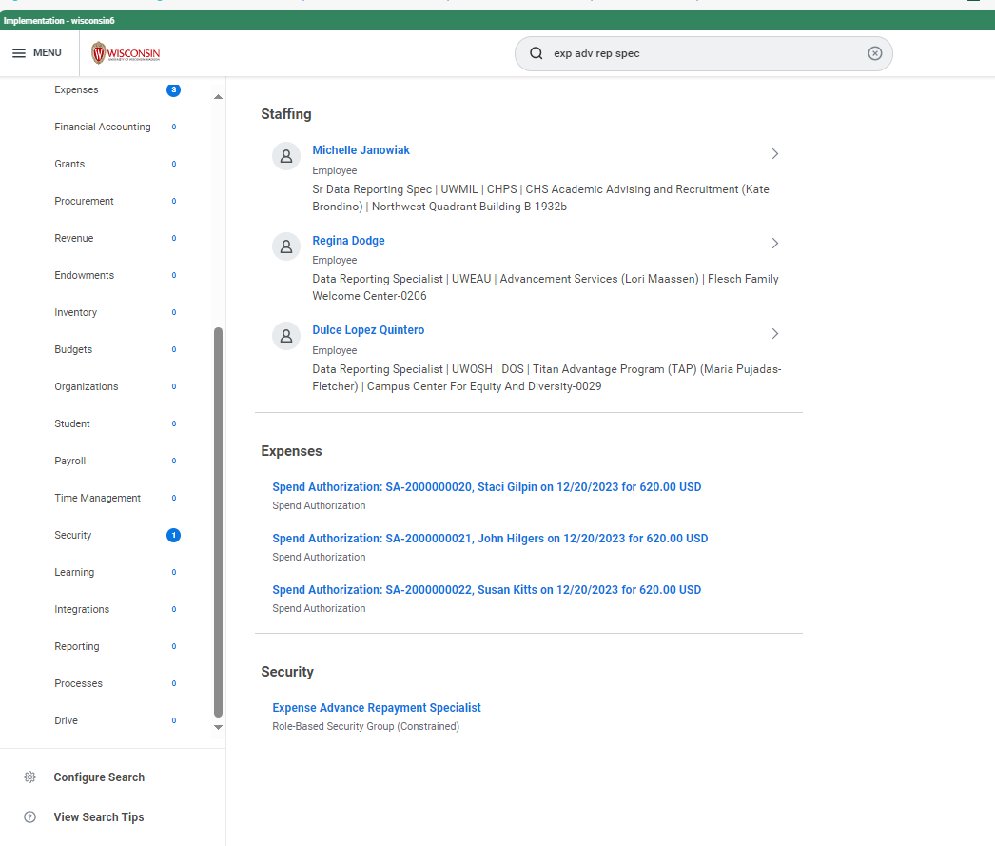
Assigned Security Roles (Role Mapping)
When you are working through items during UXT, make sure you are proxying as someone with the correct security role
You can type in name of role then find “Security” and click on the role

Slide 18
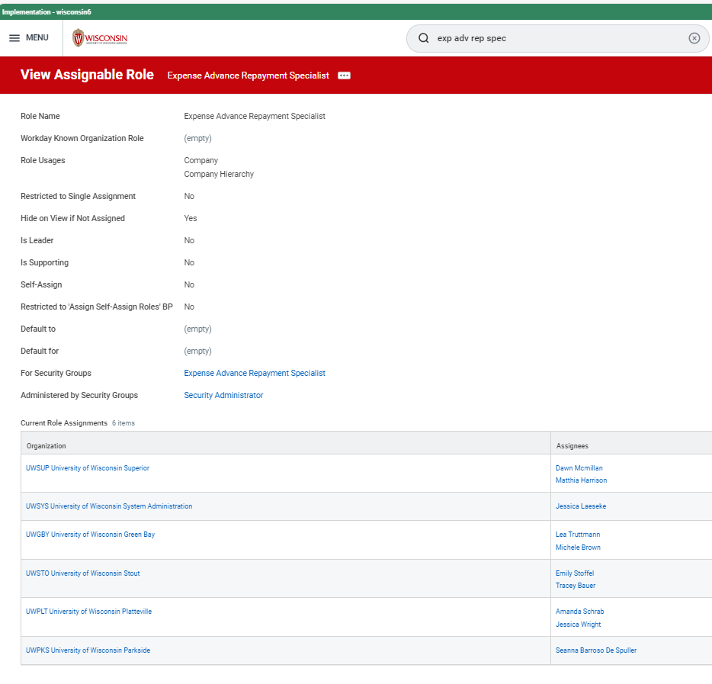
Assigned Security Roles (Role Mapping)
UXT Tenant (WI 6) will be updated with Round 2 Role Mapping
Scheduled May 11th

Slide 19
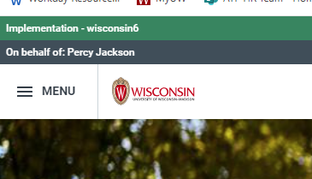
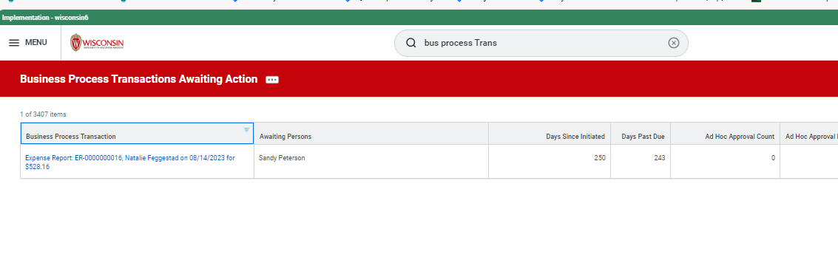
Pro Tips
Stuck or no results populating? Check your Proxy assignment (different security roles have different views and can take different actions)
BP Stalled? Use the Business Process Transactions Awaiting Action report
Make sure to note ER numbers

Slide 20
Credit Card Standardization Update
Travel Managers

Slide 21
Agenda
Review Overall Credit Card Standardization Project
Approval Process for Credit Card Applications and Limit/Change Requests in Workday
  Walk through roles/responsibilities
  Limits
  What remains on campus vs Shared Services
  Questions
Notes:
More merchant data (with Visa) through expenses.

Slide 22
Overview of Credit Card Standardization
Goal of this ATP related project is to transform and standardize the Credit Card Products offered and used across the Universities of Wisconsin
This project has been a collaboration with ATP Expenses, BPI&A teams, UW Shared Services, Credit Card Administrators, Purchasing Directors, and other stakeholders
We are presenting to Travel Managers, Controllers and Purchasing Directors stakeholder groups to give a high level overview of future state and update
Credit Card Administration function will consist of two separate teams:
  One for Madison (largely unchanged from current state) rolling up under Meghann Grove (David Honma)
  One of Systemwide (excluding Madison) rolling up under Mike Morris and Janelle Housley (Diann Sypula)
Notes:
Summary of our thought process and objectives throughout our design and C&P phases

Slide 23
Overview of Application Process in Workday
Will be using questionnaire functionality/business process in Workday
Workflow (approval steps) will vary based on:
  Credit card type Pcard vs Shared Liability Card
  If it is Madison or not
  If a single purchase limit over $5K
Note: we will be having a “Credit Card Change” questionnaire
  This change questionnaire will be required for changes (including temporary single purchase limit changes)
  Only applies to Purchase card types
    Any requests to make changes to shared liability cards will be done manually
In general, these APIs (Application Programming Interface) use both responses of questionnaire and HR data (the APIs send data to/from US Bank)
The UW will be the first or one of the first (no one has gone live yet) with this new functionality offered by US Bank
Notes:
Summary of our thought process and objectives throughout our design and C&P phases

Slide 24
Change Questionnaire and Termination
  Similar to how application questionnaire + integration/API will work when employees request changes to their Purchase card account data will come from questionnaire responses and/or HR data
  Change questionnaire will mostly be used for single purchase limit updates and/or billing cycle limit increase requests
  HR data items that trigger change/automated communication to US Bank:
    Termination
      Send “T-9 terminated” status to US bank
    If an employee requests change of address to work/home will pull the “preferred” work or “preferred” home address from Workday
  We are still working through process when an employee changes departments/jobs but not “Company” or campus, as of now, cards will not be canceled

Slide 25
Delegation Authority: High Level Plan
Brent Tilton to delegate authority for UW Systemwide (excluding Madison) to Mike Morris (UWSS)
  UWSS will ultimately be responsible for Credit Card administration, including issue cards, train cardholders and approvers, transaction audits, limit adjustments, corrective actions for non-compliance, DOA approvals for raising single purchase limits over $5K
  Audit findings for System campuses, excluding Madison ,will be for UWSS team to resolve and be accountable
  UWSS will have a feedback loop with Purchasing Directors and others (Controller, CBO) with information such as cards issued, cards closed, UWSS random audit findings (including names of individuals not complying), IA audit reports, and spend data. UWSS acknowledges this will be critical for success.
  Madison’s processes teams will largely remain as is today
Notes:
Summary of our thought process and objectives throughout our design and C&P phases

Slide 26
Campus vs Shared Services Responsibilities
UWSS (Madison/Central Systemwide) Tasks vs Campus Tasks:
Shared Service: Final step in credit card approval/credit card processing, MCC code adjustments, limit adjustments, auditing pre-approval (Expense Partner for the Expenses Business Process), post approval review, own the application process going forward (Systemwide/Madison) and follow up with any audit findings (and develop plans to help mitigate future findings)
Campus Tasks:
  Approving Credit Cards application and Purchase credit limit adjustments (will have detailed slides that follow)
  Purchasing Director on campus for single purchase limits over $5,000
    143 higher limit requests in a FY Systemwide (mostly Madison) that goes to DOA
    Guide Shared Services team, we recognize importance of Shared Service team keeping campus Purchasing Director and Controllers in the loop
      Leaning towards monthly meetings with Purchasing Directors continue post go live, as well as daily communications/escalation events (ad hoc)
      Have dedicated time – post go live, weekly post implementation meetings to start off to be able address any items
Notes:
Summary of our thought process and objectives throughout our design and C&P phases

Slide 27
Shared Services Responsibilities To Still Work Through
Repeat offenders and revoking of Credit Cards
  We understand Madison has meetings prior to issuing the notice to cardholders
When to contact Credit Card Administrator directly
  Urgent should be truly emergency – supervisor and Cost Center Manager should be the ones contacting CCA
  Training to help emphasize need for cardholders to plan in advance
  Understanding policy (contracts) and planning for travel disruptions and MCC code restrictions

Slide 28
Approval for Madison Purchase Credit Cards and Purchase Card Change Requests
UW Madison Purchase/Dept Cards – Initial Application and Change Requests excluding single purchase limit increases greater than $5,000
UW Madison Applications and Change Requests (with single purchase limit over $5K)
Manager
Cost Center Manager
Expense Operations Lead
Credit Card Admin UWMSN
CCA UWMSN to confirm training complete and may question limits
No max limit on cycle limit
No default/standard limit as previously discussed
Manager
Cost Center Manager
Expense Operations Lead
Procurement Operations Lead
(Campus Specific)
Credit Card Admin UWMSN
Credit Card Admin
(Mike/SS)
CCA (Mike/SS) to work with DOA for limits over $5K

Slide 29
Approval of Madison Shared Liability Credit Cards
UW Madison SL Cards– Initial Application
Keeping approval minimal, keeping CCA to confirm training complete and are not on a “do not issue to” list and making sure limits are appropriate
Manager
Credit Card Admin UWMSN

Slide 30
Approval for Non-Madison Purchase Cards and Purchase Card Change Requests
UW Systemwide Purchase/Dept Cards – Initial Application and Change Requests excluding single purchase limit increases greater than $5,000
UW Systemwide Change Request and Applications (only applies to Pcards and single purchase limit over $5K)
Manager
Cost Center Manager
CCA (Mike/SS)
CCA (Mike/SS) to confirm training complete, make sure not on “do not issue to” list and may question limits
Manager
Cost Center Manager
Procurement Operations Lead
(Campus Specific)
CCA
(Mike/SS)

Slide 31
Approval of Non-Madison Shared Liability Credit Cards
UW Systemwide (non-Madison) Shared Liability Cards– Initial Application
Keeping approval minimal, keeping CCA to confirm training complete and are not on a “do not issue to” list and making sure limits are appropriate
Manager
CCA (Mike/SS)

Slide 32
New Process Discussion Items
  We are working through where we house all of the Credit Card information (one website or two – one for Madison)
  Change questionnaire will only pick up primary work or primary home address (in Workday people can have multiple addresses)
  Cards can only be mailed to US/Canada Addresses
  Legal name changes can’t be made via the change API, will have to contact Credit Card Administrator (CCA) and the CCA will email US Bank as they do today (API capability to be able to change names is scheduled for this summer)
  Decision was made not to have change questionnaire apply to Shared Liability cards
    Automatic canceling of Purchase cards and Shared Liability cards will happen automatically upon termination
  Still working through storing of limits in Workday (both cycle and single purchase limits) and the last four of the actual credit card number (and not the unique ID that is sent from US Bank)
  Feedback loop with PD, Controllers, TMs, preferences (combined meetings)?

Slide 33
Next Steps and Questions
One related but separate project we (UWSA Finance, Purchasing, Travel, Credit Card Admin) working on putting together more guidance around the best way to Purchase:
  Travel
  Goods
  Services
Have to begin work early next year (calendar year) on consolidating credit cards in advance of Workday go live (and communicating timeline for cutover plan and required training for cardholders)
  Can have more than one, but want to review need
  Default funding no longer with Workday
What questions do you have for us?

Slide 34
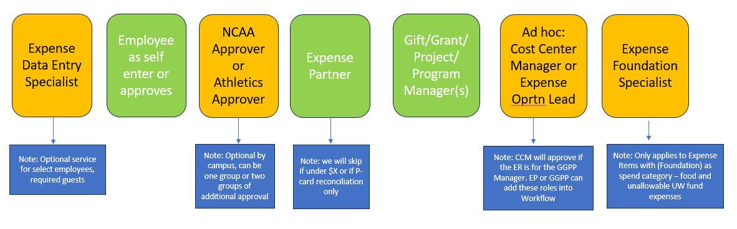
Appendix
Expenses workflow – Note the Expense Partner logic will vary for Madison, they will not have skip criteria that we have Systemwide

Slide 35
Expenses Training- Plan as of April 2024
ATP/Huron Supported Coursework
UWSS/ATP Supported Coursework
Expenses Part I: CBT
  Benefits of Workday Expenses and Expense Hub Overview
  Before Creating an Expense Report
  Expense Reports in Workday
  Workday Mobile: Expenses
Expenses Part II: CBT
  Expenses Hub: Checking Transaction Status and Routing
  Credit Cards: Reassigning Transactions
  Requesting Spend Authorizations and Cash Advances
  Identifying Funding and Itemization
  Additional Worktags: Athletics and Grants
Expenses for Admins & Support Staff: CBT
  The EDES Role & On Behalf Of Processing
  Non-Worker Travel Expense Reports: External Committee Members
Combined What’s Changing Workday for all UW Card Holders: CBT
    This is an overview of what is changing and believe this will be one overview and assigned to all current cardholders as of March 2025, do we need to have a make up batch assignment from March – June?
Overview of TravelWIse
Overview of Travel & Expenses Policies and exceptions, VUA
How to apply for US Bank cards and request changes (limits/name)
Purchase Card Training
Pcard Violator or Refresher
Shared Liability Card Training
Concur booking
Travel Program Overview (Shorts/Anthony, Fox)
Expense Partner specific overview (coding and tolerances)
NCAA Athletics overview activity code
EARS – Expense Foundation Specialist, payroll, cash advance, customer billing
Admin group overview

Slide 36

Break Time
Start Back
10:15 AM

Slide 37
Expenses UXT Walkthrough – Spend Authorizations

Slide 38
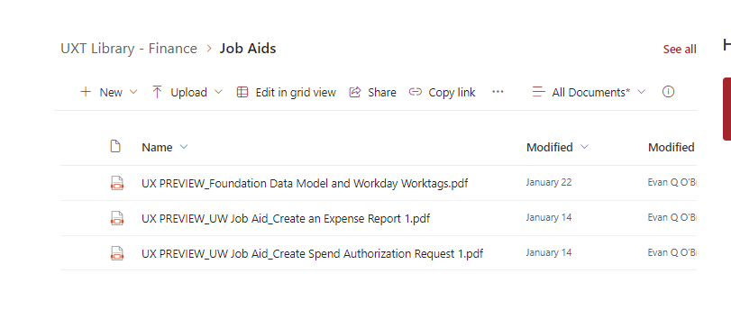
Expense Intro and Activity Overview:
Re-introduction to the Expenses team: Graig Brooks Co-Design Lead
  Elizabeth Dressel Co-Design Lead (helping if you get stuck please raise your hand)
  Jane Rolfsmeyer BA (helping if you get stuck please raise your hand)
We have job aids for you on how to complete a Spend Authorization and an Expense Report. Note these are not specific to our scenarios that we will be walking through today. They are a working draft of our general job aids for Expenses and can be referenced after you leave here today and if you didn’t have access to practice along with us today, we are hoping you practice prior to official UXT Testing that begins in August 2024
ATP Resources Center - Home (sharepoint.com) Under Job Aids & UXT Preview and Finance

Slide 39
Expense Walkthrough #1:
Will show overview of roles/reminder of process, workflow, then walk through group activity
ACTIVITY #1 – Create a Spend Authorization with Policy Exception
  This will route to (GGPP Manager and we will approve for you) then it will route to the Expense Operations Lead
  You get to start as yourselves, and create a spend authorization
You will complete the Spend Authorization using the following driver worktag (Diann Sypula is the Program Manager)
  PG000004970 UWSYS Administration Operations
  You will then proxy in as Diann Sypula (the Driver Worktag Manager) and approve the Spend Authorization
  You will then proxy in as Expense Operations Lead: Sean Nelson and approve only YOUR spend authorization – if you accidently select someone else’s please let us know
UXT attendees to approve exception – proxy in as EOL for UW System Administration who is Sean Nelson

Slide 40
Spend Authorization- Process Overview and Security Roles
Will be for all (no difference in Workflow for Madison)​
Required for cash advances and policy exceptions (90 day, airfare booked direct, official functions option)
Expense Partner to help close out spend authorizations on individual expense report.
We have special routing in place, based on business purpose or if cash advance is selected
  If Cash Advance – goes to Expense Advance Repayment Specialist (EARS) – who also will be doing monthly/weekly clean up on SAs and is a campus based role
  Note Employee approval is new since CCS, for any SA created by EDES
Current workflow anything circled in red is what you will be doing in this first exercise
Expense Data Entry Specialist
Employee as self enter or approves
Gift/Grant
Project Program
Mgr
approves
Special Routing – Expense Operation Lead
approves
Not part of demo

Slide 41
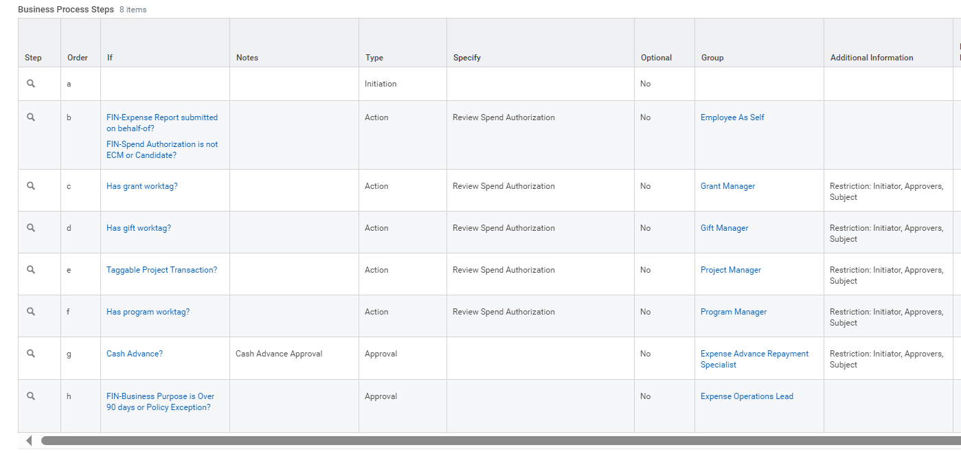
Spend Authorization Business Process:

Slide 42
Demo – Spend Authorization
Graig to enter employee as self – follow along and raise your hand with questions
Proxy to approve as GGPP Manager (Diann Sypula- Program Manager)
After approved, proxy as Sean Nelson (the Expense Operations Lead for UWSYS)
We have recommended single assignment for EOL role for campuses except Madison
  We know controller group recently finished mapping for Round 2
  Note all official function Spend Authorizations will be routed to EOL in future state
  Once the Spend Authorization is approved, it is available to be attached to an expense report
  We will show you where cash advance requested check box is in the Spend Authorization event

Slide 43
Expenses Demo and Follow Along: UXT (WI 6)

Slide 44
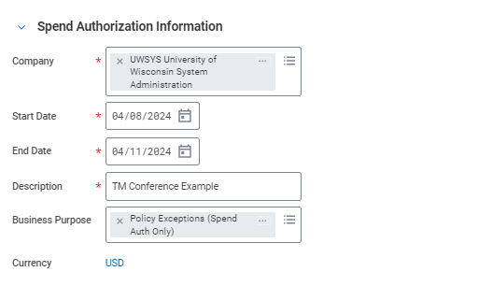
Sample Screenshot: SA Header
Make sure to change the Company to UWSYS (System Administration)

Slide 45
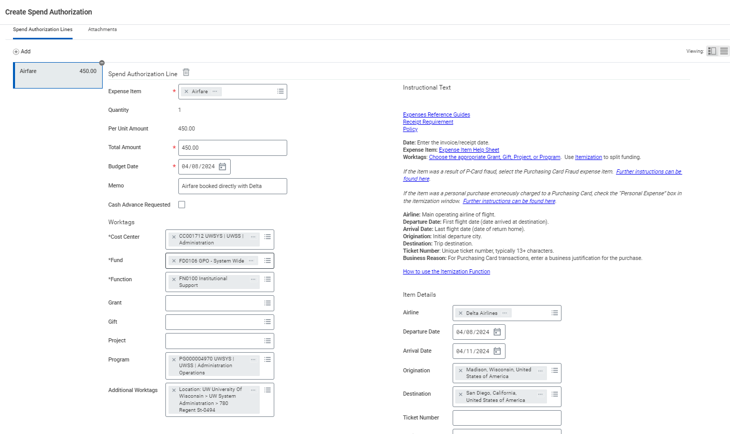
Sample Screenshot: SA Lines
Program: UWSYS Administration Operations (ends 4970)

Slide 46
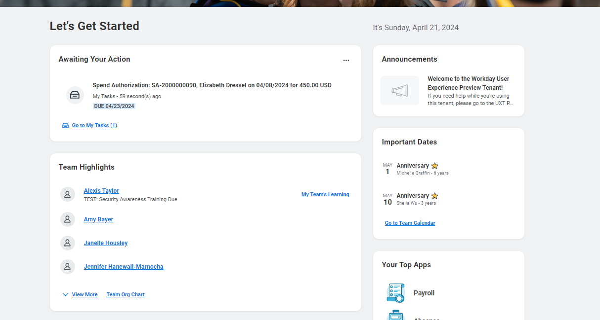
Screenshot of inbox for approval

Slide 47
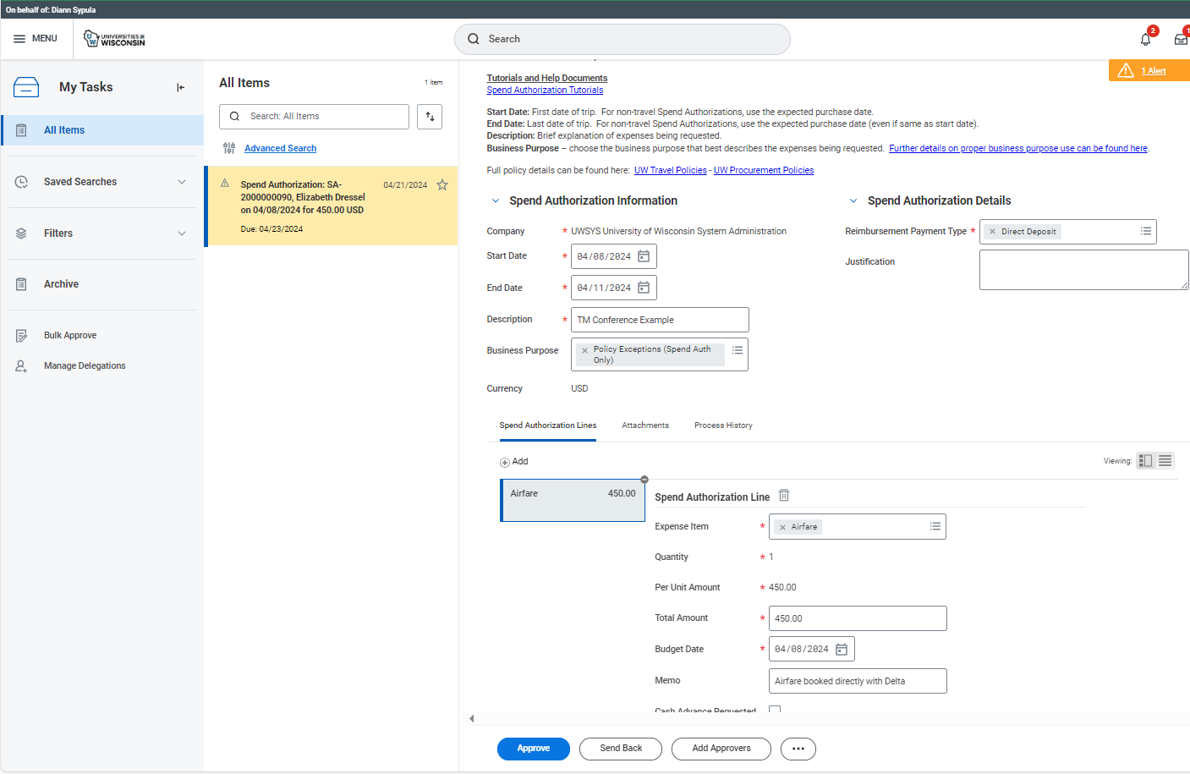
Appendix : Screenshot of how to Approve
Click on “task” then it will take you to this page you will click the blue “Approve” at the bottom of the page

Slide 48
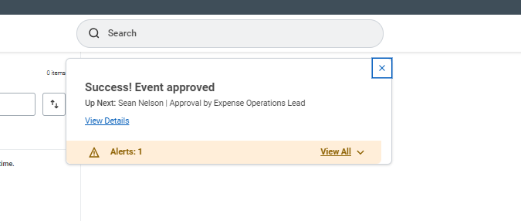
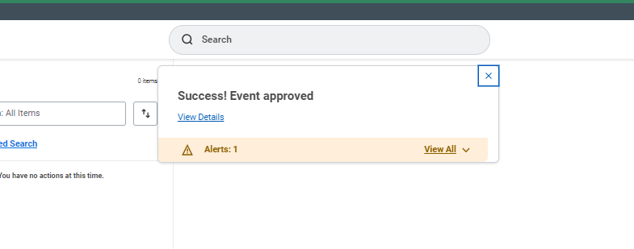
Screenshot of “Success! Event approved”
This is what Diann Sypula sees
This is what Sean Nelson sees

Slide 49
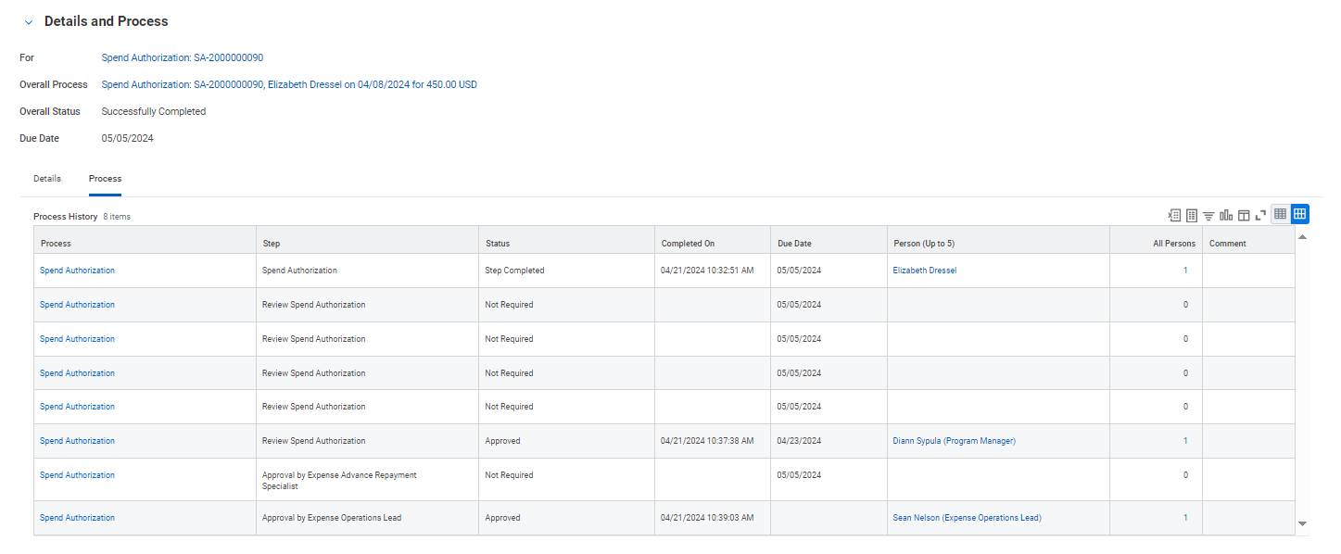
Screenshot of Details and Process

Slide 50
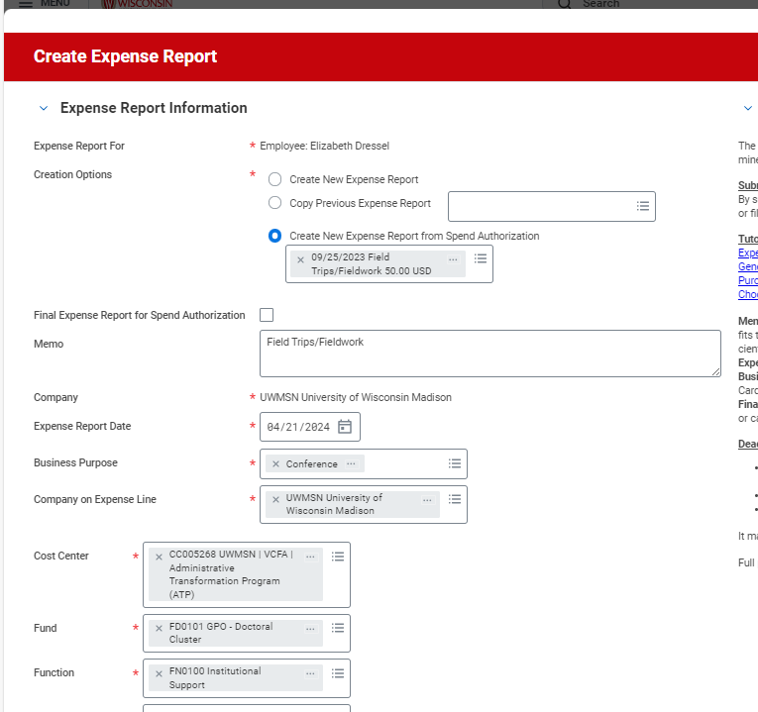
Discussion and Questions on Spend Authorizations
Employees can create one Spend Authorization and attach to multiple expense reports
  Think estimated mileage or budget for an entire FY
  Expense Advance Repayment Specialist will be cleaning up old open spend authorizations that were not marked as final Expense Report

Slide 51
Discussion and Questions on Spend Authorizations
Campuses can not require Spend Authorizations, but Program/Project Managers for example might for their staff, or perhaps when getting close to budget being used up
Can be done after travel is complete
  We see this being the case often for “Policy Exceptions”
Also can see a use case for employees estimating for Professional Development for the year or travel for the year
If we ever had another “COVID” situation or travel to restricted foreign destinations
What questions do you have for us on Spend Authorizations

Slide 52
Break for lunch
Liz up next to Discuss:
Per Diem Calculator Demo
Proposed Cut Off Dates – Rough Draft
Meal Per Diem Discussion

Slide 53
Lunch Topics

Slide 54
New Per Diem Calculator - Demo
Per Diem Calculator available for guests/students
This is a draft and some items are still being worked on
https://per-diem-calculator-a007-uat.betty.app/
Must be opened in Incognito browser

Slide 55
Proposed Cut-off Dates – Very Rough Draft for Expenses
Financial Calendar-Cutover • ATP (mural.co)
May 2025
2nd last day to submit Cash Advance
26th last day to load Shared Liability Card Transactions
29th last day to request a new non-employee profile
June 2025
June 1st last day to submit a Travel Authorization (nothing will be coming over from SFS)
June 2nd last day to submit TER for approval
  Last day to reconcile a cash advance with an TER
  Last day to create a new non employee profile or update an existing profile
June 3rd – SFS turns off ability to create a new TER
June 6th – last day to load Purchase card transaction files (cycle end date)
June 8th – last day to approve TERs (including SL card transitions)
June 9th – last day TERs settled/paid
June 10th – last day to submit Purchase Card transactions
June 14th – last day to approve Purchase Card transactions

Slide 56
Workday Integration to Concur with Fox
Will be rolling out a new integration on July 2025 with the go live of Workday that will automate profiles in Concur
For all employees that are active in Workday will be in Concur
After termination they will be “deactivated” in Concur

Slide 57
Meal Per Diem Discussion
On our last Travel Manager call UW Madison team asked to discuss as a group options for making Meal Per Diem “send back” and process better
Graig and I have met and wanted to bring forward this solution in Workday for discussion
We can also clarify that if any documentation exists on provided meals to attach the to the Expense Line files (like users will do with reciepts)
Note: this would need Executive Leadership Approval

Slide 58
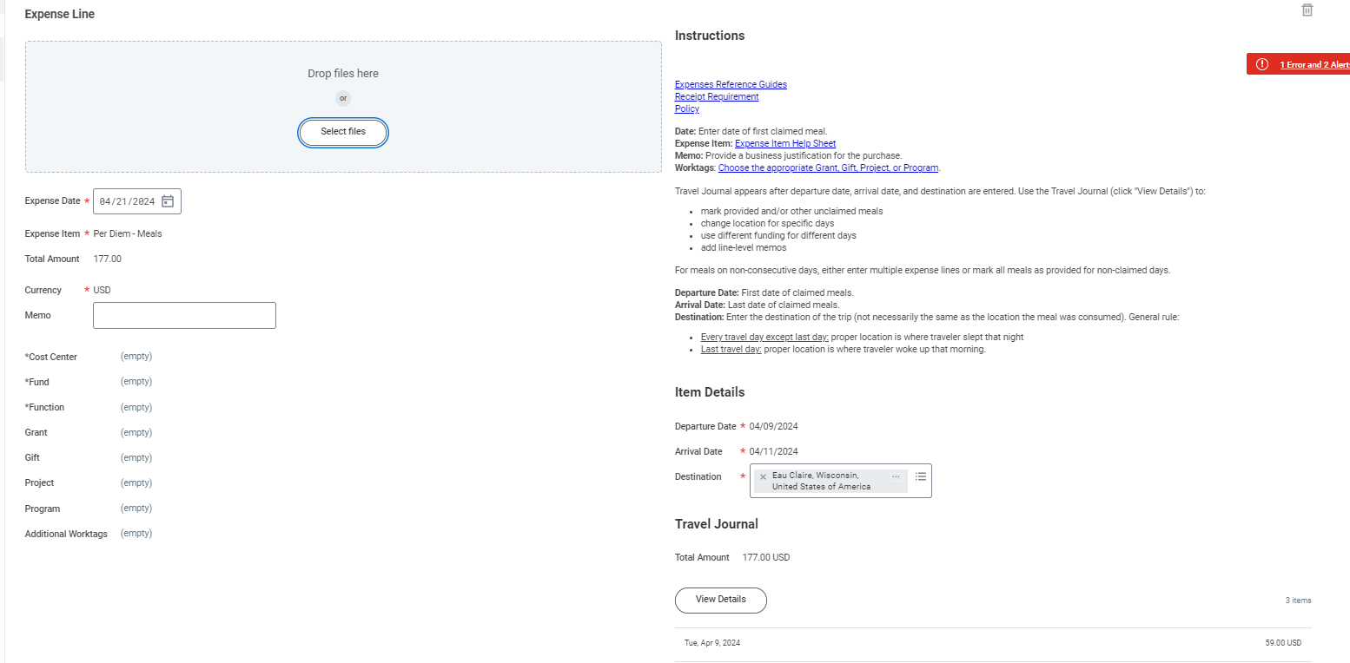
Meal Per Diem Discussion

Slide 59
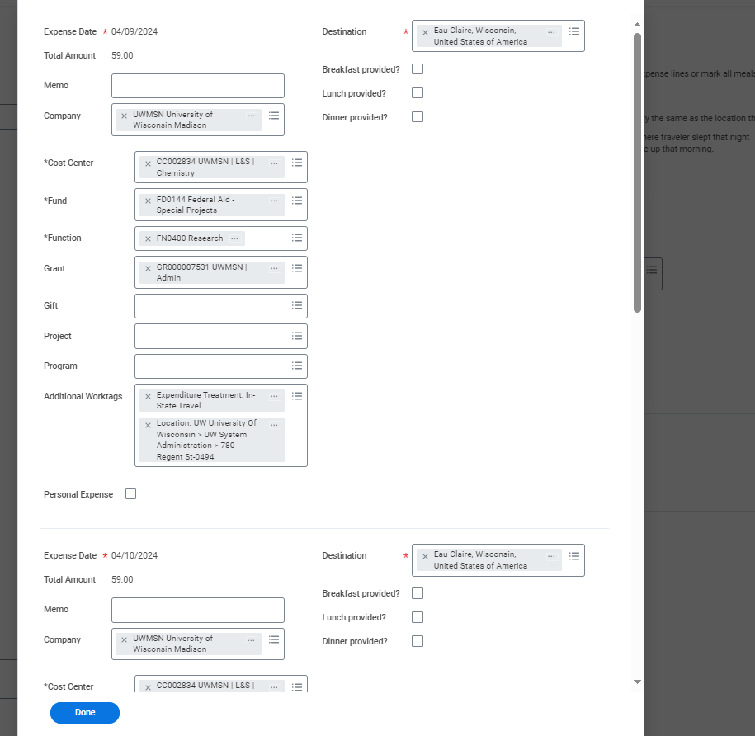
Meal Per Diem Discussion
When you enter meal per diem we currently have designed for having employees select if
Breakfast, Lunch or Dinner was provided

Slide 60
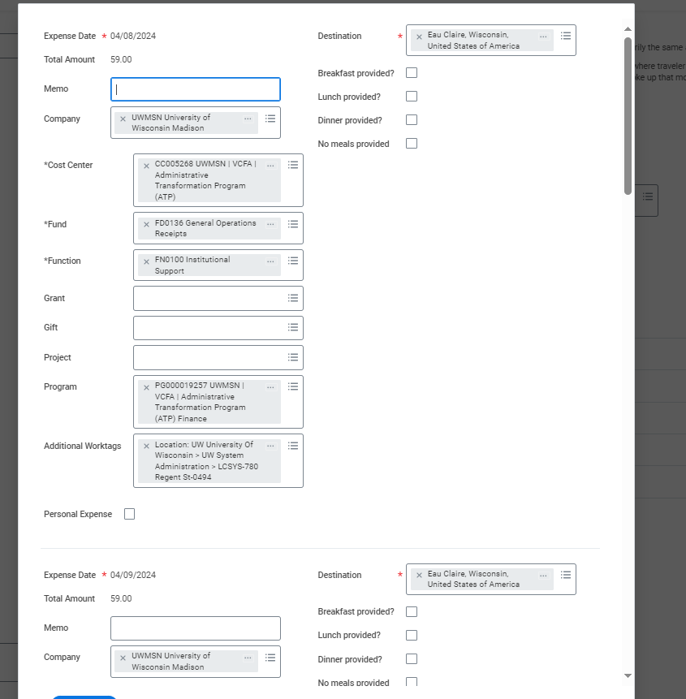
Meal Per Diem Discussion
Proposing we add a fourth option of no meals provided
And adding a validation to make sure at least one of these four boxes are selected for each day of trip

Slide 61
Expenses UXT Walkthrough – Expense Report

Slide 62
Expense Walkthrough #2:
Complete ER using the Spend Authorization created prior to lunch
  If you do not have it for some reason (you missed an approval step), just complete an Expense Report and don’t worry about it!
I will demo all steps
Attendees to complete Expense Report as self using the same funding as the Spend Authorization Example
  Use funding (driver worktag): PG000004970 UWSYS Administration Operations
  You will proxy in as Janelle Housley to approve
    If you want to be a rebel, you can use Leah Davis, Cristina Nino, Dallas Kahlhamer, Crystal Ellingson
  You will then proxy in as Diann Sypula (the Driver Worktag Manager) and approve the Expense Report

Slide 63
Expense Report- Process Overview with Security Roles – Systemwide excluding Madison
Out-of-pocket and all UW card expenses (all Corp Card/Purchase Card)
Receipts required for all Pcard expenses and any other expense at/over $50.01
Each campus determines if they will use NCAA Approver and/or Athletic Approver roles
  Skip criteria: starting with threshold ($100) per line (not total) and if Pcard reconciliation will skip EP review
Ad hoc functionality delivered, any approver can bring in Expense Operations Lead into the ER approval process or the Cost Center Manager
Cost Center Manager will be the “alternate approver” if the employee is also a G/G/P/P Manager
Employees can not approve their own ER, note: newer to our workflow since CCS, employee has to approve if EDES enters and Expense Foundation Specialist in approval
Expense Data Entry Specialist
Employee as self enter or approves
NCAA Approver or Athletics Approver
Expense Partner
Gift/Grant/Project/ Program Manager(s)
Ad hoc: Cost Center Manager or
Expense Oprtn Lead
Expense Foundation Specialist
Note: Optional service for select employees, required guests
Note: Optional by campus, can be one group or two groups of additional approval
Note: we will skip if under $X or if P-card reconciliation only
Note: CCM will approve if the ER is for the GGPP Manager. EP or GGPP can add these roles into Workflow
Note: Only applies to Expense Items with (Foundation) as spend category – food and unallowable UW fund expenses

Slide 64
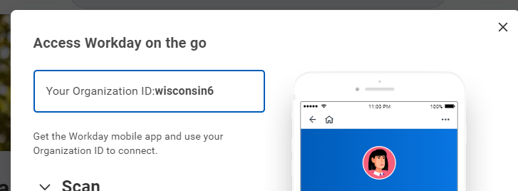
Expense Report- Process Overview Talking Points
Will demo/show missing receipt validation, does not require a spend authorization
Expense Partner and approvers other than Driver Worktag Manager can send back expense lines (this is a change since Customer Confirmation Session) and do not need to send back the entire expense report
  Note: we are recommending this to only be done for employees (not guests/students)
This creates a parent/child relationship and will create two separate payments
Note: Driver Worktag Managers will not have this ability to ensure students/guest expense reports do not get split out
Safe Harbor Statement applies – there are a few open items in our design and validations are not in WI 6. The May 11th refresh will be a more accurate picture of future state
Also note, many campus roles are not mapped. When in doubt, go to Stout (for Expenses) they have all Expenses roles mapped in round 1
We are not demoing mobile functionality today, but feel free to download the app, if it becomes available in May with the new tenant refresh and play around, it is great for approval, and starting expenses
  Go to Profile, My Account, Organization ID

Slide 65
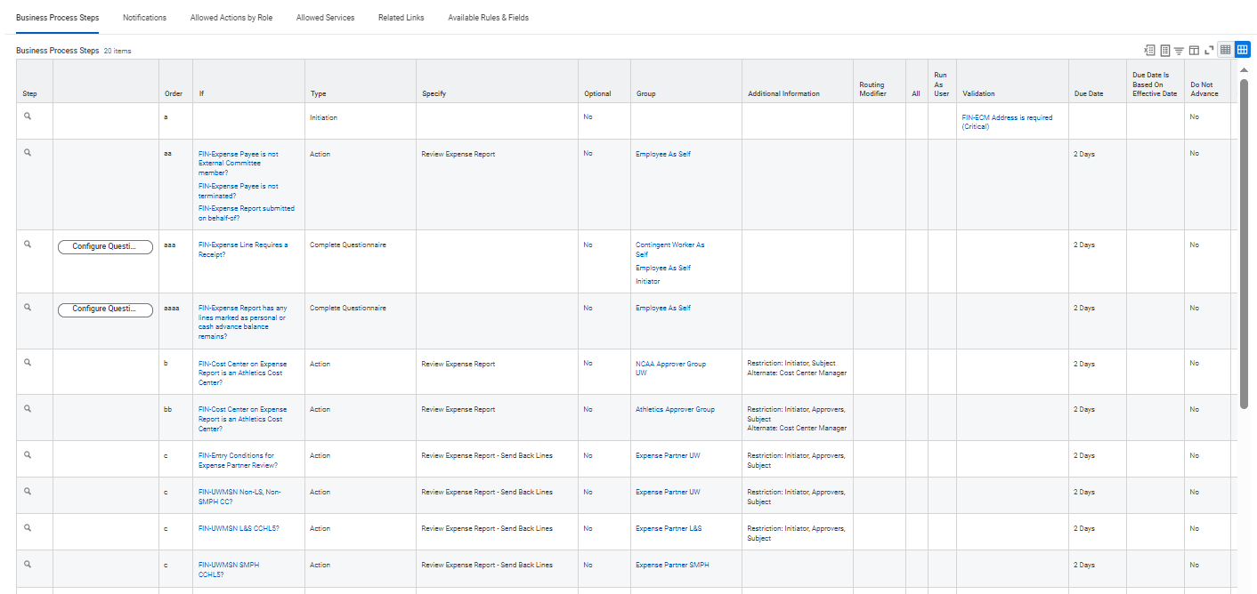
Expense Report Business Process Steps (discussed earlier difference between concurrent vs consecutive steps) this is demonstrated here (items circled in red is what will apply to the walk through)

Slide 66
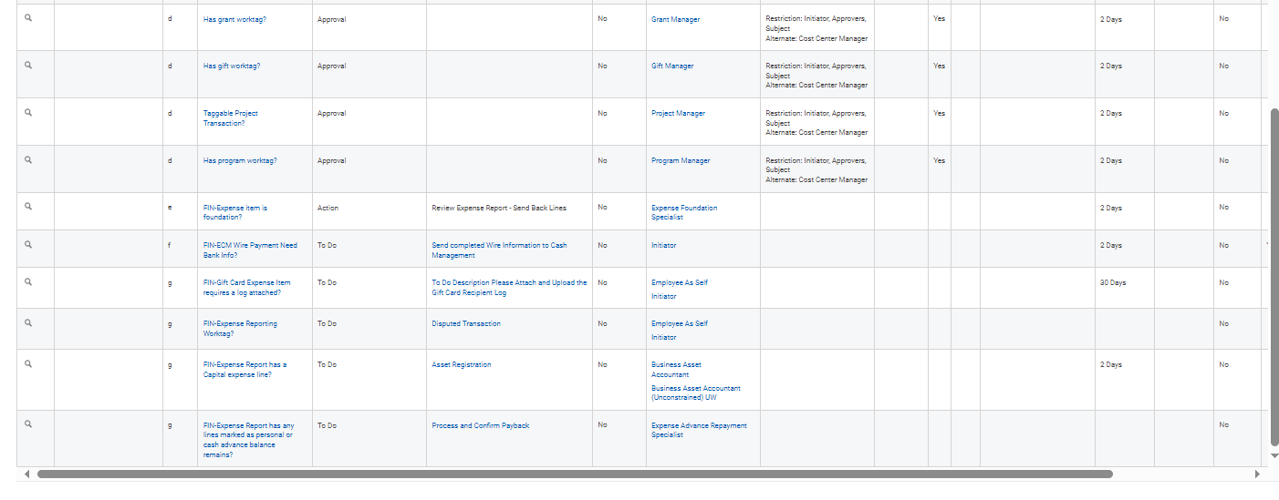
Expense Report Business Process Steps (discussed earlier difference between concurrent vs consecutive steps) this is demonstrated here (items circled in red is what will apply to the walk through)

Slide 67
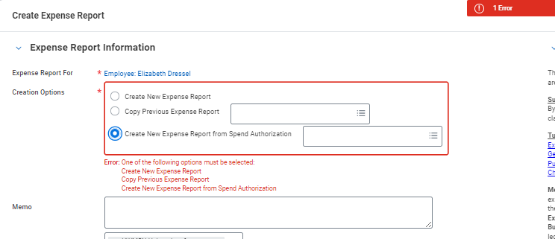
Expense Activity #2:
Create Expense Report (type that into search bar or go to Expenses Hub)
Select “Create New Expense Report from Spend Authorization”

Slide 68
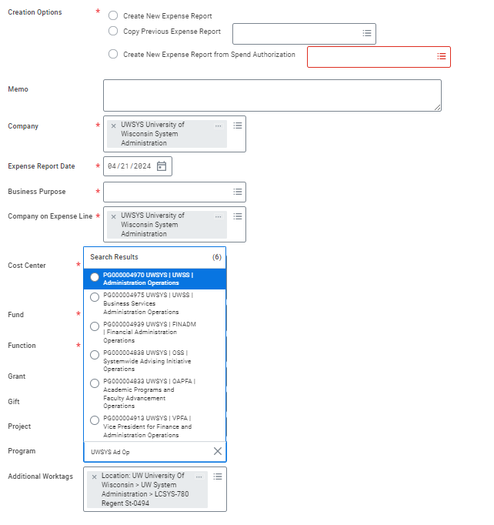
Walkthrough – Expense Report
Make sure to change your company to UWSYS
Type in “UWSYS Admin Oper” to find the Program worktag: PG (5 0’s) and 4970
Or type “PG000004970”

Slide 69
Walkthrough – Expense Report
Break once you complete the whole Expense Report and go through approval steps
You will have to proxy in as Expense Partner after you submit
You will have to proxy as Diann Sypula to approve
Raise your hand if you need help

Slide 70
Expense Additional Info:
Common Expenses commands –
  Create Expense Report
  Create Spend Authorization
  Find Expense Report
  Find Credit Card Transaction
We have “Expense Reporting” worktag to help send backs and coding for Expense Partners
Ability to send back lines instead of whole Expense Report (for Expense Partner and Expense Foundation Specialist)
We have placeholders for all of our instructional text (by Expense Item) and will be having links out to Travel Wise and other sites as needed

Slide 71
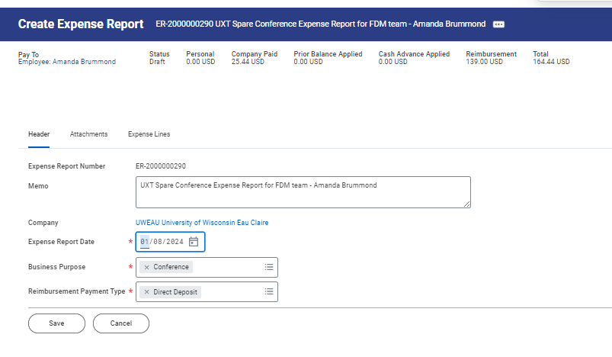
Editing is limited after the initial Header Screen
You can not modify the Company, nor the default funding
(Just Expense Report Date, Business Purpose, and Reimbursement Payment Type)

Slide 72
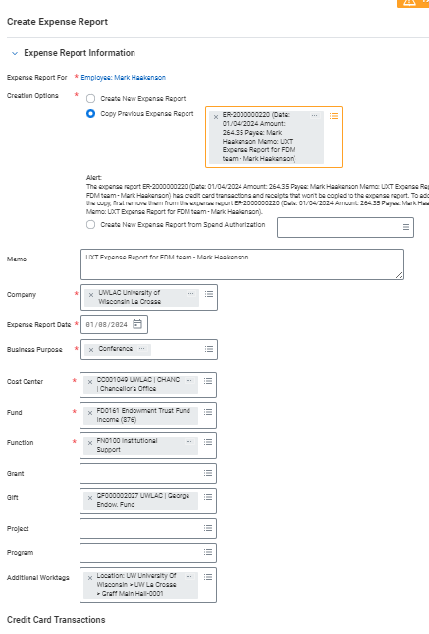
Editing is limited after the initial Create ER Screen
You can not modify the Company, nor the default funding
You have to know if you want to default funding at the header level or enter for each Expense Line

Slide 73
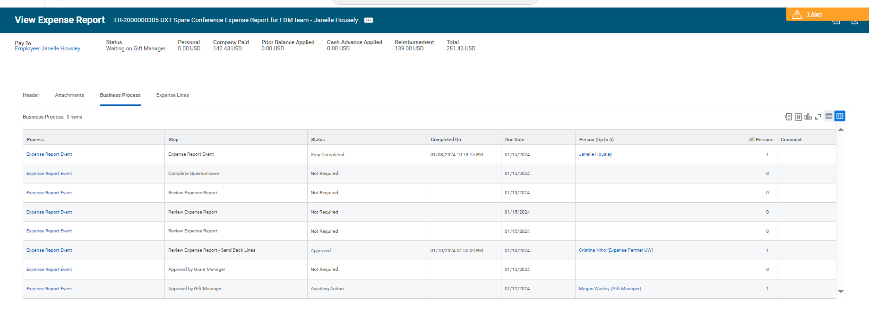
Open Role Mapping – Will Cause Workflow Issues: Example Where Working
Gift Manager is assigned so this Workflow will go through once Megan Wasley approves (you can Proxy and approve)

Slide 74
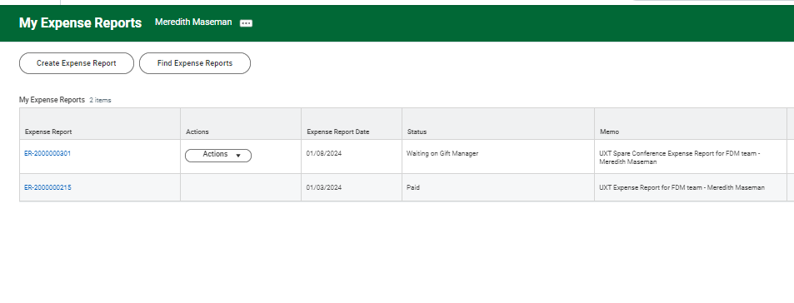
Open Role Mapping – Will Cause Workflow Issues: Example Where Not Working
If no Gift Manager is assigned so this Workflow will not go through….

Slide 75
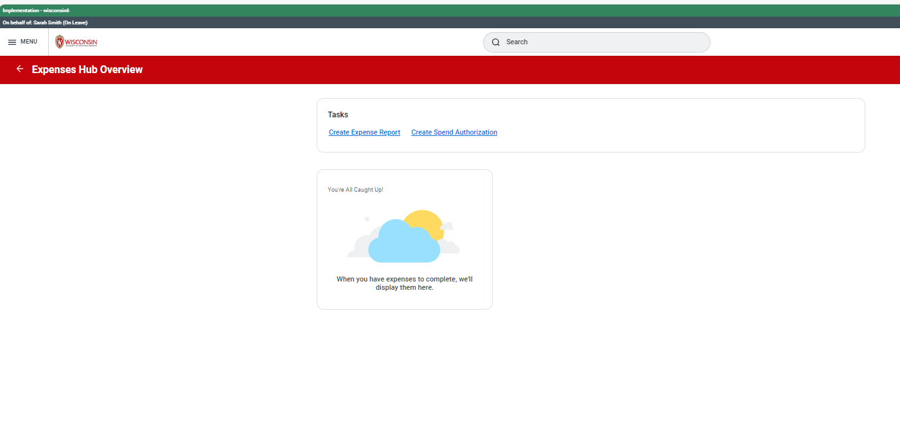
Expenses Hub – Looks Different Based on Activity

Slide 76
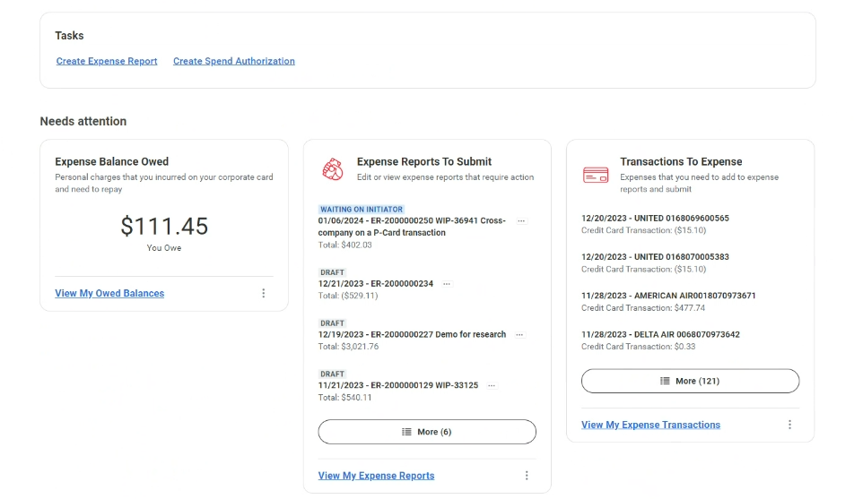
Expenses Hub – More Cards Tailored To Individual

Slide 77
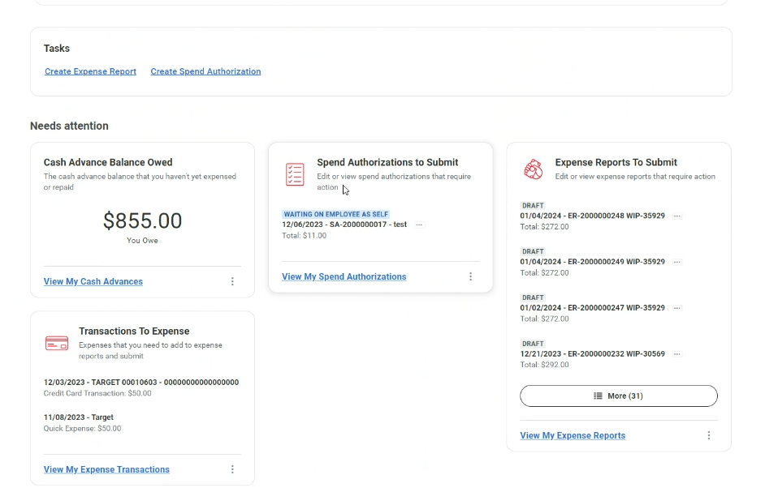
Another Expenses Hub Example

Slide 78
Expenses Demo/Discussion Wrap Up
Bigger open items for Expenses:
  US Bank Credit Card Integration has gone through lots of starts and stops and data isn’t great in WI 6 on card transactions
  Haven’t tested our API on Credit Card Applications/Changes
Focus on training materials, we will be requiring training for all approver roles in Expenses
We don’t know a lot about UXT rollout later this summer, but looking forward to having

Slide 79
Expense Walkthrough - Discussion:
What did you think about the Spend Authorization process?
What did you think about the Expense Report process?
Q&A time

Slide 80
Expenses Demo: UXT (WI 6)
Demo include if time:
Report 47
Where you can find UXT Materials

Slide 81
Break Time – Start back at 1:40
Discuss Expenses Roles (EARS, Expense Partner in Particular)

Slide 82
Expenses Payback Scenarios and Process Flows (EARS)
Cash Advance-Cash Sale
Personal Charges on University Credit Card-Cash Sale
Payback via Payroll

Slide 83
Cash Advance-Process Flow
Employee as Self
Expense Data Entry Specialist
Gift, Grant, Project, or Program Manager
Expense Advance Repayment Specialist
Creates and submits Spend Authorization for review and approval
Review Spend Authorization for correct funding
Approves Cash Advance Requested
Notes:
Adam
Data validation generally occurs in phases
First we will be leaning on Huron implementers in coordination with their UW counterparts to validate the critical config. The due data on the validation task will serve as an indicator of when validations are targeted to be complete.
The second wave of testing within the tenant will start on 7/17.
We understand that validation can be a time consuming exercise and the project teams are juggling a lot of demands. We're asking that the week of 7/17 is reserved for validation efforts so that we can stay on track to release the tenant on 7/28
Smoke testing – we currently have a handful of items identified as Smoke Testing (Name indicates Smoke Testing: Hire, Job Change, Payroll Calculation Engine) experience tells us the number of these tests will likely grow in the next couple of builds.
Three tests currently indicated under the HCM Config testing
Config Catch-up & Validation, while we've been building out the E2E tenant we know there are defects being addressed and items that were on the approved exception list that were being worked. Those can be migrated & validated during the catch-up window
Let's discuss the validation plan tracking

Slide 84
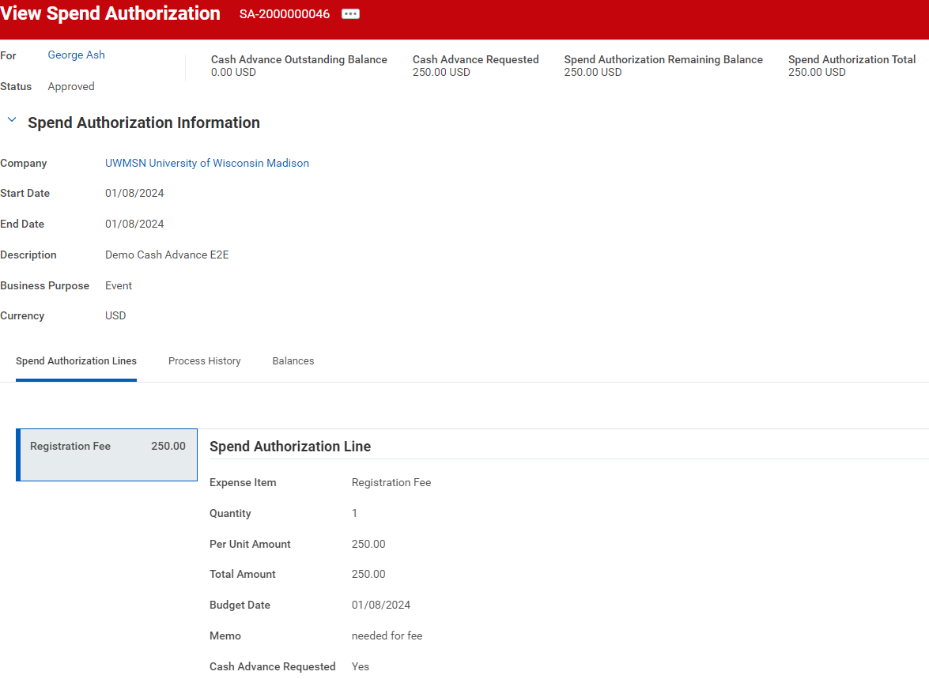
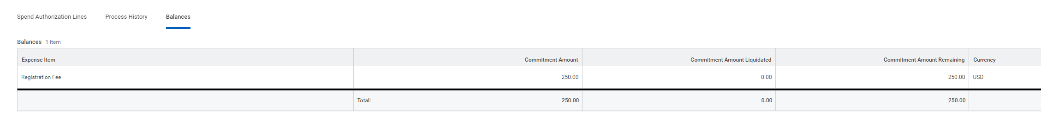
Cash Advance
See headers at top and different totals
See Cash Advance Requested
Spend Authorization Total
Notes:
Adam
Data validation generally occurs in phases
First we will be leaning on Huron implementers in coordination with their UW counterparts to validate the critical config. The due data on the validation task will serve as an indicator of when validations are targeted to be complete.
The second wave of testing within the tenant will start on 7/17.
We understand that validation can be a time consuming exercise and the project teams are juggling a lot of demands. We're asking that the week of 7/17 is reserved for validation efforts so that we can stay on track to release the tenant on 7/28
Smoke testing – we currently have a handful of items identified as Smoke Testing (Name indicates Smoke Testing: Hire, Job Change, Payroll Calculation Engine) experience tells us the number of these tests will likely grow in the next couple of builds.
Three tests currently indicated under the HCM Config testing
Config Catch-up & Validation, while we've been building out the E2E tenant we know there are defects being addressed and items that were on the approved exception list that were being worked. Those can be migrated & validated during the catch-up window
Let's discuss the validation plan tracking

Slide 85
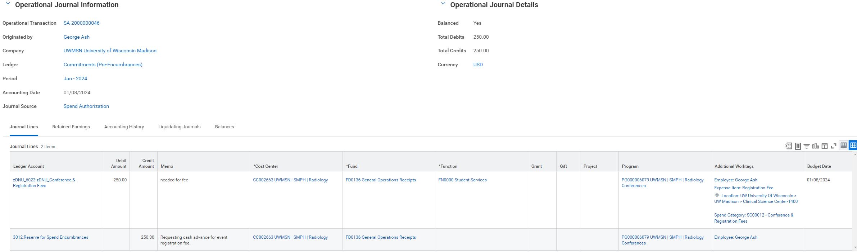
Cash Advance Approval – Once Approved
Company | Journal Source | Ledger | Ledger Account | Debit | Credit | Additional Worktags
UWMSN | Spend Authorization | Commitment (Pre-Encumbrance) | 6021:Other Expenses | 250.00 |  | Cost Center Fund Function Program/Project/Grant/Gift Spend Category Employee Expense Item Location
UWMSN | Spend Authorization | Commitment (Pre-Encumbrance) | 3012: Reserve for Spend Encumbrances |  | 250.00 | Cost Center Fund Program/Project/Grant/Gift Employee
Notes:
Adam
Data validation generally occurs in phases
First we will be leaning on Huron implementers in coordination with their UW counterparts to validate the critical config. The due data on the validation task will serve as an indicator of when validations are targeted to be complete.
The second wave of testing within the tenant will start on 7/17.
We understand that validation can be a time consuming exercise and the project teams are juggling a lot of demands. We're asking that the week of 7/17 is reserved for validation efforts so that we can stay on track to release the tenant on 7/28
Smoke testing – we currently have a handful of items identified as Smoke Testing (Name indicates Smoke Testing: Hire, Job Change, Payroll Calculation Engine) experience tells us the number of these tests will likely grow in the next couple of builds.
Three tests currently indicated under the HCM Config testing
Config Catch-up & Validation, while we've been building out the E2E tenant we know there are defects being addressed and items that were on the approved exception list that were being worked. Those can be migrated & validated during the catch-up window
Let's discuss the validation plan tracking

Slide 86
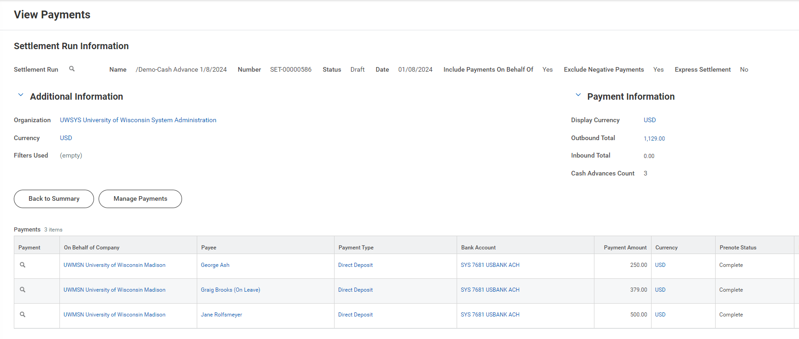
Cash Advance-Settlement
Notes:
Adam
Data validation generally occurs in phases
First we will be leaning on Huron implementers in coordination with their UW counterparts to validate the critical config. The due data on the validation task will serve as an indicator of when validations are targeted to be complete.
The second wave of testing within the tenant will start on 7/17.
We understand that validation can be a time consuming exercise and the project teams are juggling a lot of demands. We're asking that the week of 7/17 is reserved for validation efforts so that we can stay on track to release the tenant on 7/28
Smoke testing – we currently have a handful of items identified as Smoke Testing (Name indicates Smoke Testing: Hire, Job Change, Payroll Calculation Engine) experience tells us the number of these tests will likely grow in the next couple of builds.
Three tests currently indicated under the HCM Config testing
Config Catch-up & Validation, while we've been building out the E2E tenant we know there are defects being addressed and items that were on the approved exception list that were being worked. Those can be migrated & validated during the catch-up window
Let's discuss the validation plan tracking

Slide 87
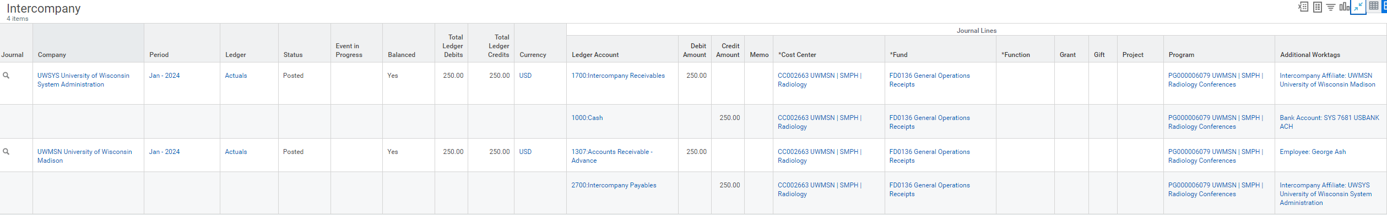
Appendix: Cash Advance Accounting-Settlement

Slide 88
Appendix:
Cash Advance Settlement-Accounting
Company | Intercompany Initiating Company | Journal Source | Ledger | Ledger Account | Debit | Credit | Additional Worktags
UWMSN | UWSYS | Cash Advance Payment | Actuals | 1307: Accounts Receivable-Advance | 250.00 |  | Cost Center Fund Program/Project/Grant/Gift Employee
UWMSN | UWSYS | Cash Advance Payment | Actuals | 2700: Intercompany Payables |  | 250.00 | Cost Center Fund Program/Project/Grant/Gift Intercompany Affiliate: UWSYS
UWMSN | UWSYS | Cash Advance Payment | Actuals | 1700: Intercompany Receivables | 250.00 |  | Cost Center Fund Program/Project/Grant/Gift Intercompany Affiliate: UWSYS
UWSYS | UWSYS | Cash Advance Payment | Actuals | 1000: Cash |  | 250.00 | Bank Account Fund
Notes:
Adam
Data validation generally occurs in phases
First we will be leaning on Huron implementers in coordination with their UW counterparts to validate the critical config. The due data on the validation task will serve as an indicator of when validations are targeted to be complete.
The second wave of testing within the tenant will start on 7/17.
We understand that validation can be a time consuming exercise and the project teams are juggling a lot of demands. We're asking that the week of 7/17 is reserved for validation efforts so that we can stay on track to release the tenant on 7/28
Smoke testing – we currently have a handful of items identified as Smoke Testing (Name indicates Smoke Testing: Hire, Job Change, Payroll Calculation Engine) experience tells us the number of these tests will likely grow in the next couple of builds.
Three tests currently indicated under the HCM Config testing
Config Catch-up & Validation, while we've been building out the E2E tenant we know there are defects being addressed and items that were on the approved exception list that were being worked. Those can be migrated & validated during the catch-up window
Let's discuss the validation plan tracking

Slide 89
Scenario 1
Expense Report with a remaining Cash Advance balance and payback via Record Cash Sale.

Slide 90
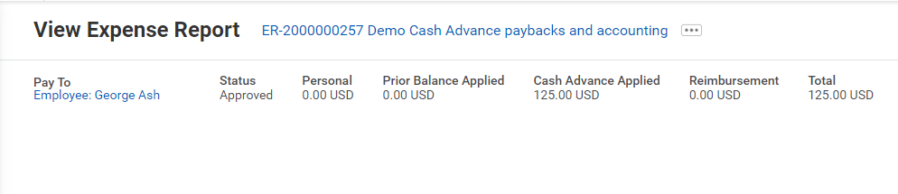
Expense Report is Approved (with cash advance)
The cash advance was applied to the expense report and has reduced the reimbursement amount.

Slide 91
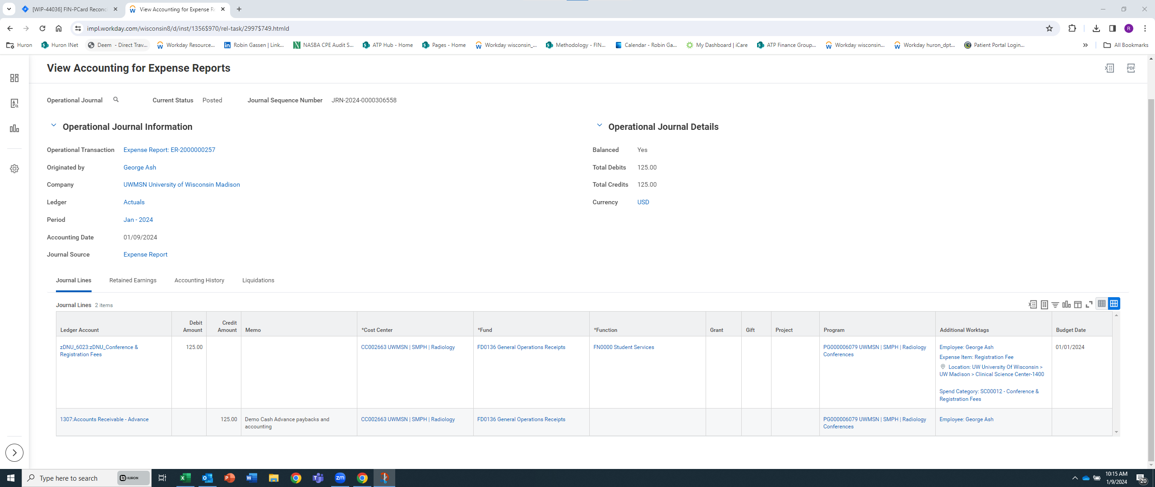
Expense Report (with cash advance) Accounting

Slide 92
Expense Report Accounting
Company | Journal Source | Ledger | Ledger Account | Debit | Credit | Additional Worktags
UWMSN | Expense Report | Actuals | 6021: Other Expenses | 125.00 |  | Cost Center Fund Function Program/Project/Grant/Gift Spend Category Employee Expense Item Location
UWMSN | Expense Report | Actuals | 1307: Accounts Receivable-Advance |  | 125.00 | Cost Center Fund Program/Project/Grant/Gift Employee

Slide 93
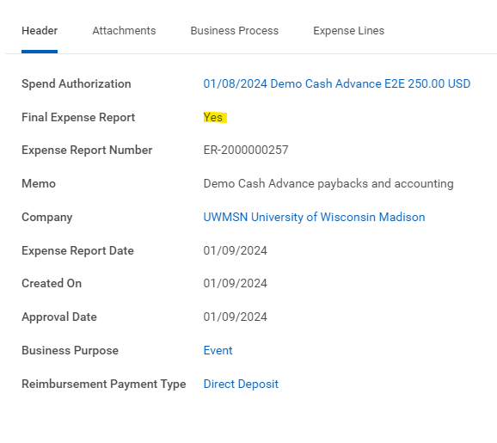
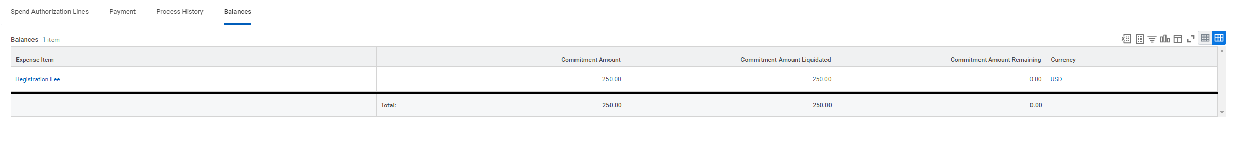
Spend Authorization Liquidation

Slide 94
Appendix: Spend Authorization Liquidation-Accounting
Company | Journal Source | Ledger | Ledger Account | Debit | Credit | Additional Worktags
UWMSN | Spend Authorization Liquidation | Commitment (Pre-Encumbrance) | 6021:Other Expenses |  | 250.00 | Cost Center Fund Function Program/Project/Grant/Gift Spend Category Employee Expense Item Location
UWMSN | Spend Authorization Liquidation | Commitment (Pre-Encumbrance) | 3012: Reserve for Spend Encumbrances | 250.00 |  | Cost Center Fund Program/Project/Grant/Gift Employee

Slide 95
Cash Advance Balance-Paid Back via Cash Sale
Employee
Cash Sale Payment/Deposit Specialist
Expense Advance Repayment Specialist
Makes payment cash/check to designated office (i.e. Bursar)
Records cash sale and deposits money
Records Cash Advance Repayment
Notes:
Adam
Data validation generally occurs in phases
First we will be leaning on Huron implementers in coordination with their UW counterparts to validate the critical config. The due data on the validation task will serve as an indicator of when validations are targeted to be complete.
The second wave of testing within the tenant will start on 7/17.
We understand that validation can be a time consuming exercise and the project teams are juggling a lot of demands. We're asking that the week of 7/17 is reserved for validation efforts so that we can stay on track to release the tenant on 7/28
Smoke testing – we currently have a handful of items identified as Smoke Testing (Name indicates Smoke Testing: Hire, Job Change, Payroll Calculation Engine) experience tells us the number of these tests will likely grow in the next couple of builds.
Three tests currently indicated under the HCM Config testing
Config Catch-up & Validation, while we've been building out the E2E tenant we know there are defects being addressed and items that were on the approved exception list that were being worked. Those can be migrated & validated during the catch-up window
Let's discuss the validation plan tracking

Slide 96
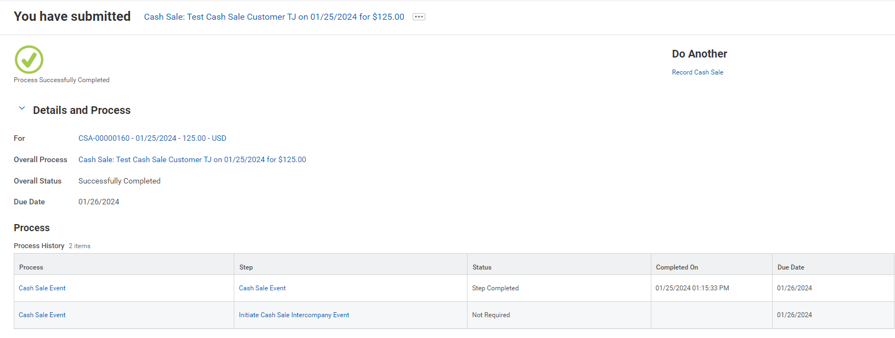
Record Cash Sale-Deposit of Cash Advance Unused Balance

Slide 97
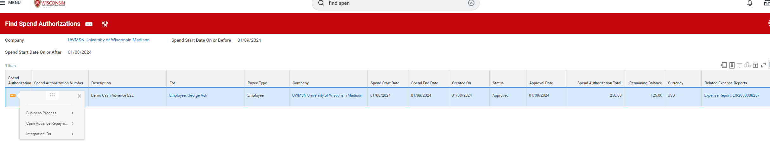
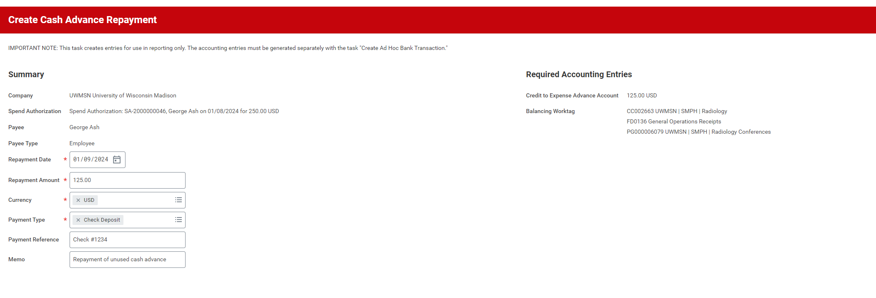
Spend Authorization-Create Cash Advance Repayment

Slide 98
Appendix:
Cash Advance Remaining Balance-Cash Sale
Accounting
Company | Intercompany Initiating Company | Journal Source | Ledger Account | Debit | Credit | Additional Worktags
UWMSN |  | Customer Cash Sale | 1000: Cash | 125.00 |  | Bank Account Cost Center Fund Program/Project/Grant/Gift
UWMSN |  | Customer Cash Sale | 1307: Accounts Receivable-Advance |  | 125.00 | Cost Center Cash Sale Customer Employee Function Fund Program/Project/Grant/Gift Revenue Category Sales Item

Slide 99
Scenario 2
Personal Charges on University Purchase Card

Slide 100
Expense Report with Personal Charges
Employee
Workday
Settlement
Creates Expense Report with Purchase Card transactions
Records any personal charges as a receivable and removes from reimbursement amount
Credit card charges are paid to bank regardless of personal
Checks any that are personal
Expense Report payment is made if any amount is remaining for reimbursment
The EARS will need to create
Notes:
Adam
Data validation generally occurs in phases
First we will be leaning on Huron implementers in coordination with their UW counterparts to validate the critical config. The due data on the validation task will serve as an indicator of when validations are targeted to be complete.
The second wave of testing within the tenant will start on 7/17.
We understand that validation can be a time consuming exercise and the project teams are juggling a lot of demands. We're asking that the week of 7/17 is reserved for validation efforts so that we can stay on track to release the tenant on 7/28
Smoke testing – we currently have a handful of items identified as Smoke Testing (Name indicates Smoke Testing: Hire, Job Change, Payroll Calculation Engine) experience tells us the number of these tests will likely grow in the next couple of builds.
Three tests currently indicated under the HCM Config testing
Config Catch-up & Validation, while we've been building out the E2E tenant we know there are defects being addressed and items that were on the approved exception list that were being worked. Those can be migrated & validated during the catch-up window
Let's discuss the validation plan tracking

Slide 101
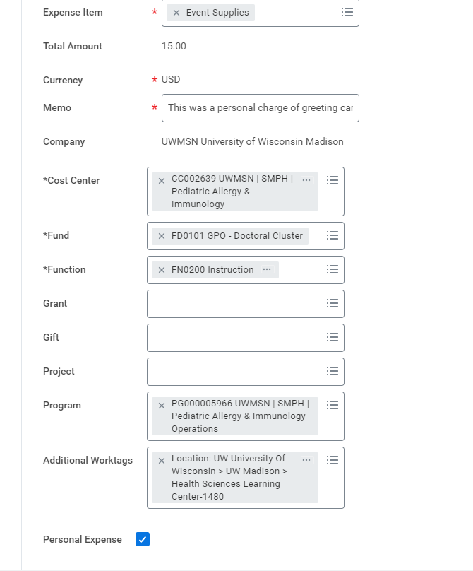

Expense Report with Personal Charges

Slide 102

Expense Report with Personal Charge

Slide 103

Payback Options will be required after submission – If Employee Selects “Withheld from Future Expense Report, EARS will monitor

Slide 104
Appendix: Expense Report-Personal Charge Accounting

Slide 105

EARS To Create the Expense Receivable Repayment
Anytime payback is done via check/cash (with Bursars) or taken out of a paycheck this final step is needed

Slide 106
Scenario 3
Payroll Deduction
(Personal Charges on University Purchase Card or Cash Advances Owed)

Slide 107
Expense Amount Due – Payroll Deduction
EARS
HR
EARS
Runs Report and sees Employee past due receivable or creates request based or employee’s questionnaire response
Processes the request on next payroll
Closes out the employee receivable
EARS will not have to complete an EIB to give to HR, likely just be an email or spreadsheet, working on finalizing format during E2E 2 phase
Also think EARS will be responsible for communications to employee
Any preferences?
Notes:
Adam
Data validation generally occurs in phases
First we will be leaning on Huron implementers in coordination with their UW counterparts to validate the critical config. The due data on the validation task will serve as an indicator of when validations are targeted to be complete.
The second wave of testing within the tenant will start on 7/17.
We understand that validation can be a time consuming exercise and the project teams are juggling a lot of demands. We're asking that the week of 7/17 is reserved for validation efforts so that we can stay on track to release the tenant on 7/28
Smoke testing – we currently have a handful of items identified as Smoke Testing (Name indicates Smoke Testing: Hire, Job Change, Payroll Calculation Engine) experience tells us the number of these tests will likely grow in the next couple of builds.
Three tests currently indicated under the HCM Config testing
Config Catch-up & Validation, while we've been building out the E2E tenant we know there are defects being addressed and items that were on the approved exception list that were being worked. Those can be migrated & validated during the catch-up window
Let's discuss the validation plan tracking

Slide 108
EARS: Report Taxable Items – High Level
This will be done by pulling reports, perhaps working with Taxes (Cora Beach)
EARS will do some investigating (any exceptions to reporting to taxes) no double tax (tuition and 90 day violation) making sure to remove student/guests
Completing EIB (spreadsheet) and sending to HR Shared Services so it goes on employee’s next paycheck

Slide 109

Taxable Items – Main Reports Run and Reviewed
Run Report 123 – Accountable Plan Non-Compliance UW (123)
Run Report 47 and filter on Expense Item types: Day trip meal allowance
Custom report ran on special Expense Reporting Worktag for any Expense Reports that were not RESUMBITTED within the 90 window
You will likely need to click on the ER to investigate (make sure truly taxable)
EARS will want to keep rolling tally of each time complete taxable reporting task to start the next cycle (recommending bi-weekly to correspond payroll)

Slide 110
EARS – Expense Advance Repayment Specialist
Other Important Expenses Duties as Assigned
Will be working with Foundation on all of the billing (invoices) via EIB
  Have Foundation meetings scheduled for May 7, 16, 22
Will complete Mass Close of Spend Authorization
    Recommending monthly clean up
    Employees will have open Spend Authorization if the do not select “final expense report”
Most of the work is not part of a business process, but open tasks that need to be completed

Slide 111
Expense Partners
Separate Team for Madison (even within Madison) and Systemwide
Similar to today for Systemwide excluding Madison
Systemwide Parameters – have skip criteria for Purchase Card Reconciliation that skips Expense Partner
Will be review Expense Reports for policy compliance and will likely be the role that will be requesting travelers to get any needed Policy Exception Spend Authorization
Will be using Expense Reporting Worktag (similar to today’s return reason codes)
Have the ability to change/edit Expense Report “review access” in Workday
  G/G/P/P Managers have “approve access” and can not make changes

Slide 112
Expense Partners
Accuracy and Ability to Change Expense Report
Will be trained on adding Expenditure Treatments for Grants and Athletics
  In State
  Out of state
  Foreign
  May also be trained on other specific parameters from other groups
    Activities for athletics
    Other reporting needs/labels are accurate
    No “other” or “miscellaneous” Expense Items in Workday so reporting accuracy should be improved by having proper Expense Items

Slide 113
Expense Partners
Anything else to add?

Slide 114
Wrap Up and Final Thoughts on Workday

Slide 115
Workday Expenses - Gaps
List of Gaps
Employees can’t see who are all involved in having to approve Expense Report
Worktags can not be updated on the header level, only the line level once the expense report is in progress (after you finish completing the initial header information)
Not able to automatically flag ER that have not been resubmitted within 90 days
Employees do not get notifies when a Purchase card transaction has been reassigned
  Does show up on home page under “Credit Card Transactions”
Request Framework (forms/BP Logix replacement within Workday) isn’t nearly as robust, no approval step can be a “review” step (no changes allowed) so will have to send back to requester to make changes

Slide 116
Workday Expenses - Wins
Much Better User Experience
Customize instructions and add Guidance (links to Websites)
Can have multiple tabs/pages open
Mobile features – especially for taking pictures and scanning reciepts
Mileage – Google maps and have ability to select “roundtrip”
Integrations built in (Concur, US Bank, DOA/Driver Authorizations) API with US Bank
Reporting – Robust and has a lot more built in/delivered
The more you are in Workday, the more you like it

Slide 117
Workday Expenses – Questions for Us
Worries?
What do you want to know more about?

Slide 118

Delegation – Future State
Delegate Task and Manage Delegation

Slide 119


Slide 120
Thank you
Thank you for taking the time to spend time to learn about Fox and Workday and coming along with us on this exciting journey of making things better for our Travelers!
Thank you for all you do for the UW and for making these two days together so productive!
Safe Travels!!

