Slide 1
Travel Training - Expense
October 29th, 2024

Slide 2


Presenter: Emily Stoffel
Regional Travel Manager
Emily.Stoffel@wisconsin.edu
Topics:
Payment Methods
Receipt Requirements
Reimbursement Policy
Reimbursement Workflow
Expense Demo

Slide 3
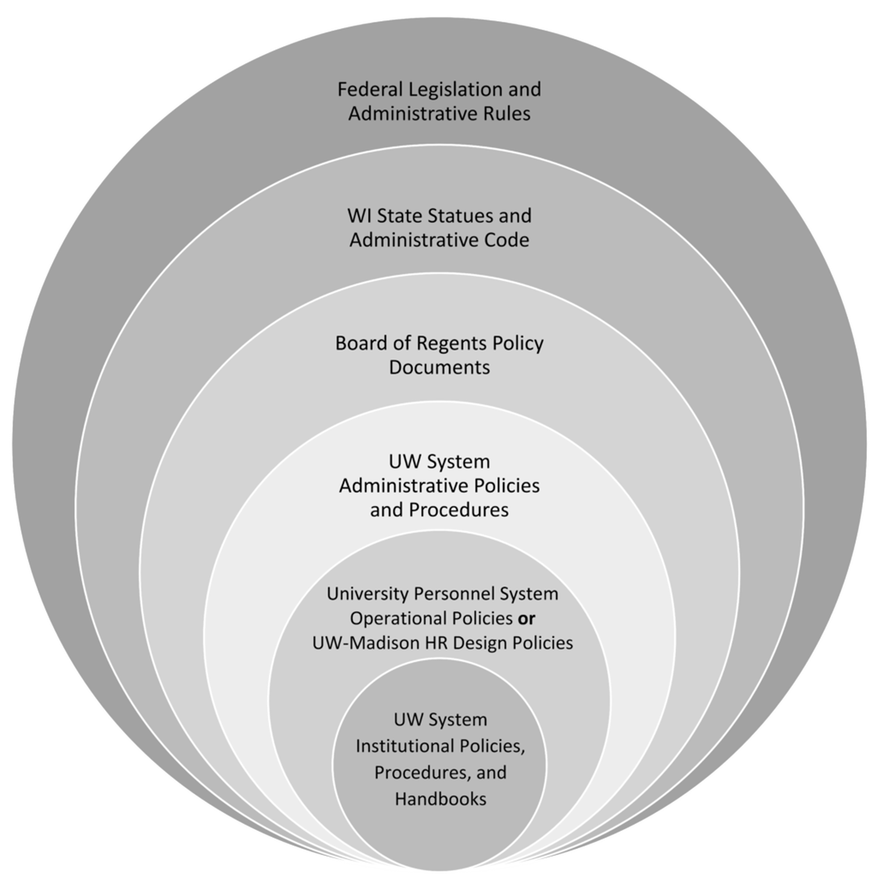
The more restrictive policy takes precedence
Always check with your supervisor/dept for specific travel policies

Slide 4
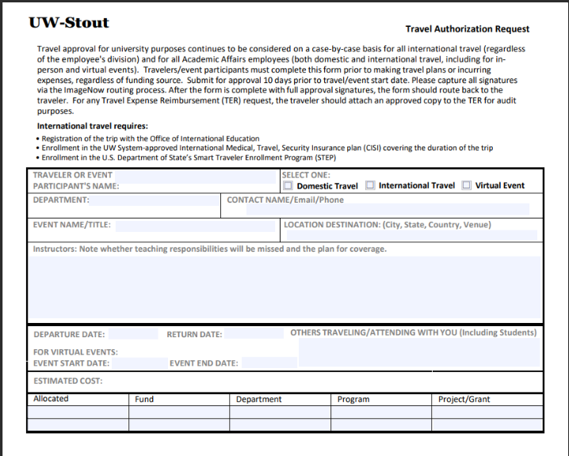
Travel Authorizations required for:
All international travel
All Academic Affairs employees’ domestic travel
All Academic Affairs employees attending virtual events even if no costs are incurred

Slide 5
Paying for Travel
Personal Funds
Corporate Cards
Personal funds may always be used to pay for travel
Reimbursement is done through e-reimbursement
Travel may NEVER be paid with P-Cards (except registration fees)
University issued personal liability credit card only for travel = cardholder’s responsibility to pay
Card must be paid in 60 days or late fees are assessed (cardholder’s responsibility to pay)
Card is paid using personal funds or e-re

Slide 6
Receipts Required for Reimbursement
Expenses over $25:
Parking
Bus Tickets/Passes (each way)
Taxis/Shuttles/Car Services (each way)
Subway Passes (each way)
Business Use of Internet Access
Tolls
Expenses over $30
Airline Baggage
Any expense regardless of amount:
Airline Tickets
Airline Penalty Fees (Change/Cancel)
Rail Tickets/Passes
Travel or Tour Company Service Fees
Registration Fees
Lodging
Vehicle Rentals (original rental agreement and receipt)
Vehicle Rental Gas
Hospitality/Hosted meals
Visas for International Travel
Vaccines/Inoculations for International Travel
Foreign Transaction Fees on Corporate Cards
Relocation – Moving Company/U-Haul
Non-travel related expenses

Slide 7
Receipt Requirements
The name & address of the vendor providing the goods or services
The date that the specific services were received, or items were purchased
Itemization of the services and/or goods and pricing
Final amount due and evidence that it was paid

Slide 8
Reimbursement
POLICY: Reports must be submitted within 90 days of expense date or end of trip
  After 90 days = exception required and report is taxable to traveler
Can submit airfare & registration fees before travel
Must include Travel Authorizations for all international travel & Academic Affairs domestic
Before you start:
  Have all receipts and supporting materials saved to your computer in the same folder
  Know your funding string
Supporting materials
  Agendas, website screenshots, receipts, etc.

Slide 9
Reimbursement Workflow
Employee
Central Audit
Department Approver
Central Audit or Dept Approvers may return the report for changes
Central Audit may reach out via email with questions or to request more information
Prompt replies and speedy resubmissions help reports get approved on time

Slide 10
Common Send Back Reasons
Incorrect dates entered​
Missing agenda​
Missing cost comparisons​
Lack of supporting documentation​
Insufficient justification ​
Missing receipts​
Incorrect expense type used

Slide 11
Expense Demo

Slide 12
Resources
UW Stout Sharepoint
UW System TravelWIse
Per Diem Calculator
Travel Manager Emily Stoffel
Emily.Stoffel@wisconsin.edu
608-263-1040
New Employee Checklist
Sign up for a Concur account
Apply for a Corporate card is desired
Complete a driver authorization

