Slide 1
Travel Manager Conference
New Expense Item and Blanket Insurance
April 13, 2023

Slide 2
New Expense Type
Received a request to add student lodging to SFS and will have in Workday
This is very “fresh off the presses”
Still a lot to work out (including account numbers)
Request addresses be entered
This is to streamline Clery Act reporting

Slide 3
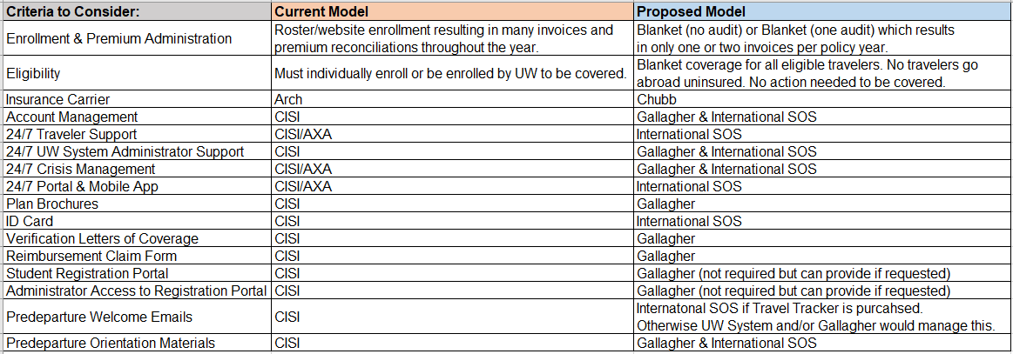
Gallagher's Proposed Solution: Chubb & International SOS Blanket Model Gallagher as the Plan Administrator

Slide 4
Risk Department Leading Insurance
Will share when we know more
Will partner with Travel Inc and other agencies
Post on Travel Wise
Will likely cover in future Travel Manager Calls

Slide 5
Happy Retirement!!
Sharon Schwartz last week with UWSA
Joan Delsrude last month with UWSA

