Slide 1
Travel Services Open House
Updates and Review of Changes to the UW Travel Program
October 13, 2020

Slide 2
Agenda
Review of New Travel Agency Vendors and Reason Behind Change
Review of new UW TravelWIse Website and Rate Calculator
Current UW Campus Travel Restrictions
Unused Ticket & UATP Card Overview
Travel Policy Changes & Updates
Q & A
Notes:
Becky

Slide 3
What Changed? What Remains the Same?
What Changed? | What will remain the same?
New UW TravelWIse website, administered by UW System | Concur will still be used for online travel reservations (but will be fulfilled and invoiced by a different travel agency)
New travel rate calculator (lodging maximums and meal per diems) | University card policy and vendor (US Bank)
Rollout of Concur app and Travel Incorporated app for booking and viewing reservations on mobile devices | Ability to use a travel agent/consultant for service
Most employees will be working with a new travel agency and new travel consultant team | 24/7 agency coverage is available, with a dedicated UW team during core business hours
‘Lite’ policy updates | Requirement to book air with contracted agencies
Full pre-payment for lodging (Air BNB allowed) | UW Madison Athletics will still book with Anthony Travel
Notes:
Becky

Slide 4
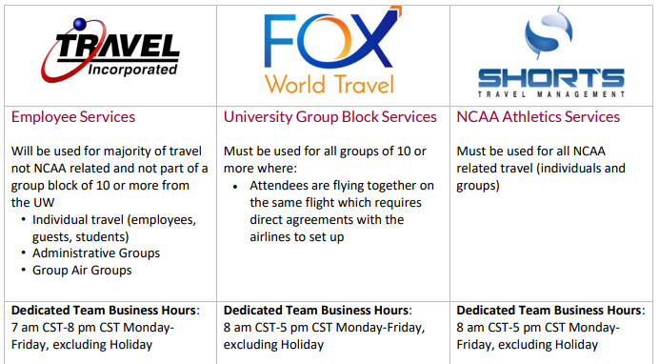
Travel Agency Vendor Guide
Notes:
Becky-

Slide 5
Focus on Travel Incorporated
Enhanced Duty of Care (ex. Covid-19 situation)
Concur & Concur App for self booking
  Concur profiles transitioned to Travel Inc at the end of June.
  Travelers are encouraged to review Concur profile for accuracy
  All travelers should have a credit card in their profile, designated to airfare.
  All travelers will have guest booking access in Concur.
  Guest booking should only be used for guests, not employees.
Travel Consultants and Emergency Services available
Enhanced Technology
  TI Mobile App to access itinerary, add meeting notes, check-in to your flight and more
  TI Travel Hub to update profile, access lost invoices
Notes:
Becky

Slide 6
Focus on Travel Incorporated
Travel Inc. Fees
  All campuses other than UW Eau Claire moved to ‘point of sale’ service fees
  Expense travel agency fee (separate expense line on TER)
  Emphasis on booking in Concur – service fee only $3.75 per ticket/transaction
  No fee for car/hotel only booking
To learn more about Travel Incorporated, please attend our upcoming trainings - go to UW TravelWIse to register
Notes:
Becky

Slide 7
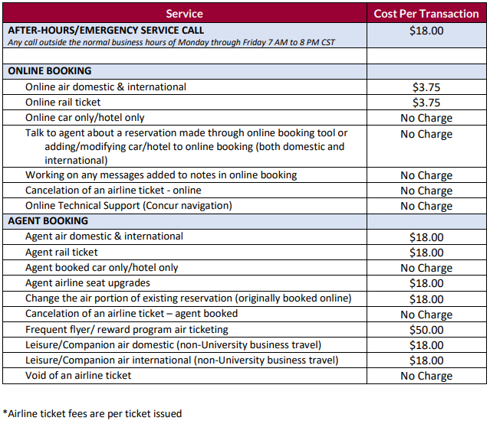
Travel Incorporated Service Fees
Compare current fees with prior Fox World Travel fees to the new fee structure with Travel Incorporated on our fee comparison grid.
Notes:
Rusty –

Slide 8
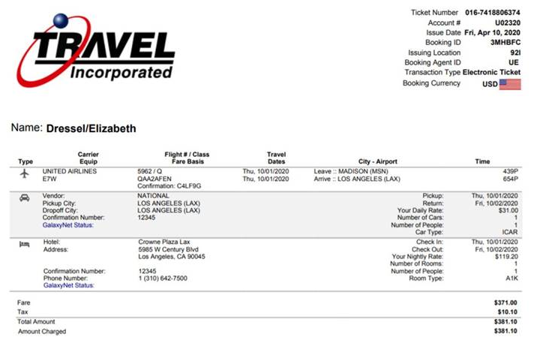
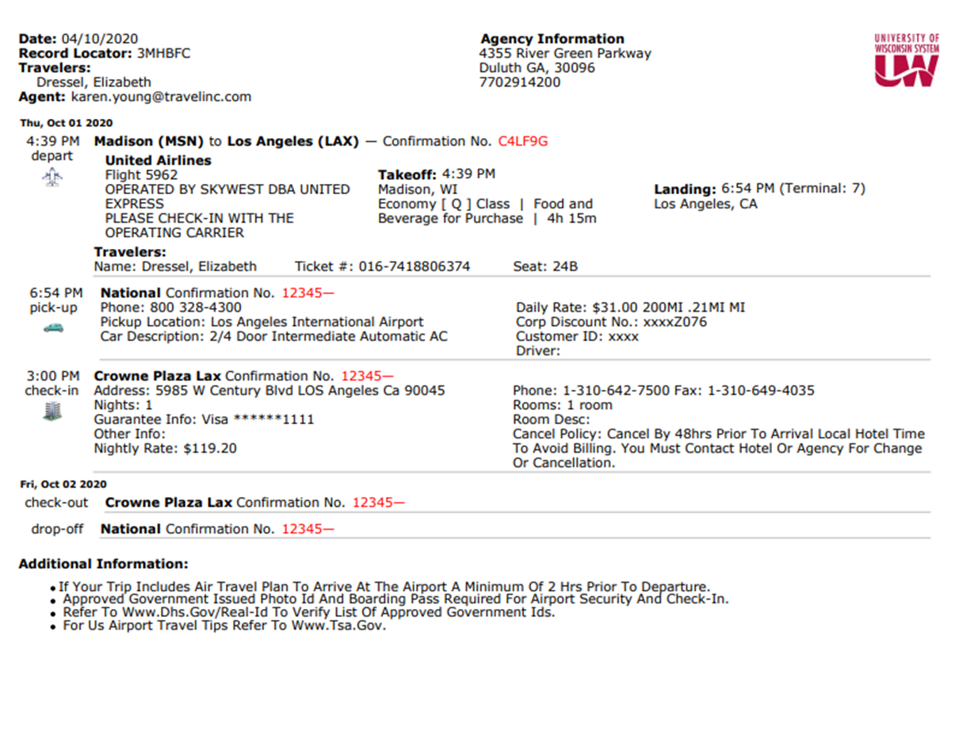
Travel Inc eItinerary and Invoice - Sample
Notes:
Rusty

Slide 9

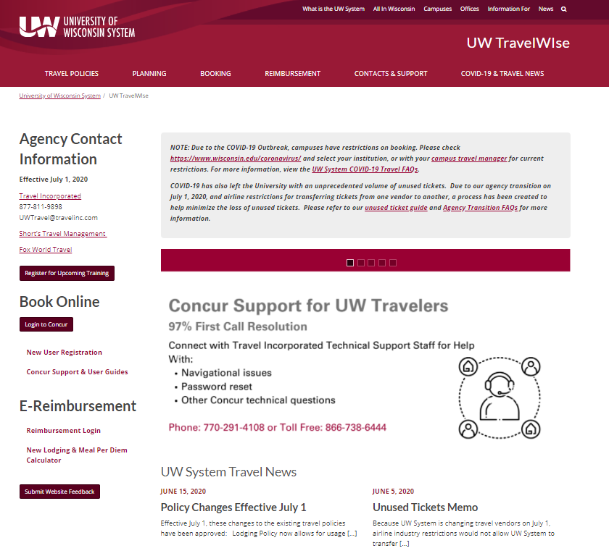
UW TravelWIse Website Change
UW TravelWIse Website – www.wisconsin.edu/travel
  New UW TravelWIse is hosted by UW System
    Consistent with other UW sites
    More user friendly
    Ease of finding information
    New agency contact information updated
    Newly created COVID-19 & Travel News page
    Please bookmark the new website and visit it for all travel related inquires/questions.
Notes:
Alyssa

Slide 10
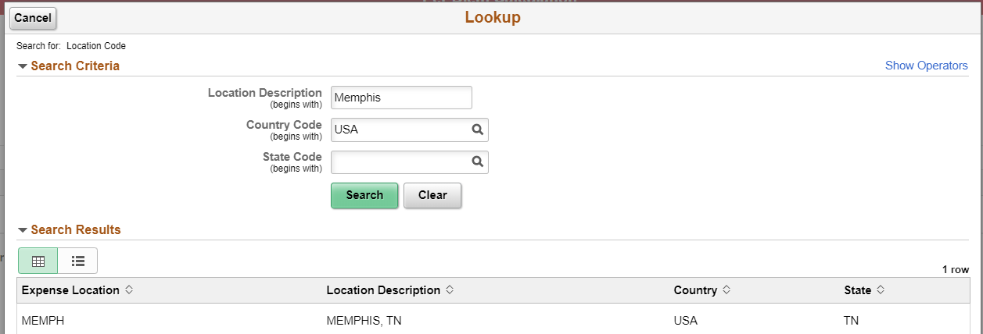
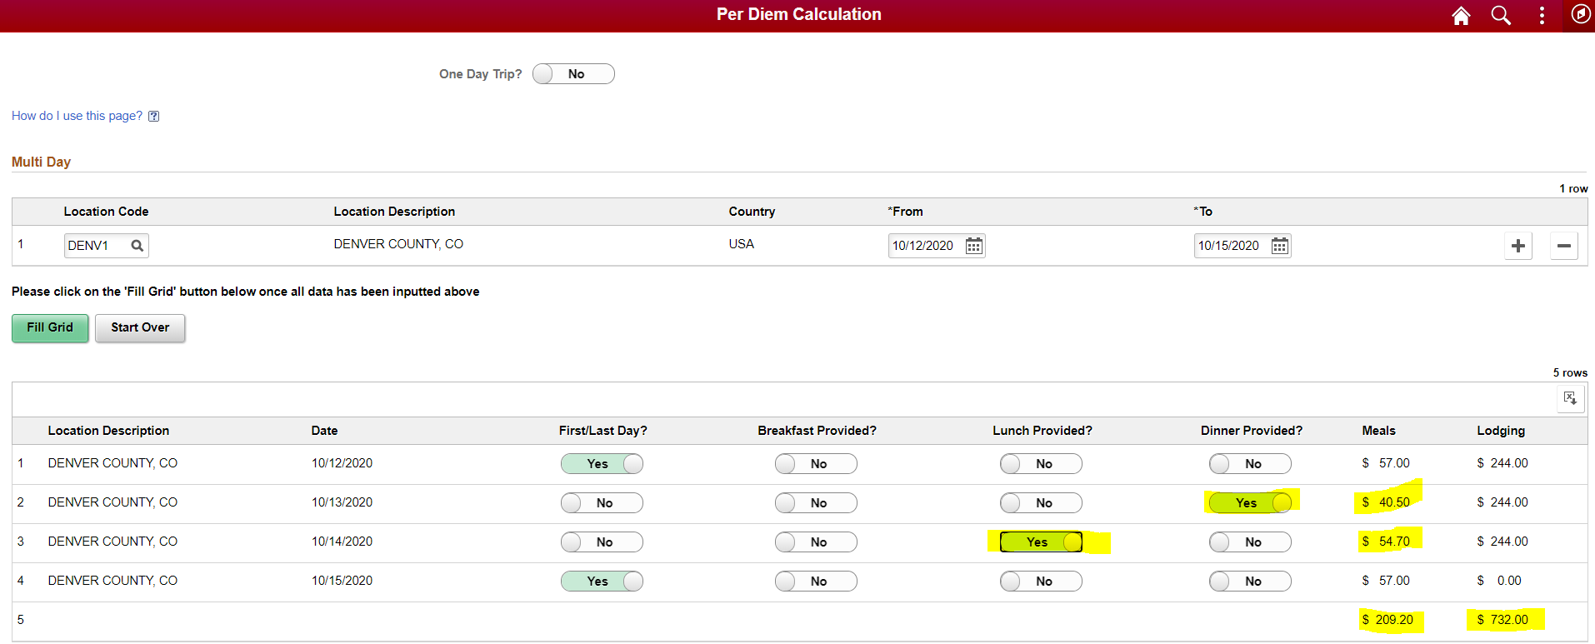
Per Diem Calculator Change
Per Diem Calculator
Accessible through UW TravelWIse (link on home page)
Everything done with same system (SFS created and will host new rate calculator)
Similar look and feel to E-reimbursement
Notes:
Alyssa

Slide 11
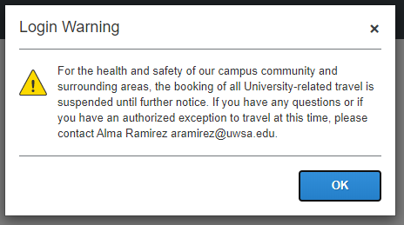
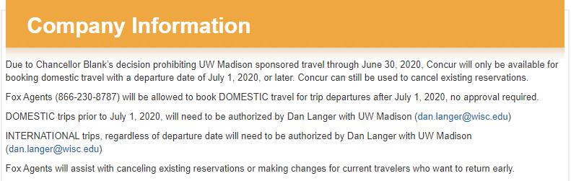
Current UW Travel Restrictions
Due to Covid-19 all UW campuses currently have travel restrictions in place
  Restrictions will vary by campus
  Concur bookings are restricted for most campuses
  Only Essential Travel is permitted for some campuses
  Pre-trip approval is required on some campuses (at varying approver levels)
  Visit the UW TravelWIse website COVID-19 page for current Campus Specific Travel Restrictions.
Restricting Concur Access & Concur messaging
  Current messaging for campuses with restrictions, Travel Inc has kept programing/restrictions in place.
For questions on campus specific travel restrictions, please reach out to your campus travel manager.
Notes:
Alyssa

Slide 12
Unused Tickets – Overview
Changed vendors on July 1, and airline industry restrictions would not allow UW System to transfer all unused tickets from one vendor to another.
UW System was able to convert the value of the unused tickets to UATP (Universal Air Travel Plan) prepaid airline cards. This will apply only to unused tickets from Delta, United, American, and Southwest, that are non-athletic related.
This process allows UW System to utilize the $3M of unused tickets when campuses resume travel without expending new funds to purchase tickets.
Each department will be made whole for amount put on UATP card (each funding string used to pay for tickets for UW System (excluding UW Madison) will be credited in FY21, all UW Madison funds were credited end FY20)
The remaining unused tickets on all other carriers (if not on Delta, United, American and Southwest) are available for individual use by calling a Travel Inc consultant (again, this applies ONLY to international tickets and some domestic carriers such as Jet Blue and Alaska Airlines).
The Unused Ticket Guide on Travel Wise is the best place to get detailed information about this process and find the list of any personal/family/companion tickets that remain open for use (directly with airline)
You can also visit the FAQs for Unused Tickets
Notes:
Liz

Slide 13
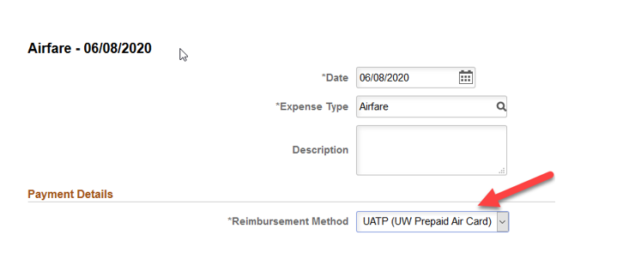
Double Check Travel Inc Invoices: UATP Cards and Process
Employees will need to pay attention to invoice receipts when booking with Travel Incorporated to confirm if the UATP card paid for the airfare or if it was charged to the card on file for the individual or campus
When creating an expense report, where the UATP Card was used for payment, be sure to select the UATP card
Each UATP transaction will have a $18 fee – as an agent is handling behind the scenes
Reminder to call a Travel Inc consultant to use any remaining “unused tickets”
Notes:
Liz

Slide 14
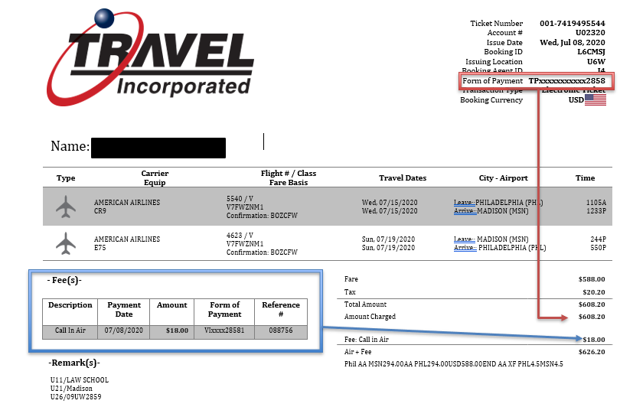
Travel Incorporated – UATP Invoice Example
Only Airfare can be charged to the UATP card. In this example, $608.20
Service Fees must be charged to a University P-card, Corporate card or personal credit card. In this example, $18.00
Notes:
Liz

Slide 15
‘Lite’ Policy Changes – Effective July 1
Changes to Lodging: allow for Airbnb, and full prepayment, continue to restrict Third Party Bookings (as is now)
  Add clarity that hotels can be booked directly.
Passports
  Allow for reimbursement (must have business purpose)
Real IDs have been added to the list of non-reimbursable expenses
Vehicle size – Allow up to mid size SUV
Employees must resubmit 90 days after TER returned
  Employees would be taxed if they don’t resubmit after 90 days (same if they don’t submit within 90 days originally)
Day trip meal allowance, not requiring deduction if meal provided
Still working on full Travel Policy Refresh for 2021
Notes:
Liz

Slide 16
Helpful Tips and Reminders
Bookmark the UW TravelWIse website. It’s your one-stop shop for all things travel related.
Sign up for the UW TravelWIse monthly newsletter to stay informed on UW System travel news.
Register for additional trainings related to the changes.
  Administrative Group Overview
  Travel Incorporated Overview
View past training webinars on demand.
The FAQ document is posted on the UW TravelWIse website that addressed many questions asked during prior Open Houses
A brief survey will be sent following this training.
  The survey will include a link to submit additional questions
Notes:
Becky

Slide 17


Slide 18
Pre submitted Questions
Q. Can Travel Inc assist with spousal/companion travel?
A. Yes
Q. Please define "group" as in the kind of "group travel" Fox will be doing separate from Athletic travel.
A. Airlines define a group as 10 or more travelers. NCAA athletic groups will be booked through Short’s, all other groups of 10 or more (Group Blocks) will be booked through Fox.
Q. Do we need to create a new group code or can we use the same one we used for Fox World Travel?
A. Group codes will be transitioned to Travel Inc.
Q. Just need information about changes in car rentals and hotels.
A. Policy now allows for car size up to mid-size SUV. Air BNB and full-prepayment now allowed for hotels.
Q. Will UW Parkside still have a ghost card on file for airline tickets?
A. Yes
Q. I have an upcoming trip in September that was booked by Fox. Do I still call Fox if I need help with that ticket after July 1st?
A. No, all live/active reservations will be transitioned to Travel Inc or Short’s (for athletics).
Notes:
Becky

Slide 19
Pre submitted Questions
Q. I need to bring my young child on work trips with me often, as a single mom. How will booking his flight work for the new agency? Will I still be charged a fee?
A. Travel Inc can help with companion bookings. You will have to work with a consultant. They do charge a fee but it’s less than the current Fox fee ($18.00)
Q. How do the changes affect faculty-led study abroad programming.
A. If the program is 10 or more travelers, the Group Block will still be booked through Fox (with minimal changes). If the program is less than 10 travelers, they would book with Travel Inc.
Q. Will power point slides, FAQ's, or helpful directions be provided? Most people don't take the time to watch video's or tutorials. When they come to me for help, I like to provide some type of document to help walk them through the process. If I don't have that, I literally go to their office and walk them through each click.
A. This PowerPoint presentation and an FAQ document will be available on TravelWIse.
Q. What communication will go out specifically to people with Concur accounts? (As an admin coordinator I'm wondering what info I need to pass on to my colleagues.)
A. Some campuses are doing targeted communication to All Concur users regarding the Changes. System is using TravelWise, the TravelWIse newsletter and the Project Website as our main forms of communication.
Notes:
Becky

