Slide 1
University of Wisconsin
Foundation Data Model
April 13, 2023

Slide 2
Agenda
FDM Timeline
FDM Mapping Update
FDM Dimensions and Structure
FDM Mapping Tool
GL Conversion
Next Steps
Questions

Slide 3
FDM Timeline

Slide 4
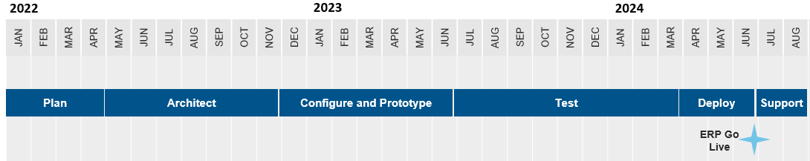
FDM Timeline & Stakeholder Engagement
Mapping Deadline
2
3
4
5
6
1
Continual Mapping – Any values added to SFS after FY22, will need to be mapped
Data Validation
Stakeholder Engagement Milestones:
FDM Mapping (Ongoing exercise until Go Live as new legacy values are created)
  100% of existing values (FY23 Q1 & Q2) mapped for all campuses by April 7, 2023
FDM Architect design playback session (UW Controllers in-person meeting)
FDM Customer Confirmation Session (Architect design review, feedback loop)
Design Confirmation (confirmation of total design)
FDM Functional Overview sessions (TBD, Change Management)
Stakeholder training, communications and final data validation
= Tenant Build

Slide 5
FDM Mapping Update

Slide 6
Foundation Data Model
Design Considerations
Identify areas for improvement in existing legacy system
Review reporting requirements and work backwards
Avoid multiple definitions for any single dimension
Determine granularity of each dimension
Consider budgeting and forecasting
Be aware of integrating systems and plan for any challenges

Slide 7
Foundation Data Model
Key Accomplishments – C&P Phase
Mapped FY23 Q1 and Q2 data – over 215k lines
41 key decisions made related to FDM
Held weekly office hours with the following groups: comprehensive campuses, MSN academic, and MSN non-academic
FDM team members met regularly on an individual basis with assigned campuses and MSN divisions to assist/support in mapping effort
Mapped existing SFS account codes to Workday ledger accounts and created associated spend/revenue categories
Approved FDM Governance model for during and post implementation

Slide 8
FDM Dimensions and Structure

Slide 9
Custom Organization vs Worktag
Custom Organizations
Up to 10 can be mapped as Financial worktags
Custom Worktags
May be inactivated
Can assign roles
Available for payroll costing allocations
Can have related worktags assigned
Can have security, hierarchies and worker assignments
Examples: Activity, Function
Limit of 15 (total)
May be inactivated
Value Description only
No worker or role assignments
Does not have security, hierarchies or worker assignments
Example: Assignee, Work Order

Slide 10
Organizations in Workday
Organization
Organize workers into groups that serve a common purpose
Typically represent how work is done and how the workforce is structured; can serve many other purposes
Are used across the entire platform
Tie workers to multiple independent organization types, each with a different purpose
Supervisory Z
Location Y
Academic Unit W
Cost Center X
Notes:
NOTES
Organizations typically represent workforce structure
Workday’s organization structure is fundamentally different from that of other vendors
You can define more org types than in traditional systems
Organization structures are shared across the entire platform (HCM orgs are ‘known’ to FIN and Costing Orgs are ‘known’ to HCM)
DETAILS
Organizations are a basic building block in Workday. In HCM, an organization typically groups people with a common purpose, goals, and objectives. In Financials, organizations dictate how you manage and report on your business.
Traditional systems can be inflexible – they allow you to track “Cost Center, Company, Departments, business units, etc” but simply because those are structures that are needed by Finance. Workday enables you to define more organizations than you typically could in your legacy system. Organization structures are shared across the entire platform; for example, HCM orgs are ‘known’ to FIN and Costing Orgs are ‘known’ to HCM.
An individual worker can and will be a member of multiple different types of organizations, as each different organization is used for different business functions. The different organization structures do not need to match up (e.g. cost centers corresponding to a specific supervisory organization)
This slide illustrates that within Workday you can view employees by business unit, by Region, by company, by cost center (or department – this is typically how other ERP’s group workers…), by supervisory or “who reports to whom” structure and by dotted line or matrix structure. And, when we say “view” employees we mean that you can view them in an organization chart, use those groupings in reports, and drive business logic off those grouping.

Slide 11
Driver and Related Worktags
Worktags Entered by User on the Transaction
Program: PG000001052
Spend Category: SC00111 Advertising & Notices
Related Worktags
Cost Center: CC000127
Fund: FD0102
Function: FN0500
Final worktags on the Transaction
Program: PG000001052
Cost Center: CC000127
Fund: FD0102
Function: FN0500
Spend Category: SC00111 Advertising & Notices
Driver Worktag: Initial/main worktag entered on a transaction by an end-user
  Driver worktags: Grant, Gift, Project, Program
Related worktags: Allow you to specify worktag values that get brought over onto a transaction along with as triggered by the driver worktag
  Improves usability and streamlines data entry, leading to more accurate reporting
  Related worktags default on the transaction when the driver worktag is entered. Related worktags can be changed on the transaction.
  Related worktags: Cost Center, Fund, Function

Slide 12
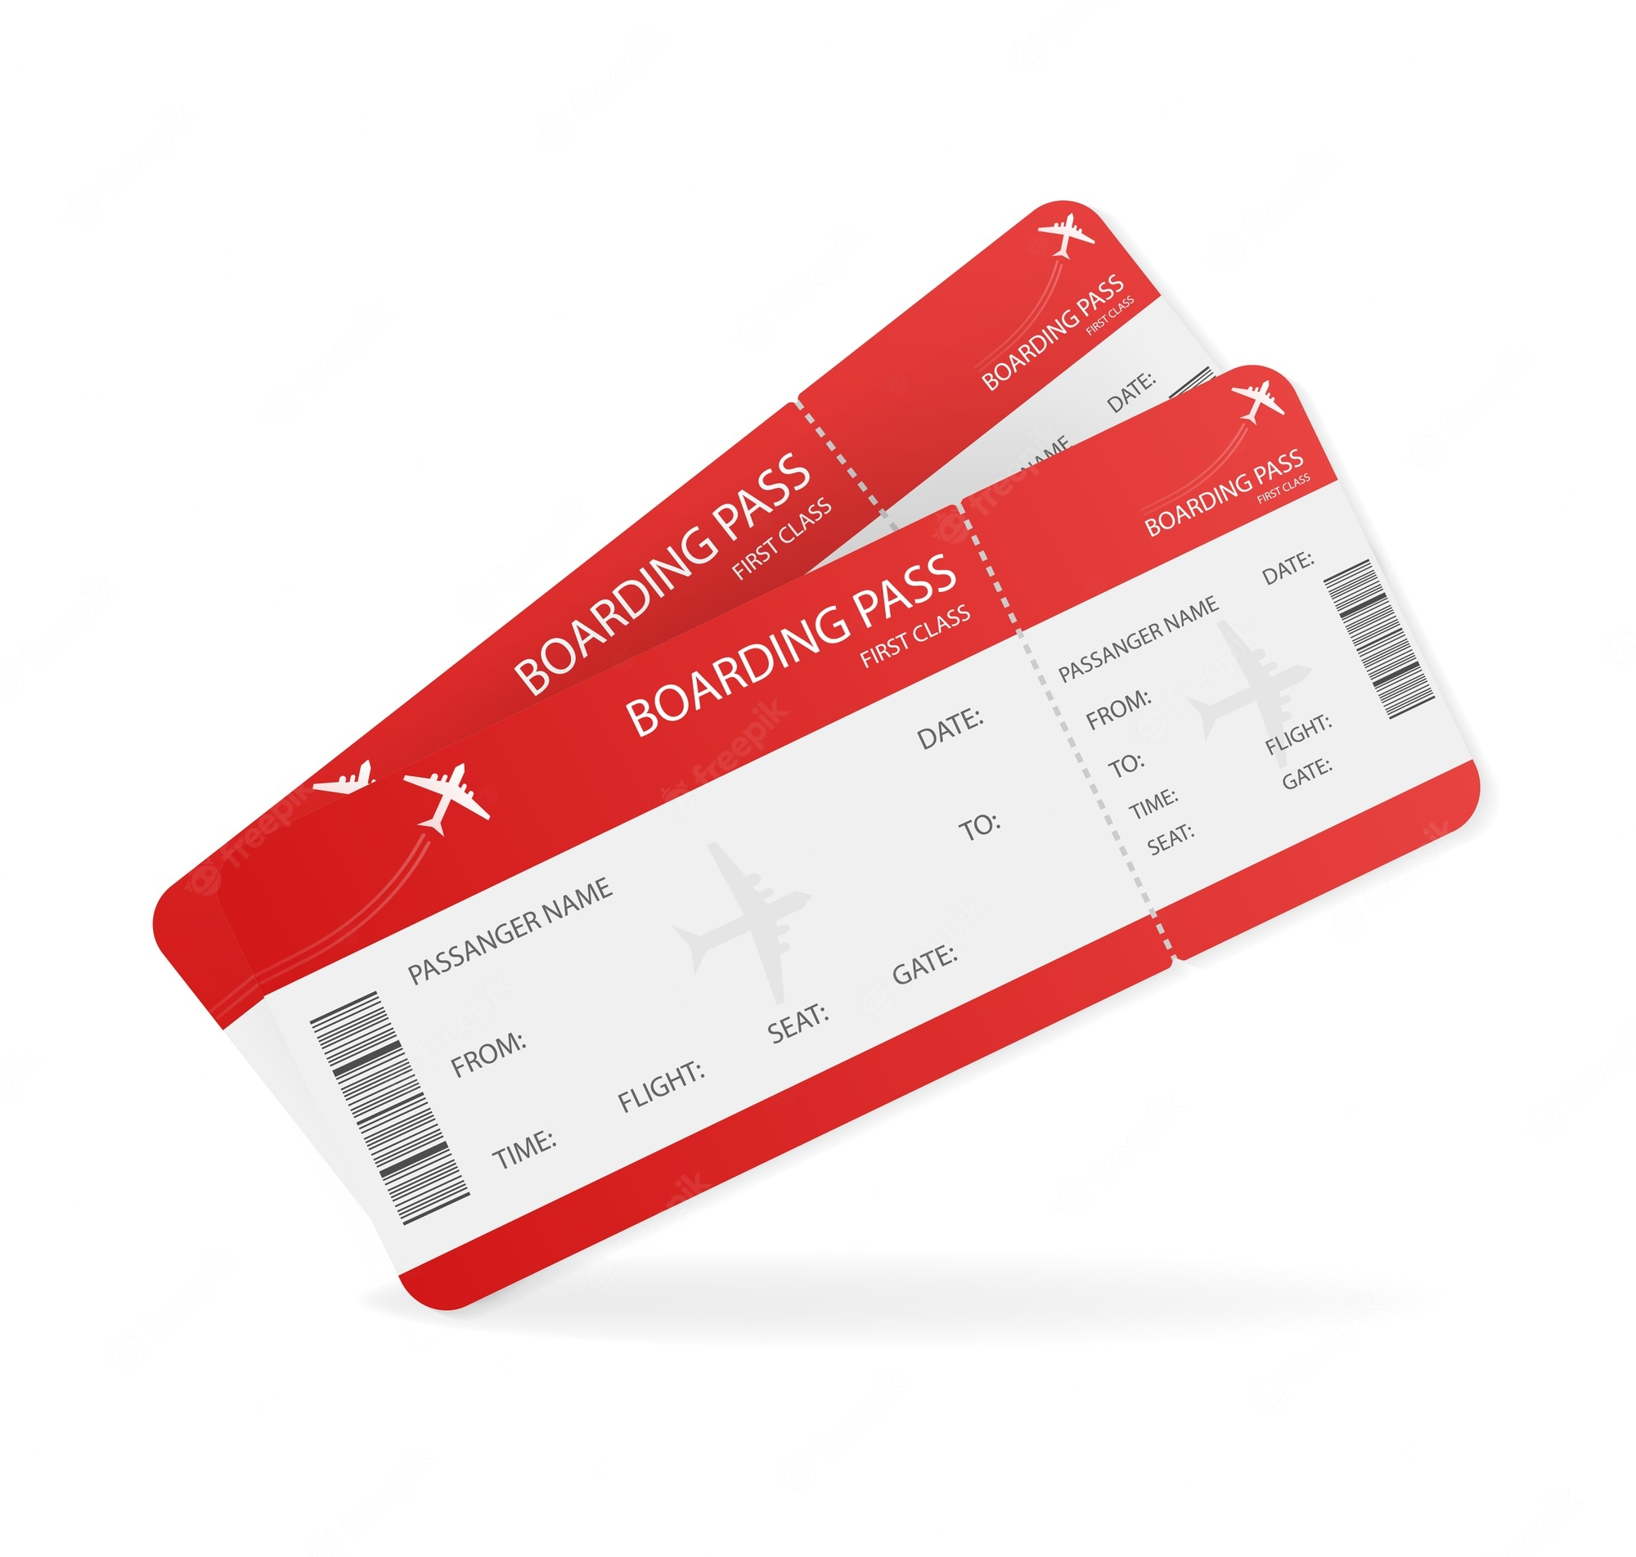
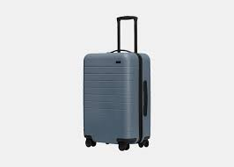



Analogy
Transaction
Driver Worktags
Optional Worktags
Related Worktags
Notes:
Talking Points:
The flight or ticket represent a transaction
The airplane represents the driver worktag
The pilot, flight attendant(s), passengers and luggage represent related worktags
Use 'luggage' as the example where you have a related worktag, but you may change it from time to time when appropriate (e.g. carry-on, purse, backpack, etc.)
The refreshments offered represent ‘optional’ worktags (i.e. Activity) that may be included on a transaction

Slide 13
Account Posting Rule Set
Drives the posting to ledger accounts for completed operational transactions based on specific rules, for example:
  Spend
  Revenue
  Accounts Receivable
  Cash
Maps to a specific ledger account based on worktags and related attributes from the recorded transaction
Examples:
  Receivable ledger account may be derived by company, customer category, and/or revenue category
  Spend ledger account derived by spend category
Evaluation order is important because it will stop on the first condition that is true
Default ledger account can be provided in case detailed mapping not found
Transaction Worktag #1
Transaction Worktag #2
Account Posting Rule
Ledger Account

Slide 14
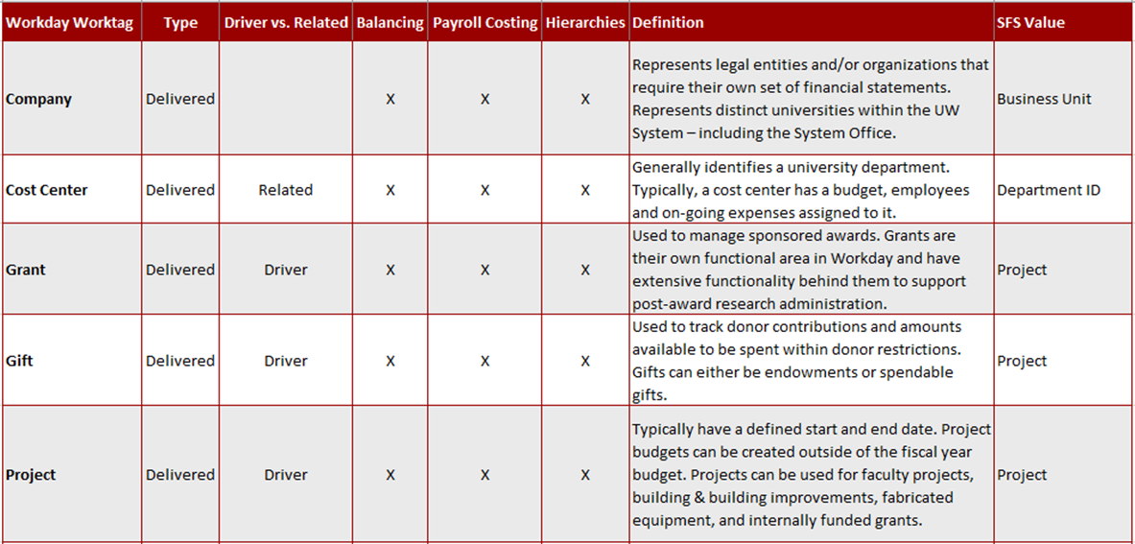
FDM Worktag Definitions
Notes:
Program – Balancing worktag

Slide 15
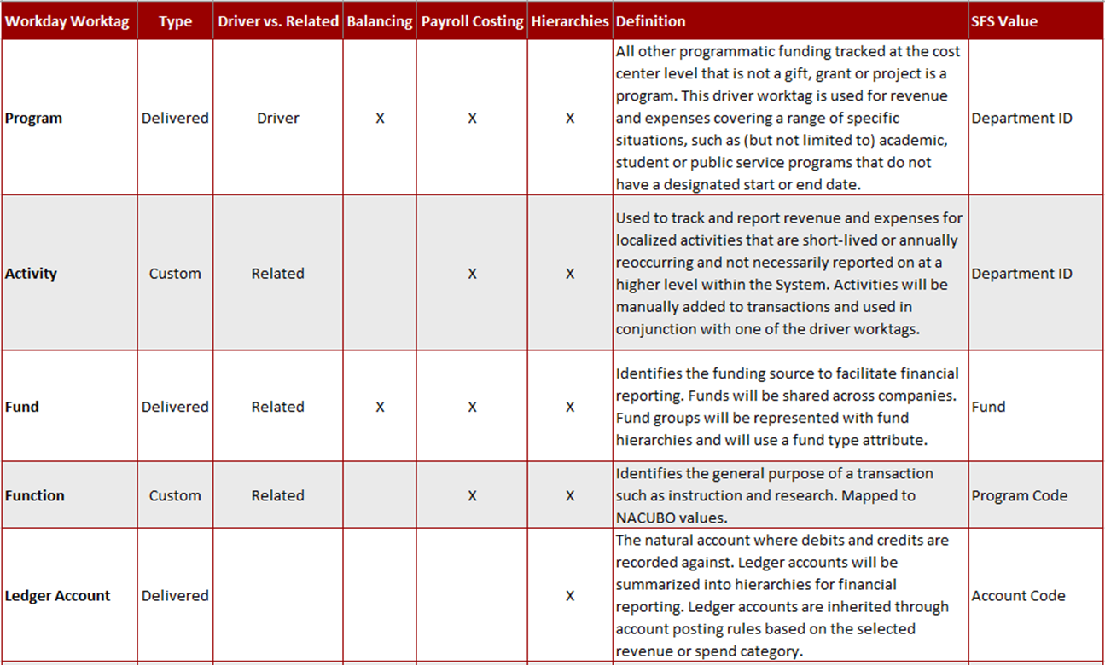
FDM Worktag Definitions

Slide 16
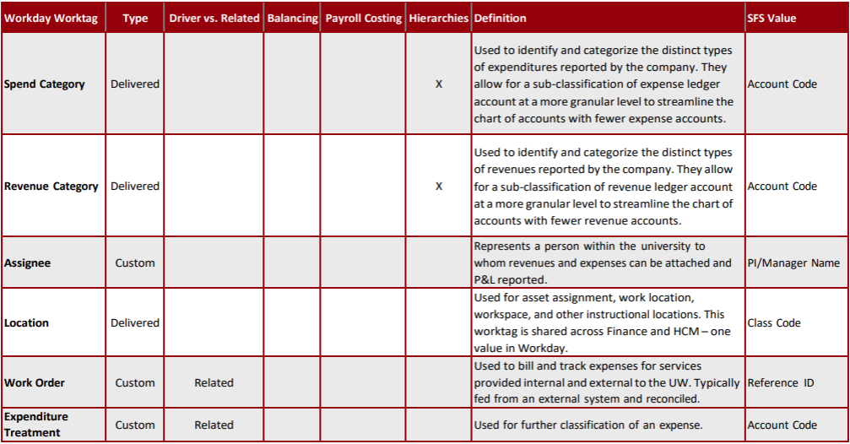
FDM Worktag Definitions
Notes:
Work Order – The main purpose of this worktag is to be able to integrate with Asset Works and get the work order number from Asset Works into Workday so the work order can then be referenced on any other related Procurement Documents (i.e., Requisition/Purchase Order/Supplier Invoice).

Slide 17
Transition to Workday Worktags –
Program Driver Example
Current Funding String
Fiscal Year
FY23
Fund
102
Business Unit
Department
260000
Program Code
0 – Student Services
Account
2626 – Services - Athletic Officials
UWOSH
Future Equivalent
Fiscal Year
FY23
Fund
FD0102 (TBD)
Company
UWOSH
Cost Center
CC000299 – UWOSH | Intercollegiate Athletics Operations
Program
PG000001696 – UWOSH Athletic Operations
Function
FN0000 – Student Services
Ledger Account
6006 – Professional Services
Spend Category
SC00056 – Athletic Officials – Services

Slide 18
Transition to Workday Worktags –
Project Driver Example
Current Funding String
Fiscal Year
FY23
Fund
131
Business Unit
UWLAC
Department
288897
Program Code
6 – Academic Support
Account
3730 –Memberships
Project
AAK2333 – Eagle Teach Excel Nicodermus
Future Equivalent
Fiscal Year
FY23
Fund
FD0131 (TBD)
Company
UWLAC
Cost Center
CC001080 – UWLAC | Archaeology and Anthropology
Function
FN0600 – Academic Support
Ledger Account
6014 – Subscriptions and Dues
Spend Category
SC00110 – Memberships and Dues
Project
PJ000000219 - Eagle Teach Excel Nicodermus

Slide 19
Transition to Workday Worktags –
Gift Driver Example
Current Funding String
Fiscal Year
FY23
Fund
233
Business Unit
UWRVF
Department
062100
Program Code
6 – Academic Support
Account
2893 – Event - Catering
Project
PRJ51NN - UWRF Foundation Support - Chemistry
Future Equivalent
Fiscal Year
FY23
Fund
FD0233 (TBD)
Company
UWRVF
Cost Center
CC001188 – UWRVF | Department of Chemistry and Biology
Function
FN0600 – Academic Support
Ledger Account
6026 – Events
Spend Category
SC00076 – Event Catering
Gift
GF000000013 - Chemistry and Biotechnology Foundation Gifts

Slide 20
Transition to Workday Worktags –
Grant Driver Example
Current Funding String
Fiscal Year
FY23
Fund
133
Business Unit
UWMSN
Department
480200
Program Code
4 – Research
Account
3105 Lab Supplies
Project
AAK9422
Future Equivalent
Fiscal Year
FY23
Fund
FD0133 (TBD)
Company
UWMSN
Cost Center
CC002819 – UWMSN | Letters and Sciences Administration
Function
FN0400 – Research
Ledger Account
6010 – Materials & Supplies
Spend Category
SC00083 – Lab Supplies
Grant
GR000019336 -Advisor Support Influences on Students of Color in Higher Education

Slide 21
How does this Compare to the PS Chart of Accounts?
Workday Worktag | Shared Financial System (SFS) Value
Company​ | Business Unit
Cost Center | Department ID
Grant | Project
Gift | Project
Project | Project
Program | Department ID
Activity | Department ID
Fund | Fund
Function | Program Code
Spend Category | Account Code
Revenue Category | Account Code
**Sample only, this is not an exhaustive list.
Notes:
Talking Points:
Benefit of FDM – when we look at Gift, Grants and Project Workday Worktags, they have individual identifiers compared to current state.
Important to note that this comparison between PS COA and FDM is the general case but there may be exceptions for some campuses.

Slide 22
FDM Mapping Tool

Slide 23
GL Conversion

Slide 24
GL Conversion: Summary
Workday Conversion is focused on data that is needed to operate the business when Workday is deployed in Production.
Two years of fiscal data (FY23, FY24) – Summarized by month
Inception through 6/30/22 revenue and expenses for converted grants and capital projects
Go-Live in 2024 will include ‘roll-forward’ of FY24 converted balances to establish FY25 beginning balances
  Reminder: final GL conversion steps will take place in PROD after 7/1/2024

Slide 25
GL Conversion Scope
Inception to 6/30/22 | 6/30/22 | FY23 | FY24 | FY25
Inception → 6/30/22 | 6/30/22 | 7/1/22 – 6/30/23 | 7/1/23 – 6/30/24 | 7/1/24 →
Grant Rev & Exp
1
Utilize roll-forward process to create FY25 beginning balances
Monthly Journals (by driver worktag, fund, rev/spend cat, CC, function). Balance Sheet and Income Statement Accounts
Cap Project Rev & Exp
2
4
For converted Grants & and Capital Projects. Inception through 6/30/22 revenue and expense balances (summarized by spend cat/object class, revenue, CC, Fund & function).
Balances as of 6/30/22 only. No Detail.
Monthly Summarized Journals
3
Ending balances from 6/30/22 converted & utilize roll-forward process to create FY23 beginning balances
Production
5
Ending balances from 6/30/23 converted & utilize roll-forward process to create FY24 beginning balances
6
Monthly Summarized Journals
Monthly Journals (by driver worktag, fund, rev/spend cat, CC, function). Balance Sheet and Income Statement Accounts

Slide 26
Next Steps

Slide 27
Next Steps
Validate ledger accounts, spend & revenue categories
Complete ledger account summaries
Evaluate Fund worktag and develop appropriate Fund hierarchies
Review & validate data in End-to-End Testing tenant
Finalize FDM Mapping Tool and develop procedures for utilizing tool
Continue mapping FY23 Q3 data and beyond
Load transactional data summarized by month and reconcile
Implement approved FDM Governance model for during and post implementation

Slide 28
Resources

Slide 29
Resources
ATP Resources Center
  FDM Mapping Dashboard
  Workday Worktags Quick Reference Guide
  Ledger Accounts, Spend & Revenue Categories
FDM Customer Confirmation Session
  Finance CCS Resources
FDM Readiness Workshop
  Workday Walkthroughs

Slide 30
Questions?

Slide 31
Worktag Balancing
Ledgers can be balanced by one or more worktags
Company is always balanced
Primary balancing worktag: one can be configured
  Fund is the primary balancing worktag
  Must be present on all transactions
Optional balancing worktags: up to five can be configured
  Not required on each transaction, but when present – the transaction will balance by given worktag
  Currently Configured: Cost Center, Grant, Gift, Project, and Program
Balancing worktags will generally inherit to offsetting entries

Slide 32
Company & Company Hierarchies
Company
Company Hierarchies
  Legal Entity, usually one company per Tax ID
  Used for Financials reports and transactions
  Payroll aggregates and reports by company
  Can be defaulted from supervisory org
  Financial Business Processes can be defined by company
  Drives Security and Workflow
  Represents how companies are rolled up (included) hierarchically for security and consolidated reporting
  Not directly assigned to transactions or workers; derived based on company assignment
UWSYS
UWSUP
UWPKS
UWMSN
UWEAU
Notes:
A Company is an organization type that represents a legal entity from a financial perspective and equates to a single tax ID within a customer’s enterprise
Every worker is assigned to a Company for payroll processing
Every financial transaction is assigned to a company, and most reports are run in the context of a company, such as balance sheets and income statements.
Also, Workday Financial Management's configurable business processes are based on companies (with the exception of the expense reports business process).
Company hierarchies represent roll-ups of companies. In Workday Financials, company hierarchies are used for consolidated reporting. In addition, bank accounts can be associated to either a company or a company hierarchy which allows bank accounts to be shared across companies and for bank settlements to be run for multiple companies.

Slide 33
Cost Center & Cost Center Hierarchies
Cost Center
Cost Center Hierarchies
  Often represent department codes
  Tied to a Budget, People, Budget Manager
  Track financial transactions like supplier invoices, expense reports
  Can default from the supervisory organization
  Can be restricted to specific companies
  Drives Security and Workflow
  Represents how cost centers are rolled up (included) hierarchically for security and reporting purposes
  NOT assigned to transactions or workers
  Cost center can be in multiple cost center hierarchies, but only once per top level
Cost Center Hierarchy
Division 1
Division 2
Cost Center 1-1
Cost Center 1-2
Cost Center 2-1
Cost Center 2-2

