Slide 1
Navigating Conference Travel
January 13, 2025

Slide 2


Presenter: Emily Stoffel
Regional Travel Manager
Emily.Stoffel@wisconsin.edu
Topics:
High Level Policy
Trip Simulator
Expense Report
Resources

Slide 3
The presentation will be recorded and posted on SharePoint.
Questions and participation are absolutely encouraged and welcome!!
Please raise your hand if you are in-person. Those folks online, feel free to type in the chat, or raise your hand and we will unmute you.
Housekeeping

Slide 4
Content of this presentation is meant to be referenced through June 30, 2025.
Be on the look out for trainings and info sessions as July gets closer.
Workday is coming July 1, 2025

Slide 5
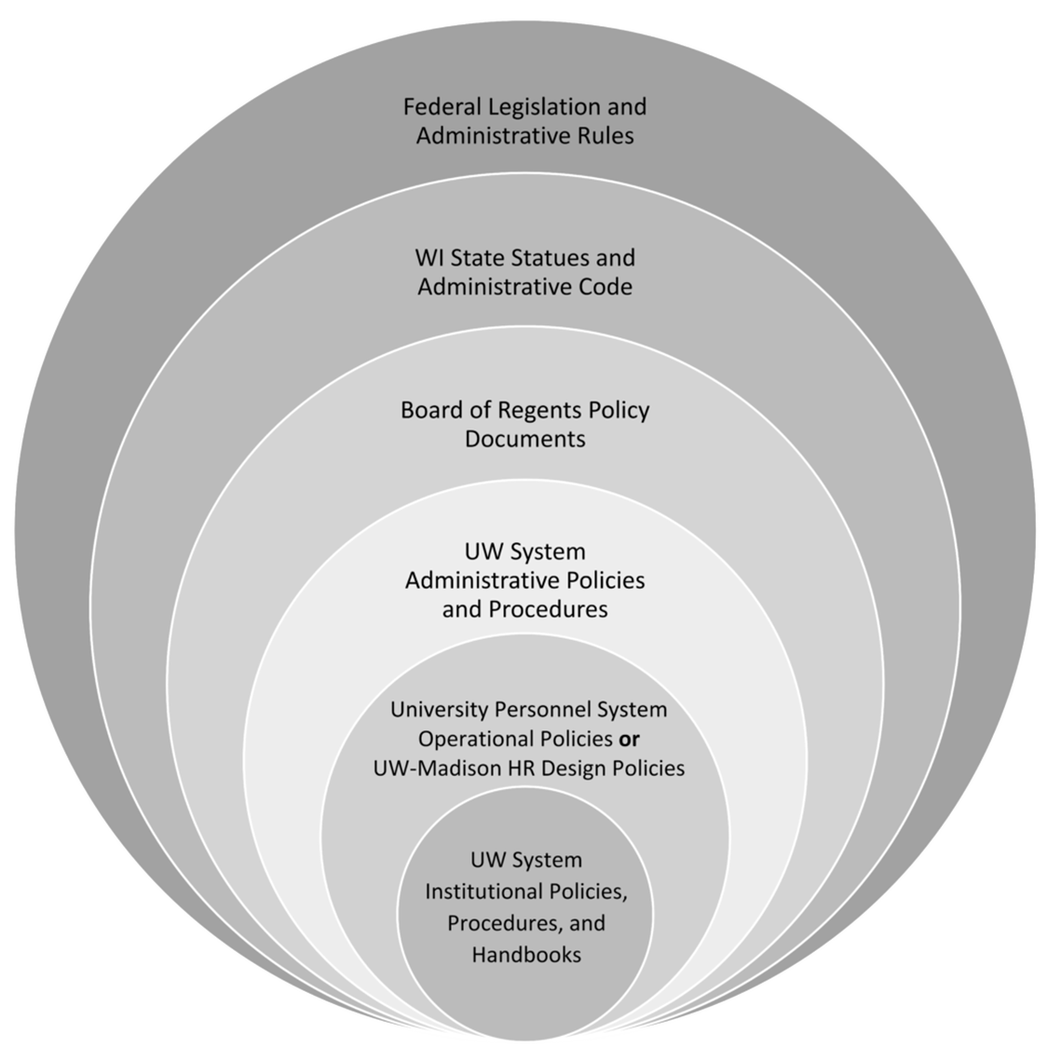
The more restrictive policy takes precedence
Always check with your supervisor/dept for specific travel policies

Slide 6
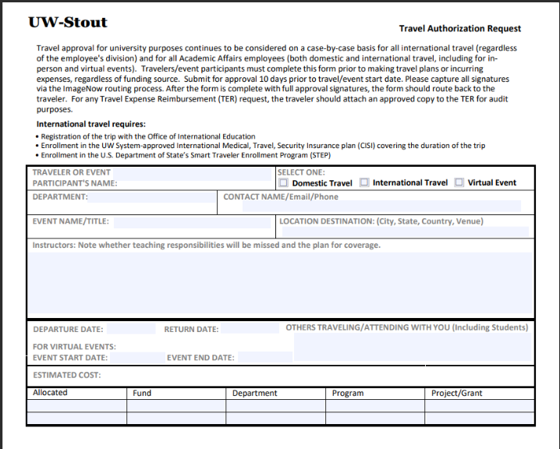
Travel Authorizations required for:
All international travel
All Academic Affairs employees’ domestic travel
All Academic Affairs employees attending virtual events even if no costs are incurred

Slide 7
Paying for Travel
Personal Funds
Corporate Cards
Personal funds may always be used to pay for travel
Reimbursement is done through e-reimbursement
Travel may NEVER be paid with P-Cards (except registration fees)
University issued personal liability credit card only for travel = cardholder’s responsibility to pay
Card must be paid in 60 days or late fees are assessed (cardholder’s responsibility to pay)
Card is paid using personal funds or e-re

Slide 8




Travel Agencies
Most university travel MUST be booked using the approved travel agency
Fox World Travel = individual travel
Concur = online booking tool
Recommend ALL employees have Concur profile (required to book in Concur or with Fox)
Fox World Travel = group travel (10 or more tickets)
Shorts Travel = athletics
Fox World Portal = invoices and forms

Slide 9

Airfare
Must ALWAYS be booked with travel agency or in Concur
CANNOT be booked on third party website (Expedia, Travelocity, etc.) or direct with airlines
Baggage fees require receipts $30+
Seat assignment fees are allowed but cannot be for cabin upgrades/class change
Lowest logical airfare = +$150 lowest airfare within an hour of desired schedule

Slide 10

Lodging
Reimbursement is allowed up to maximum nightly rate for location
  Per Diem Calculator shows rates
  If city is not listed, use county
  Exceptions:
    Designated conference hotels
    Overaged due to taxes and fees (not applicable in WI)
    No hotels available under max rate (proof required)
Can book in Concur, with travel agency, or direct with hotel
Tax Exemption
  Always tax exempt in WI
  Other states have some tax exemption.
  Check TravelWIse for list
NEVER book with a third party site (booking.com, Expedia, etc.)… you will NOT be reimbursed & BEWARE OF SCAMS

Slide 11




Ground Transport
Fleet Vehicles
103 General Services Building
715-232-2200
vehiclef@uwstout.edu
Driver Authorizations
Required for all drivers on university business
Must be completed prior to travel
Required for rental vehicles, personal vehicles, fleet vehicles
Options
Rental vehicles
Fleet vehicles
Personal vehicles
Safety & Risk Management
715-232-1793

Slide 12



Rental Vehicles
Must utilize Enterprise/National or Hertz contracts
Use rentals when it is the most cost-effective means of transport
Rent Compact/Standard/Intermediate vehicle classes
Book with Concur or through booking Portal
Gas receipts are required
Drivers must refuel prior to return
Do NOT take any add-on services
Personal booking: 5-10% off retail
Our Big10 Contract was updated 09/2023. Please ensure you have the latest rates and contract informationr c

Slide 13

Personal Vehicles
Fleet Vehicles
Fleet vehicles are encouraged for all students and employees
Managed by Facilities Management
Not entered into reimbursement system
Mileage is entered into reimbursement system at Standard or Turndown rate
MapQuest or Google Maps are used to determine direct route
Only mileage is reimbursable
Turndown Rate: $0.45/mile
Reimbursement rate for use of personal vehicle when:
  Trips over 100 miles per day and fleet vehicles are available
Standard Rate: $0.70/mile
Reimbursement rate for use of personal vehicle when:
  Trips under 100 miles per day or;
  Parking at airport or terminal for more than 2 days or;
  Fleet Vehicle Non-Availability slip obtained

Slide 14

Meal and Incidental Per Diem
Per Diem rates
  Reimbursement paid directly to the employee AFTER travel
  Vary based on location and number of meals needed
  Day Trip - $15 taxable
Incidentals - $5
Not recommended to pay for meals with Corporate (travel) card; but, if you do, make sure to pay these card charges with personal funds
No receipts required for per diem
Per Diem Calculator

Slide 15

Combining Personal & Business
Must still follow UW policy for business related travel
  Lodging for business dates must be under nightly max or at conference hotel
  Airfare must be booked with Fox or in Concur
  Business date rentals must be with National/Enterprise or Hertz (can use contract for all dates, but only expense business dates)
Cost comparisons required for airfare when:
  Indirect routing or extra stops for personal reasons;
  Stopovers that result in a hotel stay for more than one night;
  Using transportation methods that are not the most efficient or cost-effective (i.e., electing to drive/take a train versus fly when flying would be the most efficient and cost-effective option); or
  Departing from/returning to an airport outside of Wisconsin or more than 100 miles from the Wisconsin border for personal reasons (including departing from/returning to a voluntary remote work location).
Watch how you pay for things. Personal travel should not be put on Pcards; may need to personally pay corporate cards

Slide 16

September 15th, 2024
I want to attend the TRAVL Conference in Denver on January 5-10, 2025.
To Do:
Verify it is okay with my supervisor
Confirm funding string
Do I need any special forms completed before I register?
Complete a Driver Authorization & Register for Concur

Slide 17
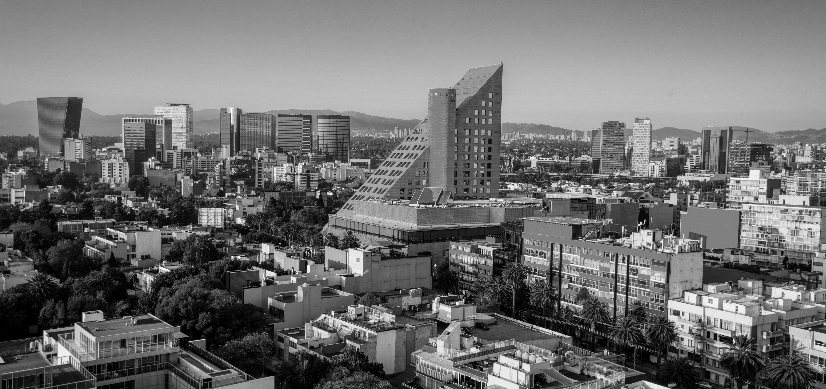


Time to Register!
2025 TRAVL Conference Registration
2025 TRAVL Conference
Denver, CO
Jan 5-10, 2025
September 17th, 2024
Attendee Information
First Name Last Name
Email
Telephone Number
Mailing Address
Dietary Restrictions:
Billing Information
Name on Card
Card Number
Expiration CVV
Billing Address
To Do:
Visit the conference site to register
Confirm pricing hasn’t changed
Pay with personal funds, corporate card, or PCard
Hotel
Conference Room Block available at Interlocken Resort. Use the link below to book. Rooms fill up fast. Book your room today!
Rates available Jan 4-11
Early bird rate (book before Oct 1): $275/night
After Oct 1: $350/night
Registration
Before October 1, 2024: $600
After October 1, 2024: $900
Can use:
Pcard,
Personal funds
Corporate card
to pay for registration
Use University information when possible
Register Here
Agenda
Summarized Agenda click here
Full Agenda click here
Register $600
Book Now!

Slide 18
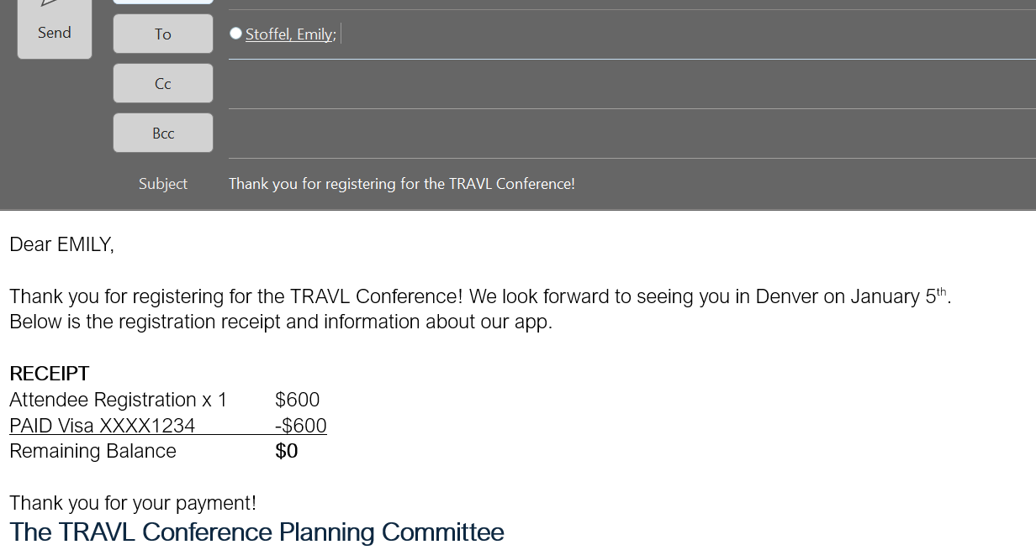
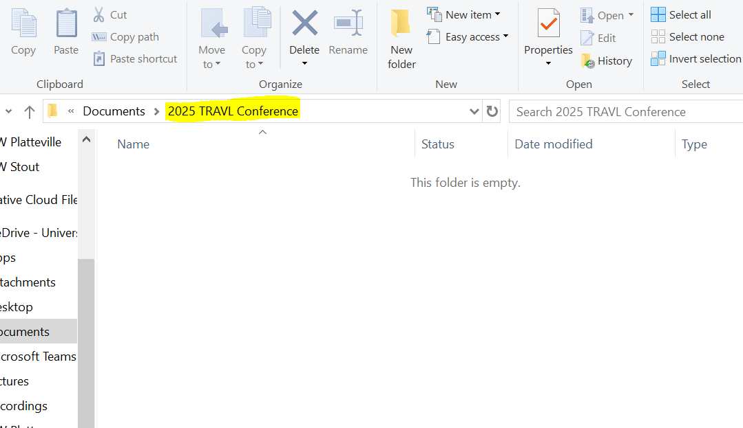
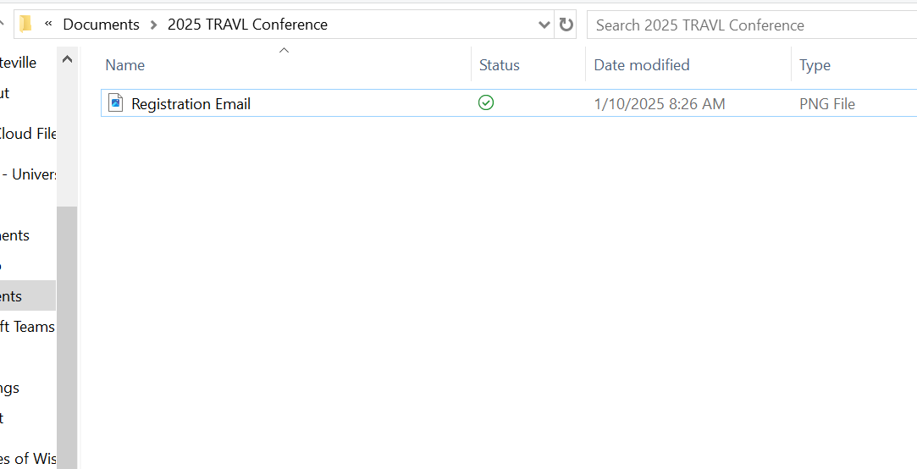
SAVING…

Slide 19
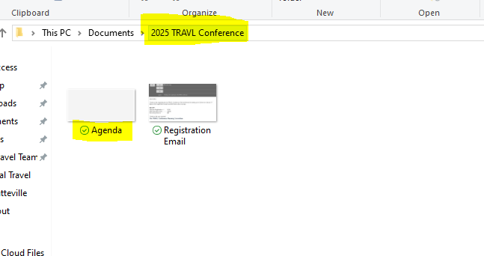
2025 TRAVL Conference Agenda
Saving…
September 20th, 2024
Jan. 5th – Day 1
12p-4p Registration & Check In
6p Welcome Reception
Jan. 8th – Day 4
7a-9a Breakfast
9:30a-11a Session 3
11:30a-1p Lunch
1:30p-3p Vendor Fair
3:30-4:30 Workshop 3
Dinner on your own
Jan. 10th – Day 6
7a-9a Breakfast
9:30-2 Member Only Sessions
It’s time to book flights!!
Jan. 6th – Day 2
7a-9a Breakfast
9:30a-11a Session 1
11:30a-1p Lunch
1:30p-3p Vendor Fair
3:30-4:30 Workshop 1
Dinner on your own
To Do:
Look at agenda to determine flight times
Access Concur
Book flights
Review and save invoice
Jan. 9th – Day 5
7a-9a Breakfast
9:30a-11a Session 4
11:30a-1p Lunch
1:30p-3p Vendor Fair
3:30-4:30 Workshop 4
5:30-10 Dinner/Closing Reception
Jan. 7th – Day 3
7a-9a Breakfast
9:30a-11a Session 2
11:30a-1p Lunch
1:30p-3p Vendor Fair
3:30-4:30 Workshop 2
Dinner on your own

Slide 20
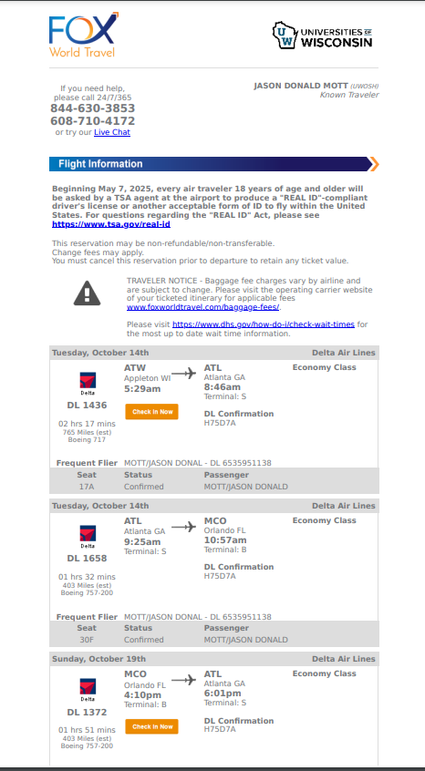
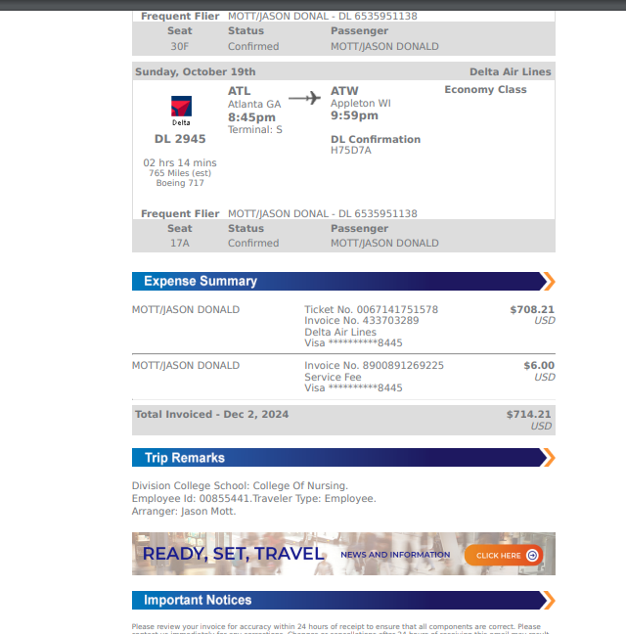

Slide 21
September 25th, 2024
Time to book the hotel.
To Do:
Verify max rate in the per diem calculator
Book hotel directly through conference booking link
Utilize Corporate Card or personal funds to make the reservation

Slide 22
September 25th, 2024
Complete first expense report.
To Do:
Registration Fee $600
Airfare $708.21
Concur Fee $6.00

Slide 23
January 4th, 2025
Leaving for trip tomorrow
To Do:
Check in with airline app/online
Ensure I have all my travel documents

Slide 24
January 5th, 2025
Time to leave!
To Do:
Drive to MSP and park at airport
Check a bag and pay for that (need receipt)
Take an Uber from airport to hotel ($45 need receipt)
Check into conference and hotel

Slide 25
January 10th, 2025
Time to go home!
To Do:
Check out and pay for hotel ($1375)
Take an Uber from airport to hotel ($45 need receipt)
Check a bag and pay for that (need receipt)
Pay for airport parking ($120 need receipt)
Drive home

Slide 26
January 15th, 2025
Complete final expense report
Expenses
Hotel ($1375)
Uber ($45 x 2)
Baggage ($35 x 2)
Parking ($120)
Mileage x 2
Meal & Incidental Meal Per Diems (Jan 5-10)

Slide 27
Resources
UW Stout Sharepoint
UW System TravelWIse
Per Diem Calculator
Travel Manager Emily Stoffel
Emily.Stoffel@wisconsin.edu
608-263-1040
New Employee Checklist
Sign up for a Concur account
Apply for a Corporate card is desired
Complete a driver authorization

