Slide 1
Workday Expenses FAQ’s and common Errors
September 24, 2026

Slide 2
Uw travel team and West introductions
Elizabeth Dressel
Director of Travel Management Services. Supporting UWSA while Alma is on leave through April 2027
Alma Ramirez
Regional Travel Manager Supporting UW-Whitewater, UW-River Falls, & UWSA on leave through April of 2027
Alyssa Totoraitis
Regional Travel Manager Supporting UW-Milwaukee & UW-Parkside
Tina Chorlton
Regional Travel Manager Supporting UW-Platteville and UW-Whitewater and UW-River Falls through April of 2027
Emily Stoffel
Regional Travel Manager Supporting UW-Eau Claire, UW-La Crosse, & UW-Stout
We are joined today with the WEST Expense Operation team member Graig Brooks
Notes:
Tina

Slide 3
UW Credit CardS
Every UW Credit Card transaction must be reconciled – even if you are not asking for reimbursement or have paid US Bank directly
Apply for UW Credit Cards in Workday
Training is required prior to the cards being issued, and the training is in Workday
  Students not allowed to have UW Card
Request changes (limits, name changes, cancelations) for Pcards in Workday
Requests for changed to Shared Liability card limits submit a GetHelpUW ticket Get Help | Workday
Links to KBs on Workday UW System Workday KnowledgeBase

Slide 4
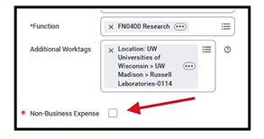
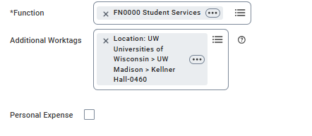
Personal checkbox Likely to change to Non-Business expense
Currently, each Expense Item has a “Personal Expense” checkbox at the bottom of the left side
We expect that label change to “Non-Business Expense” fairly soon

Slide 5
Expenses FAQ
Q. What are the Receipt Requirements?
UW Purchase Card always requires receipts (even for a $2 item or a credit)
UW Shared Liability card or anything paid on a personal credit card or cash – anything over $50

Slide 6
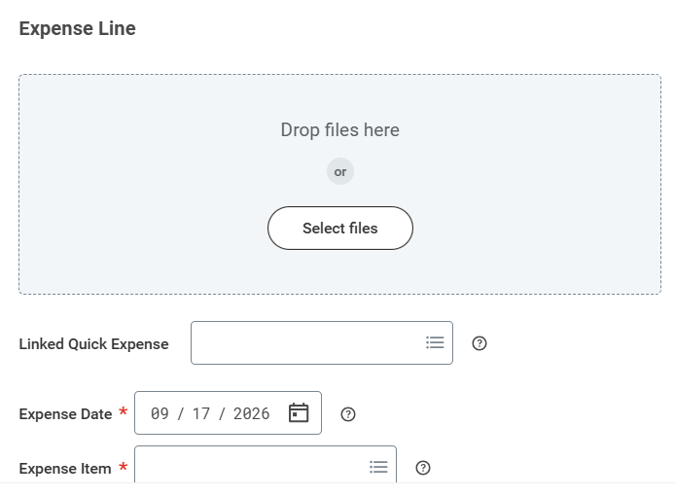
Expenses FAQ
Q. How do I add an Attachment?
When starting a new expense report if you have any “Quick Expenses” you entered/scanned (screenshot next slide)
At the top of the Expense Lines screen (screenshot)
Each Expense Line will be checked to see if an receipt is needed (over $50 or Pcard) and you will get a warning if it is not attached at Expense Line level
You can also add to “Attachments” tab (next slide screenshot)
Attach more information – all conference materials, schedules, event information

Slide 7
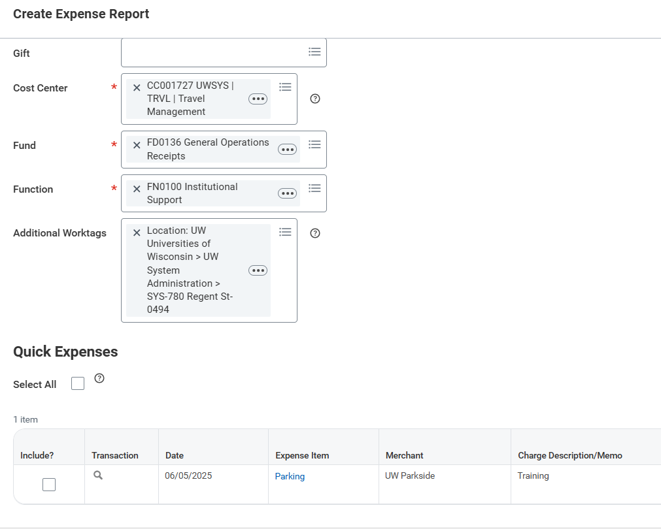
Screenshots
Quick Expenses on bottom when you Create Expense Report

Slide 8
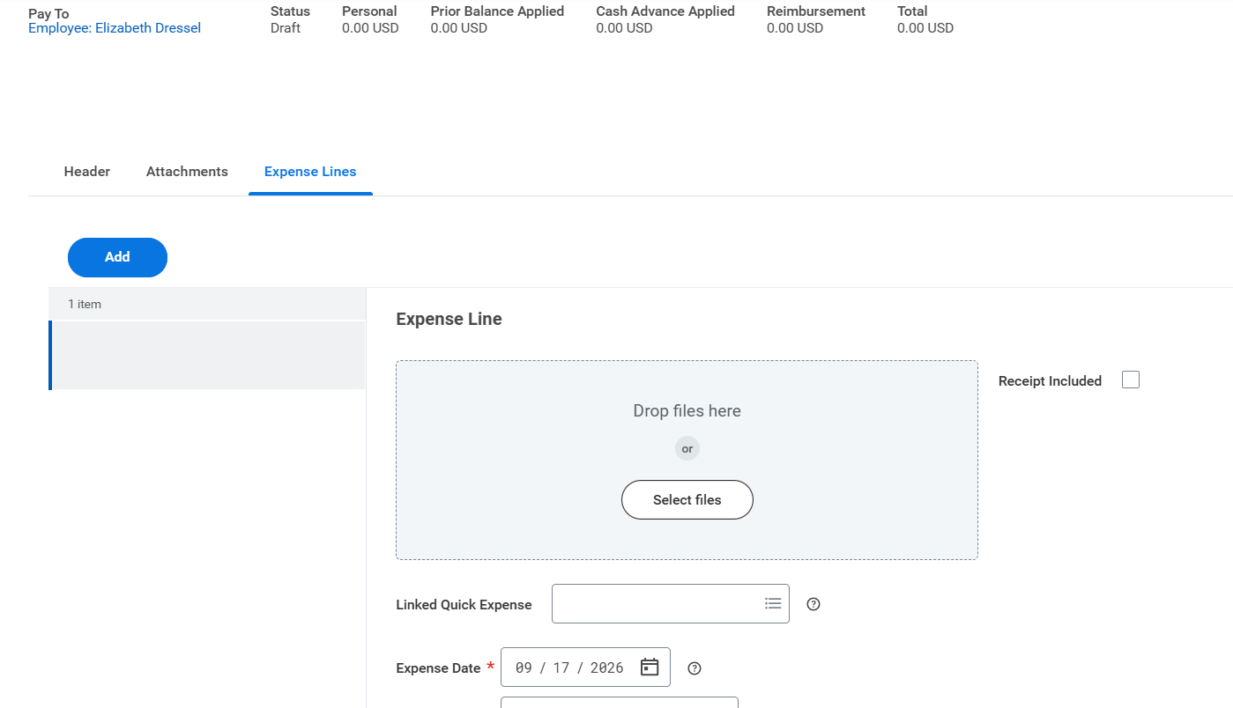
Screenshots
Add Attachments on Expense Line is preferred

Slide 9
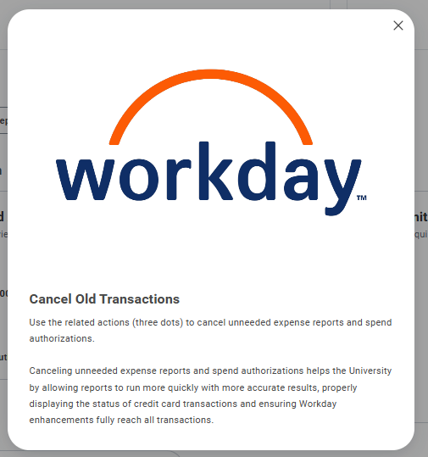
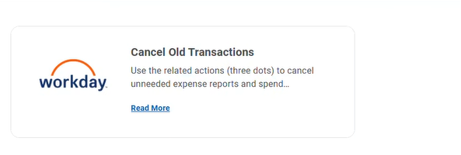
Expenses FAQ
Q. What does “Cancel Old Transactions” do?

Slide 10
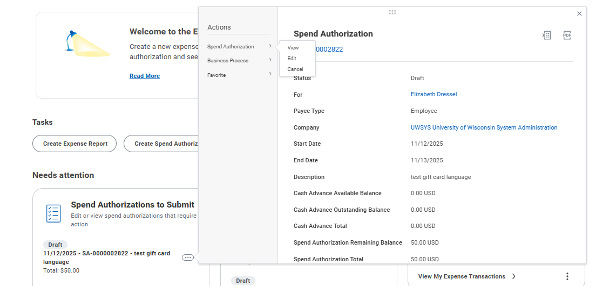
Expenses FAQ

Slide 11
Itemizations and Foundation Expenses
Some common Expense Items that need itemization:
  Lodging (may need to separate out parking and/or internet)
  Airfare from Travel Agency Service Fee
Any Expenses that are split funded (partial grant funded and program funded)
Foundation Expenses – vary by campus on additional pre-approval
  Travel (Foundation)
  Non-Travel (Foundation)
  Alcohol (Foundation)
  Meals-Hosted/Event Food and Drink Overage (Foundation)
  Other Business Meal/Event Expense (Foundation)

Slide 12
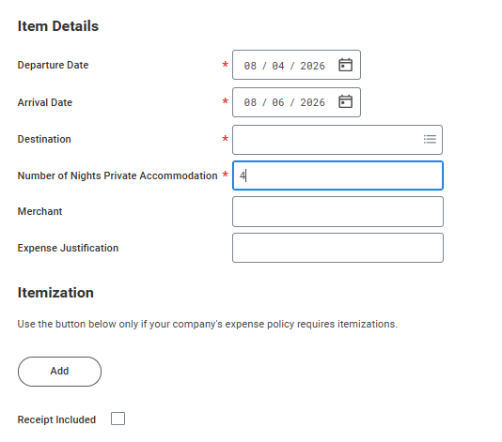
Common Errors and Reminders
Number of Nights Accommodation field for Lodging
Number of Nights Private Accommodation = nights x number of people in room
(Example 2 nights for 2 people = 4

Slide 13
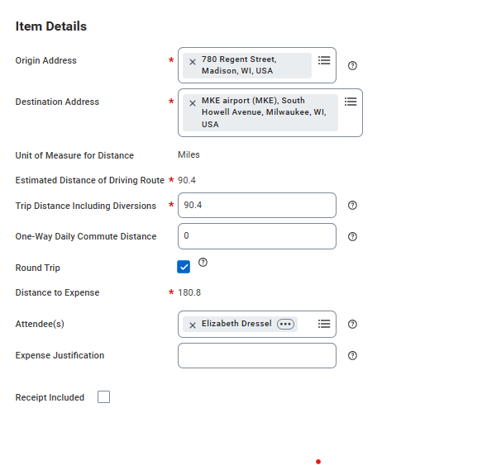
Common Errors and Reminders
Mileage Expense Item
Shortest distance, home vs headquarter city location unless traveling on a non scheduled work day (ex. Saturday or Sunday)

Slide 14
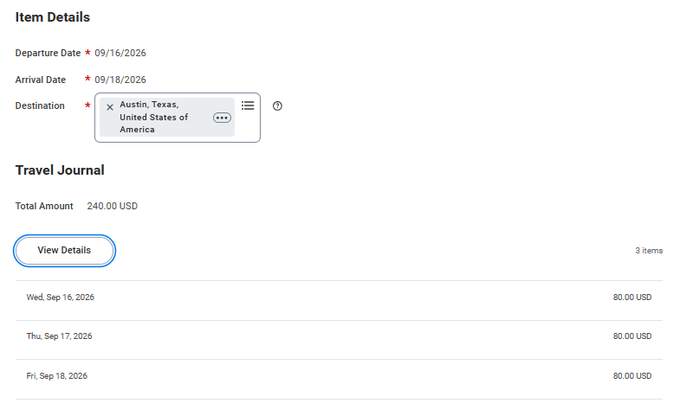
Common Errors and Reminders
Per Diem: Three Expense items
  Per Diem – Meals Reduction
    Can be used if you have an exact amount (say $100 in budget for meals for the trip)
    Enter Per Diem – Meals then enter the Per Diem – Meals Reduction Expense Item to get to the desired total
  Per Diem – Meals
    Once you Enter Departure and Arrival Date and Destination you need to click “View Details” to select provided meals and can change locations by day (screenshots next slide)
  Day Trip Meal Allowance
    No overnight and the $15 is taxed

Slide 15
Common Errors and Reminders
Per Diem: Three Expense items
  Per Diem – Meals Reduction
    Can be used if you have an exact amount (say $100 in budget for meals for the trip)
    Enter Per Diem – Meals then enter the Per Diem – Meals Reduction Expense Item to get to the desired total
  Per Diem – Meals
    Once you Enter Departure and Arrival Date and Destination you need to click “View Details” to select provided meals and can change locations by day (screenshots next slide)
  Day Trip Meal Allowance
    No overnight and the $15 is taxed

Slide 16
PER DIEM

Slide 17
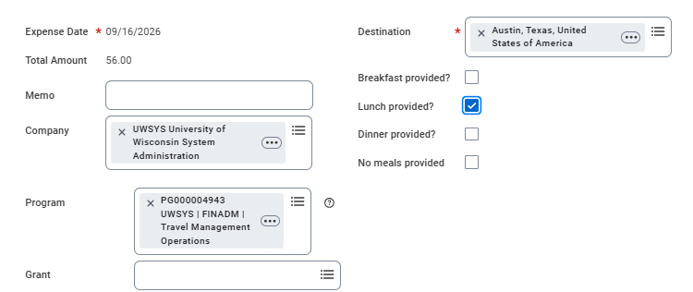
PER DIEM
Selected provided meals or “No meals provided” for each day
Can change Destination for each day of trip

Slide 18
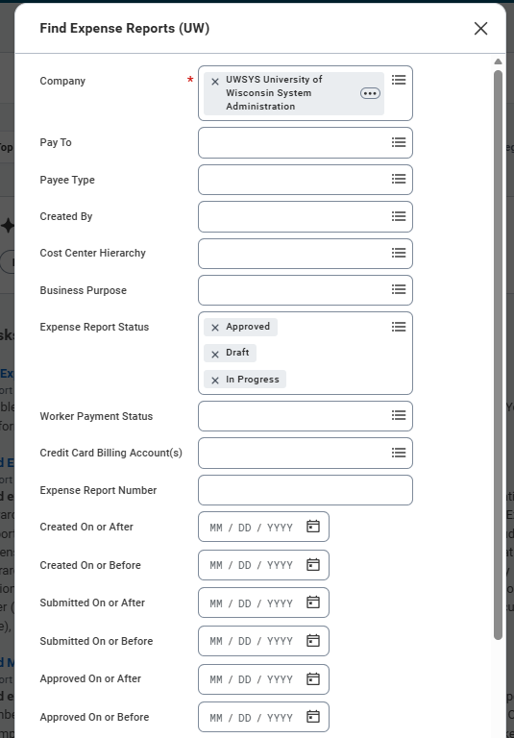
Common Errors and Reminders
Find Expense Reports for Others by
Using the “Find Expense Reports UW” report in Workday
Filter by Pay To, Created By, Expense Report Status

Slide 19
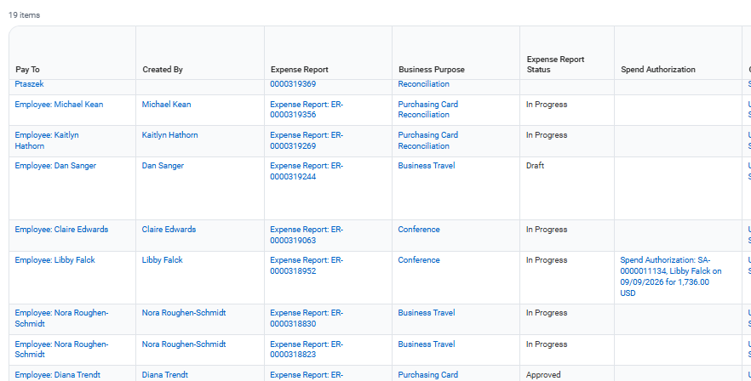
Next to the Expense Report Number hover to the right and you can see the Expense Report in a new tab

Slide 20
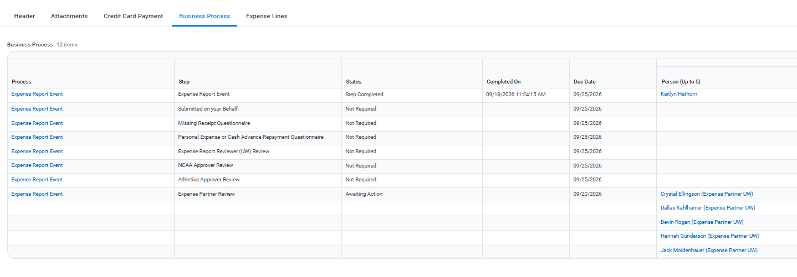
Click on Business Process tab to see who it is waiting on

Slide 21
Common Errors and Reminders
Look at the top bar while you are completing an ER
Cash advances applied, Company Paid will be all UW Credit Card Transitions, Personal will be total items marked “Personal Expense”

Slide 22
Common Errors and Reminders
Breaking out Expense Items:
  Agency Fee from Airfare
  Parking from Lodging
Selecting the correct Expense Item
  Lodging-Group
  Lodging-Student this must always be used for students, even for groups for Clery Act reporting
  Lodging-Individual

Slide 23
Common Errors and Reminders
Add Memo to all Expense Reports with a detailed description on reimbursement
Bad Example – Sheet music
Good Example – Purchased new sheet music for a class I teach in Music Theory/Fundamentals where students learn the basic alphabet of sheet music.
Include the who, what, where, when, why of the purchase. Describe to someone outside of the University why this was a necessary University expense.
You might want to explain situations that are somewhat unusual/exception:
Had 10 boxes of research equipment so had to drive.
Stayed at a friend's house so have no lodging included.

Slide 24
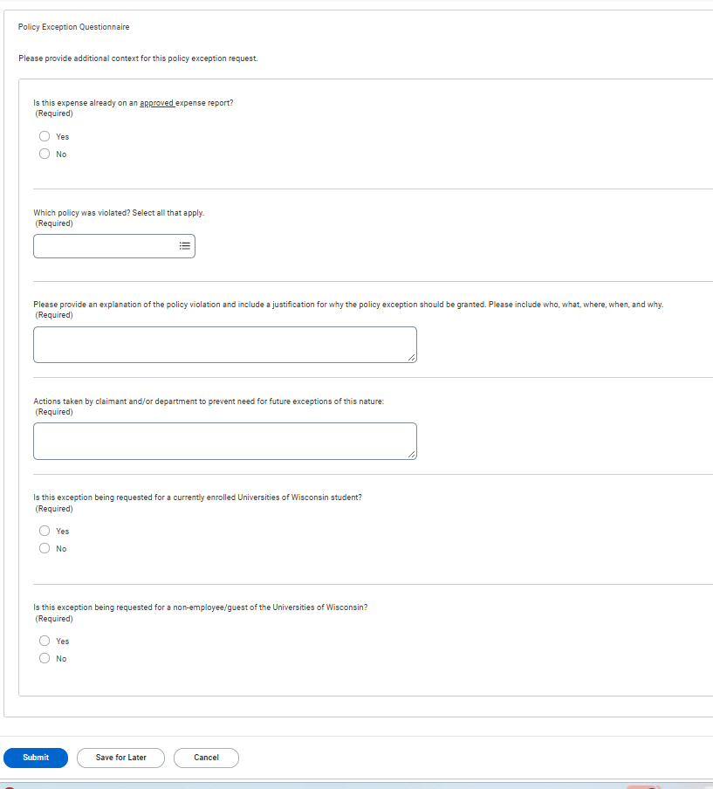
Business Purpose
Choosing Correct Business Purpose on Spend Authorizations – Example - Policy & 90 Day Exceptions for reports past the 90 Day.
You will have to complete questionnaire after you submit the Spend Authorization

Slide 25
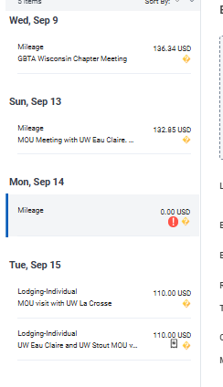
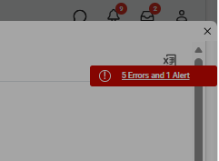
Common Errors and Reminders
How to read Alerts vs Error
Red Exclamation mark errors need to be fixed, Expense Items with yellow question mark are Alerts” which you should just review (potential duplicate, expense item is today’s date, Workday Manager is Cost Center Manager and Initiator or Subject
Will need to click on the top right to see the link with all the specific Errors and Alerts

Slide 26
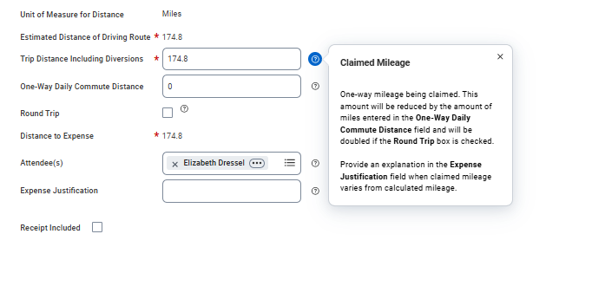
Common Errors and Reminders
Guidance bubbles – helpful to explain policy or give more details about how to complete properly

Slide 27
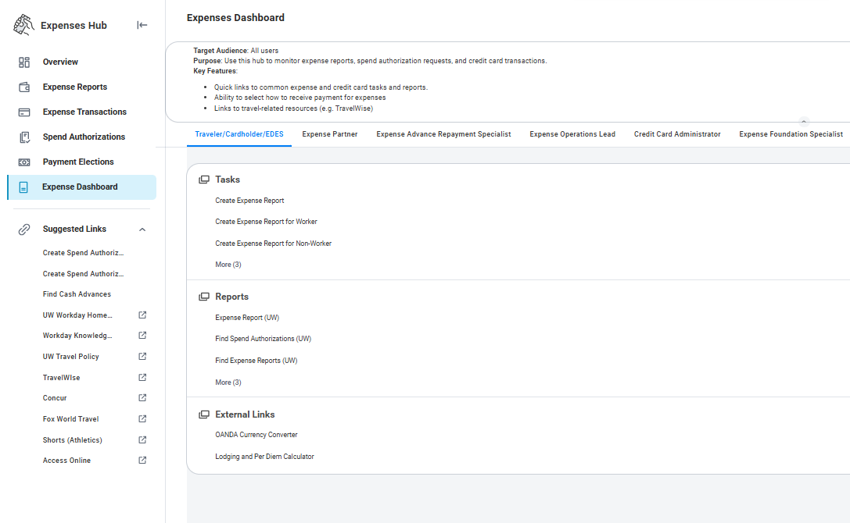
Common Errors and Reminders
Currency conversion for receipts in foreign currency – use OANDA Currency Converter

Slide 28
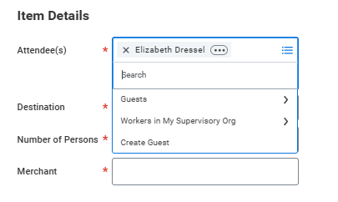
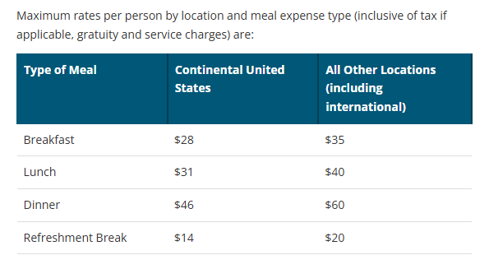
Common Errors and Reminders
Meals Hosted require attendee list
Will default to yourself as Attendee

Slide 29
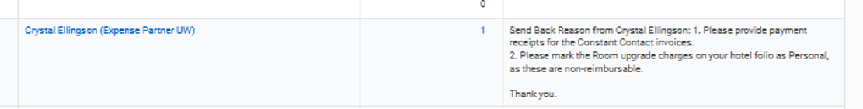
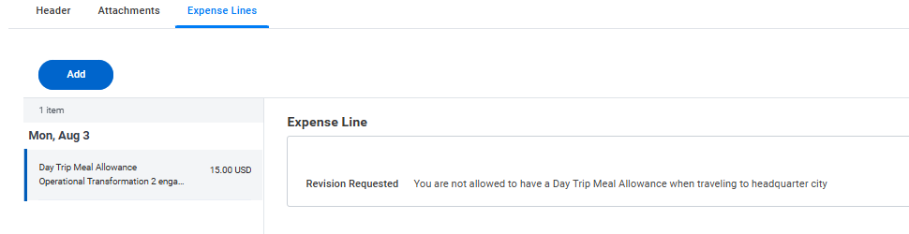
Common Errors and Reminders
Send back comments can be viewed in Business Process tab
If only an expense line was sent back, you have to go into the Expense Report, and go the Expense Lines to read comments

Slide 30
Common Errors and Reminders
EDES (Expense Data Entry Specialist) entering an expense report for themselves vs others
Registration fees has been a common expense item this happens with
Plan is to no longer allow the candidate and pre hire options later this fall
  this might not be approved, but is expected to be
All guests will have to be an Expense Committee Member (ECM)

Slide 31
Helpful links
Learning Course in Workday
UWS - Expense Reports in Workday - Workday
Workday KBs (Job Aid on how to do a task)
UW System Workday KnowledgeBase

Slide 32
Expense report approvals
UW Madison has made great progress. Links to find current estimated Expense Partner (Central Audit) turnaround time:
Centralized Audit of Expenses at UW–Madison – Division of Business Services – UW–Madison
All other campuses: Expense Report Status | Shared Services

Slide 33
Any Questions/comments?

