Slide 1
UW Travel Team presents:
Industry Updates & Policy review
September 24, 2026

Slide 2
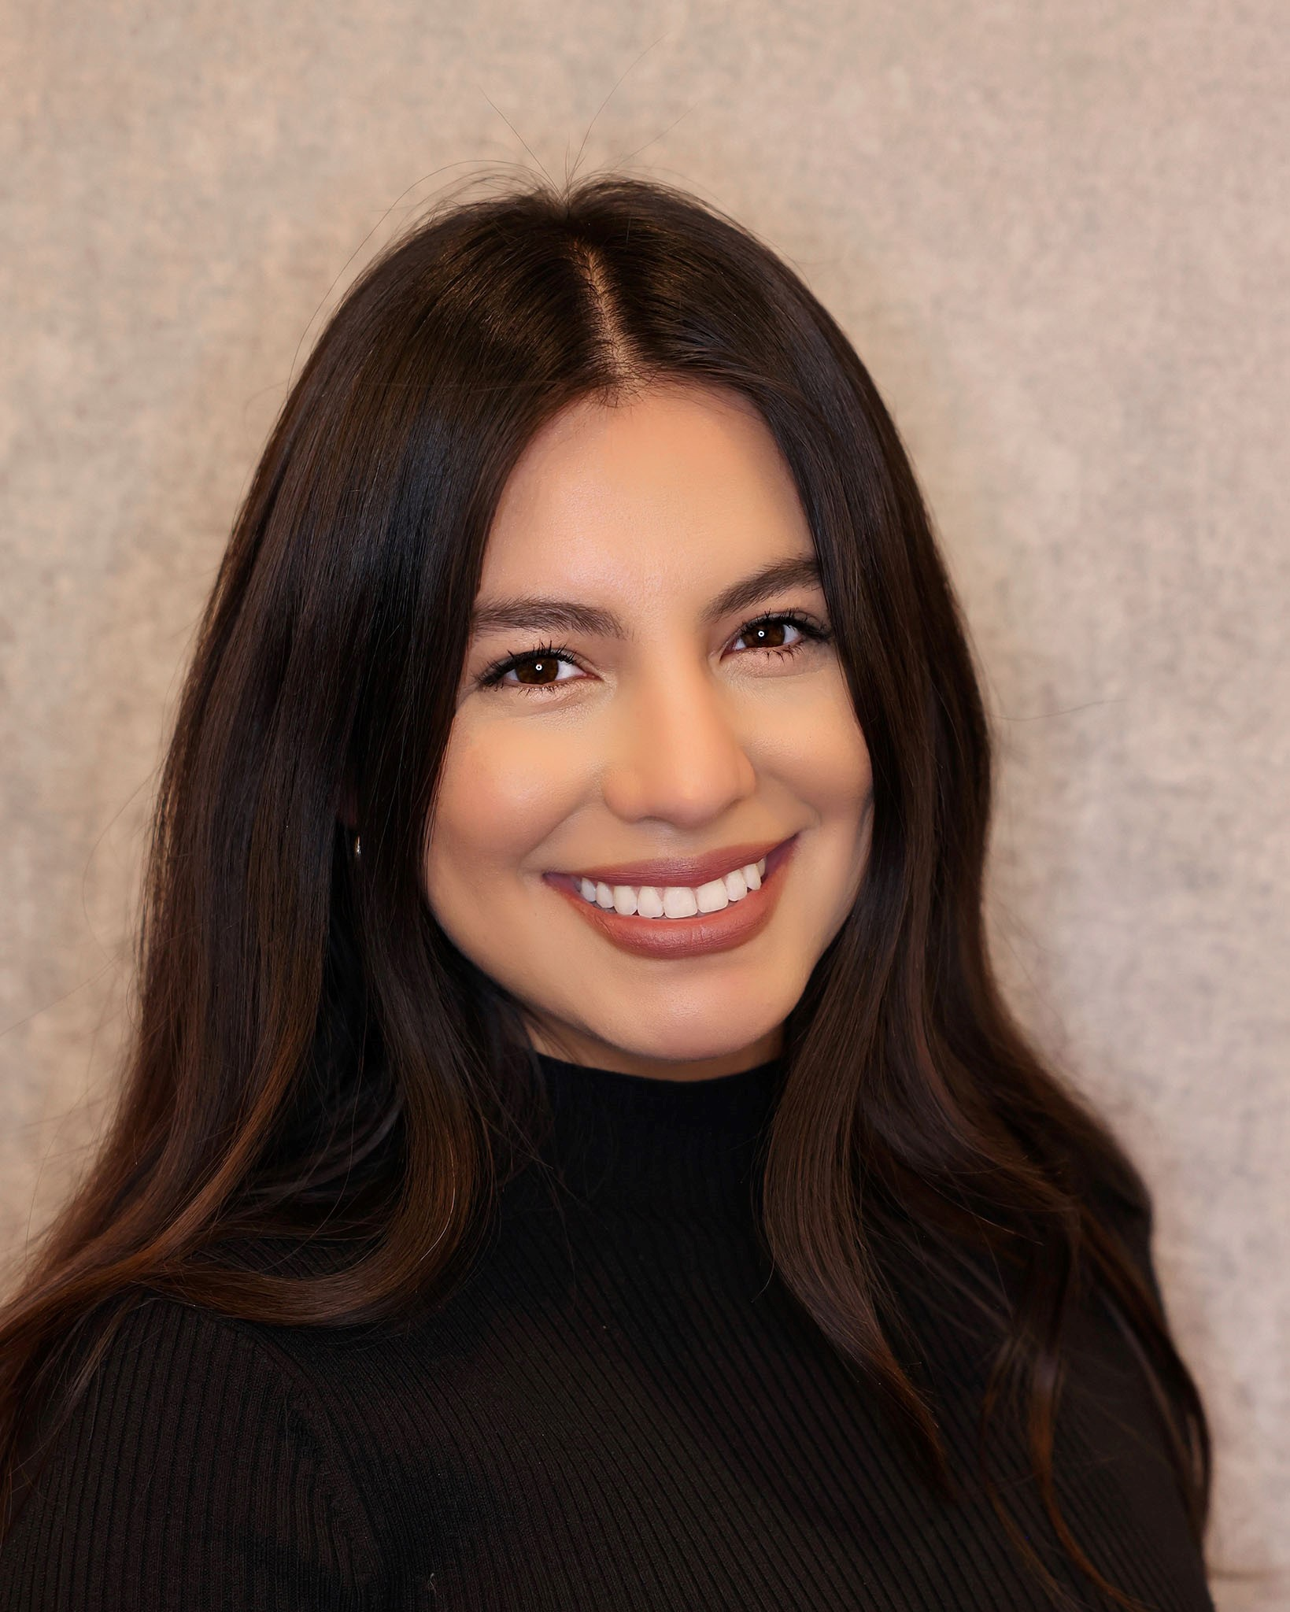
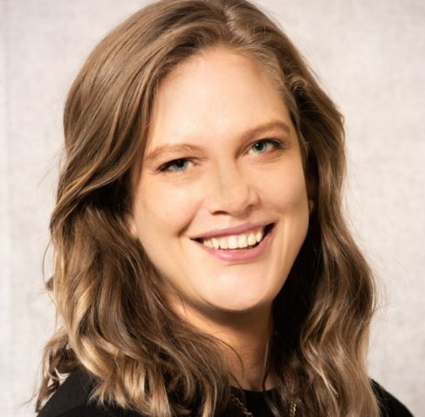
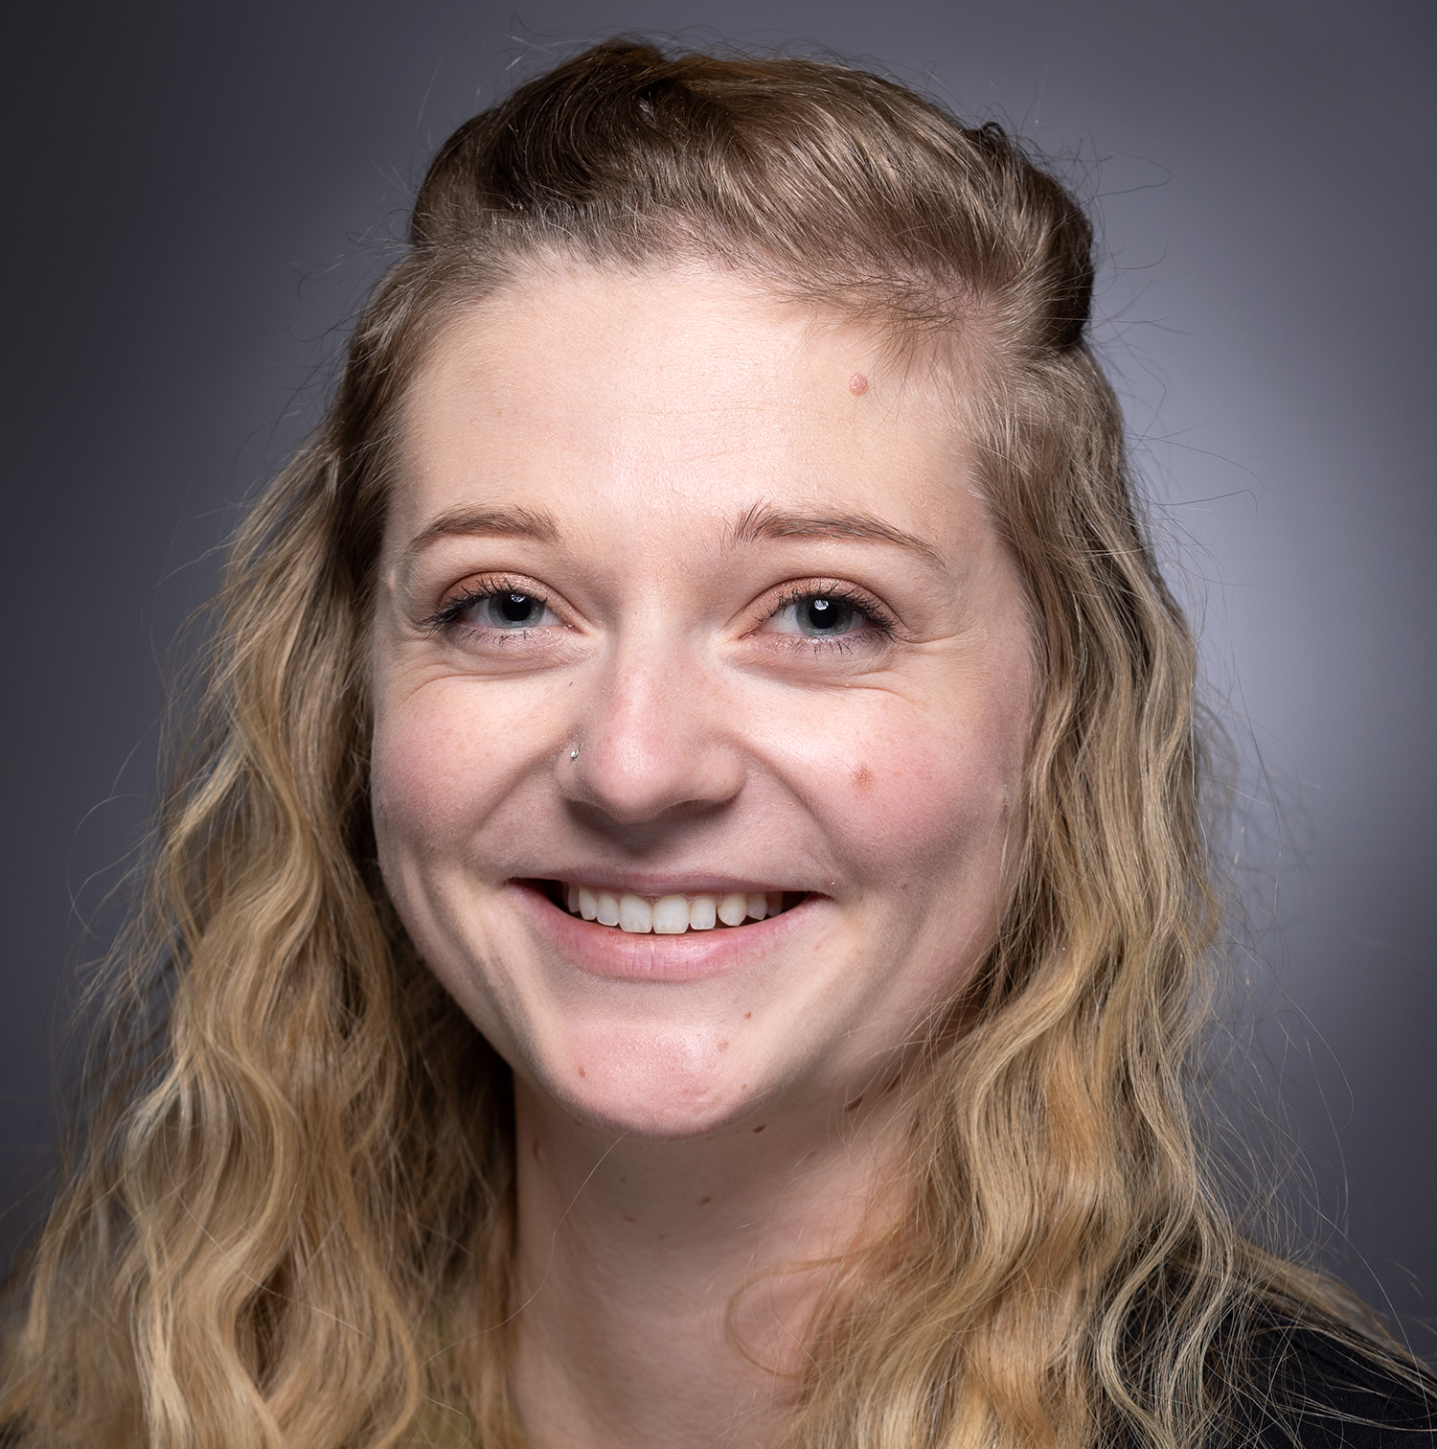
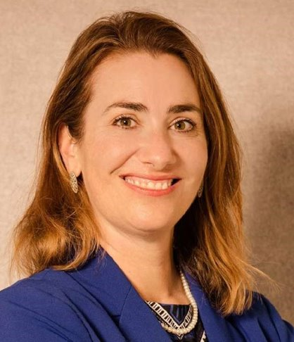
Uw travel team introductions
Elizabeth Dressel
Director of Travel Management Services. Supporting UWSA while Alma is on leave through April 2027
Alma Ramirez
Regional Travel Manager Supporting UW-Whitewater, UW-River Falls, & UWSA on leave through April of 2027
Alyssa Totoraitis
Regional Travel Manager Supporting UW-Milwaukee & UW-Parkside
Tina Chorlton
Regional Travel Manager Supporting UW-Platteville and UW-Whitewater and UW-River Falls through April of 2027
Emily Stoffel
Regional Travel Manager Supporting UW-Eau Claire, UW-La Crosse, & UW-Stout
Notes:
Tina

Slide 3
Policy Updates
No changes have been made since the new Travel and Expense Policy was effective July 1, 2025 to coincide with the Workday Expenses go live
We are planning on making some minor changes later this year or early next year

Slide 4
Policy Updates – July 2025
Receipts are required over $50
(unless on Purchase card, receipts are ALWAYS required)
New IRS rate $.76 per mile as of July 2026
Employees are to submit an Expense Report within 60 days of purchase date
  Accountable plan – Employees need an exception and will be taxed for expenses over 90 days of purchase date with exception for expense items that have arrival dates (such as airfare and lodging)
New meal and incidental rate where first at last day are not at 75%

Slide 5
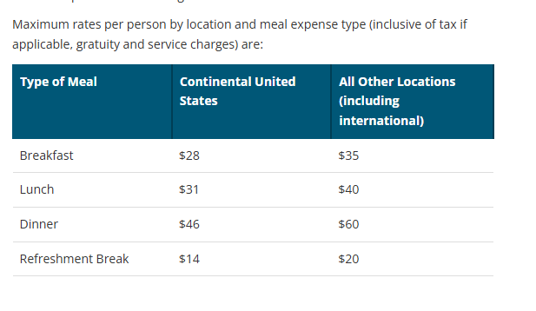
Headquarter city and sponsored events policy
Policy 435 new rates as of last fiscal year
  This updated policy as of July or 2025 does allow for overage to be charged to UW gift funds of UW Foundation funds
  Example you spend $40 per person for an interview with 2 people (total was $80 with tax and gratuity)
  $62 is allowable on any UW funding source ($31 per person)
  The additional $18 may be charged to any Gift funds or using Foundation funds (most common athletics)

Slide 6
Spend Authorizations
All Policy exceptions required a completed and attached Spend Authorization in Workday
Have to use Policy & 90-Day Exceptions (Spend Auth Only) business purpose
Other required use of Spend Authorizations include:
Cash Advances
Gift card purchases
Research Participants
Some campuses require, some departments use/require for pre trip approval (before money is spent)

Slide 7
Travel Policy - Course in Workday
Link to Travel Training: Booking Your Own Travel
https://www.myworkday.com/wisconsin/d/inst/1$17816/17816$61.htmld

Slide 8
Travel Industry Updates
Airlines -Fares trending upward
Airlines are passing rising fuel costs to travelers and trimming routes
Airline tickets – average ticket price domestic for this year Q2/Q3 - $519
Average ticket last year for Q3 - $437
Baggage fees increased to $40 as a standard for US Domestic check bags. Link below for baggage fees across carriers. If one airline raises rates, others follow.
  Airline Baggage Fees | Fox World Travel | Fox World Travel
IRROPs (Irregular Operations) are increasing year over year, and even during summer. Next few slides cover best practices during these situations.

Slide 9
Travel Industry Updates - IRROPS
How Fox World Travel Can Help:
Flight rebooking and itinerary changes: Assisting when cancellations, delays, or missed connections occur.
Alternative route options: Searching for available flights, connection points, and airline options when permitted by airline rules and agreements.
Impacted travel coordination: Helping adjust related hotel, rental car, rail, and future itinerary segments when applicable.
Refund and unused ticket support: Assisting with applicable refunds or unused ticket credits based on airline rules.
Traveler guidance: Explaining airline policies, available options, and the potential impact of accepting or declining rebooking offers.

Slide 10
Travel Industry Updates - IRROPS
Fox World Travel cannot override airline policies, create unavailable inventory, waive airline-imposed restrictions without airline authorization, or guarantee compensation. Final decisions regarding reaccommodation, refunds, seat assignments, upgrades, vouchers, and compensation remain with the airline.
Fox cannot:
Put a traveler on standby
Upgrade a traveler at no cost
Uncheck a traveler in or check a traveler in
Rebook a traveler on another carrier at no cost
Provide hotel vouchers

Slide 11
Travel Industry Updates - IRROPS
When Travelers Should Work Directly with the Airline:
During IRROPS, certain actions are best handled directly by the airline at the airport because airline staff control same-day flight inventory, airport operations, standby lists, vouchers, and immediate compensation decisions.
Travelers should contact the airline directly for:
Immediate reaccommodation
Gate agents and airport customer service agents often have the fastest access to available seats and standby lists.
If a cancellation occurs while you are already at the airport, getting in the airline's queue immediately can be critical.
Same-day standby requests
Airlines typically require their own agents to add travelers to standby lists or clear standby seats.

Slide 12
Work with airline directly
Meal, hotel, and transportation vouchers
When the disruption is covered by the airline's policies, airport staff generally issue these accommodations directly.
Denied boarding situations
Compensation and rebooking resulting from oversales are usually handled directly by the airline.
Seat assignments and upgrades
Airport agents have access to last-minute seating inventory and operational upgrades.
Baggage issues
Delayed, damaged, or lost baggage claims should typically be handled with the airline's baggage service office before leaving the airport.
Border, security, or travel document issues
Airline staff can provide guidance regarding boarding eligibility, visa concerns, and documentation requirements affecting immediate travel.

Slide 13
Travel Industry Updates - IRROPS
Handled by Fox World Travel Agents:
Finding alternative routings
A Fox Business agent will search for multiple airlines, connection points, and fare options simultaneously
Managing complex itineraries
Multi-city, group, international, university, or grant-funded travel
Coordinating hotels, cars, and rail
A Fox agent can adjust the rest of the trip while the traveler focuses on getting on the next flight

Slide 14
Travel Industry Updates - IRROPS
Best Practice for Travelers
A good rule of thumb is:
If you are physically at the airport and need a seat on a flight today, work with the airline immediately while also notifying Fox World Travel. The airline controls aircraft inventory and airport operations, while Fox can explore broader alternatives, coordinate impacted travel arrangements, and provide continued support.
This parallel-path approach often produces the fastest and most effective outcome during major travel disruptions.

Slide 15
After hours service fees
Fox charges $20 for each call outside of 7-7:30, Monday-Friday
  Fox is adding additional after hours staff on weekends to keep up with the demand
Number of waivers offered year over year has gone up drastically. Weather, FAA shutdown, government shutdown, pilot strike, technology disruptions
  3,779 waivers for 2024
  5,661 waivers for 2025
  5,240 just through end of August of this year

Slide 16
Travel Industry Updates
Ground Transportation Ground Transportation | Travel
New Big 10 Agreement National/Enterprise effective September of 2026
Rates went up a few dollars for most vehicle types but have brought back a match with our business rates with personal rates
  Exception of mini vans, and large and premium SUVs which charge an additional surcharge for personal/leisure rate
Insurance should be purchased for all international trips for Hertz, sometimes Enterprise and National. Every country is different so traveler must do research if booking an Enterprise and/or National brand vehicle. Insurance is always allowable when renting overseas.
Hertz doesn’t offer rates for compact vehicles

Slide 17
Travel Industry Updates - Hotel
Hotel – UW System does have a Preferred Hotel Program near all campus locations
  UW System Hotel Directory | Travel
Per Diem calculator (link: Per Diem Calculator – Home) should always be used to determine if a stay is in our out of policy. Per diem listed in Concur is not always accurate
Accuracy of Concur’s “In-Policy” Rate Notification:
  Concur may inaccurately flag a hotel as “in policy” because it can only display rates in whatever format the hotel provides, which varies by property.
  This is misleading because hotels often send varying data, such as only the first night’s rate or an average for the stay, rather than a full daily breakdown.
  Because nightly rates often fluctuate, the initial search results may not reflect the actual cost of every night.
The federal fiscal year set by the GSA was recently released for Oct 1, 2026 – Sept 30, 2027)
    2027 Per Diem Rates Released | Travel

Slide 18
Travel Industry Updates - hotel
Confusion are State Government Rates in Concur and Fed Rate Program
UW employees are eligible for State Government Rate in Wisconsin
We currently display State Rates outside of Wisconsin in Concur but generally those rates are only for employees who work in the state the hotel is located
Information about the State Government Rates in Concur
https://www.wisconsin.edu/travel/general-travel-and-expense/lodging/uw-system-hotel-directory/

Slide 19
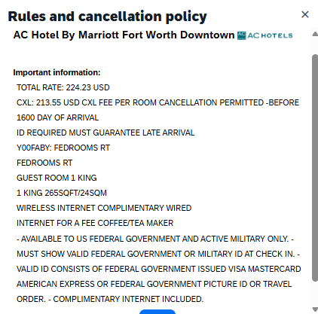
FedRooms rate program
Eligibility & Booking: Travelers on UW business are able to use the FedRooms rate, as long as the booking is made through Concur or with one of our travel agency partners
Concur Language: is confusing and not accurate, but can not be updated

Slide 20
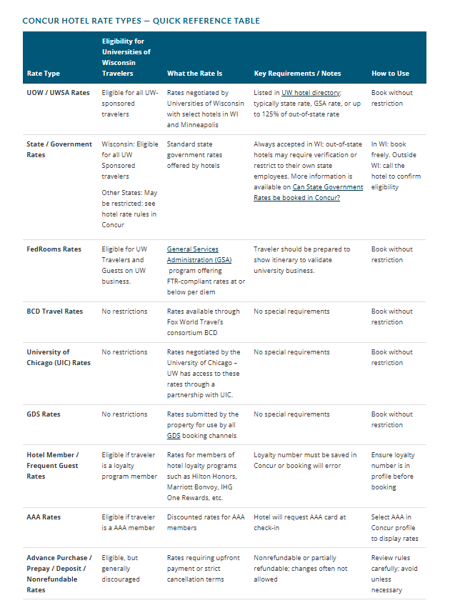
Lodging | Travel page on Travel WIse
Shows this chart that breaks down the rates available in Concur and who is eligible

Slide 21
Travel Program – Why Have one?
Why does the UW have a managed/mandated travel program?
We have a duty of care – legal obligation to ensure safety and security of travelers during each trip
Ability to report on where are travelers are and share information with Risk and Legal Departments as needed
  Report out on number of trips to each country annually for insurance purposes
  Report on our Carbon Footprint annually
  Report back to campuses as needed if/when they are determining to restrict travel to certain countries
Ensure we are as fiscally responsible as possible by leveraging our spend with airline, vehicle rental and lodging partners
Meet Purchase requirements of bidding out travel services to ensure the best solutions for our employees, guests, and students (best solutions, expertise and overall value)

Slide 22
Travel Agency news
Updated Concur (online booking tool) booking experience will be live December 2nd
We will be adding information to this page on Travel Wise:
Book Online via Concur | Travel
UWSA will be going out to bid this year for travel agency services, we will have selected TMCs by end of this fiscal year
If we do have any travel agency changes will have webinars next year

Slide 23
Get help
If you need support, contacts are listed on Travel WIse
Resources | Travel
There are links to each campus travel office or Expense Audit Team (after you submitted an Expense Report – Get Help ticket)
During Travel Status – contact Fox World Travel (recommend saving on your phone and in your contacts)
Call: Local: 608-710-4172
Email: uwtravel@foxworldtravel.com

Slide 24
Expense report approvals
UW Madison has made great progress. Links to find current estimated Expense Partner (Central Audit) turnaround time:
Centralized Audit of Expenses at UW–Madison – Division of Business Services – UW–Madison
All other campuses: Expense Report Status | Shared Services

Slide 25
Helpful links
Travel | UW TravelWIse – UW Systemwide all things Travel
Student and Guest Travel Reimbursement Form | Travel – New to help upload receipts and provide details administrators need to complete an expense report on others behalf
Per Diem Calculator – Home to be used for all lodging stays
Currency Converter | Foreign Exchange Rates | OANDA
Fox Portal - Dashboard - UW System Administration

Slide 26
Any Questions?
Thank you for your time and participation!

