Slide 1
Project Management Light (No affiliation with Oracle) October 19, 2015
The Service Center Mission is to provide “best in class” HRIS and customer service to support the effective management of the University of Wisconsin System’s Human Capital at the highest value.

Slide 2
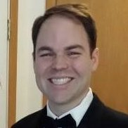
Scott Krause
Project Manager
UWSA – Service Center (2 Yrs)
MBA – Lake Forest Graduate School
BBA-Marketing – UW Madison
PMP – Dec. 2012
Past - 5 Years in Supply Chain & IT
http://www.linkedin.com/in/sjkrause/

Slide 3
Agenda
Project Management Light
Purpose
Background
Templates
Phases
Process
The basics of Project Management
Improved state-wide use of PM
Payoff
Notes:
This PPP is just for the meeting.

Slide 4
About Project Management
What is a project?
Temporary
Specific Objectives
Method of Project Control
(IT) Waterfall-focused
What is a Project Manager?
Project Management

Slide 5
Soft Skills
What are the most important skills for a project manager?
Leadership
Communication
Effective Motivation
Integrity
Decisiveness
Project Management
http://www.pmi.org/learning/~/media/pdf/surveys/pp_sofian.ashx

Slide 6
You might get a project…
It’s not that bad!
Communication x3!
Quality + Acceptance = Success
Don’t assume everyone understands.
Wanted to make sure we’re…
“speaking the same language.”
“on the same page.”
“following the same map.”
Remember your customer!!!
Document!!!
Project Management

Slide 7
You’ve got a project…
Who is our customer?
What forecasts are there for the project?
What does done look like? And success?
What is my role? Authority?
How does the project fit in to everyone’s work?
What does the organization want to know?
Communicate
Project Management

Slide 8
Planning
Documentation

Slide 9
Documentation
What are the most important pieces of documentation?
Charter
Work Breakdown Structure
Reporting Instrument
Project Plan
Project Management
All UW Madison DoIT Templates

Slide 10
Charter
Project Management

Slide 11
Charter
Everyone should understand the project!
Explain the project
Scope – In and Out
Cost/Time/Resources 1st Pass
Approval means….
The sponsor (or other approvers) understand the idea.
Sally forth!
Move on to more detailed planning.
Communicate
Project Management

Slide 12
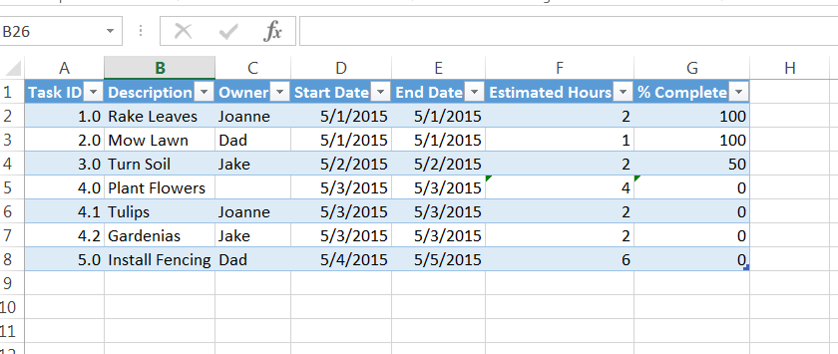
Work Breakdown Structure
Project Management

Slide 13
Work Breakdown Structure
Everyone should understand what needs to be done!
Task ID
Task Description
Owner
% Complete (or Status)
Start Date
Finish Date
Optional
Hours
Predecessor
Communicate
Project Management

Slide 14
Project Plan
Project Management

Slide 15
Project Plan
Detail of the project!
Consider it all
Detail on cost/time/resources
Think what leadership would want to know
How much?
How long?
With who?
What could go wrong?
Approval means….
The sponsor (or other approvers) are OK with the plan.
Sally forth, again!
Communicate
Project Management

Slide 16
Control & Execute
Documentation

Slide 17
Get to it!
Is the project tracking projections?
What are the risks/issues facing the project?
Report
Milestones
Achievements
Setbacks
Cost/Timeline
Decisions
Set expectations early and often.
Communicate
Project Management

Slide 18
Status Reporting
Project Management

Slide 19
Close
Documentation

Slide 20
Are we done?
Conduct lessons learned
Close the project, IN WRITING!
Celebrate!
Communicate
Project Management

Slide 21
Templates
UW Madison DoIT Full Methodology
UWSA Service Center Templates (Firewalled)
Project Management

Slide 22
Questions

