Slide 1
Gleam in the Eye to Charter Principles, Intentions, and Techniques for Successful Project Start-Up
Robert Merrill
Senior Business Analyst
Division of Information Technology
University of Wisconsin-Madison
Notes:
“Chartering is indispensable, Charters are useless” – way more
Reminder – Experience - Agreement
What, Why, Who, When, Where, How

Slide 2
What do you really want?
Sponsor
Intentions
Yourself
Triggers
Implementation Team
STORIES
All affected
Empathy
Brené Brown talks
“Crucial Conversations”
Notes:
We’re all people: Feelings, Intentions, and Stories driving Words and Actions.
Story – “If perfect, no conflict. If conflict, I did something wrong. Disagreement equals rejection.”
We’re all different: Abilities, Personalities, Experiences, Triggers, Tribes, and Status.
New, or troubled past, single word triggers story. Feelings, fight or flight, maybe misplaced.
I can override or retell my stories. It’s work.
“It’s all about the ideas. If people are upset or aggressive, it’s because I didn’t explain it well enough.” – story
Psychological safety – innovation, learning.
Intention for idea person, sponsor, users, oversight people (compliance). Respect and lasting best, absolutely. All wants, probably not. Children.
Expect Messy. No blame, shame, grudges. Guard safety and success, softest that work.
Brene Brown on vulnerability and shame, Crucial Conversations on heart and safety.

Slide 3
Make Success BIG
BIG
Value > Cost
Constraints Safe
Johanna Rothman
“Manage It!”
Notes:
Trained: time, budget, spec. Set up and watched four “problem children.”
Real success: Sustainable, profitable, referenceable.
Generalized. Driver—reason why—value. Constraints, often people, time, and money, and compliance. Technology, context, project process, prescribed roles …two great, three typical, four or more trouble.
Not driver, not constraint, Johanna calls float; wiggle room, shock absorber, air bag.
Probe. BA work. Why? Help me understand.
Sometimes soften by safety. Positions and boundaries when feel threats.
Success is delivering more value than cost, while not blowing through constraints.
“Good landing, you walk away. Great landing, airplane still flies.”

Slide 4
Expectations about Expectations
Cynefin (say “Kin-Evan”) Framework
Notes:
Who wants management? Does your spouse?
Stop dehumanizing language, “resource,” “expectation management” to hide the messiness. Too much control yields none.
Project start—the more that’s new, the more confusing. Collab and learning require psych safety. Will this hurt? Can I cope? Does anyone care?
Coping—expectations matching reality. Makes Sense.
Sense-making framework. Expectations and approach match reality.
Complicated or Complex. Making Success Big is expecting Complex world.
People have preferences.
Chaos = head rush, cover for selfish purposes.
Simple = supervisor / manager, “Make it so.”
Complicated = project manager. Bridge over Fox River. Planning cheap and relatively accurate compared to total cost. Lots of parts, but most are simple. IT infrastructure.
Complex = project start-up, and many info system projects. IT applications. Malleable, intangible, mental, solving it changes it.
Forced simplicity leads to breaking wave and Chaos. Denial is false simplicity. Catastrophizing is chaos.
Expect turbulence. Expect changing understanding. It will work itself out if we don’t fight it. Take my hand—as long as *I* don’t panic and start boundaries everywhere!

Slide 5
Map the Swamp and Mind the Gap
Why? (Driver)
User
Interface
Function
Requirements
Are
Round
User Stories!
SMEs
Rules
Data
Examples!
Gottesdiener “Reqts by Collaboration” Ch. 3
Notes:
BAs and especially PMs are sick of psycho-babble. Techniques and Templates!
Part of Done is a Description. Use visual models, “All are wrong, some are useful.”
Reqts are Round—jump on anywhere, go around a couple of times. People think differently. BA, know Myers-Briggs S is Solution. Let them. It’s not right, but its useful.
Function lets people manipulate Data through a User Interface, subject to Rules.
Draw. Take pictures of whiteboards. Note the date and who was there.
Down from hand-waving clouds (What, How), up out of weeds (Why)
“Why five times” will usually get you to Function, the verbs, and value, the Why.
User Stories: role, function and data, value. IEEE System Shalls are lawyer language, not tools to understand.
Smaller things important, but can wait.
Big Two get us to By When—estimation.
It will turn around and drop a big How Many on Function and Data; the set of those is your best Float.
No heart-work, elicitation misfires. Data modeling by example. Can there ever be more than one of those? Give me an example. Can you proceed without one of those? Give me an example.
Learn the basic models—Gottesdiener Ch. 3. Your SMEs can review them, often with eagle eyes. Just don’t ask them to draw one, starting from a blank board.

Slide 6
Map the Swamp and Mind the Gap
Report
Create
Gizmo
D00dad
Widget
Thingy
Maintain
Update
Whatsits
“Context Diagram”
Rosenberg & Scott Ch 4
Function Point counting
Notes:
Here’s Mind the Gap. This is where you put the A in BA.
Big box is our emerging solution.
Little box are Nouns, Entities, Data – Logical, business view.
Ellipses are Function – use case symbol, value deliverers
Use your Functions and Data to check each other.
Systems of Record for Data, who owns it? – Stakeholder
Does our system maintain Data? Use others Data? Synch, integration.
Orphan data? You missed a Function. Orphan Function? You missed some Data.
Big thing is to find most of the Stakeholders !!

Slide 7
Chainsaw Math
Effort
Function
People
Data
Schedule
Notes:
Here’s where you make the A in BA upper case.
Post-modern BA is an Estimator. Effort and Schedule are constraints or requirements, you must elicit, understand, and analyze for consistency.
Resize Function and Data to match typical Effort, Schedule, and People constraints.
Effort and Schedule appear early and start to harden, too optimistic. Psychology, project advocacy, thirst for Simplicity, everything’s against realistic expectations here.
Get involved early and often.

Slide 8
Chainsaw Math
100%
“Stretch”
90%
50%
0%
0
2
4
6
8
10
12
Notes:
PMs estimate, need a WBS and plan.
Can’t wait for that. Expectations are hardening by the hour.
Here’s how to estimate anything, anytime, and fosters right thinking.

Slide 9
Chainsaw Math
Target, Desire, Goal, “Estimate,” Demand
6 months? What’s driving that? Tell me more.
Estimate
Number and probability, or range
Commitment / Plan
Including explicit Float – what will give
Notes:
Critical vocabulary
Don’t panic. Elicited requirement. Curiosity! Introduce scope-to fit

Slide 10
Chainsaw Math
Project C
?? people
18 months
5400 hours
Description
Start Date
End Date
Effort (hours)
People (names)
Tech platform
Countables
Project A
6 people
8 months
1500 hours
Project B
10 people
13 months
3700 hours
6 months?
Don’t think so…
Reference Class Estimating

Slide 11
Chainsaw Math
Impossible
“Doom Loop”
Zone
Fixed Effort
Scope Range
Fixed Scope
Effort Range
Parkinson Zone
You CAN’T will uncertainty away
You CAN choose where to manage it

Slide 12
Head for the Hairballs
Technology
Conflict
DATA

Slide 13
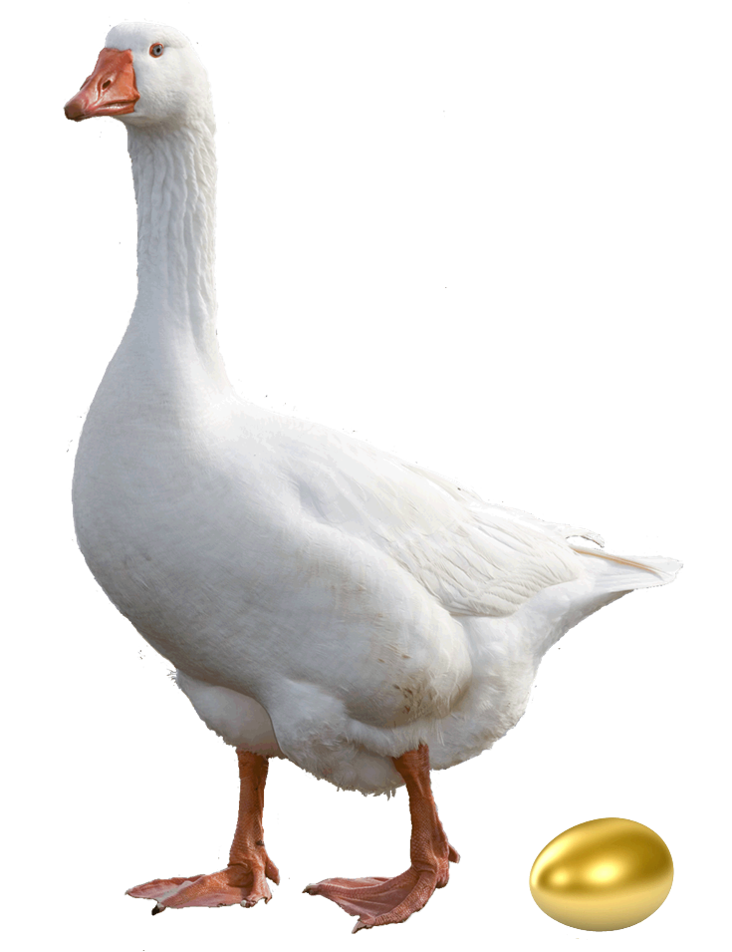
Hills to Die On
Overtime
Cost / Quality
Schedule / Effort
Don’t Squeeze the Goose!

Slide 14
Conflict Quadrants
Aware
Empathetic
Responsible
Stressed
“Unreasonable”
Dialogue
Issues not People
Interests not Positions
Options for Mutual Success
Boundaries
Limited engagement
Good Conflict
Bad Conflict
Conflict Cycle
Blowing up
Shrinking back
Perpetual “Storming”
“Groundhog Day”
Drama
Never wrong
Shame & blame
Disengagement
Turnover
Principled Negotiation
“How to Solve Your People Problems”

Slide 15
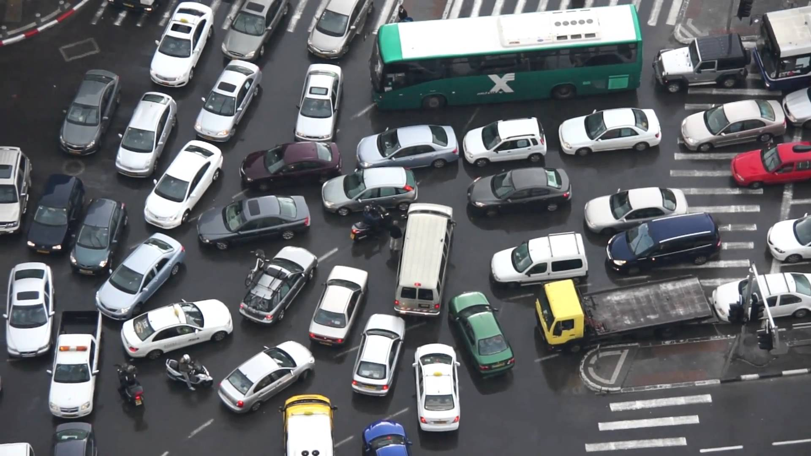
Is There Room for One More?
Evaluation / Triage
Cycle Time
Throughput
WIP Limit
Buffers
Policy & Governance
Notes:
Evaluation – Triage
Cycle Time
Throughput
WIP Limit
Buffering
Policy and Allocation – Customer Steering Committee
Empathy

Slide 16
Saying Yes To Something Better
I hear you saying…
No, because…
And what about…

