Slide 1
University of Wisconsin Business Intelligence
UWBI Coordinators and Executive Sponsors
August 11, 2017

Slide 2
Agenda
MEETING OBJECTIVES
UWBI Coordinators…
Review deployment timeline
Learn of plans for developing training
Have a chance to share their progress.
Executive Sponsors…
Review UWBI Progress Dashboard
Understand project issues and risks
Have an opportunity to ask questions and discuss transition of UW to OBIEE.
AGENDA
Welcome, Objectives, Agenda
UWBI Progress Dashboard
UWBI Project Risks
UW-System OBIEE Deployment Timeline
UWBI/Shared Queries Look/Feel
Training Next Steps
Summer Meeting – Common Interests
Project Transitions
Questions

Slide 3
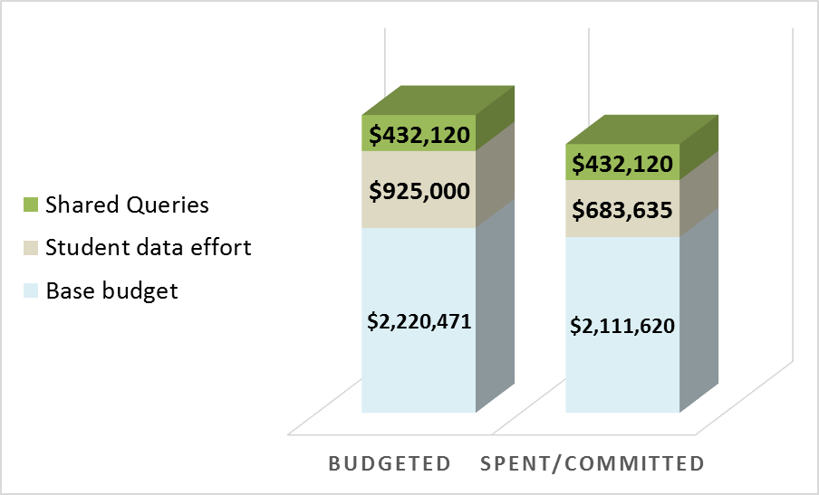
UW Business Intelligence Effort
PROGRESS DASHBOARD
Approved Scope
OBIEE IMPLEMENTATION
TODAY
Budgeted v Spent/Committed
FY16/FY17
Completed | On track | Minor delay | Serious delay | Future activity
Campus Progress
For details behind this campus information, see the wiki. If you have questions, contact Kathy Luker and Mark Treiber.
T | Eau Claire |  | Green Bay |  | Milwaukee |  | Platteville |  | Stout |  | Whitewater |  | Madison |  | Superior |  | River Falls |  | Stevens Point |  | Oshkosh |  | Parkside |  | La Crosse |  | Colleges/Extension
Key Highlights
Current critical issues
Potential issues (i.e. risks)
Shared Queries – Release A nearing completion and being readied for Preview Testing.
Merge Management
Processes complete and being tested
Platteville, Eau Claire and Madison moving into Central Environments
Security – Security functioning. Middleware working on security table ETL.
Infrastructure – Central Test ready for use
Issue | Mitigations | Owner
Central Merge Manager hire fell through. Resource constraints on shared query team Kathy’s replacement | Interviews progressing, offers pending. See Risk Matrix In discussions for short term and longer term solution | Andy C.. Andy C. David S.
Risk | Mitigations | Owner
Shared Query conversion just beginning, campus custom reports at risk May not have all SFS/HRS elements used by campuses in RPD by deadline Merge manager position difficult to fill | Pilot approach to deliver content as quickly as possible to campuses Topic of discussion with Rob Cramer Executive Sponsors Offer pending | Andy C. Nikki B Andy C.

Slide 4
UWBI Risk Matrix
To facilitate discussion and tracking, the risks have been categorized into three areas.
Adoption
Risks in this category are related to the adoption and effective use of the OBIEE suite and the ability of the solution to fulfill the requirements identified as part of the initial selection of the software
Schedule
Risks in this category involve items that will prevent IR from being retired in April, 2018
Technical Support and Setup
Risks in this category involve items that could jeopardize the setup and stability of the OBIEE environment or the ability to meet the technical requirements of the system

Slide 5
Risk Matrix - Adoption
 |  |  | As of 5/23 |  | as of 8/9
# | Category | Risk Description | P | I | P | I | Risk Response | Current Response Tasks
1 | Adoption | Funding has not yet been approved to build a central Finance RPD for the campuses to build reports from. Campuses heavily rely on Finance data for day to day operations. If funding is not approved soon, there is a high probability campuses won't have time to rebuild their reports before April, 2018 deadline and will go in another direction. (Also a schedule risk) | High | High | High | High | Avoid | 1. Discussion held with Rob Cramer on 8/8, discussing options.
2 | Adoption | End users will need appropriate training to enable them to use OBIEE effectively. UW-System does not currently have an effective structure to provide UW-System wide training. | Medium | Medium | Medium | Medium | Avoid | 1. UW-System hiring a full time training resource. Committee being formed. 2. Huron proposing short term options. 3. Leverage UW-Platteville materials
3 | Adoption | The solution for the shared queries does not address the underlying data quality and consistency issues with the EPM warehouse. Risk that existing data quality issues will limit usage of OBIEE reports. | Medium | Low | Medium | Low | Accept | EPM Data quality is a larger issue, not part of this effort.
4 | Adoption | Ad Hoc query capability is a top priority for many of the campuses. Decision is needed on tool to be used. Note that Oracle indicated Visual Analyzer can be used for mashups. | Medium | Medium | Medium | Medium | Avoid | 1. Visual Analyzer training conducted in July, need to evaluate usage. 2. Mashup limitation being researched by Oracle and Robert Flum.
5 | Adoption | Complexity of the UW BI support model will make it difficult to establish production support. | Low | Low | Low | Low | Avoid | 1. Governance Committee has responsibility and is working to establish. Approach is to keep it simple and leverage similar model to IR support.

Slide 6
Risk Matrix - Schedule
 |  |  | As of 5/23 |  | as of 8/9
# | Category | Risk Description | P | I | P | I | Risk Response | Current Response Tasks
6 | Schedule | Current work on the conversion of the shared queries is just beginning. There is a risk that they will not be available in time for campuses to recreate their custom reports. | Medium | Low | High | High | Accept | 1. Need a plan to address
7 | Schedule | Campuses are just getting started with development, Campuses indicate they are on track as reported by the campuses and in the dashboard but solid plans with milestones have not been shared. and there is a risk they will not make it by April, 2018 | Medium | Medium | Medium | Medium | Accept | 1. Campuses provided initial schedule for move. 2. Need to continue to monitor.
8 | Schedule | UW Decision Making process can take significant time; there is a risk that project timelines could slow while waiting on decisions. | Medium | Medium | Medium | Medium | Avoid | Same as above

Slide 7
Risk Matrix – Technical Setup and Support
 |  |  | As of 5/23 |  | as of 8/9
# | Category | Risk Description | P | I | P | I | Risk Response | Current Response Tasks
9 | Technical Setup and Support | In house OBIEE Admin knowledge centrally and at the campuses is limited. Troubleshooting ability is limited and there is a high probability that future technical issues will be difficult to solve. | High | High | Medium | High | Avoid | 1. Technical issues have been limited in last month. 2. Assess risk after campuses start moving centrally and heavy report development begins
10 | Technical Setup and Support | UW Federated security model is somewhat complex. There is a risk that there will be continuing technical difficulties getting it to work within OBIEE. | High | High | Low | High | Avoid | 1. Discussions have indicated MFA requirement is not as complex as expected. 2. Further testing needed, but risk appears to be lower.
11 | Technical Setup and Support | The merge manager position may be difficult to fill given the complexity of merge administration. Huron is currently playing this role and there is a risk this role may not be filled by the end of the Huron contract on 7/31. | Medium | High | Medium | High | Avoid | 1. Continues to be an issue with merge manager hire falling through. New interviews in progress, offer may be pending. Monitor closely effort after Platteville merges in.
12 | Technical Setup and Support | There is a risk of turnover of the technical staff. | Medium | High | Medium | High | Avoid
13 | Technical Setup and Support | The security and merge management processes and procedures are complex, there is a risk that it will be difficult to manage these efforts for the campuses. | Medium | Medium | Medium | Medium | Avoid | 1. Process in place, pilot and then reassess risk.
14 | Technical Setup and Support | There is no common UW security approach. Multiple logons, 2-factor authentication in some instances. There are multiple decision maker(s). It is not clear who should approve and the final solution may miss key requirements. | Medium | Medium | Medium | Medium | Avoid | 1. Recent conversations indicate this is resolving.
15 | Technical Setup and Support | Oracle is historically very slow in responding to SR's. There is a schedule risk of an answer from Oracle is needed. | Medium | Medium | Medium | Medium | Avoid | 1. Escalate if need be.
16 | Technical Setup and Support | Connecting so many different data sources may negatively impact the stability of the OBIEE environment. | Low | High | Low | High | Accept | 1. No action, address if it becomes an issue

Slide 8
Draft as of July 11, 2017 What changes have occurred?

Slide 9
UWBI/Shared Queries Demo

Slide 10
Training Next Steps
Sept. 6-8 Reports and Dashboards class in Eau Claire
Kathy needs names!
Training Brainstorm discussion – Project Coordinators Meeting (7/11)
Training Discussion and Demo (7/31)
Trainer/Communication Position

Slide 11
Summer Meeting – Common Interests
Common Development Approach
Release by Subject Area
Gradual transition into Central Environments
Common Training Materials
End User Guides (including videos)
Use of Central Trainer
Common Communication Materials
Collaboration
Face to Face Working Group Sessions
Listserv to ask questions/ask for help
Use of UW-Platteville RPD
Centralized repository of who’s working on what; solutions to problems
Security Roles Documented
How to secure folders, subject areas, dashboards

Slide 12
Project Transitions
New Data Council formed
CSRG Data Management Workgroup reported out on July 27th
New Data Management Council was named and will convene in August
Todd Carothers
Rob Cramer
Jason Fishbain
Jim Henderson
Anne Milkovich
Sean Nelson
Lynsey Schwabrow
Next steps include
Define data domains
Define roles and responsibilities (Data Management Council, Campus Councils, Data Stewards etc.)
Finalize Common Charter
Determine methodology for prioritizing data management requests
Consider acquisition of UWS data dictionary platform
Develop reference/training materials and communication plan to promote data management as a strategy
Kathy Luker retiring on September 1, 2017
Short term: Rob Cramer is considering engaging Huron to aid in management
Long term: Hire a BI Program Director reporting to David Stack and working closely with the new Data Management Council
Give David Stack feedback on the roles and responsibilities of the BI Program Director position

Slide 13
Good-bye!
Next Update: To be scheduled
Wisline Web

