Slide 1
University of Wisconsin Business Intelligence
UWBI Coordinators and Executive Sponsors
April 28, 2017

Slide 2
Agenda
MEETING OBJECTIVES
UWBI Coordinators…
Discuss Consulting Support Options
Have a chance to share their progress.
Executive Sponsors…
Review UWBI Progress Dashboard
Understand project issues and risks
Confirm continuing consulting support chart reflects their needs
Have an opportunity to ask questions and discuss transition of UW to OBIEE.
AGENDA
Welcome, Objectives, Agenda (David Stack)
Announcements (Kathy Luker)
What we learned at HEDW Conference
UWBI Progress Dashboard (David Stack)
Issues and Risks
Campus Student Consulting Support Options (Cati Cederoth)
Campus and Central Systems Progress (Kathy Luker)
Shared Queries update
Eau Claire demo of prototype for navigation using portals/dashboards
Others? (UWBI Project Coordinators)
Questions and discussion (All)

Slide 3
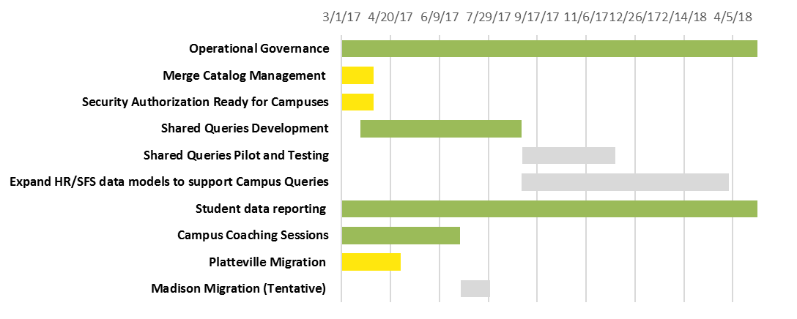
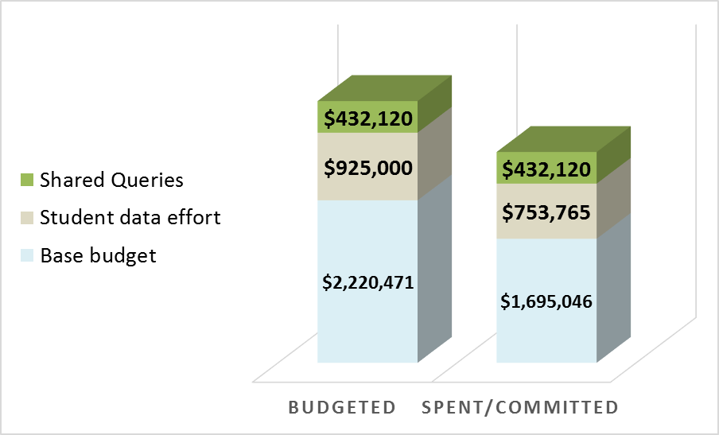
UW Business Intelligence Effort
PROGRESS DASHBOARD
Status update on the effort of UW
to begin work towards enabling
business intelligence.
OBIEE IMPLEMENTATION
TODAY
Budgeted v Spent/Committed
FY16/FY17
Completed | On track | Minor delay | Serious delay | Future activity
Campus Progress
For details behind this campus information, see the wiki. If you have questions, contact Kathy Luker and Mark Treiber.
 | Eau Claire |  | Green Bay |  | Milwaukee |  | Platteville |  | Stout |  | Whitewater |  | Madison |  | Superior |  | River Falls |  | Stevens Point |  | Oshkosh |  | Parkside |  | La Crosse |  | Colleges/Extension
Key Highlights
Current critical issues
Potential issues (i.e. risks)
Shared Queries – Job and Person Star populated, Report development beginning
Security and Merge Management – Behind schedule; working groups meeting daily to complete
Campus Coaching completing week of 5/1. Gathered input from campuses.
Issue | Mitigations | Owner
Lack in house Merge Management expertise Determine authentication and user roles Security setup and instructions to campuses delayed | Huron resources filling role, piloting all processes Piloting draft process; Focused effort by Central team, Platteville and Huron to complete | Andy C. Mark T. Mark T.
Risk | Mitigations | Owner
Shared Query conversion just beginning, campus custom reports at risk May not have all SFS/HRS elements used by campuses in RPD by deadline Merge manager position difficult to fill Options for ad-hoc query not yet resolved. | Development proceeding, OBIEE development in progress Discussion at meeting 21 applicants, interviews in May Resolve Oracle VA issue; determine next steps | Andy C. Mark T. Nikki B Andy C. David S.

Slide 4
Results
The outcome of submissions by campuses and discussions with Eau Claire and Stout are as follows:

Slide 5
Campus: Service: |  |  | Early Adopters |  |  |  |  |  |  |  |  | Other Campuses
 |  | CDR | Green Bay | Eau Claire | Madison | Milwaukee | Parkside | Platteville | Stout | River Falls | White-water | Colleges & Extensions | La-Crosse | Osh-kosh | Stevens Point | Super-ior
1 | RPD and Report Development |  |  | Financial RPD |  |  |  |  | Potential Summer for several subject areas, financial RPD | Interested in copying Eau Claire’s RPD | TBD
2 | Report Development |  |  |  |  |  |  |  | Summer (small # of reports) |  | 17-Jul
3 | Training Delivery |  |  | Author Training Materials, 3 more Maverick classes |  | Additional Maverick training |  |  | User, Consumer, Author training materials |  | 18-Jan
4 | Testing Support |  |  |  |  |  |  |  |  |  | TBD
5 | Deployment Support |  |  | Focused education sessions |  | Facilitate working sessions; collaboration between campuses |  | 12c Migration support | Facilitate working sessions; collaboration between campuses; RPD training |  | TBD
6 | Project Management
7 | Technical Help |  |  | System Admin Assistance |  |  |  |  | Email and hotline support |  | 17-Jun
The outcome of submissions by campuses and discussions with Eau Claire and Stout are as follows:

Slide 6
recommendations
DRAFT – WORKING COPY
Summary of Requests
For the campuses that responded, they would like: .
Training Materials and templates
Additional Maverick Training
Financials (SFS) RPD ready for use
On demand technical assistance (email, phone support, etc.)
Collaboration among campuses
Limited RPD and Report development assistance
Discussion Points:
Do all campuses agree with this list? Are there other needs?
How important is the financial (SFS) data?
Collaboration among campuses? What is the most effective way to accomplish this task? Huron recommendation is that this be UW-led. Huron resources can participate in education sessions as requested.

Slide 7
recommendations
DRAFT – WORKING COPY
Use of Central Team/Huron
Top Priorities:
Central Environment setup: Already in progress including security and merge management assistance for campuses as they move to the central environments.
Shared Query Conversion: In progress
Additional proposed tasks:
Development of standard training materials General OBIEE and template training materials for campuses to create their own content. Target: Summer?
Technical Assistance. Formal on demand support for campus infrastructure; informal support for RPD and report development (email, phone calls from resources on Shared query team)
Campus RPD and report development – Handle campus by campus on an as needed basis. No formal schedule at this time.
Financial (SFS) RPD and report development

Slide 8
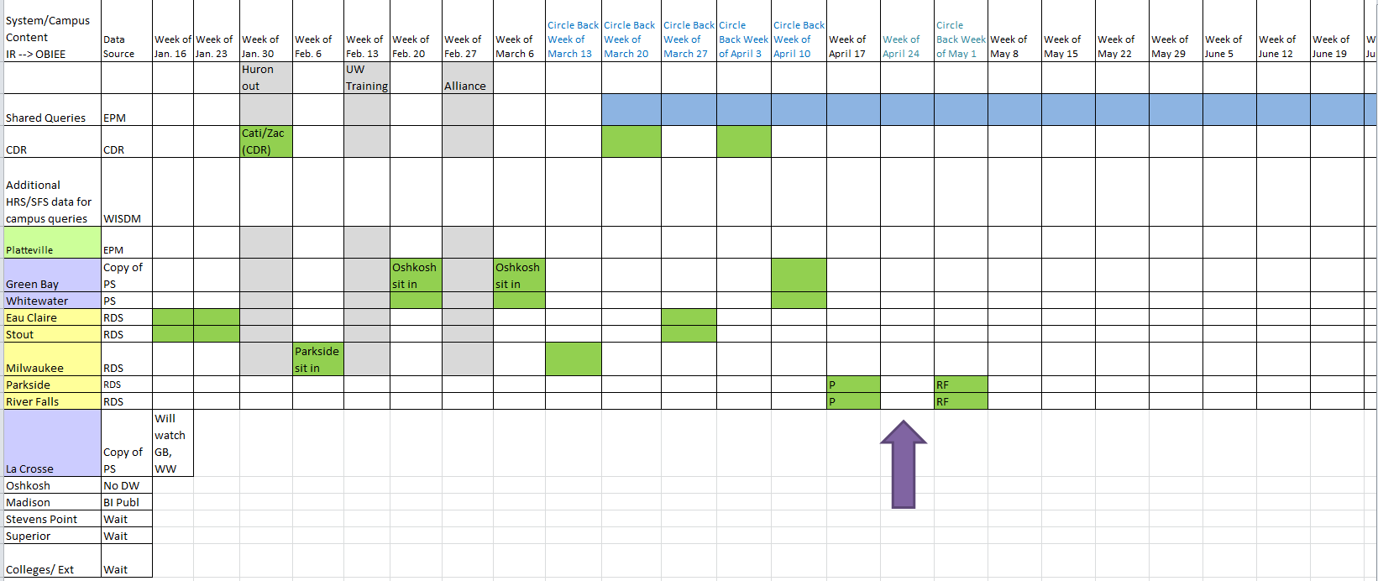
System/Campus Updates

Slide 9
HRS-SFS Shared Queries Project:
Scope:
Migration of existing Hyperion Interactive Reporting Shared Queries into UWBI.
UWBI Reports and Dashboards will fulfill the same informational needs as the existing queries and may result in fewer reports.
Develop dimensional models within the existing EPM data warehouse to support the Shared Queries.
RPD and report development will be done iteratively - by releases.

Slide 10
Preliminary Shared Query Releases
*Detailed drill down into IR query replacements is included!

Slide 11
Rollout Approach – for each release
Pilot/Beta
Selected group participate
Ideally, power users from each campus and decision makers
Opportunity to validate and provide feedback
Rollout
Rollout to all campuses who choose to provide access to institution users
Dimensional models (data menu) and RPD (report data menu) will be provided
Future
Incorporate feedback on existing releases
Note: Additional dashboards/reports and dimensional models beyond ones specific to shared queries are envisioned, but no timeline at this point.

Slide 12
Eau Claire Demo
Prototype for navigation using portals/dashboards

Slide 13
Discussion & Questions
What remains unclear?
What help does your campus need?
What could the UW system do to help?

Slide 14
Good-bye!
Next Update: May 26
or June 2
Wisline Web

