Slide 1
e-Portfolio in an Environmental Journalism course
Steve Hill, Division of Communication
UW-Stevens Point

Slide 2
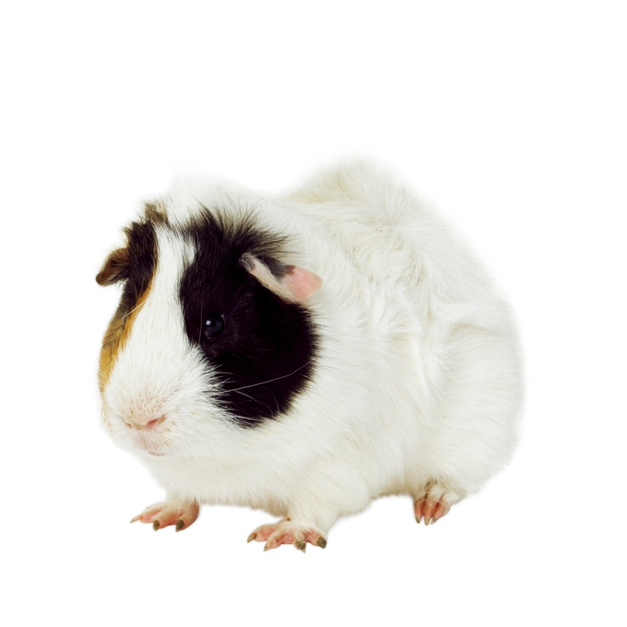
Mary
Me

Slide 3
COMM 324, Fall 2009
Journalism-track elective
Environmental literacy credit
Writing emphasis credit
11 students, juniors and seniors
Mix of majors and non-majors
Little real interest in journalism

Slide 4
Learning outcomes
Use appropriate formats and a concise, detailed approach to write the following about significant environmental issues:
analyses of media coverage, journal articles, books or other important sources of environmental information; and
news and public affairs stories about environmental issues.
Conduct thorough research on issues of public significance, using interviews, databases, reports, Internet sources, and other appropriate resources and skills, such as a class-compiled sourcebook and freedom-of-information requests

Slide 5
Learning outcomes
Demonstrate increasing capability in other core journalism skills, such as following AP style, organizing and structuring information, listening and observing, and conducting interviews
Analyze news stories or other information sources and articulate your understanding of ways they do or do not reflect principles of ethical communications practice and appreciation of diverse and global perspectives
Produce journalistic work on environmental issues of local, regional and national significance

Slide 6
Assignments
Analysis of journal article
Story from news release, report and supplementary material
Book review
Final project
Longer research paper/article
OR
Coverage of SEJ annual meeting

Slide 7
e-Portfolio
Tertiary role in class
Other D2L tasks (quizzes, discussion boards) were greater part of class
End-of-class task focusing on gathering, reflecting upon semester’s work

Slide 8
Reflection prompts: Course
What are some specific competencies or skills you learned about/improved in this class? Explain, give examples.
What are some specific competencies or skills that you learned about in this class that you need more work on? Why? Explain.
What did you learn about environmental journalism in general and its role in public discussion, resolution of issues? Explain.
How have your thoughts and opinions about the role of environmental journalism in particular and journalism in general changed? Explain.
How will you use what you learned? Explain.

Slide 9
Reflection prompts: e-Portfolio
Focus on potential use for students, especially in capstone classes
Specific questions:
How easy to use? Explain – give details.
Useful to students? How? Explain.
Any parts of using it difficult? Explain.

Slide 10
What the students wrote
Being in a class where I had to write about topics I wasn't very comfortable with allowed me to step outside the box and realize I am going to have to report on many different topics that I might not always know a lot about. That is when I need to talk to people who do know a lot about it … I now use more primary sources than secondary sources when I do research.

Slide 11
What the students wrote
One important lesson that I feel that stoodout to me over the semester was the importance of using narrative in my writingin order to keep the readers attention.

Slide 12
What the students wrote
I will use the skills I havelearned in the future mostly in the areas of time management, and also in theway I do research. I learned that in order to do good journalism you need toknow what your talking about, and you also need to interview those who knowwhat they are talking about. I feel that I will use lessons that I learnedthrough being unprepared to do better quality work in the future.

Slide 13
What the students wrote
“once I started playing around on my own, I realized how simple this program is.”
“very easy to use … not difficult to upload your files and share …”
“very useful to a student for a number of things” (archiving projects through college, job searches, professional presentations)
Collections? Huh?

Slide 14
What one student wrote
My time in Madison required me to stand in front of an audience of professional journalists and record what a panel of professionals had to say on important environmental topics like global warming changing the economy and invasive species taking over the Great Lakes. I was nervous at first when I had to sit with the panel of professional, but as time went on, I felt like I fit right in. It was a great experience, one I won't forget.

Slide 15
Reflections: What I learned
Students like it; easy to use
To assess: prompt, prompt, prompt
Give detailed instructions
Refer back to outcomes for greatest value (theirs and yours)
Leave room for authentic reflection

Slide 17
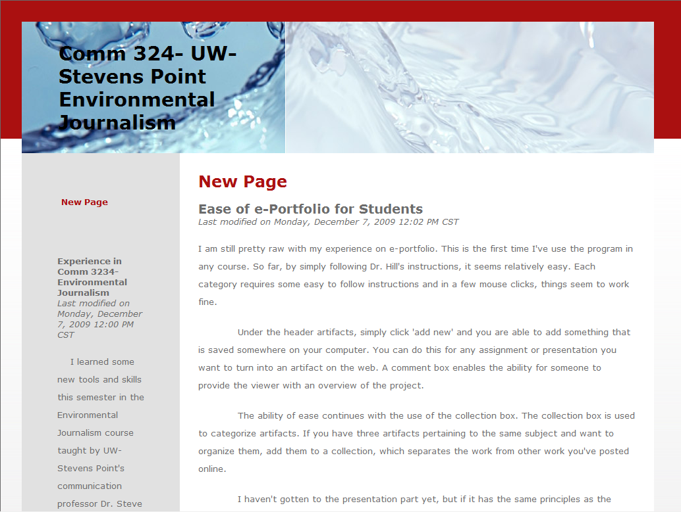

Slide 18
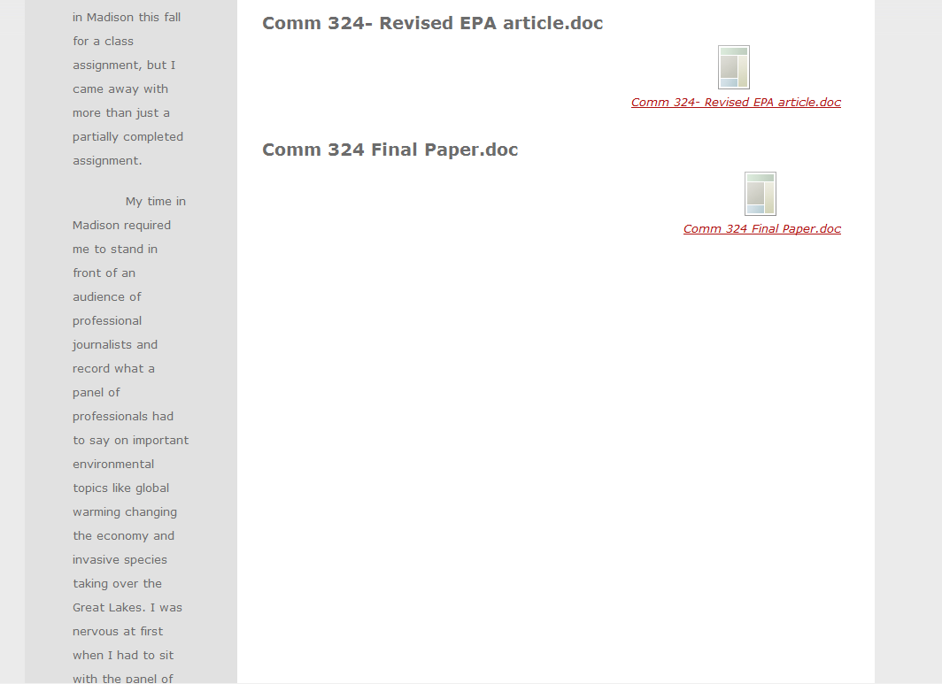

Slide 19
