Slide 1

Going Green in Wisconsin:
Using ePortfolios for Faculty Review
Patricia Fellows & Dr. William Bultman
University of Wisconsin Colleges

Slide 2

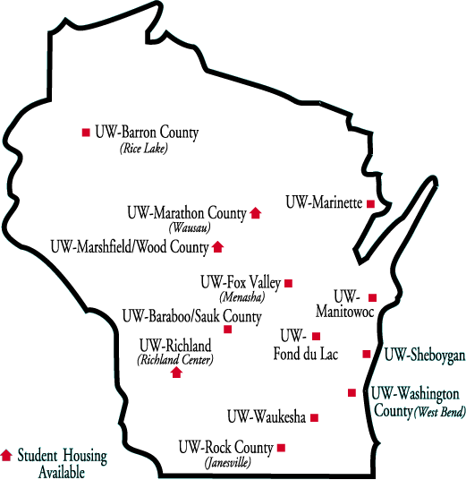
Who We Are!
UW Colleges: Two year campuses of the University of Wisconsin System

Slide 3
From Red to Green – Where we started and where we are now!
2003
2004
2009
2010
Faculty Senate
Go Digital
Meet Vendors
Desire2Learn ePortfolio
Senate supports pilot
Portfolios Submitted
Pilot Reviewed

Slide 4
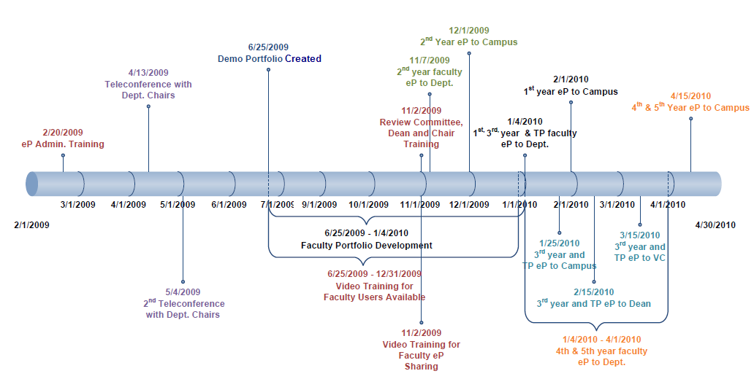

Timeline
Pilot Timeline

Slide 5
Stakeholders
IT Support (2)
Change
Faculty
Department
Campus
Reviewers (64)
Reviewers (40)
Others
Provost (1)
Dossier Preparer (51)
Chair
(7)
Chair
(13)
Dean
(13)

Slide 6
TRAINING
Faculty
  Desire2Learn Site
    Camtasia Videos - how to use ePortfolio tools
    Documentation – Desire2Learn and UWC
  Sample Dossier created & shared with pilot participants in ePortfolio
Review Committees
  Desire2Learn Site
    Camtasia Video - how to access and open dossiers
Deans
  Email – screenshots on how to access and open dossiers
Provost
  All dossiers are printed for 3rd year and 6th year faculty)

Slide 7

CHALLENGES
Mandate: all training will be done online, not webcast
Information Sharing:
  Many didn’t read emails
  Many didn’t watch training videos
  Many chairs didn’t forward information
Late: Many Faculty created ePortfolio last 2 days
“HELP!”: 11th hour phone calls to Pat
Notes:
Used narrated Camtasia videos

Slide 8

CHALLENGES cont.
We planned to have faculty “share” their
presentations but …
  11th hour sharing solution – use the dropbox
How do we make sure the dossier shared with
the department and campus are the same?
  Create 13 campus and 7 department eP sites
  Individual dropbox folders for all 51 faculty 2 locations
Notes:
different due dates for dossiers
in their campus and department sites with date restrictions

Slide 9

Let’s Take
a Look!
Notes:
Screenshots

Slide 10
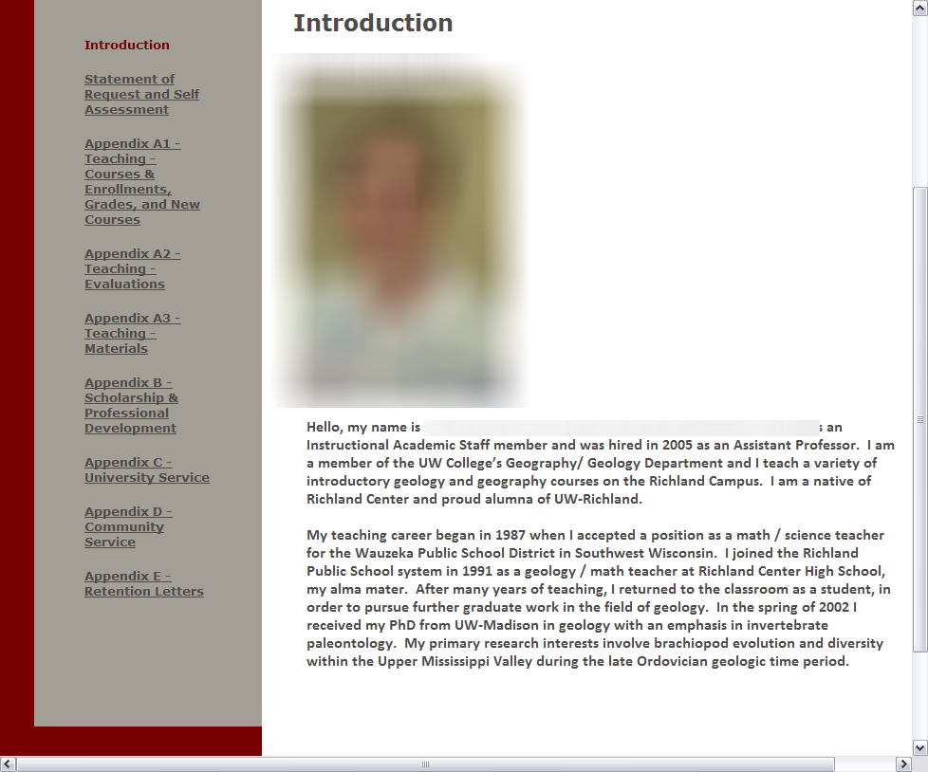

Slide 11
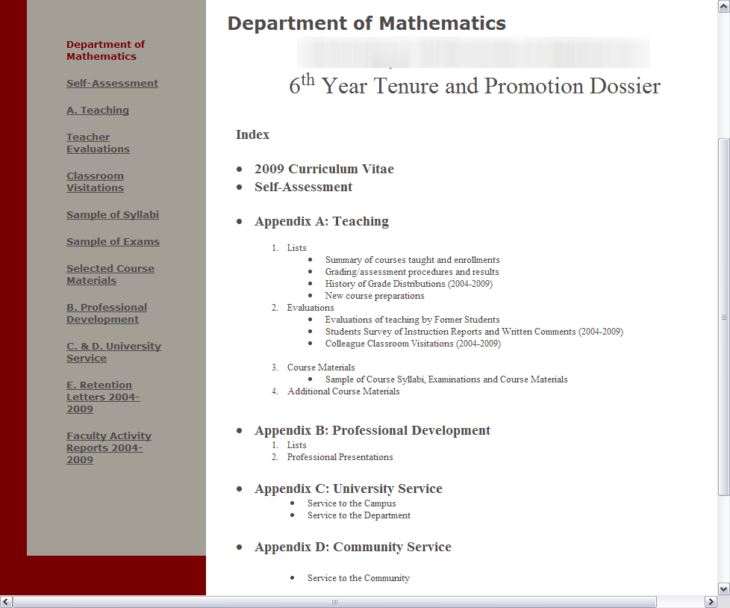
NAME

Slide 12
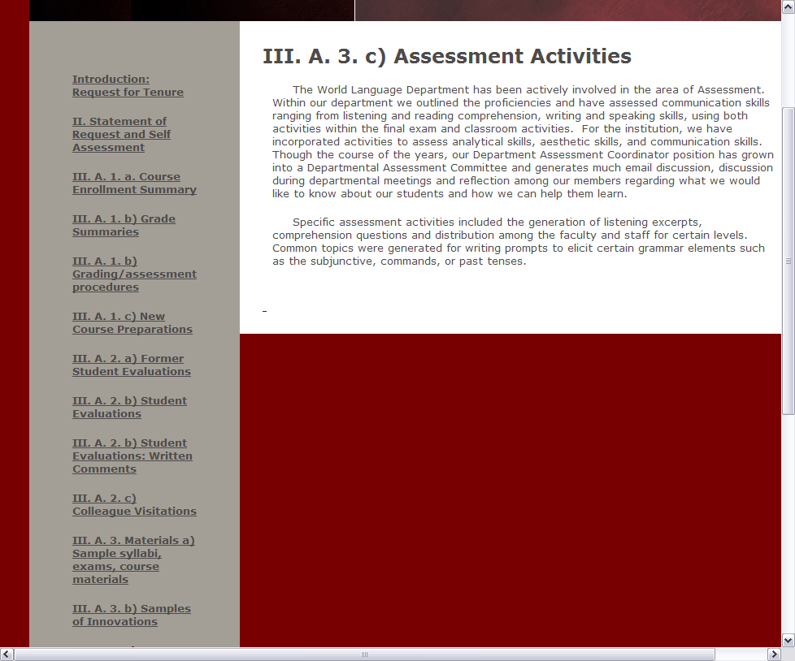

Slide 13
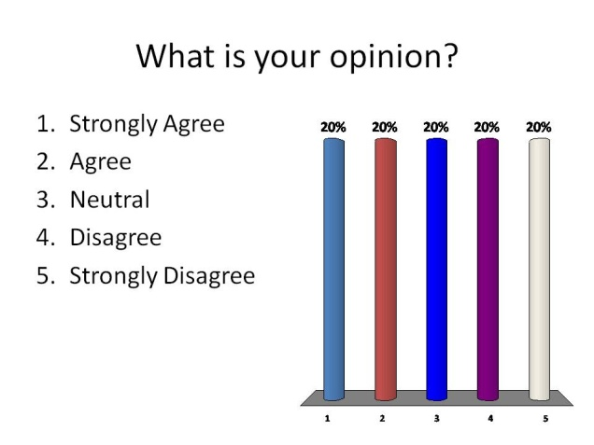
ASSESSMENT
Online Surveys of all participants
  Tenure-track faculty
  Reviewers
  Deans & Chairs
  Provost
Invited comments from Senate Professional Standards committee members who were involved in pilot

Slide 14
Summary of Survey Results
Comment Category | Pro | Con | Pro% | Con%
General Assessment | C |  | 6% | 3%
“Fit” of ePortfolio to Dossiers |  | DDD | 5% | 18%
Flexibility of Using Artifacts | C | D | 6% | 8%
Ease in Working with ePortfolio |  | DD | 3% | 15%
Standardized Organization |  | DD | 3% | 11%
Finding Files with ePortfolio |  | DDD |  | 18%
Compared to Paper Dossiers | CCC | D | 19% | 8%
Compared to Single PDF |  | DDDDDDD |  | 39%
Instructional Materials | C | D | 6% | 10%
UWC Policies and Timeline |  | DDD | 2% | 16%

Slide 15
Faculty Survey Data
ARTIFACTS
Create Artifacts – 1.96
Upload/download - 1.77
Place in presentation – 2.35
The ePortfolio Tools – Scale 1-5 (1 – Strongly Agree)

Slide 16
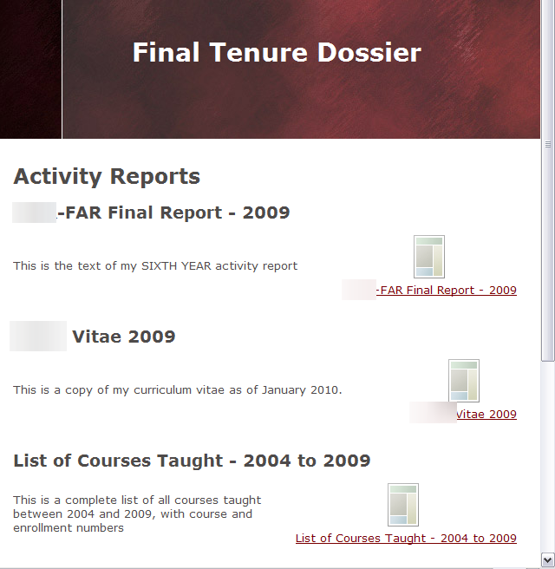
Faculty Survey Data
PRESENTATIONS
Create Presentations – 2.26
Edit Presentations – 2.62
Personalize – 2.77
Share Presentations – 2.19
Overall ability to develop a quality dossier using the Desire2Learn eP – 2.57

Slide 17
Faculty Comments
I really liked creating the portfolio much more so than a paper copy. It was easy to complete sections "out of order" in the dossier. I could easily pick and choose to work on pulling documents together and uploading a particular section of the dossier out of order according to my table on contents.
I did not find the interface intuitive. I leaned heavily upon Pat's generous support in answering my questions.
Since I was in my sixth year, I thought it was difficult to arrange everything. I think for first years, etc, it will be excellent to store everything, and arrange for the second and third year, etc. But, for me, in my last year, I don't think it turned out beautifully, but, apparently it was adequate. I kind of learned just by doing, but there were glitches in how things displayed.
I found it a bit frustrating to have to learn so much new sort of esoteric terminology to do something which was relatively simple. I felt this took too much time to figure out, but hopefully would be remedied by a quick guide.

Slide 18
Reviewers’ Survey Data
I prefer to review an eP dossier as opposed to a paper-based (binder) dossier - 2.25
Finding the dossiers in Desire2Learn was not difficult – 2.65
I am satisfied with the process for review of dossiers in Desire2Learn – 2.91
The online training provided to review dossiers was helpful – 2.73
I am satisfied with the Desire2Learn electronic portfolio tool – 2.92
The Desire2Learn portfolio tool is adequate for both PTR dossiers and faculty activity reports for merit for UW Colleges faculty – 2.94
The portfolio Reviewers – Scale 1-5 (1 – Strongly Agree)

Slide 19
REVIEWERS’ COMMENTS
Rather than relying on D2L being accessible and rather than having to navigate the layers of pages down to where the document that I wanted to view each time, I downloaded all documents to my desktop and converted all to PDF and used them that way. I don't need to look at frames and logos and bright colors when I want information.
It was easer to review the dossiers and we saved paper and money. I could review the dossiers even when I was out of the country.
I tried but could not access ANY dossiers on our D2L site.
Love the fact that it is available without having to wait for the departments to send it to the campuses. Love the fact that there are no huge binders to lug around to meetings.
Tenure track faculty have had to focus on difficulties with the ePortfolio tool and its administration when they should be working on the much more important aspects of content in their dossier. Reading and navigating the ePortfolio is different, but not better than an indexed PDF file.

Slide 20

Is the eP the BEST TOOL?
Faculty Perspective (anecdotal)
  I like it – will we have it next year?
  Ease of use – great for those who used training materials
  Paper copy – for 3rd and 6th year faculty
  Too many clicks – very tedious work to create dossier
Photo used per Creative Commons license: http://www.flickr.com/photos/oberazzi/318947873/
Notes:
Paper copy required by Provost

Slide 21

Is the eP the BEST TOOL?
Reviewers Perspective (anecdotal)
  Was there really a difference in organization/quality?
  Where are the dossiers?
  Better than paper, but not as good as PDFs
Photo used per Creative Commons license: http://www.flickr.com/photos/valeriebb/3006348550/sizes/s
Notes:
(permissions issue) and didn’t read instructions

Slide 22
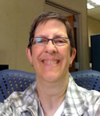
Is the eP the BEST TOOL?
Pat’s Perspective
  Obstacles – Major issues with sharing – forced to find workaround
  Quality of dossiers – average – last minute work
  Please READ! - Faculty and reviewers did not read messages or follow instructions
  More training! – we needed ITS staff involved too
Notes:
Did not take advantage of features as we had hoped

Slide 23
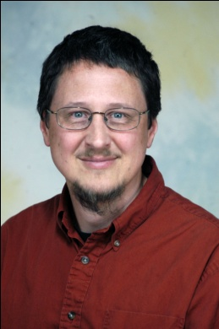
Is the eP the BEST TOOL?
Bill’s Perspective
  Unfriendly – Hard to find documents, no search ability
  Efficient – Nice to not cart paper… until the meetings
  Chaotic – Very clear that we were in a pilot
Notes:
Audience – what are you doing?

Slide 24
NEXT STEPS
Share data widely
Work with CIO and Provost, Senate Professional Standards Committee and Department Chairs to determine what will happen next year
Write a white paper on pilot

Slide 25
How has your institution gone digital with faculty dossiers?

Slide 26
CONCLUSION –
This worked but….
Worked well for faculty who took the time
Sharing function inconsistent and difficult (fixed in 9.0?)
Need export function that can be read without Desire2Learn
Dropbox worked, but reviewers want single navigable PDF
Future: ePortfolio to gather artifacts, Word to create dossiers, PDF for single document, Dropbox for dissemination

Slide 27

QUESTIONS

Slide 28
THANK YOU!
Patricia J. Fellows (patricia.fellows@uwex.uwc.edu)
    Instructional Technology & Training Specialist
    University of Wisconsin Colleges & UW Extension
William Bultman, PhD. (bill.bultman@uwc.edu)
    Professor: Computer Science
    Department Chair: Computer Science, Engineering, Physics & Astronomy
    Associate Dean: University of Wisconsin – Fox Valley

