Slide 1


Assessment of
Industrial Internships
Karyn Biasca

Slide 2
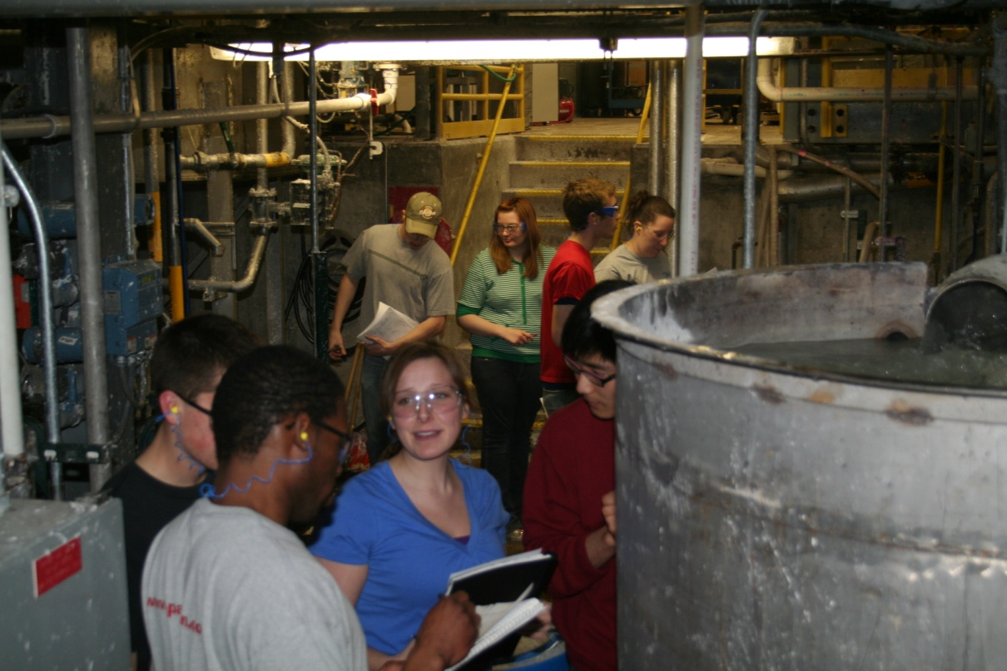
Presentation Outline
Background of program
Description of internship
Student learning outcomes for internship
Use of D2L

Slide 3


Paper Science and Engineering
ABET accredited engineering program
Thirty-five consecutive years of 100% placement in entry-level engineering positions
Rigorous curriculum
Extensive laboratory facilities

Slide 4
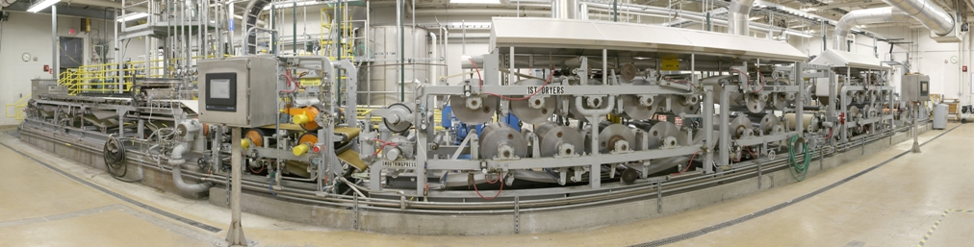
UWSP PAPER SCIENCE AND ENGINEERING
PILOT PAPER MACHINE
Photographed by:
Tom Charlesworth
“Fastest Student Operated Paper Machine in the World”

Slide 5
Internship
Requirement for graduation, 3 credits
Companies actively recruit students for positions
Nine-month term in the field
Originally assigned grades based on extensive paper written about pulp and paper technology
Incorporated supervisor review into grading process
~Fifteen years ago, students’ papers retained at mills due to concerns about proprietary information
Supervisors provided with a rubric to grade the papers

Slide 6
ABET Student Outcomes for Internship
Students will demonstrate:
  ability to design a system, component, or process to meet desired needs within realistic constraints such as economic, environmental, social, political, ethical, health and safety, manufacturability, and sustainability
  ability to function on multi-disciplinary teams
  ability to identify, formulate, and solve engineering problems
  understanding of professional and ethical responsibility
  knowledge of contemporary issues
  ability to use the techniques, skills, and modern engineering tools necessary for engineering practice

Slide 7
Record of Activities During the Internship
Problems with students remembering their activities throughout their internship
Used Discussion Forum in D2L with questions about their activities while on their internships
Wide range of question “depth”
Provides a record of their internship

Slide 8
PSEN 300: Mill Internship
Course taken upon return to campus
Will now use D2L ePortfolio to collect and present evidence of achievement of learning outcomes
Requirements
  Reflection essay
  Video description of experience
  Evidence of work done during internship

Slide 9
Student Learning Outcomes for PSEN 300
Students will be able to:
explain the operation of the industrial facility in which they worked
describe the professional skills they developed during their internship
demonstrate communication skills (written and oral)

Slide 10
Current status of Internship Assessment
Meeting with PSEN 300 students at beginning of semester
Extensive discussion of ePortfolio requirements
Will meet at mid-semester to review progress

Slide 11
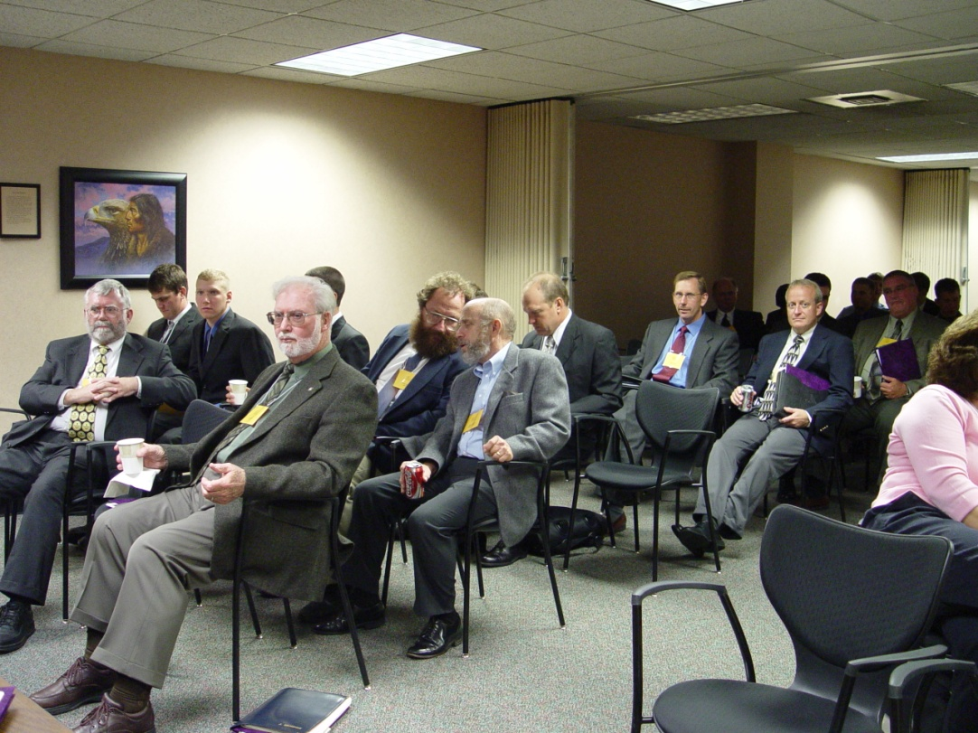
The Path Forward
ePortfolios will be shared with industry advisory committee members
New approach will be discussed at spring meeting of industry advisory committee
Changes made if needed

Slide 12


