Slide 2
Multi Factor Authentication with Duo

Slide 4
UW-Eau Claire went with Duo
…based upon UW-Madison’s extensive RFP that they did in 2017
Interestingly, Symatec did not bid on that RFP
Even more interesting, Microsoft’s solution lets you ask for what you have first.

Slide 5
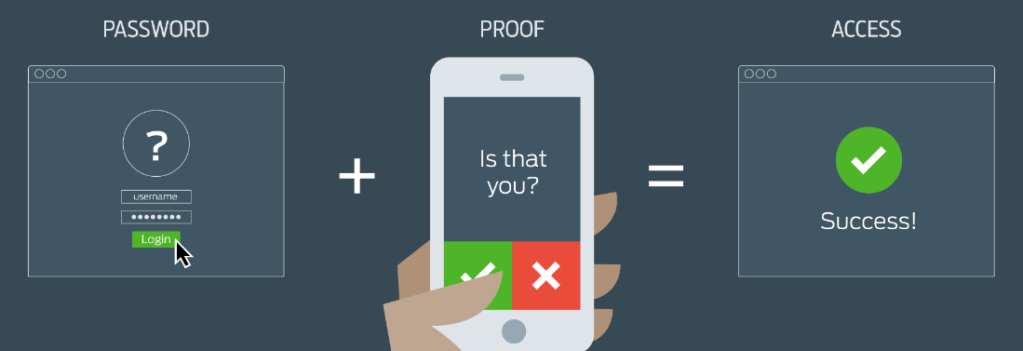
What is Multi-Factor Authentication?
Adds a 2nd layer of security
Combines something you know with something you have (i.e. password + code sent to mobile device)

Slide 6
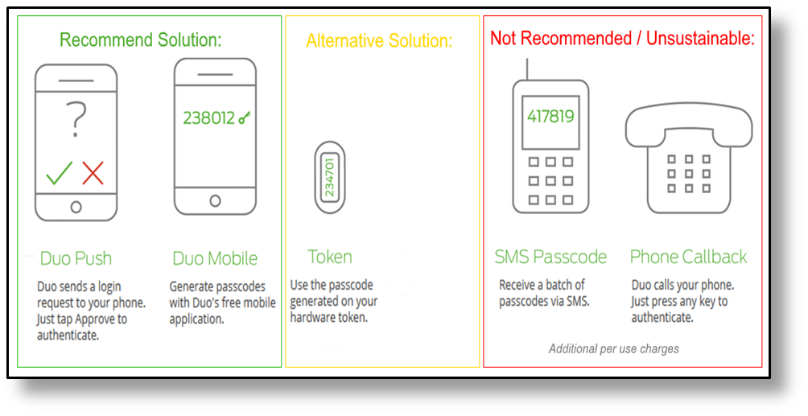
Options for Multi-Factor Authentication

Slide 7
Note:!!!
Duo will tell you 98% of your clients will use a smart phone—NOT TRUE!
Learned from a conference call with University of Idaho ~5,000 clients needed ~300 hardware tokens
At UW-Eau Claire it has been ~200 out of ~1,100 so far
UW-Eau Claire purchased tokens in quantity of 1,000 (which drops the per token cost to $4 each)

Slide 8
Tokens are $4.38 each…if you buy in quantities of 1,000

Slide 9
Using 2-factor on a smart phones does NOT subject the phone to open records requests
From: Jennifer Lattis [mailto:jlattis@uwsa.edu] Sent: Wednesday, March 21, 2018 5:10 PM To: Joseph Kmiech <joseph.kmiech@uwrf.edu> Cc: Andrew Preboski <apreboski@uwsa.edu> Subject: Using personal cell phones
Good question. The Public Records Law applies based upon the content of a record, and not where it is kept. A work related email or text message is a public record whether it is sent on a personally owned device or a UWS device. A personal email unrelated to work is not a public record no matter where it is kept. So while the fact that an employee is using two step authentication on a personal phone might generate a public record, it won’t subject the rest of an employee’s phone to a public records request. I use my own personal phone for two step authentication myself.

Slide 10
More on open records and Duo
From: Erin Kastberg <ekastberg@uwsa.edu> Sent: Monday, March 26, 2018 2:51 PM To: Eckardt, Chip <eckardpp@uwec.edu>; Joseph Kmiech <joseph.kmiech@uwrf.edu>; CIOs Only <cios_only@uwsa.edu> Subject: RE: Second Factor Question
I agree with you, Chip.
Thanks,
Erin
Erin E. Kastberg Senior System Legal Counsel University of Wisconsin System Office of General Counsel 1848 Van Hise Hall 1220 Linden Drive Madison, WI 53706 Telephone: (608) 262-6497 Fax: (608) 263-3487 Email: ekastberg@uwsa.edu __________________________ The preceding e-mail message (including any attachments) contains information that may be confidential, be protected by the attorney-client or other applicable privileges, or constitute non-public information. It is intended to be conveyed only to the designated recipient(s). If you are not an intended recipient of this message, please notify the sender by replying to this message and then delete it from your system. Use, dissemination, distribution, or reproduction of this message by unintended recipients is not authorized and may be unlawful.
From: Eckardt, Chip <eckardpp@uwec.edu> Sent: Tuesday, March 20, 2018 12:02 PM To: joseph.kmiech@uwrf.edu; CIOs Only <cios_only@uwsa.edu>; Erin Kastberg <ekastberg@uwsa.edu> Subject: RE: Second Factor Question
I would suggest asking System Legal (that is why I am copying Erin Kastberg on this reply).
At UW-Eau Claire we say that no, it does not. The rational is your phone is only used to grant yourself access. There is no university data on the phone that results from using Duo to give yourself 2-factor access.
HOWEVER, if people are storing sensitive university documents on their phone that phone CAN be subject to open record requests. But just using the Duo app should NOT subject phone to open records request by itself.
Chip

Slide 11
Why are we doing Multi-Factor Authentication [MFA]?
Protect our clients and customers online identities
Provide a way for our customers and clients to know if someone is attempting to use their username and password
Protect our University
Protect our Faculty and Students

Slide 13
Testing
Testing
Testing
TESTING
TESTING
Testing
Testing!

Slide 14
All faculty and staff (including student employees) will be required to use Multi-Factor to access systems with HIGH data classification
vi. Authentication for users with access to high risk information shall employ multi-factor authentication mechanisms and commensurate controls to ensure integrity of the credentialing process;
Secure control of the credentials (i.e., devices); and,
Determine the de-authorization of the credential.
https://www.wisconsin.edu/uw-policies/uw-system-administrative-policies/information-security-authentication/information-security-authentication/

Slide 15
Data Classification Levels
Unauthorized disclosure, alteration, loss, or destruction of data
High Risk
RED
Moderate Risk
YELLOW
Low Risk
GREEN

Slide 16
Data Classification Levels
High Risk
Moderate Risk
Low Risk
Causes personal or institutional financial loss or violates a statute, act or law
Violates confidentiality agreement in possessing, producing or transmitting data
Causes significant reputational harm to the University
Requires UW System to self-report to the government and/or provide public notice if the data is inappropriately accessed.
Mild adverse impact on the institution or UW System mission, safety, finances, or reputation.
No adverse impact on the mission, safety, finances, or reputation of the institution or UW System.

Slide 17
Strategic Communications Plan
Administration
LTS Help Desk
University Senate
Student Senate
Classified Staff Council
Faculty & Staff
Student Employees
Students

Slide 18
Key Points on Why UWEC is implementing Duo Security:
We are trying to protect student and employees’ identities. With the exponential rise of identity theft we need to put more effort into helping our students and our employees.
If you use a smart phone if hackers do attempt to log in to your account you are notified from the Duo app on your smart phone.
Duo has the most flexibility and considered the simplest for clients to use. If you use a smart phone, Duo also lets all students and employees use it to provide additional security on commercial sites such as Amazon.com. With Duo one solution works in multiple places to protect you, not just for campus resources.
We are trying to protect our students and employees from financial theft. Unfortunately, people have lost money because of accidentally giving up their passwords. We almost had an incident where well over $10,000 could have been stolen. That incident was escalated to the FBI.

Slide 19
Key Points on Why UWEC is implementing Duo Security:
UW-System has implemented IT security policy 1030.A that requires the use of 2-factor authentication when accessing high risk confidential data such as; grades, personal information, and health records.
Implementing Duo should reduce the number of phishing attacks that come from compromised UW-Eau Claire accounts where clients unknowing gave up their passwords.
Hackers can get your estimated income, social security number and file for tax refunds in your name if they get your password and there is no 2-factor authentication in place.
Hackers can break into your account if they find your password and you are not using 2-factor authentication and see information about you which would lead them to such things as social media login information, bank login information, etc.

Slide 20
When Will Duo Be Available?
December and January--We will be testing Duo. We will be asking for volunteers to help test the product
February/March—We will be rolling Duo out to ADAs and administrative staff, including student employees
March-and April—We will be rolling Duo out to faculty
Fall—We will be rolling Duo out to all students

Slide 21
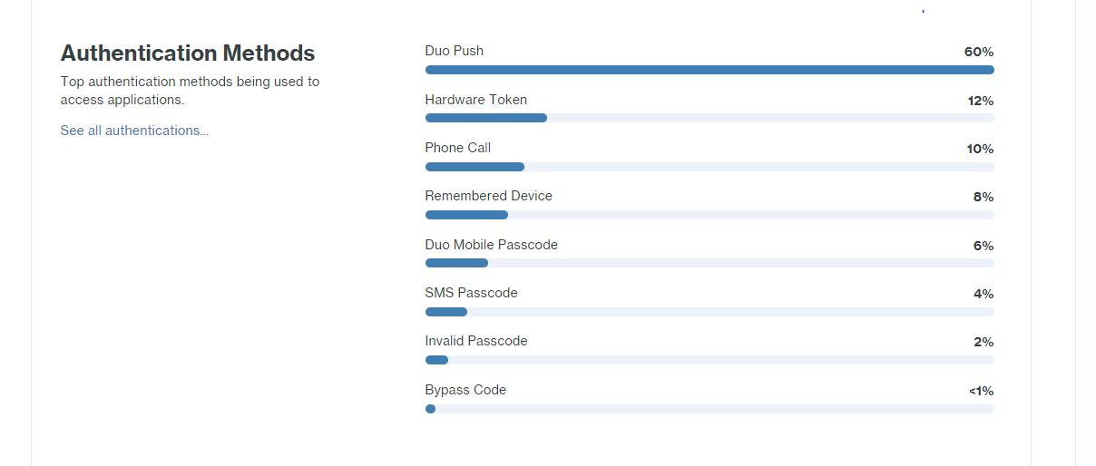
When Will Duo Be Available?
UPDATE
As of April 10 we had over 1,100 faculty and staff in production on Duo

Slide 22
Buy Telephony Credits
…Let your clients know that costs money

Slide 23
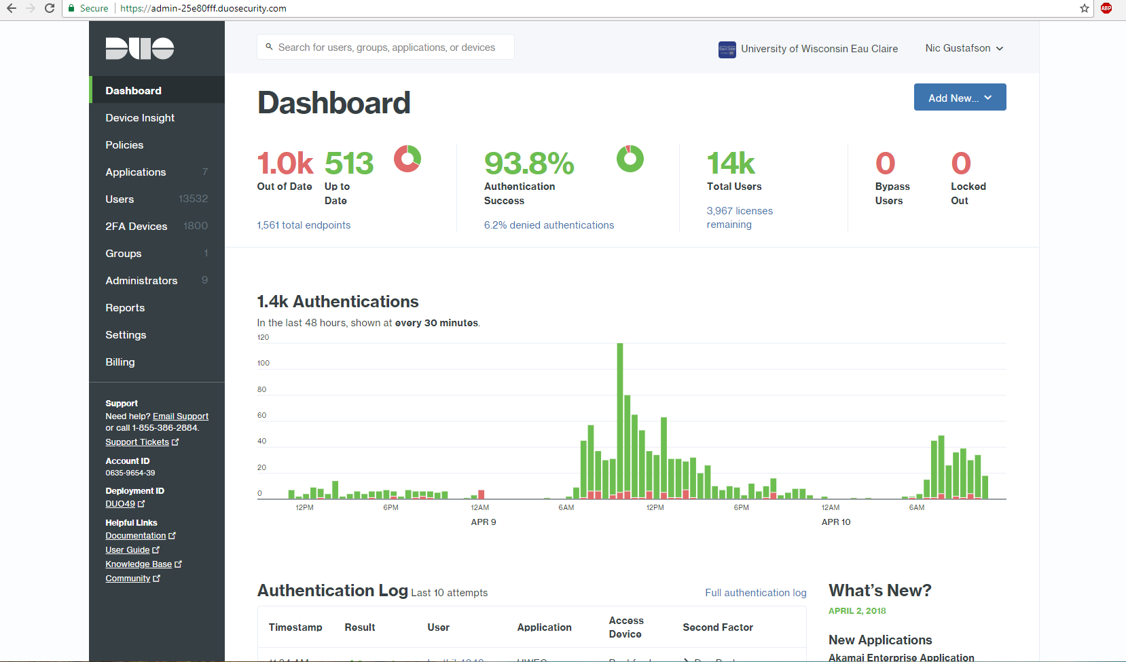

Slide 24
Email to dep chair and ADA
Hi,
LTS is rolling out a new ‘sign in’ procedure using DUO multi-factor authentication, which is required by the UW-System policy. Geography & Anthorpology is the next department that will receive this application and procedure change. This new procedure will effect CampS at first, and later be used for other services. If you would like to sit down and meet for around 30 minutes, I can show you how DUO works, and explain what the timeline looks like for this process to go live in your department. Otherwise I can just email you a timeline and then we can start the process.
For more information on DUO, please check out the link: https://www.uwec.edu/kb/article/services-duo-overview/ or watch the video https://www.youtube.com/watch?v=EMj89Ulpx6c
A typical timeline looks like the one below
4/9 – Initial informational email will be sent to all staff members
4/12 – Enrollment email sent to all staff members
4/13– Go live; DUO will need to be used to log into CampS
We try and have someone there in your department when we turn it on to answer any questions or deal with any issues that might arise.
Please reply and let me know what works best for you and your department.
I would be glad to answer any questions you may have.
Thanks,

Slide 25
Email 1
SUBJECT – UW System New Login Procedure date go Live
Hello X Department,
To protect your online identity, secure our campus, and comply with UW-System Policy we are implementing two-factor authentication starting with CampS. So, when you log into CampS on or after DATE OF GO LIVE, you will need a phone or token (looks like a key fob) in addition to your UWEC password.
When you receive the email from Duo Security tomorrow, please do the following:
Click the link and register a phone. Refer to the Duo Security Overview guide for additional information and instructions. NOTE: We recommend a smartphone if you have one. If not, you can use a regular phone. Complete this efrom if you wish to have a token https://eform1.uwec.edu/form.aspx?pid=d6b4de7a-a68b-41af-97f5-ecc275ef7d2d&formid=f7fe69a5-ccc2-4725-b7b1-6499f6cb1e06&coxxxetext=Please.
After Duo Security has been installed your phone or you receive a token, go to https://logintest.uwec.edu/duo/ log in to test that it works. NOTE: If Duo Security is configured correctly you will see “It Works!”
While this process may take some getting used to, it will be useful in reducing fraud and data leaks. Duo Security will be rolled out to more services soon. An additional benefit to using this service is that you may be able to secure some of your personal accounts like Amazon. Refer to Duo for Amazon guide for instructions.
Please register your phone or request a token before GO LIVE DATE. Contact me with questions.
Thanks,
Steve Ranis CISSP CSAdmin / Information Security Officer 102 Schofield University of Wisconsin-Eau Claire

Slide 26
Email 2
From: Duo Security <no-reply@duosecurity.com> Sent: Friday, December 15, 2017 11:52 AM To: client email Subject: Duo Security Enrollment
Hello,
UW-Eau Claire is implementing Duo Security, a secure way for you to log into your organization's applications. Set up your account for Duo to start protecting your online identity.
Duo Security is a two-factor authentication service that allows you to use your password (something you know) plus Duo (which is something you have).
To learn more about Duo authentication, visit the guide here:
https://guide.duo.com/enrollment
To begin, click this link to enroll a phone, tablet, or other device:
https://SOME CUSTOM LINK

Slide 27
Email 3
Forward original email and put this on top of it
Hello X Department,
As a reminder, we go live with Duo Security for CampS tomorrow.
If you have not enrolled yet, please do so before TIME tomorrow. You will not be able to log into CampS until you complete you reenrollment. Instructions are in my original email below.
Contact me with questions.
Thanks,
Steve Ranis CISSP CSAdmin / Information Security Officer 102 Schofield University of Wisconsin-Eau Claire Eau Claire, WI 54702 715-836-5190

Slide 28
Impossible to Over Communicate
We developed a communication plan before we started
We developed a project plan
Informing leaders/deans/directors
Publicize multiple different ways
We do initial email to head of department, offer to do an in-person demo
We send three separate emails
We have staff (mainly students) onsite when it goes live to assist
Tell them how 2-factor can help them (Amazon)

Slide 29
Question and Answer

