Slide 1

Ensuring Youth Protection and Compliance within Bridge Programs
Prenicia Clifton- Director of Youth Protection and Compliance
University of Wisconsin-System Office of Compliance and Integrity
April 6, 2021

Slide 2

A Holistic Approach to Protection in Bridge Programming
Abuse Prevention
  Peer to Peer Abuse
  Adult to Minor
Covid-19 Mitigation Planning
Youth Mental Health

Slide 3

Abuse Prevention
Adult to Minor
Orientation Planning
CBC’s and Reference Checks
Appropriate Interactions
Monitoring and supervision
Feedback
Consumer participation
Responding
Administrative practices
Notes:
Policies, screening, training, monitoring and supervision, internal feedback, consumer participation, responding, and administrative practices

Slide 4

Abuse Prevention
Peer to Peer
Unstructured Free-Time
Bullying
Reporting Protocols
Consumer participation
Responding
Administrative practices
Notes:
Policies, screening, training, monitoring and supervision, internal feedback, consumer participation, responding, and administrative practices

Slide 5

Abuse Prevention Planning Questions
  Do have a program orientation schedule that trains on peer to peer and adult to minor abuse prevention?
  Does your daily planning limit unstructured free time?
  How will participants tell you that they are having problems?
  How do you train staff around appropriate and inappropriate interactions with participants?
  (Access, Privacy, and Control)

Slide 6

Covid-19 Mitigation Planning
Professional Development Opportunities
ACA Field Guide
Daily Screening Plans
Testing Protocols
Communicable Disease Protocols
Communication Planning
Staff Training

Slide 7

Covid-19 Mitigation Questions
  Have you updated Communicable Disease Protocols for Minors on Campus?
  Have you created Covid-19 specific waivers and Consent
  Do you have a transportation plan that mitigates program exposure?
  What is your communication plan to families

Slide 8

Social Emotional Considerations for Program Development
Looking to the Future
Altruism
Emotional Security
Autonomy
Empowering
Builds Trust
Culturally Based
Relationship Building
Experiential Learning
Flexible Attendance
Programming should encourage altruism

Slide 9
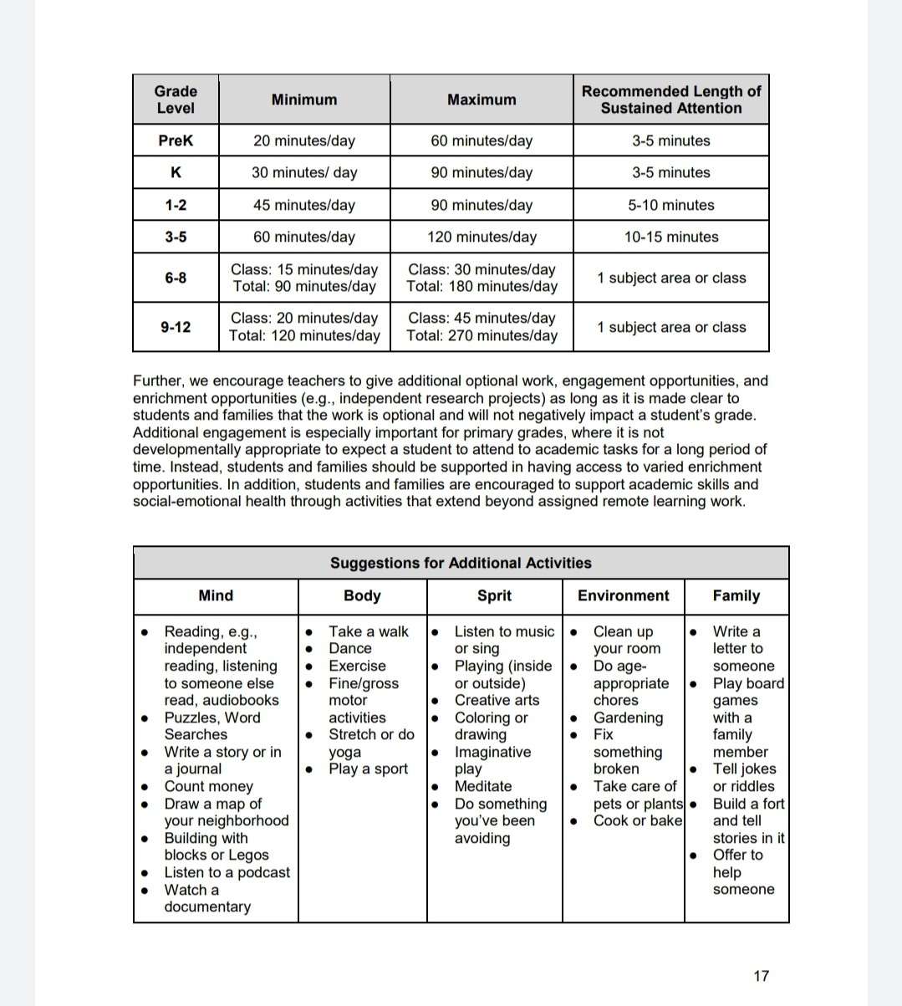
Considerations for Virtual Program Development

Slide 10

Mental Health First Aid
Signs and Symptoms
Changes in Typical Adolescent Behaviors
Disengagement
Misconduct
Apathy
ALGEE Plan
Assess for Risk of Suicide or Harm
Listen nonjudgmentally
Give Reassurance and Information
Encourage Self Help and Other Supports
Encourage Appropriate Professional Help

Slide 11

Social Emotional Learning and Mental Health Questions
  How much time will you dedicate to social emotional experiences during your program?
  What does culturally responsive engagement with participants look like?
  How will staff support a youth in distress?
  What campus supports will be available to program participants?

Slide 12
May Professional Development Series
Building a Program from Scratch:
Daily Schedule Planning
Program Checklists:
PPE
TESTING
Daily OPERATING PROCEDURES
Staffing
Schedules
Trainings

Slide 13

Questions:

