Slide 1
Scaling Up Summer Bridge Programs
Program Assessment
Warren Anderson
Senior Equity, Diversity, and Inclusion Officer
UW System Administration

Slide 2
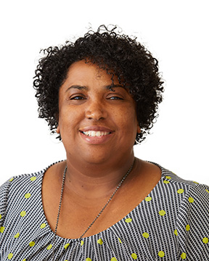
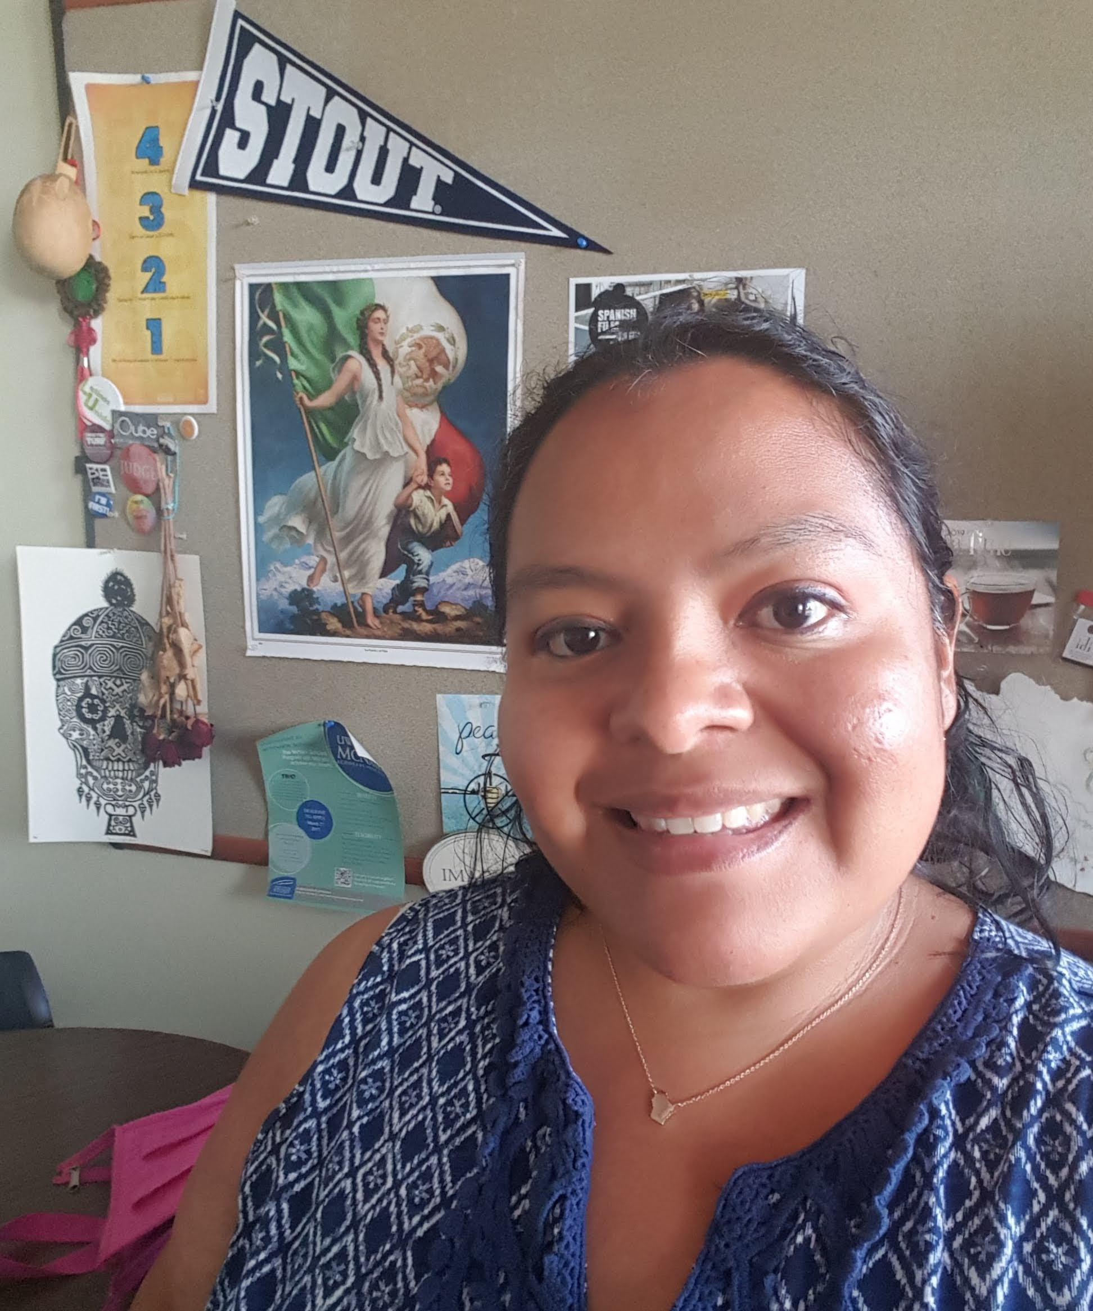
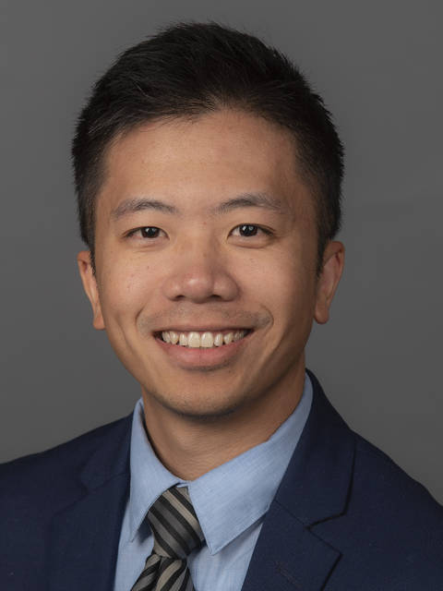
Panel Members
Antoiwana Williams
Director of Multicultural Student Services
UW-La Crosse
Vickie Sanchez
Student Services Coordinator
UW-Stout
Dang Yang
Director of Multicultural Affairs
UW-Eau Claire

Slide 3

Session Objectives
  Discuss the impact of the pandemic and social justice issues of the past year on students with varying identities;
  Discuss how to ensure inclusive and equitable bridge programs.

Slide 4

Panelist Questions
Provide a high-level overview of your bridge program.
How can programs address the impact of the pandemic and social justice issues of the past year on students with varying identities (LGBTQ+, student of colors, students with disabilities, etc.)?
How can administrators ensure inclusive and equitable bridge programs?
What do you see as the biggest challenges and opportunities for scaling up bridge programs?

Slide 5
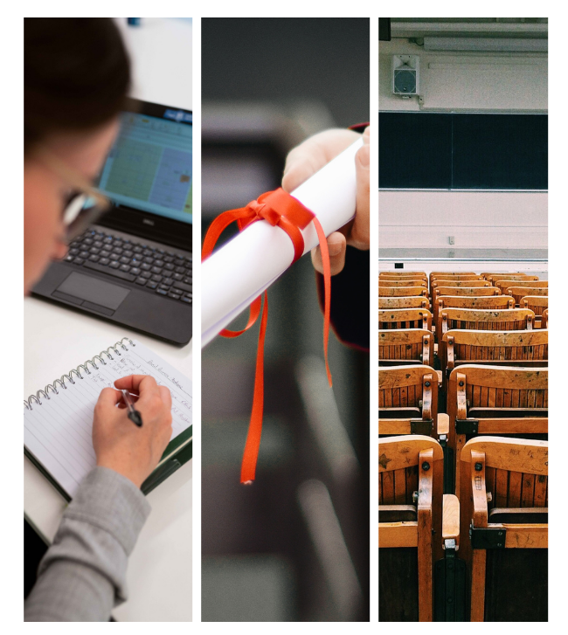
Life After Bridge – Next Steps
How can campuses benefit from the success of summer bridge programs.
Notes:
SLIDE SPEAKER: Vitaliano
*Mention challenge and discuss how the campus pivoted to address the challenge and turned it into a positive outcome
Talking Points:
Impact on students and staff: provide some examples of how campuses are promoting self care and wellness tips to manage the virtual environment
Access to technology: what are some campuses doing to make sure technology is being provided to students in hybrid or online formats
How important video conferences capabilities were when it came to tele health and tele counseling
Campus communications: external communications, hotlines, newsletters, etc.
More communications across units – UW-Milwaukee example of Pathways & Interventions
Space: how has existing space been converted to support testing or classrooms
Budgetary impacts: impact of seg fees and furloughs on student affairs

