Slide 1
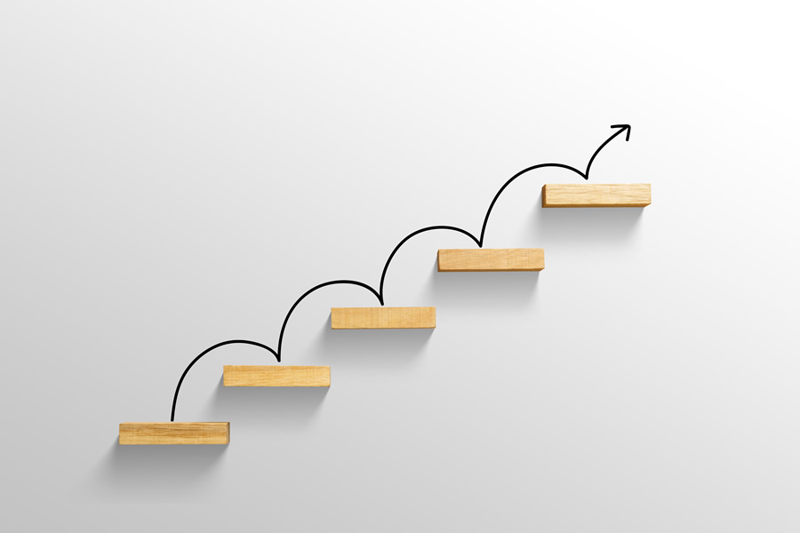
Scaling Summer Bridge Programs
UW System Student Success Summit
Chris Navia, Ph.D.
Associate Vice President for Student Success
University of Wisconsin System Administration

Slide 2

Today’s Objectives
Reflect on the question of what it means to scale up a summer bridge program with an intentional focus on equity
Explore the critical steps involved in the scaling process
Discuss the notion of institutional readiness and assess where we are in terms of our own scaling efforts
Explore stakeholder mapping to help us think through who needs to help us in the scaling process and why
2021 | 2

Slide 3
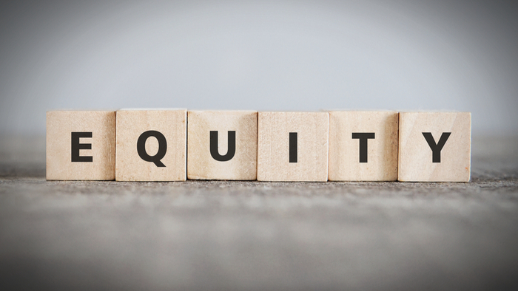
In the context of summer bridge programs, good scaling efforts start with an intentional focus on equity
Inclusive in Planning Efforts
Which students could most benefit from participation in your newly scaled summer bridge program? How are you going to make sure they have access to it and can readily participate?
Equitable Outcomes & Goals
What metrics will you track to ensure that your
newly scaled summer bridge program fosters
learning and growth among all of the students who participate in it?
Student-Centered Focus
How do you ensure that your scaled-up summer bridge program will effectively serve all students in
the ways they most need?
2021 | 3

Slide 4
A Definition: What do we mean by scaling up?
“Scaling up” (v). The process of increasing the size and/or scope of a successful, evidence-based practice which currently exists in one or few places across the institution in order to impact more students.
When determining a practice to scale-up, the practice should:
Be a proven evidence-based practice with clear results
Be aligned with campus/system goals and strategic objectives
Have full commitment from leadership
Impact a targeted and/or at-risk population
Be realistic in nature
Be able to produce favorable results within given time constraints
Adapted. Education Delivery Institute, 2012.
2021 | 4

Slide 5
Key Question: How will we know when we have successfully scaled our work?
SCALE IS ACHIEVED WHEN…
The program, service or policy has the intended impact on the student population you expected it to
There are measurable outcomes or improvements that you can readily point to
The program, service or policy is ”institutionalized” and can now be taken for business as usual
Resources are aligned to support the scaled-up program, service or policy
2021 | 5

Slide 6
The process of scaling involves several critical steps
Assess Institutional Unit Readiness
Prepare Campus for Change
Develop and Execute Plan
Assess Campus Readiness
Evaluation and Follow-Up
Scaling Up Framework
THEORY OF ACTION
Communication
Stakeholder Engagement
Adapted. Education Delivery Institute, 2012.
2021 | 6

Slide 7
Communication and stakeholder engagement are also critical components of the entire scaling effort
Assess Institutional Unit Readiness
Prepare Campus for Change
Develop and Execute Plan
Assess Campus Readiness
Evaluation and Follow-Up
Ensuring that relevant stakeholders are engaged in the planning and implementation process and provided with the necessary information, at the appropriate time
Communication
Stakeholder Engagement
Adapted. Education Delivery Institute, 2012.
2021 | 7

Slide 8
It is important to keep in mind that every scaling effort is susceptible to obstacles and challenges
Scaling Obstacles
Lack of leadership
Lack of financial and human resources
Lack of faculty support
Lack of adequate institutional research or information technology support
Intervention fidelity
Too many other initiatives going on on campus
2021 | 8

Slide 9
There are some principles and basic practices that can aid in the mitigation of scaling obstacles
Practice
Examples
Design pilot with scale in mind
  Think about the pilot as a phase in a long-term change process
  Start with a clear definition of the problem at scale
  Develop an evaluation plan that includes scalability
Establish systems to gauge readiness
  Identify a process or a plan for assessing readiness
  Conduct cost studies
  Identify potential risks
  Explore other scaling models outside of higher education
Engage stakeholders effectively
  Identify key individuals who will need to be engaged and develop plans to include them
  Communications plans that include faculty, students, and potential critics
Align resources
  Shift resources from programs that are not working to those that might
  Reallocation of staff or budgetary lines
Adapted. Education Delivery Institute, 2012.
2021 | 9

Slide 10
This template is intended to help you determine your level of institutional readiness
 |  | Readiness Level
Readiness Criteria | Questions to Consider | Not in Place | Challenges Present | Gaining Traction | Established
Stakeholder Management | Do key stakeholders understand what you’re trying to accomplish? Do they feel motivated to help? | ❒ | ❒ | ❒ | ❒
Theory of Action | Is the strategy aligned with the organization’s aspiration? Has the strategy been assessed to determine projected impact? Has a clear theory of action been articulated and shared? | Rationale:
Leadership Commitment | Has leadership made a commitment to support and drive the strategy?
Stakeholder Assessment | Have all potential stakeholders been identified? Has potential impact on them been assessed?
Change Management | Has the organization created an implementation environment conducive to the change? | ❒ | ❒ | ❒ | ❒
Cultural Alignment | Is the current organizational culture conducive to implement the strategy? Have the necessary cultural shifts been identified and communicated to impacted organization staff? | Rationale:
Practices and Procedures | Have the required everyday practices been identified and set in place (e.g. policy changes, removal of organizational barriers)?
Infrastructure/Capacity Building | Have necessary structural changes been identified and implemented (re-allocation of roles and responsibilities, new positions established)? Are the mechanisms in place to support organization staff with the appropriate tools, training, and/or additional support needed?
Implementation Management | Are project and program management tools in place to plan, execute, and monitor the strategy’s implementation? | ❒ | ❒ | ❒ | ❒
Team | Is there a team in place to coordinate the implementation of the strategy? | Rationale:
Funding | Has adequate funding been allocated to support the implementation and management of the strategy?
Data/Routines | Is the data needed to monitor progress and evaluate the efficacy of the strategy available and accessible by the appropriate people? Are processes in place to provide feedback to leadership and the implementation team on implementation progress? Have routines been established to inform leadership of progress and to identify and address challenges?
Plan | Has an actionable implementation plan, which includes measurable outcomes, timelines, and communication strategies been developed?
SCALING UP
READINESS
ASSESSMENT
Relational Skills
Report
Adapted. Education Delivery Institute, 2012.
2021 | 10

Slide 11
Communication and stakeholder engagement are critical components that require attention throughout the entire scaling effort
Assess Institutional Unit Readiness
Prepare Campus for Change
Develop and Execute Plan
Assess Campus Readiness
Evaluation and Follow-Up
Ensuring that relevant stakeholders are engaged in the planning and implementation process and provided with the necessary information, at the appropriate time
Communication
Stakeholder Engagement
Adapted. Education Delivery Institute, 2012.
2021 | 11

Slide 12
To develop a stakeholder engagement strategy, it is helpful to think of the engagement’s purpose, flow, and method
Question
Examples
Purpose
  What do we need from this stakeholder group?
  Gain buy-in
  Inform of upcoming changes
  Receive approval
  Obtain feedback
  Consult in planning efforts
  Change work practice
  Change attitude
Flow
  Receive information from group
  Provide information to group
  Back and forth information sharing
  What direction(s) should communication flow ?
Method
  What is the best way to communicate with and engage this group?
  Standing meetings
  Email blasts
  Memos
  Chain-of-command
Adapted. Education Delivery Institute, 2012.
2021 | 19

Slide 13
Stakeholder Mapping
TARGETS
Messengers/ champions
activate them
Opponents
watch them
High
Power to influence outcome
Not a priority
minimize engagement with them
Fan club
inform them – proportionate to their influence
Low
Low
High
Level of support for your effort
Adapted. Education Delivery Institute, 2012.
2021 | 13

Slide 14

Closing Thoughts
2021 | 23

