Slide 1
“I’m afraid I’ll say something wrong”
Supporting the Facilitation of Difficult Conversations in the Classroom and Beyond
Julie Minikel-Lacocque, PhD
UW-Whitewater

Slide 2
Turn & Talk:
What has your heart right now?
How do you want your learning spaces with students to feel?

Slide 3
Why the Questions?
What has your heart right now: A question to ask our students & ourselves
How do you want your learning spaces with students to feel: Figure out your answer
Our heart is in everything we do
Acknowledging this with our students connects us
Asking this and sharing this shows our humanity & makes room for vulnerability
We need to know this in order to create a community in which “difficult conversations” can happen
Knowing your answer & staying connected to it will guide your facilitation (both planned and unplanned)

Slide 4
The Plan
  1. A Critique/ Food for thought:
    a. “difficult conversations”
    b. “civil dialogue”
  2. Why should we do this?
  3. Creating environments in which we can talk about hard things
  4. Ideas about “how to”
  5. Work with scenarios

Slide 5
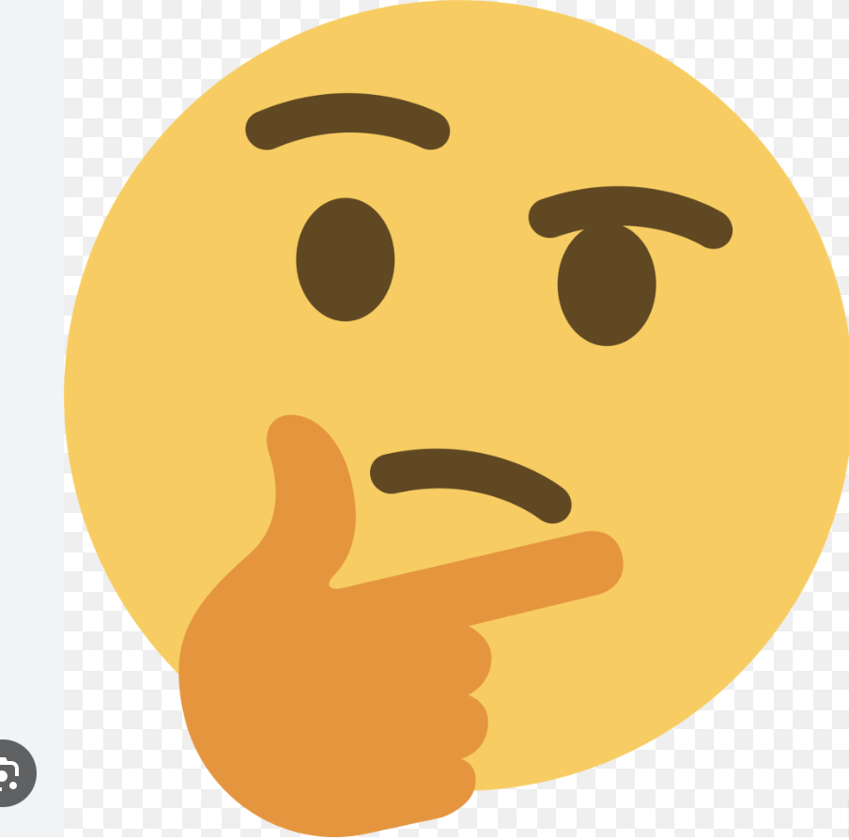
A Critique: “Difficult Conversations”
Whose experience tends to be centered when we think about how conversations about oppression are “difficult?”
What are the distinct ways different identities experience the difficulty/ discomfort?

Slide 6
A Critique: “Civil Dialogue”
Power Dynamics & Tone Policing
  When marginalized groups are expected to discuss their oppression in calm, measured ways, the focus shifts away from the CONTENT of what is being said to HOW it’s being said. When applied selectively, it becomes a way to silence those targeted by injustice.
Protecting the comfort of the privileged
  Comfort of privileged groups is prioritized over the need for marginalized groups to be heard.
Historical (racist) concepts of “respectability”
  Marginalized groups have been expected to adhere to dominant norms to be deemed worthy of rights or equality. This can reinforce racist dynamics: those who express their frustration or anger in non-"civil" ways don’t deserve attention or empathy.
Equating civil dialogue with Neutrality & Objectivity
  Demanding calm and neutral language as people confront systems that harm them erases justified anger and frustration that can be catalysts for change.
  Do we need a title? (Authentic & Equitable Dialogue?)

Slide 7
Why should we engage?
Why do people avoid?
Destigmatize talking about oppression, esp. in mixed identity groups
Become more comfortable & skilled at talking about oppression, esp. in mixed identity groups
Be a part of dismantling systems of oppression
Negative impacts on marginalized identities when avoided/ silence
Negative impacts on privileged identities when avoided/ silence
Can be easier to not take the “risk”
Don’t want to say something wrong/ “make a mistake” (mostly the privileged)
Don’t want to get in trouble (most/all identities)
Don’t want to be judged as fitting into oppressive stereotypes (marginalized identities)

Slide 8


Identity Matters (facilitators & students):
My whiteness = shield & tool (especially within PWI context)
My whiteness can make it easier to talk about race in predominantly white spaces
What are your identities and how do they affect how you are perceived and received when talking about oppression and social justice? How can you leverage your identities given your context?

Slide 9


“tips and tricks”

Slide 10
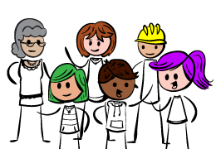

This is a human endeavor…
THERE IS NO FORMULA

Slide 11
JUST DO IT
Have a clear purpose
Have guidelines
Start from a supportive place
Be willing to uphold the guardrails
Do the work on yourself (identities, oppression, triggers, biases, guilt, etc.)
Be willing to get uncomfortable
Learn as you go, accept that we are all “in training”

Slide 12

“Challenge vs. Threat”
Research in Sport Psychology
Uphill, Rossato, Swain, O’Driscoll (2019)
We can acknowledge the “stress” of certain conversations
We can look for ways to help our students perceive challenge as opposed to threat
Challenge: opportunity for growth
Threat: potential for harm or loss

Slide 13

Key Ideas for Creating Cultures
Conducive to Authentic & Equitable Dialogue
Be clear & Intentional : What kind of culture do you want to create and nurture?
  Culture of Curiosity? Of Conversation?
Be clear & explicit about your beliefs about the learning space
SAFE, BRAVE, GRACE SPACE
Be open to sharing how you are doing
  Our hearts are in everything we do
  Makes our humanity accessible
  Model vulnerability
Show your mistakes & faults
Name oppression, name race, name whiteness especially if you are white
Intent vs impact
Guilt
Use humor
Have guidelines for the learning space (not just for the “difficult conversations”)

Slide 14
Sample “beliefs” statement on syllabus
My beliefs:
The classroom should be a supportive and transformative space: safe space, brave space, grace space
We should strive to learn together and challenge ourselves and each other with grace and rigor
Growth and learning are not always comfortable, but it’s our duty to commit to both
We need to be aware of all curricula: written, operational (the how), hidden (the culture), extra, and null (what is not taught) and the messages each of these can send
Translanguaging is encouraged

Slide 15
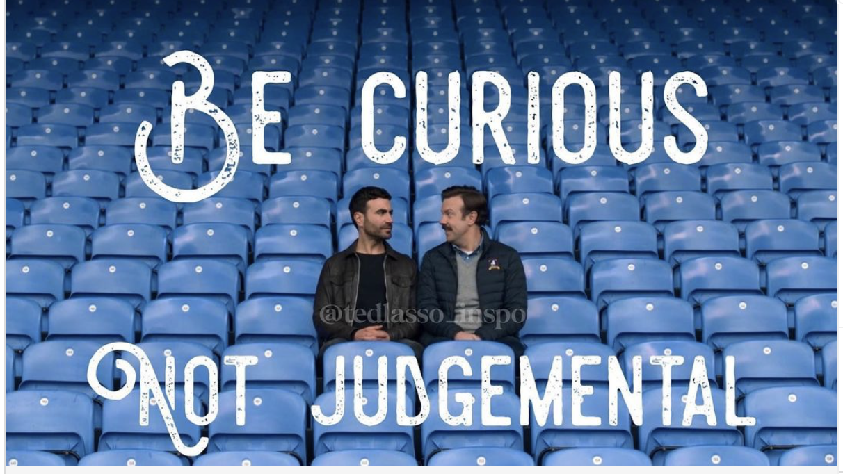

Slide 16
Have Foundational Guidelines
GUIDELINES:
Be present and curious.
Use “I statements” when speaking: Share from your personal experience and perspective rather than generalizing.
Balance taking space and making space: Take the risk to lean in and share while being mindful of your use of airtime.
Expect and accept messiness and discomfort: We are all in process and it is okay if our thoughts are not perfectly formulated.
Appreciate the both/and: Two (or more) things can be true at the same time.
Confidentiality: Share the plot, not the characters. What’s said here, stays here. What’s learned here, leaves here.
-Witnessing Whiteness (Tochluck 2022)
Guidelines serve as foundation for the entire learning space and process
Guidelines are for always, not only for having “difficult conversations.” Otherwise, we decide what people need a “warning” about and need “special guidelines” for. This is usually from a white, straight, cis, able-bodied, etc. (privileged) place

Slide 17
“What’s become clear is that racial progress and white comfort cannot exist in tandem.”
  -Jamelle Hill (2020)

Slide 18

So How Do We Do It?

Slide 19
Move away from the separation of “our class/ our learning space” and ”difficult conversations & when we need guidelines” → they are one and the same
Move away from “this isn’t related to my content”
When intentionally planning for conversations around oppression, identity, social justice: be clear about the WHY. What do you want them to walk away with and how do you want them to feel
Model naming oppression: this can be freeing, create safety, make it more approachable & can destigmatize
Model owning and naming privilege
Model getting past guilt (re: offenses and privilege)
Uphold guardrails and norms (be clear in your role as leader, someone who can maintain safety and rigor)
  You are vulnerable and learning with and from your students AND:
  You are the leader in the space; students will look to you to maintain guardrails and uphold guidelines/ norms
  Refer to guidelines as you go

Slide 20
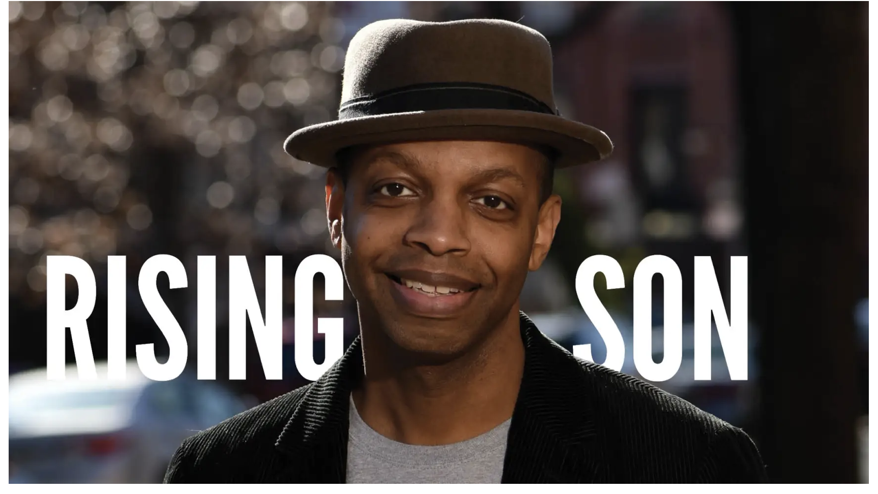
“We can disagree and still love each other unless your disagreement is rooted in my oppression and denial of my humanity and right to exist.”
- Robert Jones, Jr. (author and founder of “Sons of Baldwin:

Slide 21
Use open-ended questions as a tool where appropriate: Can you say more?
Model graciousness when hard stuff is said: “I’m grateful you brought that up because that is a question that people have/ a viewpoint some hold, and it’s important to talk about.”
Be ok with discomfort: train ourselves in this, and model it
Connection & understanding VS convincing others, proving you’re right/ they are wrong
Not necessarily working toward a solution; rather, working toward connection and deeper understanding
Listen to listen and not make a rebuttal
“We don’t change peoples’ minds; we change their hearts with personal stories of discrimination” –NCBI Principle #21 …
CONNECTION = ESSENTIAL

Slide 22
Scenarios
In your student teaching seminar class, a student says: “I want to support all my students, but, I know from my religion that being gay is a sin. What should I do?”
After a discussion of the ways in which colorblindness is an oppressive act/perspective, a student says, “but how can you say we shouldn’t be colorblind? It’s a good thing to be colorblind!”

Slide 23
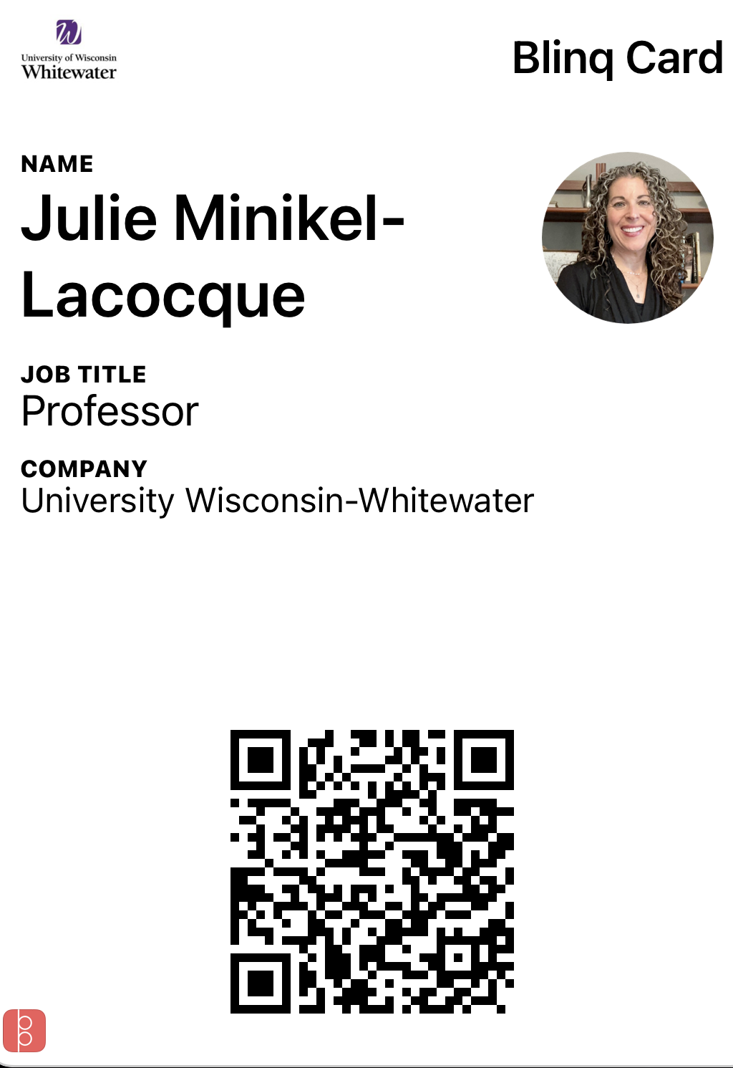
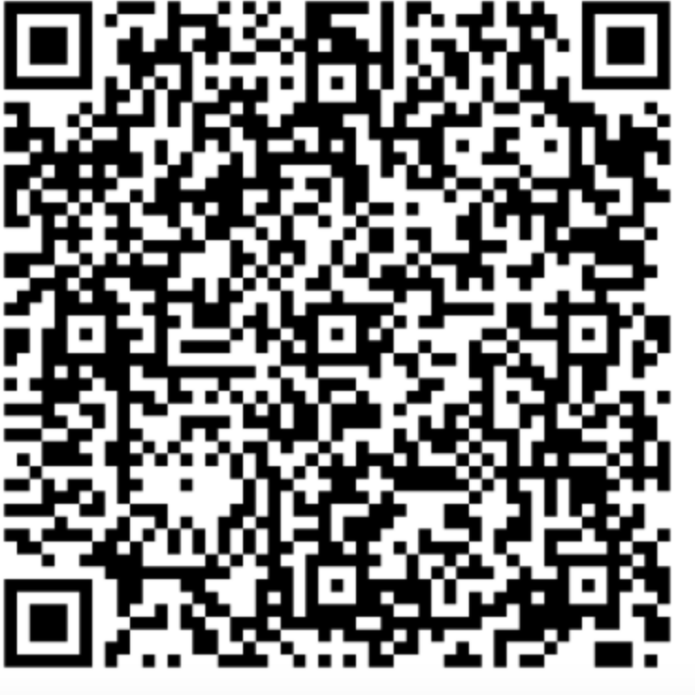
^ Session Evaluation ^

