Slide 1
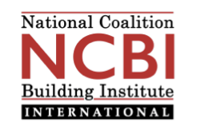

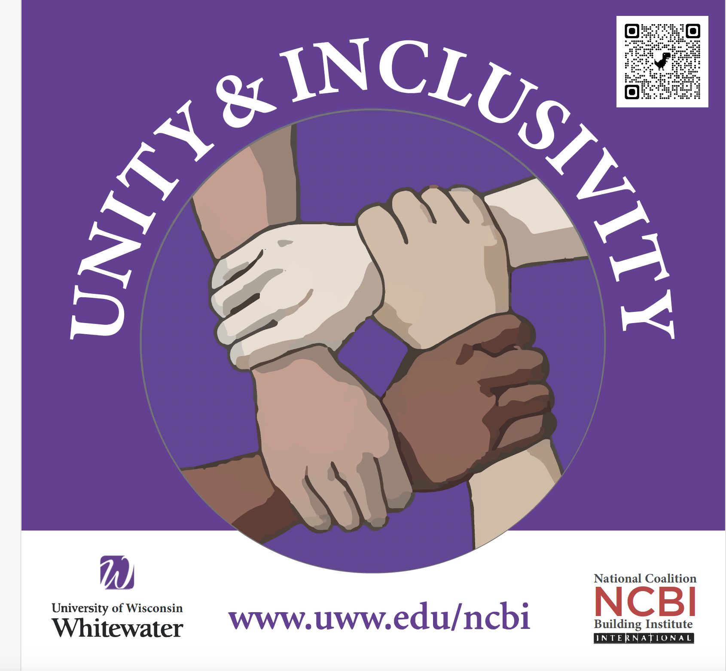
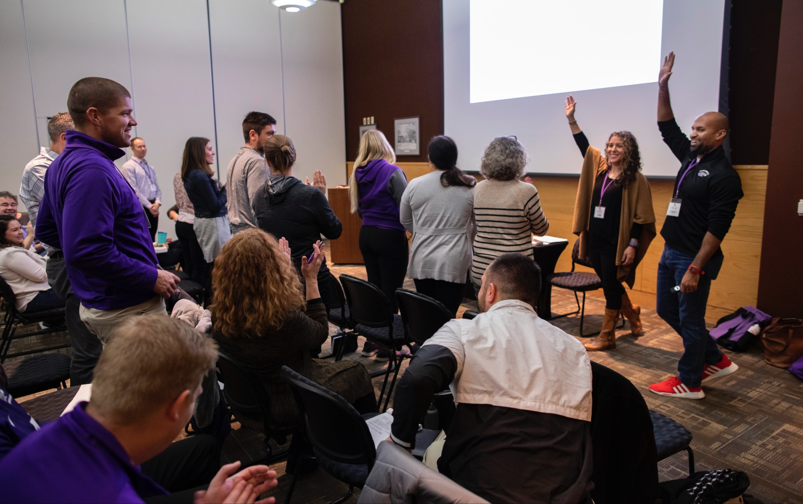
NCBI &
UW-WHITEWATER

Slide 2
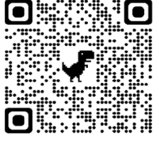
NCBI in the US and Beyond
Nelson Mandela Award
Best Practice Award from US Dept of Education
Conflict Resolution globally
Higher education
K-12
Communities
Law enforcement
…
Building bridges, ending oppression, understanding ourselves and others

Slide 3
NCBI at UW-W
Team on campus
Free workshops each semester
  (240 participants so far this semester)
Full-day, half-day, & shorter
Teams, orgs, classes
Two distinct workshops:
  Equity & Inclusivity
  Controversial Issues Process

Slide 4
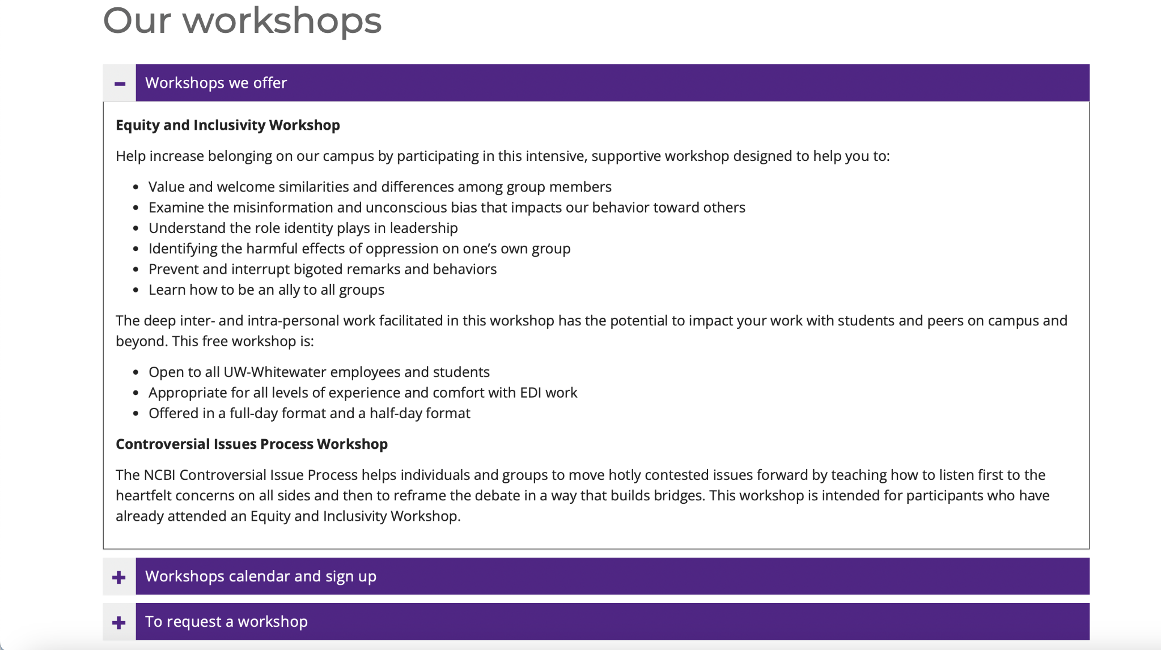
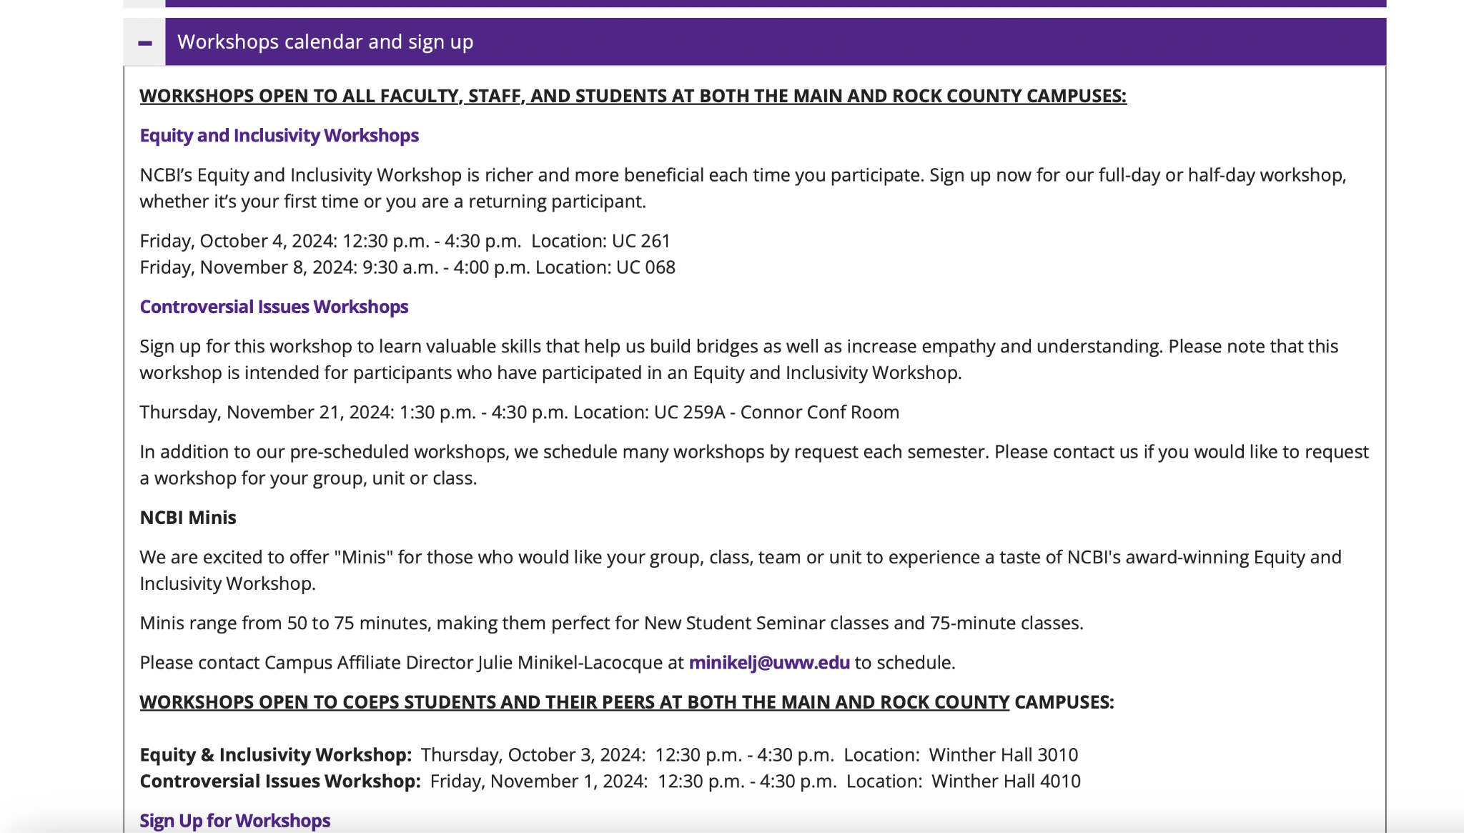

Slide 5
