Slide 1
Shifting Perspectives:
Finding Space in Rough Place
Dr. Sabrina M. Brown

Slide 2
Agenda
Ground Rules
Affirmations
Introductions
The Rough Place
Creating Space
Conclusion
Questions/Conversation
Evaluations

Slide 3
Ground Rules
Focus on yourself
Speak your truth
Agree to let everyone have their own experience
Give yourself time and space to reflect

Slide 4
Affirmations
I am calm.
I am focused.
I do what it takes to care for myself.
I am exactly where I belong.
Mentally, Physically, and Emotionally, I am present.
Today is a great day to invest in me!

Slide 5
Introductions
Who are you?
Why are you here?
Who makes up your family?
What were you taught to believe?
What are you passionate about?
What do you do for enjoyment?
In this field
On this earth
In this session

Slide 6

The Rough Place
How did you get here?

Slide 7
The Rough Place
How do we create a better environment for the people we work with (supervise, colleagues, supervisor)?

Slide 8
The Rough Place
What can you do to create a better environment for yourself?

Slide 9
My Journey

Slide 10

What can you do to move from here there?
Social Health
Mental Heath
Spiritual Health
Physical Health

Slide 11
There is hope.
Things you can do….
Things you can control….
    Give yourself time before or after work
    Positive self-talk
    Compliment a co-worker
    Leave your office for lunch
    Visit a co-worker just to inquire about their day
    Walk during the day
    Eat balanced meals
    Journal
    Talk to a therapist
    Spend time with friends or family
    Pray
    Go to church
    Visit your doctor for a check up
    Listen to motivational messages (podcasts, social media content creators, etc.)
    Limit social media time
    Or Increase social media time
    Take vacation
    Take sick days (mental health days)
    Learn a new hobby
    Find time to decompress
    Write a list of frustrations and work through them
    Keep an open mind for new opportunities
    Find a new position

Slide 12
Conclusion
Questions/Conversation

Slide 13

For Contact information or to purchase Affirmation Cards, visit:
ShiftBySabrina.com

Slide 14
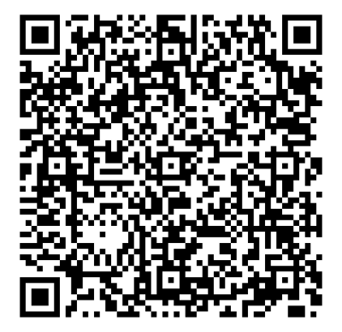
Please complete the evaluation for this session.
Thank you!

