Slide 1
A holistic approach to creating space for students of color at UW- Lacrosse
Sadie Kuhl- Precollege Coordinator
Office of Multicultural Student Services
UW-La Crosse

Slide 2


STUDENTS OF COLOR
1,055
A Quick Breakdown
Undergraduate Students: 945 Students
students
Graduate Students: 110 Students
  Midsized campus in the Midwest
  Non-urban environment
10.2 %

Slide 3



our mission
Multicultural Student Services
uses a holistic development approach to academic excellence, leadership,
and the personal/social development
of African American, Indigenous/American Indian, Hispanic/Latinx, Asian American, Hmoob, and biracial or multi-ethnic students at UWL.

Slide 4
Our values
Authenticity
Access
Belonging
Connection

Slide 5
A Snap shot of
our space

Slide 6
First impressions
Connection to all values
  Our office employees 8-10 students each semester to work the front desk. We strive to have a student there for our entire office hours.
  They answer questions, help students “swipe in” and help students go into the direction they need to
  Having students “swipe in” helps us create the data base to see how students are using our office

Slide 7
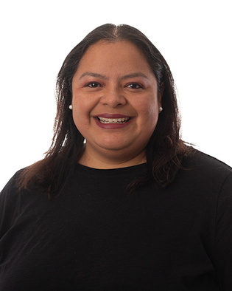
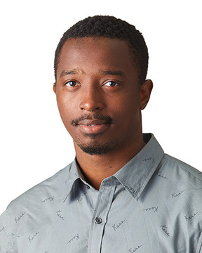
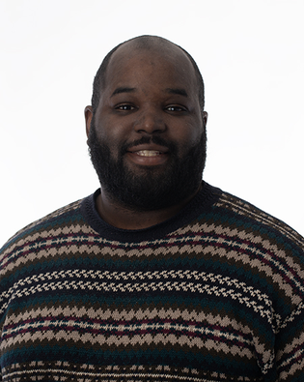
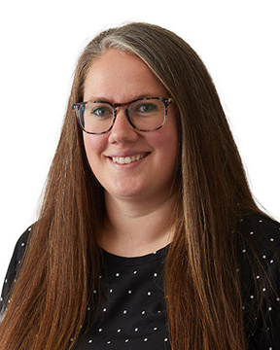

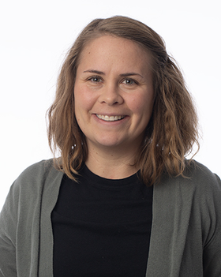
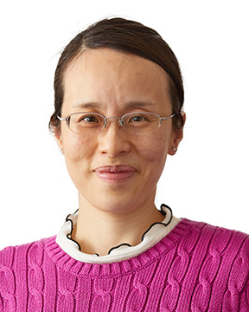
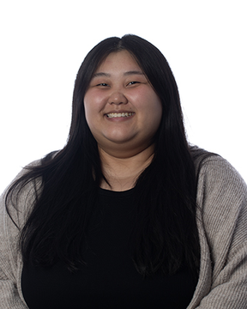
Meet the Team
Authenticity
Vickie Sanchez
Jesi Banjiram
Reg Hawkins
Laura Lauderdale
Director
Program Coordinator of
Student Leadership & Development
Assistant Director
for Retention
Assistant Director
for College Pathways
Ellen Cervantes
Sadie Kuhl
Lilly Zou
Noona Xiong
Administrative Assistant
Pre-College Coordinator
Retention Specialist
Retention Specialist

Slide 8
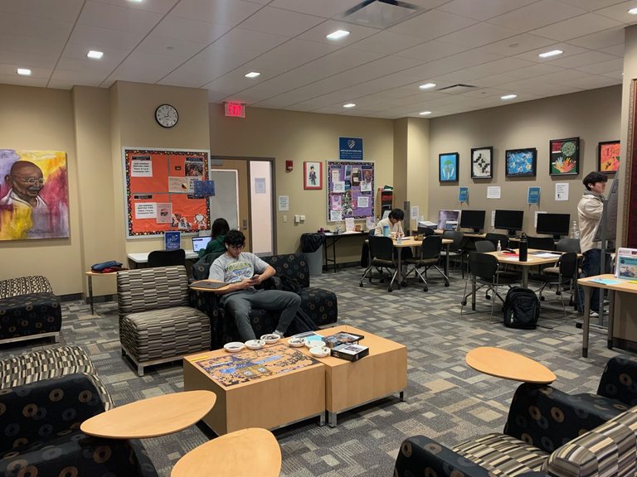
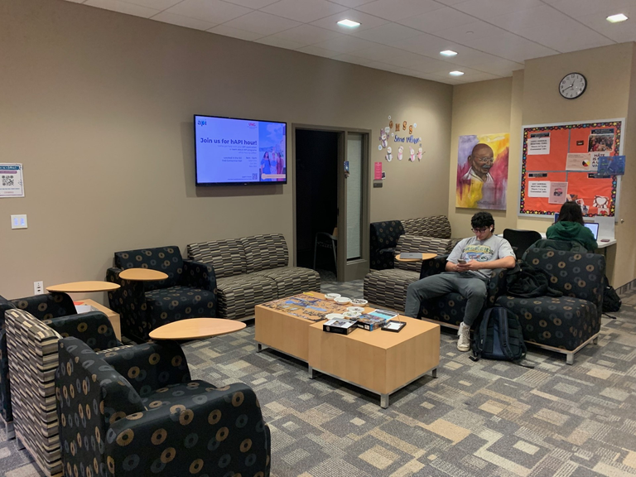
The student lounge
Belonging and Authenticity
  Study or Hang Out
  Partners in Residence
  Puzzles, Crafts, etc.
  Free Printing
  Snacks, Food Pantry, Fridge and Microwave
  Open Doors

Slide 9








MULTICULTURAL STUDENT ORGANIZATIONS
BELONGING AND AUTHENTICITY
ALANA
HOPE
Asian, Latina, African, Native American Womxn
Hmong Organization Promoting Education
ASO
IOPA
Asian Student Organization
Intercultural Organization Promoting Education
BSU
LASO
Black Student Unity
Latin American Student Organization
DiSTEM
NASA
Diversity in Science, Technology, Engineering, and Mathematics
Native American Student Association

Slide 10

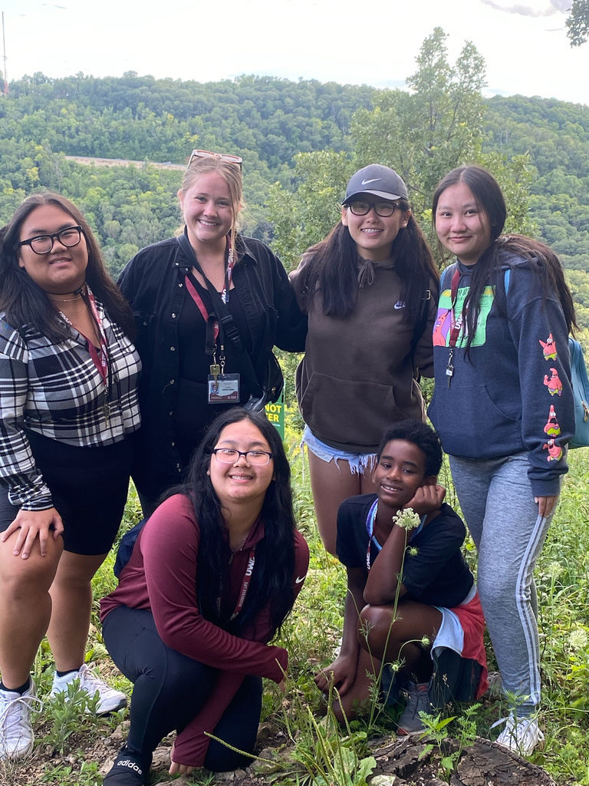

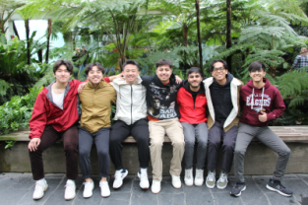

Scholar programs
Belonging
Pre-College
AERIE
Hekima
Ultimate College Visit
Attend K12 or be a mentor
First Year Experience
Living and Learning Community
Men of Color
(Hekima means “wisdom”
in the Swahili language)

Slide 11
PARTNERS IN RESIDENCE
ACCESS AND CONNECTION
  Career Services
  Financial Aid
  Student Leadership and Development Intern
  Wellness Wednesday
  Violence Prevention
  Second Year Experience
  Counseling: Let’s Talk

Slide 12
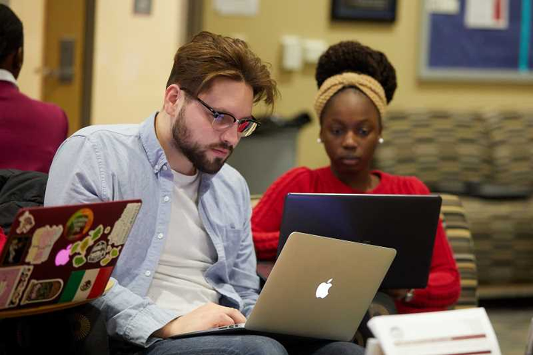
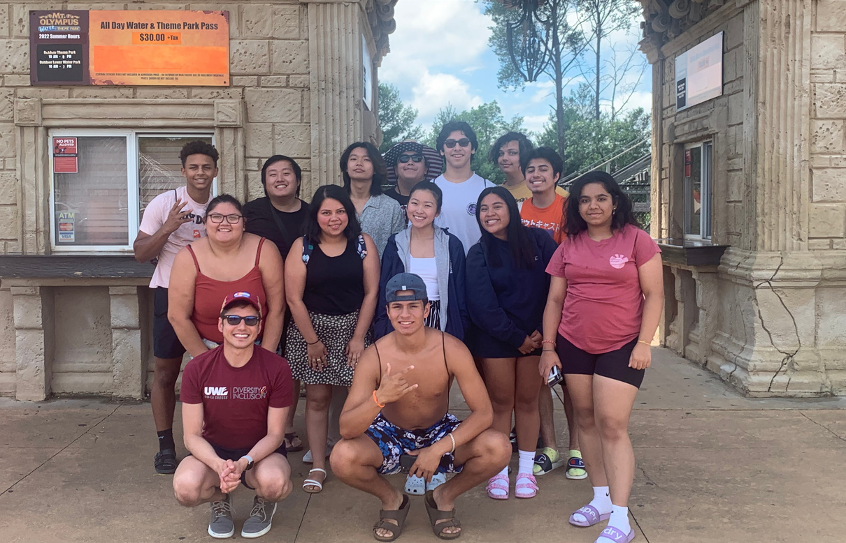
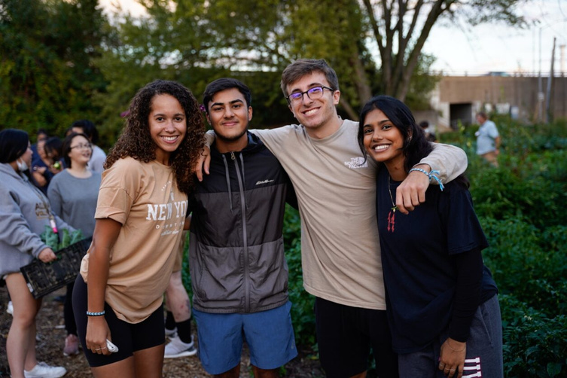
Access and connections
Personal
Academic
  Advising
  Peer Tutoring
  Referrals
  Partners in Residence
  Involvement
  Leadership Development
Career
  Workshops
  Networking
  Resume Help

Slide 13
FINANCIAL RESOURCES
ACCESS AND CONNECTION
On-Campus
and
Off-Campus
Jobs
Financial
Literacy
Grants and
Scholarships

Slide 14
Recap
  Our programs and our space provide holistic care to the students we serve
  All four values can be seen in what we do on a semester wide basis

Slide 15


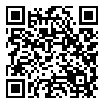



REACH OUT FOR QUESTOINS!
1101 Centennial Hall, La Crosse WI 54601
608-785-8225
omss@uwlax.edu
@uwl_omss
@uwlomss

