Slide 1

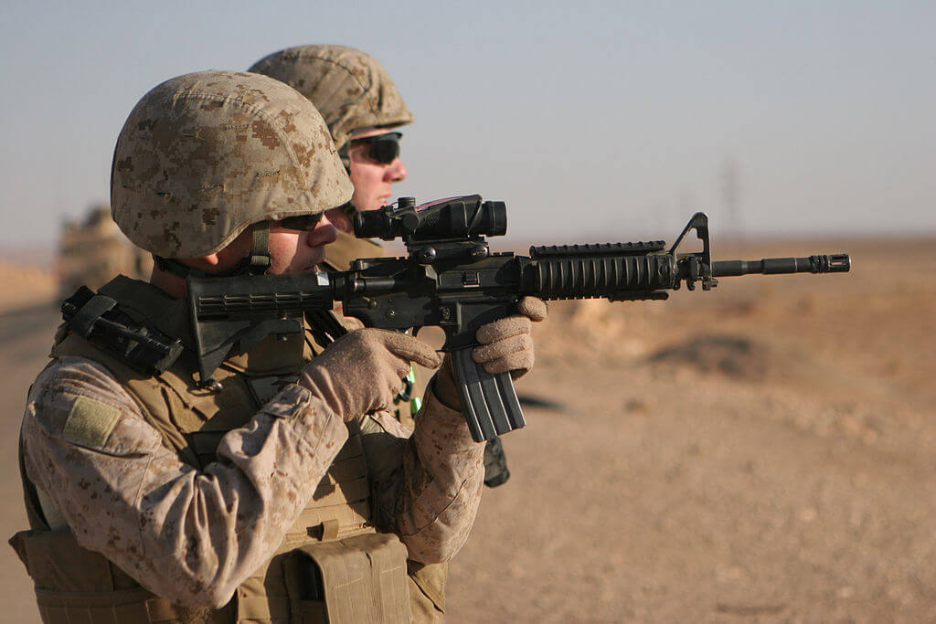

Military Culture
Presented by
UWM Military and Veterans Resource Center
Yolanda Medina, Director
Groovy Cocroft, Assistant Director

Slide 2
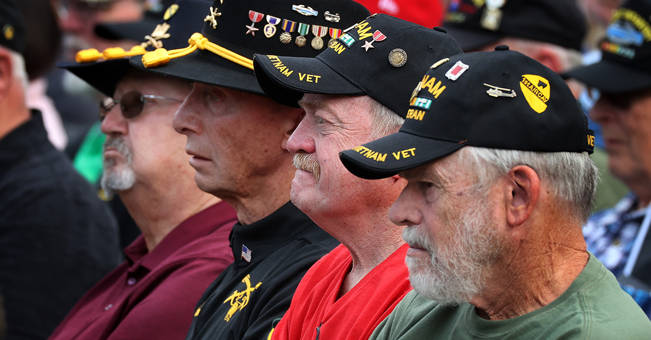
Military Culture

Slide 3

Military Culture

Slide 4
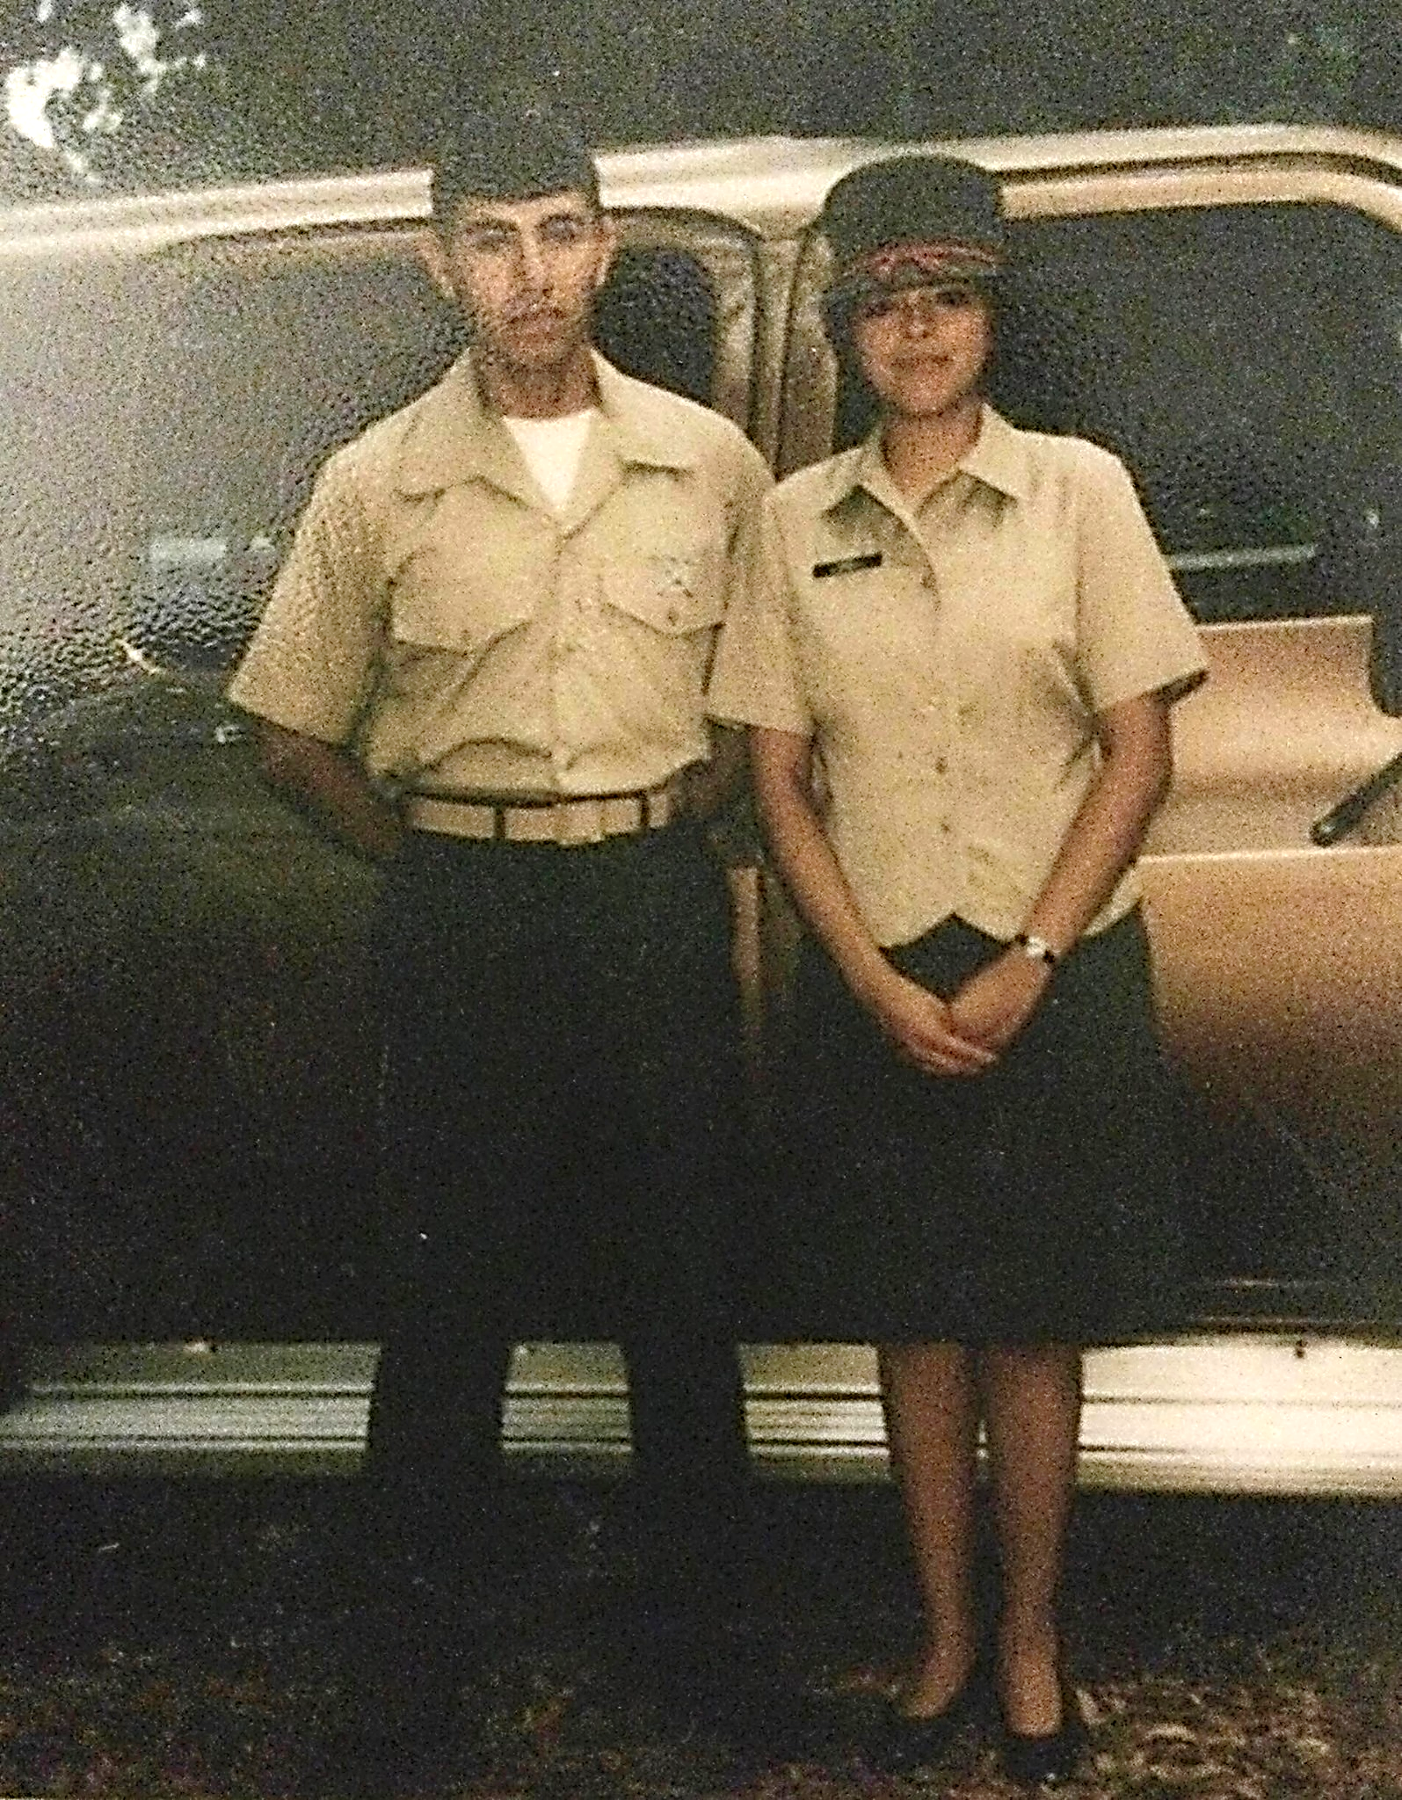
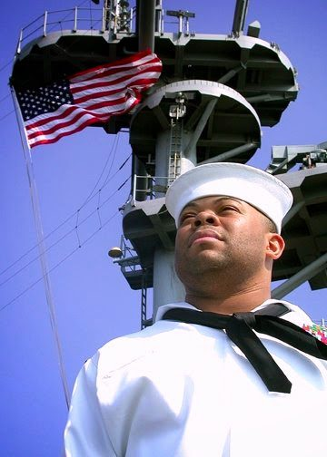
MAVRC Staff
Yolanda Medina, Director
United States Marine Corps (4 years)
B.A., Religious Studies, Carroll University
M.ED., Adult, Community, and Professional Education, Carroll University
James “Groovy” Cocroft, Assistant Director
United States Navy
(20 years – retired)
B.S. Information Science and Technology, University of Wisconsin Milwaukee

Slide 5

Demographics
83% of the US military identify as male
Of this, 69% of the male population identifies as white
Statista, Politics & Government, 2019

Slide 6

Demographics
17% of the US military identify as female
54% White
28% Black
21% Hispanic
10% American Indican, Asian American, Pacific Islander
17% Non-White male population
18% Hispanic
16% Black
12% American Indican, Asian American, Pacific
Islander, or unknown
An estimated one million U.S. Veterans identify as members of the LGBTQ+ community.
VA Health Systems Research
LGBTQ Health, 2024
50% Married
Military One Source, 2022 Demographics Profile

Slide 7

Service
Only 60% of those who join the military ever get deployed.
Of the 60%, approximately 20% enter a combat zone.
Most of the troops who enter combat zones do not see battle. They are support troops backing up those who do.
When you break it down, about one out of every 10 service members — 10% overall — go to combat and fire their weapons.
“10% of the Military” https://www.youtube.com/watch?v=IB9ukB5rUTA

Slide 8

The 90%
Mechanics
Engineers
Science and Technical
Health Care
Motor Transport
Food Service
Administrative
IT Service
Most jobs in the military mirror the civilian community.
Armed Forces Careers
Learn How to Become
Updated March 9, 2023

Slide 9
Veterans Attending UW-Milwaukee

Slide 10

UW-Milwaukee
1,000 to 1,300
MILITARY-RELATED Students
Veteran
National Guard
Reservist
ROTC
Active Duty
Dependents

Slide 11

A Few Other Considerations
Branch of Service
Era of Service
MOS (job)
Officer or Enlisted
Rank
Retiree

Slide 12
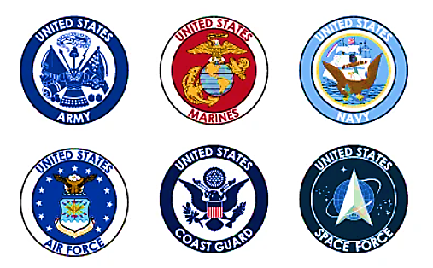
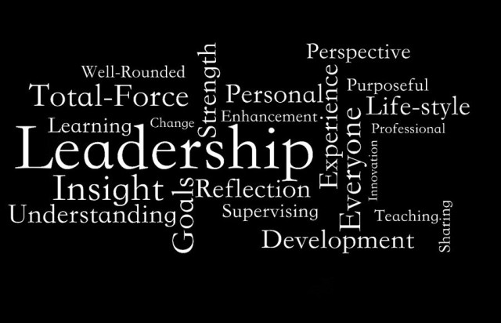
MISCONCEPTION
“The military creates leaders.”

Slide 13

Military Mindset
ORDERS
POOR LEADERSHIP
Follower vs Leader
Instructions vs. Discovery
Orders vs. Independence
  Followership: Secret to Military Leadership
  Promoting a Military-Friendly Learning Environment (2020)
LACK OF DIRECTION
POOR ORGANIZATION

Slide 14
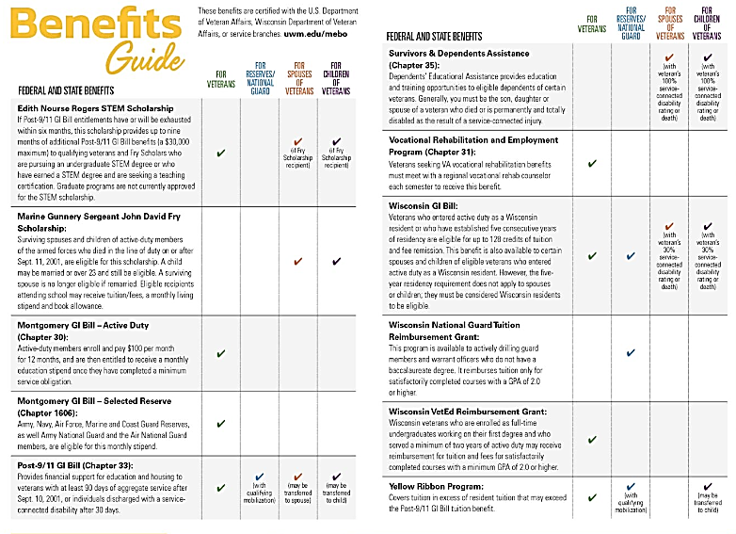
Education
Benefits
Federal
State DoD
Active Duty
Reserve
National Guard
Survivor
Dependent
Vocational Rehab

Slide 15
“VETERAN”

Slide 16



Frustrations
DEPRESSION
ISOLATION
ANGER

Slide 17
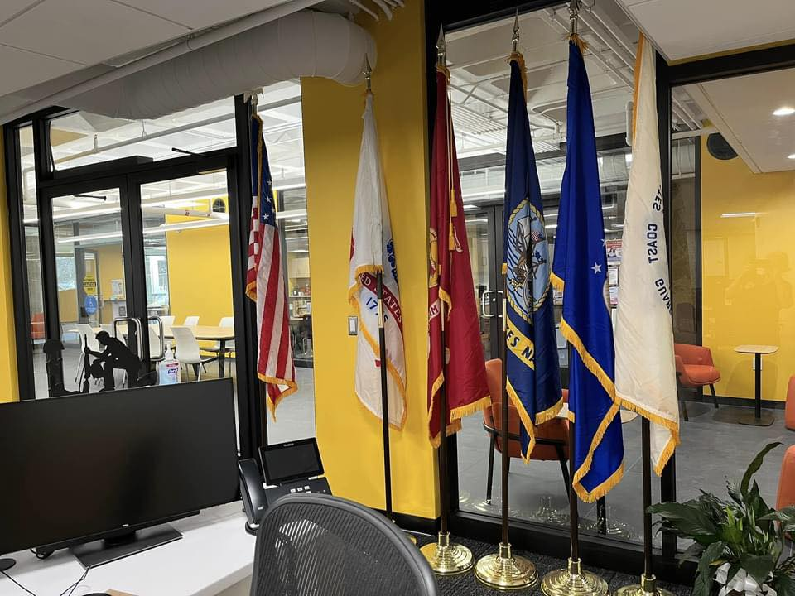



Military and Veterans Resource Center
(MAVRC)
Student Union – EG40
Military Education Benefits Office
VetSuccess on Campus
(VA Vocational Rehab)

Slide 18




Resources
Military Education Benefits Office

Slide 19

THANK YOU!
Questions?

