Slide 1

Shifting Perspectives: Meditation as the NEW Medication
Dr. Sabrina M. Brown

Slide 2

Agenda
Ground Rules
Affirmations
Introductions
Conversation
My Journey
Guided Meditation Exercise
Final Thoughts
Evaluations

Slide 3
Ground Rules
Focus on yourself
Speak your truth
Agree to let everyone have their own experience
Give yourself time and space to reflect

Slide 4

Affirmations
Today is a great day.
I am focused.
I am exactly where I belong.
Mentally, Physically, and Emotionally, I am present.
I do what it takes to care for myself.

Slide 5

Introductions
Name
From
Why are you at this conference?
What do you think about when you hear mental mindfulness?

Slide 6
Conversation
Why is it important that we pay attention to our thoughts, feelings, and body?
What can happen when we do not pay attention to our thoughts, feelings, and body?

Slide 7
My Journey

Slide 8
…What did you do?
I had to think about who I am (poem)
Started googling things to calm anxiety
Incorporated affirmations into my life
Breathing exercises
Drink hot tea
Time in the morning (do not rush)
Calm down my nights (lower lights, stop talking, make some tea)
Stop thinking about work /
Find something else to talk about
Reduce nightcaps (less alcohol)
Guided Mediation before sleep
Exercise
- - -
massage chair
Created a company Shift By Sabrina to help others

Slide 9

Guided Meditation Exercise

Slide 10
Let's Process
How do you feel?
Is this something you can do on your own?
Will you try another guided mediation exercise?

Slide 11
Conclusion
Questions/Conversation

Slide 12

For Contact information or to purchase Affirmation Cards, visit:
ShiftBySabrina.com

Slide 13
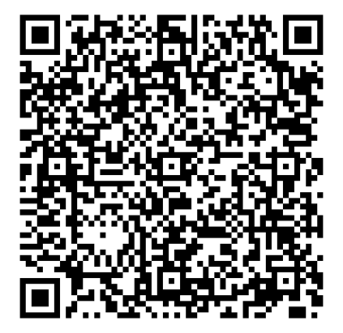
Please complete the evaluation for this session.
Thank you!

