Slide 1
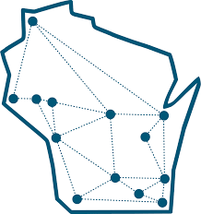
Redefining Wellness as a Campus Community
Culturally Responsive Approaches to Mental Health
UW Behavioral Health Initiative
November 15, 2024
Marcia Liu, Ph.D.

Slide 2
Today’s Objectives
Consider this Moment and Reflect on the State of Mental Health on Campus
Discuss the Barriers and Challenges of Inclusive Campus Mental Health
Discuss Strategies for Leveraging Power
Find Community with one another, Refuel and Recharge for a Moment
Commit to Where You’d Like to Go From Here, What You’d Like to Learn or Do

Slide 3

About Me
Asian American/Pacific Islander (AAPI)
Chinese American Cis Queer Woman (she/her/hers)
2nd Generation→ Children of Immigrants, 3rd Culture Kid
Able-Bodied, English as a First Language
Middle Class, Grew up in US Schools, went to college + grad school
New Yorker, Brooklynite, East Coaster
Sister, Oldest of 3
Caregiver of folks with chronic medical diagnoses
Interests: Fish & Seafood, Being Outside, Dim Sum, Soft Serve Ice Cream, Homemade Egg Rolls, Watching Movies, Sci-Fi, crossword puzzles, puns.
Counseling Psychologist

Slide 4


Mindfulness Check-In

Slide 5
A Note about this Moment on Campus
Sociopolitical Uncertainty: Legislation regarding Inclusion & Belonging Conversations; Racism, Islamophobia + Anti-Semitism, Transphobia and Anti-Queer legislation; Global Conflicts and Unrest Continues; Questions about Next Administration’s Goals re: Higher Education; Climate Change/Gun Violence Issues Continue
Pandemic Aftermath: A Different Cohort of Students with Different Academic + Mental Health Needs and Challenges; Bereavement and Grieving; Increased Anxiety + Suicidality of Young People

Slide 6
This Moment on Campus
Economic Worries: Inflation, Income and Housing Insecurity, Food Insecurity, Financial Aid Instability, Post-Graduation Job Market Uncertainty, Questions about the Purpose/Worth of Going to College
Campus Community Instability: Campus Protest + Dissent Increasing, Increasing Part-Time Staff, Attrition of Faculty and Staff of Color, Staff & Faculty have also been personally impacted/changed by the Pandemic
A Changing Technological Frame: Asynchronous and Online Classes, Artificial Intelligence and ChatGPT, Social Media + Phone as the Centerplace for Community

Slide 7
All of This → Doubt and Disconnection
Doubts About How to Be with Each Other
  Worries about Interpersonal Conversations, Misspeaking or Stumbling
  Fear of Being Harmed, Being Disappointed, or Neglected by One Another
  Censorship, Fear of Punishment/Retaliation, Job Insecurity
  Unsure How to Represent Self with Students and Colleagues
  High Pressure of this Moment: Visceral Political Differences and Everything Being at Stake
  … Relational Anxiety with Each Other, Feeling Pulled to Disconnect or Detach or Avoid

Slide 8
All of these Issues = Mental Health Issues
An Inclusive Definition of Wellness means Regularly Taking Inventory of the Sociocultural Moment We are Living In
All of these Social Determinants are Impacting our Mental Health and Wellness, in varying ways depending on our backgrounds
Prioritizing an Awareness and a Desire to Consider and Empower all Students’ Voices, and especially BIPOC and other Minoritized Students, can help Establish a Culture of Care.

Slide 9
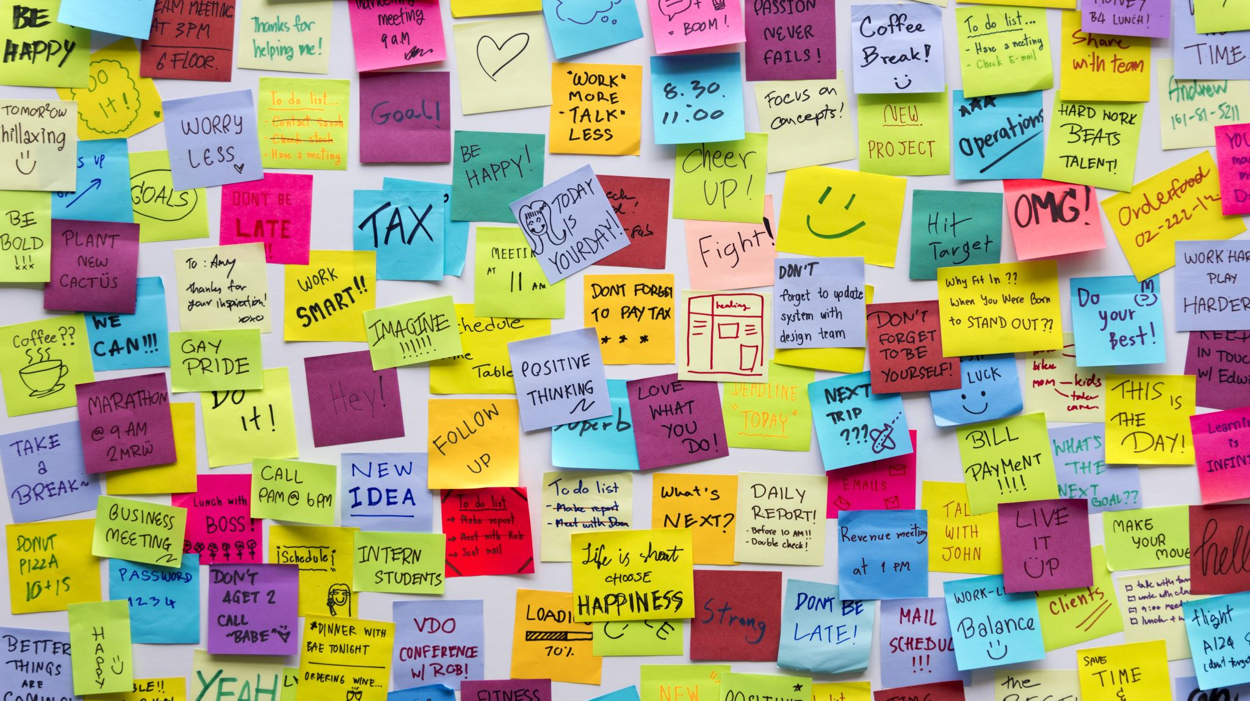
Gentle Reminder
Think about developing comfort with the questions rather than pursuing hard and fast universal answers.

Slide 10

What challenges do you and your institution face when addressing the mental health of Students of Color on your Campus?
Reflect.
Share with 1-2 people next to you
(5 minutes)

Slide 11
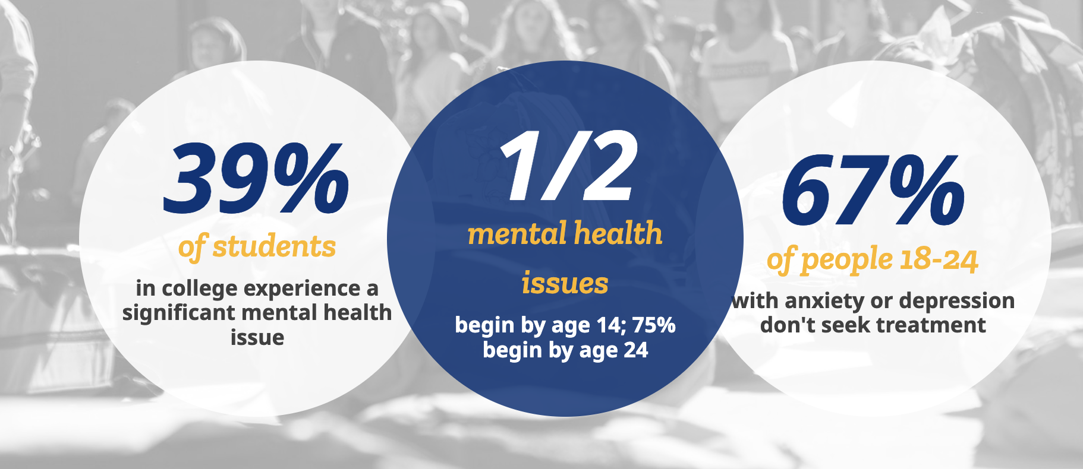
Source: Active Minds, 2024

Slide 12
National College Health Assessment: Universities of Wisconsin
Results from Spring 2024
N = 10,363 across the UW System
  83% of Students Self-Identified as White
  17% of Students Self-Identified as BIPOC
Described their Health as Very Good or Excellent
  59% of Cis Men,
  47.2% of Cis Women, and
  28.2% of Trans/Non-Binary Students

Slide 13
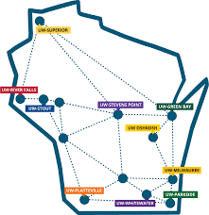
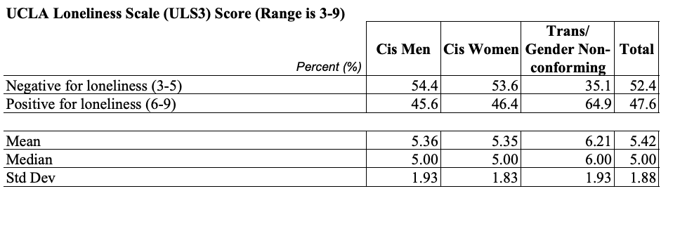
Student Loneliness on Campus

Slide 14
Example UCLA Loneliness Scale Items (ULS3)
How often do you feel alone?
How often do you feel that there is no one you can turn to?
How often do you feel part of a group of friends
How often do you feel you have a lot in common with people around you?
How often do you feel left out?
How often do you feel close to people?
How often do you feel isolated from others?
How often do you feel there are people who really understand you?
How often do you feel that there are people you can turn to?

Slide 15

BIPOC Students At the UW’s

Slide 16
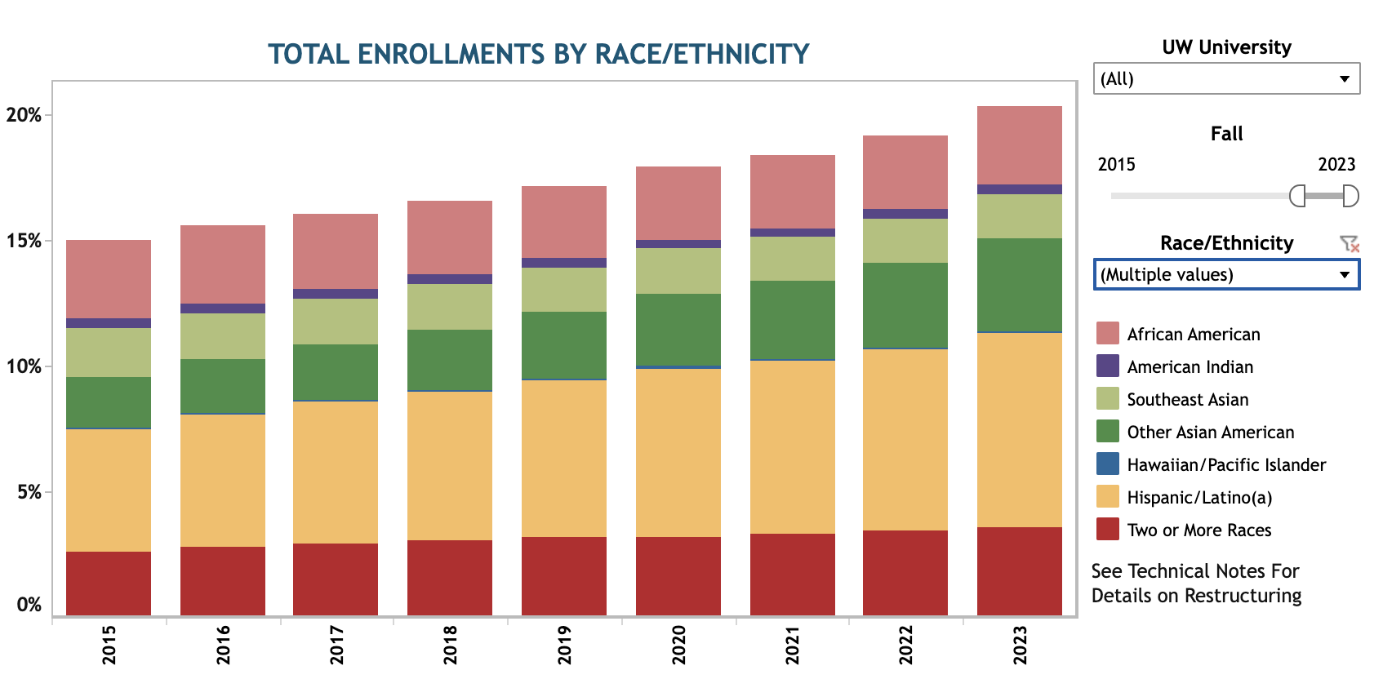

Slide 17
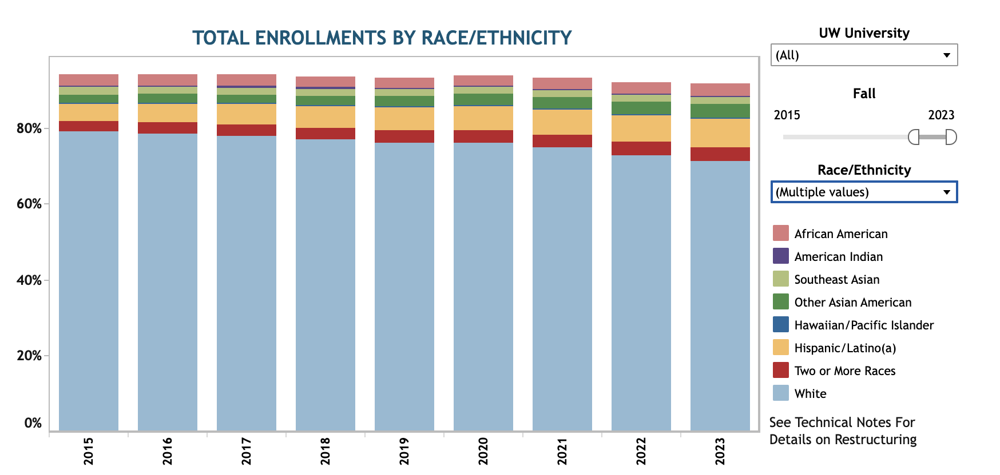

Slide 18
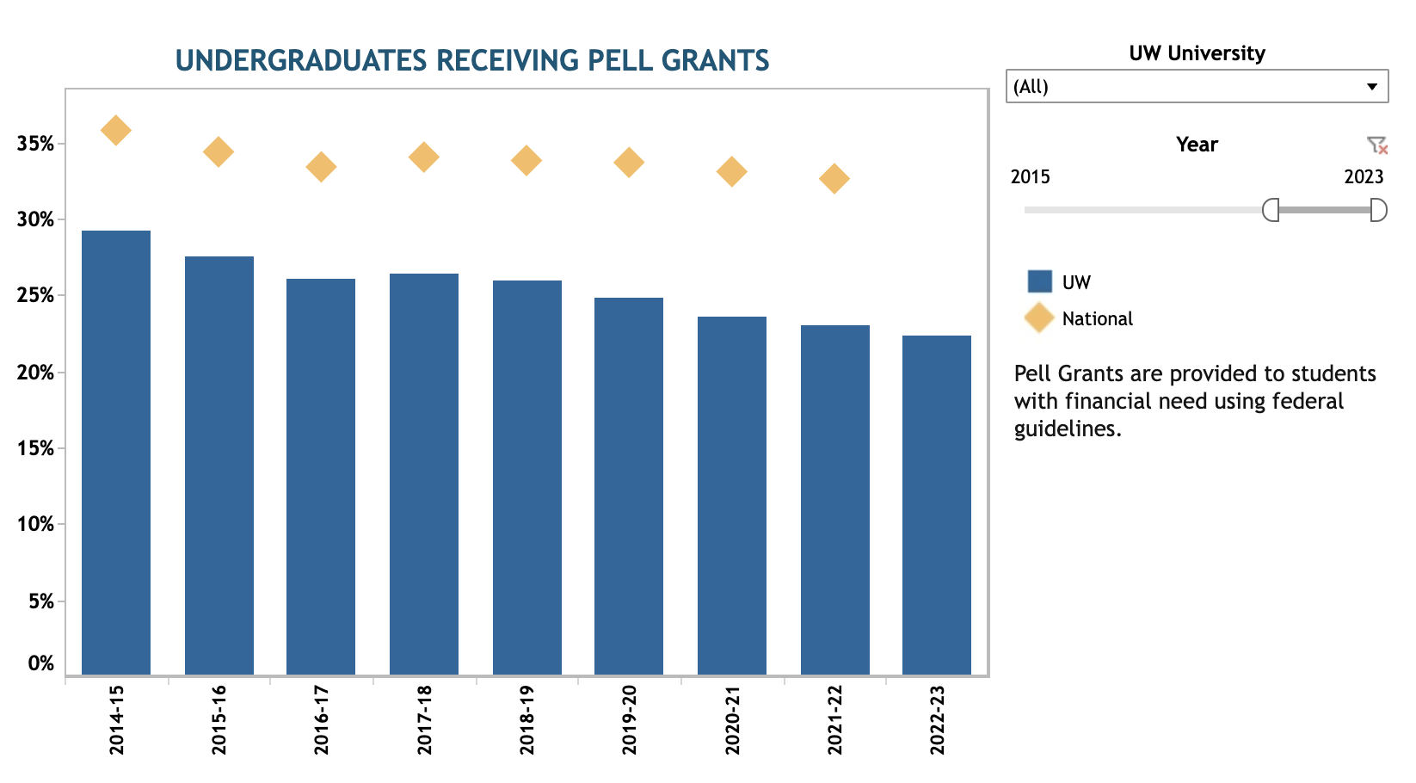

Slide 19
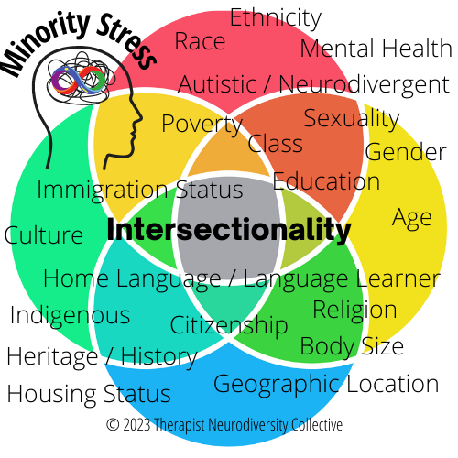

Slide 20

Using An Intersectionality Framework for Inclusive Wellness (Collins, 2019)
Power is Organized According to Changing Political Systems.
Social Context (Historical + Current) and Social Inequality = Critical for for Understanding/Considering Stress
Power: Wielded Differently Across Demographic Groups
  What Subgroups Exist on my Campus? How is Power Organized Differently Between & Among Them?
Complexity: Resisting the Tendency to Flatten Out Cultures
  How do people in the same subgroup differ from one another and why?
Social Justice: Centering Justice and Joy as an Essential Value and Purpose
Notes:
Queer & Gender Diverse folks, undocumented folks, geographic communities, caste-specific experiences, ability status, language fluency, parents' educational backgrounds, political affiliation, previous exp's of imperialism/civil war...

Slide 21
Ethnic Differences Within BIPOC Groups
BIPOC Groups Are Often Grouped Together for Efficiency’s Sake Despite Salient Within-Group Differences
Some BIPOC Students Hesitate to Claim Membership with their Larger Racial Group
  Different Racial Physical/Phenotypic Presentation
  Immigrants Previously Socialized as the Racial Majority: New Racial Socialization as Minoritized Community
  Religious, Ethnic Cultures Differences
    Sociopolitical Histories between Ethnic Country + the U.S. vastly different
    Pre-Existing Conflicts Between Ethnic Communities
  Marginalization Within the Racial Group → Preference for Being with the Ethnic Community

Slide 22
Racial Identity: Fluid and Contradictory (Helms, 1999)
Race is a Political Variable: As a Social Construct, it’s Always Changing
Race Determines Our Power and Struggle in the US
BIPOC and White Folks use Various Thinking/Emotional Patterns to Make Sense of Race in their Environments
These Ways of Thinking May Contradict One Another
  Can be confusing/disorienting to feel both pride and confusion, or shame and hope about belonging to a particular group, all at the same time

Slide 23
What are some Mental Health Stressors for BIPOC Students?
Discuss for 5 Minutes with 1-2 people.

Slide 24
Ongoing Racial Stressors for BIPOC Students
Institutional / Systemic Racism and Oppression
Internalized Racism: Imposter Phenomenon & Stereotype Threat
Further Harm due to Gender & Sexuality
Microaggressions, Overt Racial Trauma
Marginalization within their BIPOC Communities
Lack of Representation especially in Roles of Campus Leadership
Lack of Community Space to Gather, Sense of Community Dignity being Neglected
Stories Being Unknown, Flattened Out, Exoticized, Misunderstood, or Ignored
Pressure to Perform, to Achieve on Behalf of Others
Lack of Power in relationship with Staff/Faculty as well as Peers

Slide 25
Difficulty of Confronting Microaggressions
Proof: Few times is there “proof” that they occurred
Clash of Sociodemographic Realities: Two Realities Taking Place (Intention v. Impact)
Inaccurate Perception of Minimal Harm of Microaggressions
Future: You Often Have to Maintain a Healthy Relationship with the Perpetrator due to Power Dynamics
Often happens by a Student’s Teacher, Boss, Landlord, Advisor
Tacit Approval vs. Retaliation/Punishment

Slide 26
Barriers to Mental Health Care for BIPOC Students
Mental Health Care often viewed by BIPOC students as a luxury/privilege, and only for those who are weak. Seen as shameful, culturally inappropriate, and of diminished importance compared to academics + financial security.
Barriers to mental health support: cost, time, lack of culturally competent providers, stigma/discouragement from community members and self, skepticism, fear, wrong information about what happens in counseling, minimization of problems.
Suicide = Second Leading Cause of Death for Young People Ages 15-24, and the First Leading Cause of Death for AAPI Young People
(Center for Disease Control & Prevention, 2022)

Slide 27
Some Strategies for Prioritizing Wellness for All Students on Your Campus

Slide 28
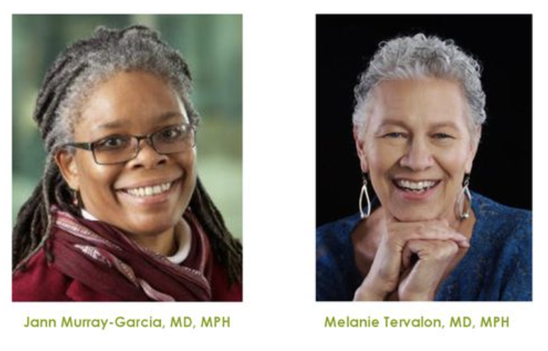
First, Cultural Humility
“a lifelong commitment to self-evaluation and critique, to addressing power imbalances . . . and to developing mutually beneficial and non-paternalistic partnerships with communities,” colleagues, and self.

Slide 29
Cultural Humility: Key Points
Recognizing Our Individual Limitations in Knowledge and Skills
Embracing a Growth Mindset of Lifelong Learning
Openness, Self-Awareness, Being Egoless (trying!)
Incorporating Self-Reflection & Critique
Each Student being the Expert of their own Identity
Being Flexible, Embracing Fluidity
Finding Ways of Sharing Power

Slide 30
Incorporating a Cultural Humility Practice
Eliciting Cultural Opportunities: Finding Openings for Students to Share about Who They are Outside the Classroom
Fostering a sense of Ease or Cultural Comfort when talking about and with BIPOC and all Students
  Being Curious, Asking Questions
  Growing an Ability to Listen to Others to Learn, rather than to Get it Right
Having a general sense of what or who you’d like to learn more about
Considering How to Empower your Students with Choice, Helping them Grow their own Agency + Sense of Purpose

Slide 31
Intention ❌ Impact
Intention ❌ Impact
Intention ❌ Impact
“They probably come from a strong immigrant family…”
“They probably are at a disadvantage because their parents didn’t have a lot of time for them…”
“Well, I bet they’ve a lot of pressure, since they they come from a culture that’s so patriarchal, conformity-based, religiously conservative …”
“They’d probably prefer to work in a group where there are other Latinx students…”
“This student has such a commanding voice. I can count on her to help lead this classroom conversation. Afterall, she knows more about that experience than me.”

Slide 32
Cultural Humility Exercise
Think of an interaction with a student, peer, or community member where you stumbled regarding the cultural dynamics of the situation. Maybe you misspoke, made an assumption, or aren’t really sure what happened but you know you left feel queasy and awkward.
What happened?
What feelings come up for you as you recall that experience?
Is There Something You’d do Differently?
Who are you wanting to learn more about?
What Communities are New to You?
How might you go about learning more?

Slide 33

Discuss with 1-2 People
What Came Up for You?
(5-Minutes)

Slide 34

Second, Practice Repairing After a Stumble
Acknowledge the Offense and Own the Impact of it– without dwelling on intentions
Truly Apologize for the Impact of your Action
Thank them for their Honesty and Trust
Figure out on your own a Concrete Actionable Way to Learn and Do Better Next Time. Follow-Through.
Source: TED Talk by Melanie Domenech Rodriguez, TEDx, 2014

Slide 35
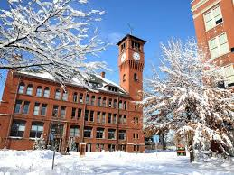
Third, Think Critically About On-Campus Work.
Whose Experiences am I Centering?
  Who will have an easy time participating in this?
  Who may have more hesitance or skepticism in Approaching Me or This Program?
  Who may not be able to access these Resources?
Are there ways that I am seeing these students as either sub-human (deficit-based) or superhuman (toxic positivity/resilience based)? (Green, 2022)
How can I bring in Student Voices to Directly Inform my Work?
How can I consider Ongoing National Conversations about BIPOC communities, and stay as up to date and aware of their impact on BIPOC students on my campus?

Slide 36
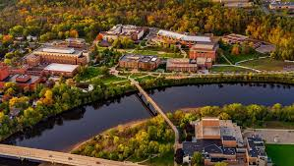
Long-Term Questions
How do I hold power in comparison with differing BIPOC and other student groups on campus?
How am I cultivating relationships with my BIPOC students and colleagues of Color over time, with fidelity and consistency, aiming to share space and power?
How am I growing, in my lifelong learning towards empathy and care for myself and others?

Slide 37
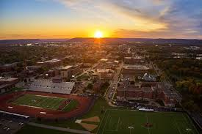
Cultivating a Campus Culture of Ongoing Wellness and Cultural Affirmation
Developing Meaningful Relationships Across Time
Allowing Space for Growth and Process
  Physical Space for Students to Gather
  Administrative Space to Incorporate Wellness as an Ongoing Structural Priority
  Checking-In, as a Norm.
Creating New Opportunities for Cultural Affirmation and Story-Telling for Students, embedded in the classroom and campus culture
Normalizing Conversations about Mental Health and the Structural Determinants of Mental Health
Committing to Mental Health as a priority for the entire campus, not just the Counseling Dept.

Slide 38
Thank You!
DrMarciaLiu@gmail.com

