Slide 1
Bias and the Student Experience
Cyndi Kernahan
cynthia.kernahan@uwrf.edu
Professor of Psychological Sciences and Director of the Center for Excellence in Teaching and Learning, UW River Falls

Slide 2
What to expect today?
Types of bias
How bias may affect our students
  Belonging Uncertainty
  Stereotype Threat
What we can do about it

Slide 3
Types of bias
Individual bias
  Residence halls, classrooms, campus
Systemic bias
  Funding, curriculum, resources
Jones, 1996; Tatum, 2017

Slide 4
Belonging Uncertainty

Slide 5
Belonging
Belonging Uncertainty
  More likely for marginalized and underrepresented students
  Strong predictor of retention
  Tied to academic achievement, well-being, mental health
Maghsoodi et al., 2023; Williams Institute, 2022

Slide 6
Cues for belonging-racial bias
Explicit racial hostility or intimidation
Racial bias
  39% felt uncomfortable b/c of race
  51% experienced stereotypes
  30% of classrooms
Curriculum, resources
Harwood et al., 2015; Suarez-Orozco et al., 2015

Slide 7
Cues for belonging-gender bias
Bullying, harassment, assault
  LGBTQ: 32%
  Non-LGBTQ: 19%
Most did not report or know how to report these instances
Curriculum, resources
Williams Institute, 2022

Slide 8
Stereotype Threat

Slide 9
Stereotype threat
Situational experience in which people are or feel themselves to be at risk of conforming to stereotypes about their social group
Contributing factor to long-standing racial and gender gaps in academic performance
Steele, 2010

Slide 10
Across social groups
  Situational interaction between some part of your identity and the environment
    Race Gender Social Class
    Body Size Religion Ability/Disability
    Examples:
      The “Black woman” in the Computer Science department
      The “old person” in a college class

Slide 11
Short term consequences
Decreased ability and performance
  Women (math and science)
  Black students
Why?
  Increased stress, decreased attentional capacity
  Too many background programs
Steele, 2010

Slide 12
Long term consequences
Distancing oneself from my social group
Dis-Identification with the environment
    (I’m not a _____ person)
Why?
  Lack of trust that I can succeed in the environment
Silverman and Cohen, 2014; Steele, 2010

Slide 13
It is about the situation, not the student
  You don’t have to believe, but you know others may believe
    Lack of trust in environment
  Not always explicitly conscious (often unaware this is affecting us)
  “boosting confidence” will not work

Slide 14
Questions? Comments?

Slide 15
What can we do for students?

Slide 16
Cues in the environment
Pronouns, gender-neutral bathrooms, policies and resources for marginalized students, symbols, artwork
  Greater belonging
  Fewer absences, more positive feelings toward instructor
Howansky et al., 2022; Maimon et al., 2023

Slide 17
Inclusive teaching
Increased representation in course materials and curriculum
Less lecture, more activities in class, small groups, small assignments
Especially helpful to students most at risk
  Lower income, students of color
Dee and Penner, 2017; Eddy and Hogan, 2014; Hogan and Sathy, 2022 Inclusive Teaching

Slide 18
Case study: structured, active
Traditional Classes (Intro Biology):
  In-Class Activities (<15%)
Moderate Structure (Intro Biology):
  In-Class Activities (35%)
  Guided reading and homework
Eddy & Hogan, 2014

Slide 19
What Happened?
Improved exam performance, lowered failure rate for everyone, but especially Black and First Gen students
2.6 more hours per week on course
2x more likely to complete reading
4.7x more likely to say homework is important
  Eddy & Hogan, 2014

Slide 20
Why Increased Structure?
Belonging
  2.4x more likely to report that students in the class know each other
Trust
  Explicit tasks show me how to succeed, clearly tie effort to reward
Eddy & Hogan, 2014; Steele, 2019

Slide 21
What is “structure”?
In-class activities, more interaction
  Group problem solving with clear format
Guided homework/activity
Practice is explicit
Trust that work is associated with success

Slide 22
Questions? Comments?

Slide 23
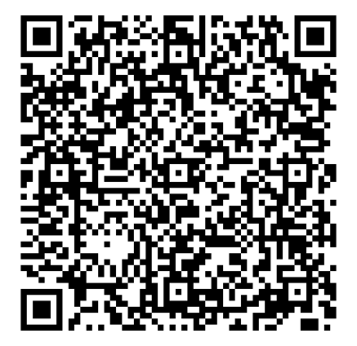
cynthia.kernahan@uwrf.edu questions, resources, comments

