Slide 1
Universities of Wisconsin Updates
Wisconsin Area College Counseling Conference
John Achter, Ph.D.
Sr. Director for Student Success & Wellbeing
4/17/2026
Notes:
How many non-UW people in the audience? While my presentation will be UW-focused, I hope you can take something away for your context.
You do noble work. You help students in their times of greatest struggle, help them become their best selves, and this helps them persist and graduate.
I’m glad you are able to take the time to be at this conference, which as a long history dating to the 1970s, I believe, if you can believe that!
Your work has gained much more attention to mental health needs of students in the last few decades. This has mostly been good—counseling centers have grown in staff, recognition, and respect. I started in the field in the 90s and I can attest to this.
Another positive, in my opinion as resources have grown and needs continue to increase (although leveling out recently), conversation has turned to looking upstream. . . Toward building cultures of care, building skills, and encouraging connection—in addition to important referral, crisis response, and treatment mechanisms.
This has also increased scrutiny, to which you have responded well by studying and reporting on your work. I have now been working at Universities of Wisconsin in this position since 2020, and it would not have happened without this prior work and response to trends. I want to begin by acknowledging that history and sharing that I’m honored and humbled to be doing this work.

Slide 2
Overview
Systemwide News and Initiatives
Ongoing Behavioral Health Activity
Mental Health and Wellbeing Advisory Committee
Future Funding
Closing Reflections

Slide 3
Systemwide News and Initiatives
System president transition
State budget and Core General Education Requirements (CGER)
DEIB
Direct Admit WI
Title II ADA – Digital Accessibility
University Budgets
2027-29 Biennial Budget – student success-related considerations
  Tuition Promise
  Wrap-around services (advising, basic needs, etc.)
  Fostering Success
  GI Bill funding
  Mental Health

Slide 4
Ongoing Behavioral Health Activity

Slide 5
A Public Health Approach to Well-Being
Universal Prevention/Mental Health Promotion
Building connection and skills to enhance well-being for all students
Early Intervention
Identification and resources for at risk students
Treatment & Crisis Response
Notes:
From the start the Behavioral Health Initiative recognized that a public health approach to mental health was needed. Driven by large increases in students seeking services, people recognized that we had to beef up clinical services, while also looking upstream.
When thinking about system support for mental health, the focus is on doing the most good for the most students—to elevate the MH and wellbeing of as many students as possible—and the campus community
These efforts both support campus-based efforts, and fill gaps and/or add capacity for campus services
In the future, we hope to continue to supporting cultures of care, enhancing opportunities for positive connection, and building skills for students, and also addressing the wellbeing needs of staff and faculty

Slide 6
Ongoing Behavioral Health Activity
State funding for virtual mental health services (Mantra Health contract)
  Maintained: counseling, psychiatry, 24/7 phone support
  Added:
    Self-help and coaching for emotional wellness and productivity
    On-demand texting and video support
    Peer support through Togetherall
  Lost: YOU at College (continued at 3 UWs)
Recognize, Respond Refer suicide prevention training
Shared Projects Coordinator

Slide 7
Ongoing Behavioral Health Activity (cont’d)
MIEA Training
Healthy Minds Program App course integration
Counseling Impact Assessment Report
BIT/CARE/TAT Training
Basic Needs
  250 In-person and 100 Virtual attendees
2026-27
  New person in my position
  Healthy Minds Study or NCHA survey
  Culturally Responsive Approaches Training (TBD)

Slide 8
Mental Health & Well-being Advisory Committee
2+ members from each UW
Chaired by a counseling director and dean of students
Areas represented:
Counseling | Health | Health Promotion
Dean of Students/Conduct | Disability/Accessibility | Advising
Diversity/Inclusion | Res. Life/Dining | Student Involvement
Violence Prevention | AoD Prevention | Recreation
Admissions | Faculty | Veterans
Police | Athletics
Notes:
Counseling centers represented by Riley McGrath, Randy Barker, and Teresa Miller
In a word, the committee exists to review and provide feedback on initiatives that support student mental health and wellbeing.

Slide 9
Mental Health & Well-being Advisory Committee
Three Priorities
Healthy Minds App in the Classroom
  Propose expanding to all UWs
Service Needs and Gaps
  Propose administration of Healthy Minds Study survey
Faculty/staff resources for helping students
  Propose sustained support for Recognize, Respond, Refer
Notes:
This committee will live on and these subcommittees will evolve to meet current needs

Slide 10
The Case for Future Funding

Slide 11
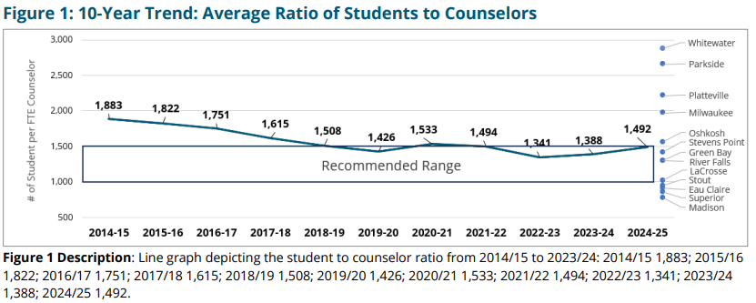
Ratio of Students to Counselors
Source: UW Counseling Impact Assessment Annual Reports 2014-15 to 2024-25
Notes:
Since Counseling Centers started collecting and reporting data, we have seen significant gains in staffing—completely funded by campus resources (largely seg. fees)
This growth represents an increase of 27 FTE across the system, 20 if you exclude UW-Madison

Slide 12
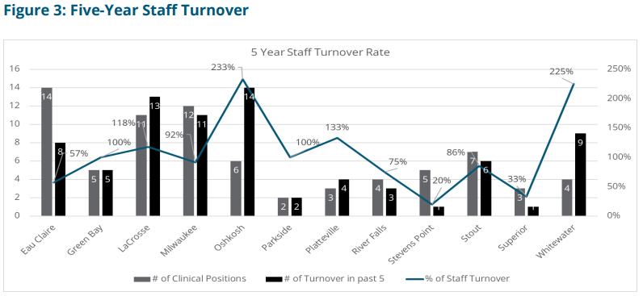
Five-Year Staff Turnover Rate
Source: UW Counseling Impact Assessment Annual Report 2024-25
Notes:
Average center turnover of over 100%
Alarming turnover trends among UWs and Nationwide. Slowing a bit last year but still at high levels historically

Slide 13
Salary Discrepancies
Average Annual Salaries for University Counselors and Psychologists
 | Starting Salary Averages¹ |  | Overall Salary Averages
Position | UW | National | UW | National
Clinical Counselor | $60,122 | $73,893 | $68,500 | $73,893
Clinical Counselor in training (LPC-IT, APSW, LMFT-IT) | $57,944 | NA | $61,474 | NA
Psychologist | $75,000 | $86,660 | $79,379 | $90,980
Source: UW Counseling Impact Assessment Annual Report, 2024-25

Slide 14
Reflections from a 30-year career
The work is critically important
Continue to distinguish yourselves
Continue to evolve and innovate
Maintain hope
Notes:
I’m leaving; it is time for someone else to come in and bring fresh ideas. Please embrace and support them
It has been a privilege to do this work. It has provided meaning and purpose, and I know lives have been changed—from individual clients, to populations of students
Importance of the work
Practicum in 1993; “mental health needs are rising; more students are seeking services”
This was over 30 years ago, and the story has been consistent in every decade since
From short-term clients with adjustment issues to longer-term clients with complex trauma—you make a difference
From clients with safety risk to campus crisis response. You make a difference.
In training new professionals for the field—you make a HUGE difference
In setting the tone to create a campus culture of care, you make a difference and your voice is critical.
Need to distinguish selves
Counseling center work and talk of mental health was much less in the spotlight when I started in the field. There were benefits to this. . . If we wanted to, we could sort of hide under the radar and do our thing, helping students in the ways we were trained to do.
As times and needs changed, mental health was thrust into center stage. This has come with benefits too—of attention, increased resources, and respect. We continue to ride a wave of mental health being elevated in importance;
The attention has also come with challenges, especially with an increase in expectations from clients, staff and faculty, and parents.
Centers have had to evolve—often in creative ways to manage rising need. Sometimes the evolutions were voluntary; oftentimes they felt forced.
There was no behavioral health initiative until 6 years ago. There was no position like mine to elevate mental health and wellbeing at the system level
We need to continue to nurture this so that the needs of students continue to be center stage. To do this. . .
Need to evolve and innovate
Higher education is changing. Counseling center work has also changed significantly, as we all are experiencing. Both will continue to do so.
If we want to stay relevant, and be seen as the mental health experts on campus that we are, we have to adapt, include others, and get outside of our four walls.
There are many places you can just be a therapist—but that is rarely the case anymore in higher education.
Population statistics remain clear—a significant portion of our populations experience levels of distress that would benefit from mental health intervention—more than you are currently or ever could treat. It is OK to embrace that fact.
In fact, this is one thing that always interested me in doing this work, in this environment. The range of resources available to students that can contribute to their mental health, well-being, and personal growth—and the concentration of intelligent, committed people who care, is unmatched in any other stage of life. These are our partners with whom we can genuinely build cultures of care. Many of you are doing that and I applaud you
More people getting involved means more complexity—that has never been more true for me than in my present role, working with 13 campuses and seeking common ground. But it also means more buy-in and richness in strategies.
Internally, continue to consider things that put you where students are, like Let’s Talk; peer education, or peer counseling
Continue to consider briefer interventions, which is what the the majority of clients seek anyway—I call this the dirty little secret in counseling center data--that the modal number of sessions a client attends as one.
The theme of this conference is timely in this regard. Find creative ways to embrace this, from adjusting intake models, to setting up single session care; to flipping your model to flexible care (find out more from Will Meek)
Externally, be in the spaces where others are considering strategies to make their classrooms, residence halls, athletic teams, etc. places that balance high expectations with support and care. You know what leads to positive mental health and others can benefit from this knowledge.
Maintain hope
Focus on what brought you to this work. . . And savor it; It really is a privilege to do this work. To participate in this stage of students’ lives when so much lies ahead. Really focus on why it matters. When the external motivation of salary isn’t there, other things need to keep you going.
Keep working on salary equity. . . And, also, don’t forget there are deferred benefits for sticking around—I can retire early because of a sick-leave conversion benefit that pays for healthcare—how many of you even know about that? Talk to HR and explore your LT benefits. Look at your annual statement of benefits and see that total compensation is more than your take-home pay, and continues to be better than outside of higher education. All of this really does translate to dollars and cents.

Slide 15
“May your choices reflect your hopes, not your fears.“
-Nelson Mandela

Slide 16
QUESTIONS & DISCUSSION

Slide 17
WWAACCCCCC
Unwind + connect at
camp
april 21 - 23, 2027
green lake hotel and conference center

