Slide 1
Budget Update
President’s Advisory Committee on
Mental Health & Well-Being
May 8, 2026

Slide 2
Service Needs and Gaps
Budget Item | Amount ($) | One-time or Recurring?
Healthy Minds Survey | $55,700/$65,300 | One Time
Total FY27 Request | $55,700/$65,300

Slide 3
Faculty & Staff Training
Budget Item | Amount ($) | One-time or Recurring?
Primary Recommendation: Sustainability + Growth/Enhancements of Recognize, Respond, Refer $88,320 (full-time role focused on RRR) + $10,000 program enhancements (video development, alternative/accessible formats, translation services) | $98,320 | Recurring, annual cost
Second Choice: Sustainability of Recognize, Respond, Refer $52,992 (60% role focused on RRR) | $52,992
Total FY27 Request | $ 98,320 / year | Requesting a 3-year commitment to allow for stability and growth

Slide 4
Healthy Minds in the Classroom
Budget Item | Amount ($) | One-time or Recurring?
Marketing to faculty and staff to encourage adoption | $500 | One-time
Subsidize app cost to keep free to students | $15,000 | Recurring
Support LTI creation for Canvas integration with Humin | $33,250 | One-time
Stipends to incentivize faculty adoption & data collection | $5,000 | Recurring
Total FY27 Request | $53,750

Slide 5
Expanding Healthy Minds App Use at UW
PACMHW Subcommittee on HMP in the Classroom
Spring 2026 Report

Slide 6
Subcommittee Members
John Achter, UW-Admin
Randy Barker, UW-Superior (co-chair)
Issy Beach, UW-La Crosse
Stacey Duellman, UW-Stevens Point
Amber Handy, UW-Parkside (co-chair)
Aaron Hobson, UW-Madison
Sarah Jakupciak, UW-River Falls
Kim Lebard-Rankila, UW-Superior
Amy Lloyd, UW-River Falls
Jennifer Meuhlenkamp, UW-Eau Claire
Jo Solverson, UW- Whitewater
Lily Ray, UW-Parkside

Slide 7
Updates and Accomplishments
Advantage of pilot already in place
Five (or more) committee meetings
Comprehensive resource site in Teams for instructors
15-week and 8-week app versions used both in-person and online
Discussed co-curricular opportunities and launched one
Submitted budget request
Began work on faculty/staff advertising campaign
Humin: HMI’s new name and brand (humin.org) but same app name Healthy Minds Program

Slide 8
Courses Using the Healthy Minds App per Semester Across UW
* Number of unique courses/programs, some of which have multiple sections using the app
**Student count for Spring 2026 not yet official, likely higher
Semester | No. of Courses* | No. of Campuses | No. of Students
Fall 2024 | 3 | 3 | 494
Spring 2025 | 3 | 2 | 522
Fall 2025 | 12 | 6 | 827
Spring 2026 | 8 | 5 | 688**

Slide 9
App Usage Across the State
Campuses Using the App
Campuses Not Using the App
UW-Eau Claire
UW-Milwaukee
UW-Parkside
UW-Stevens Point
UW-Stout
UW-Superior
UW-Whitewater*
UW-Green Bay
UW-La Crosse
UW-Madison
UW-Oshkosh
UW-Platteville
UW-River Falls
UW-Whitewater since FA24

Slide 10
14 Courses and Programs Using the App
HWF 100: Intro to Health, Wellness, and Fitness
HSW 102: The Healthy American
HHP 102: Foundations of Wellness
UWP 112: Human Flourishing & College Success
PE 120: Self-Paced Personal Fitness
HSW 131: High-Level Wellness and You
PE 160: Intro to Mindfulness
HLTH 270: Lifetime Wellness
ENGL 272: Perspectives in Popular Texts
ITS 201: Intro to Integrated Studies Seminar
HWF 370: Personal and Group Exercise: Theory and Methods
SOC WRK 410: Social Work Practice II
COUNSED 718: Principles of Counseling
Nursing Scholars Program UWM (co-curricular)

Slide 11
Instructor and Student Highlights
6 instructor reports on 1/7/26 were universally positive across campuses, experience with the app, course modality, student types, and use of 8- vs 15-week versions.
Student response pulled from Humin’s pre/post surveys and from instructor course evaluations is largely positive. Initially dubious students report finding benefit over time, several report signing up for free app to keep going.
One “course” was a first-gen nursing scholars support group, not a credit-bearing course, marking the first co-curricular use in UW.

Slide 12
Challenges Reported by Instructors
Enrolling students in the student-facing app vs. public app continues to be a challenge, but improving
Timely and easy access to student engagement reports on a weekly basis has some hiccups, but plans to improve it have been made pending funding
Correctly tracking student enrollment vs. student app use: students who do not sign up for or complete the app often do not complete other course work

Slide 13
Obstacles for Further Rollout
Accessibility
Humin has responded, plans in process to meet extended federal deadline
First-year seminars and Act 15 effect
Promising areas: Health and Wellness GenEds, Intro to Major courses, targeting departments with high need for practitioner self-care (e.g. nursing, social work, theater, etc.)
Reaching more campuses and courses/subject areas
Skepticism of some faculty about the program
Still takes more effort to implement than ideal, plans in place to improve pending budget
Budget
Expect cost of $15 per student starting Fall 2026 when initial waiver runs out
Fall 2025 would have cost students $12,450
Also need funding for further marketing, faculty training and/or incentives, better Canvas integration, and more research into outcomes for students to show impact on our population

Slide 14
Budget Requested
Budget Item | Amount
1. Marketing to faculty & staff to encourage adoption (website & digital fliers) | $500 (one-time) Thanks, John!!
2. Subsidize app cost to keep free for students | $15,000 (recurring)
3. Support LTI creation for Canvas integration with HUMIN | $33,250 (one-time)
4. Stipends to incentivize faculty adoption & data collection | $5,000 (recurring)
Total FY27 Request | $53,750 $53,250

Slide 15
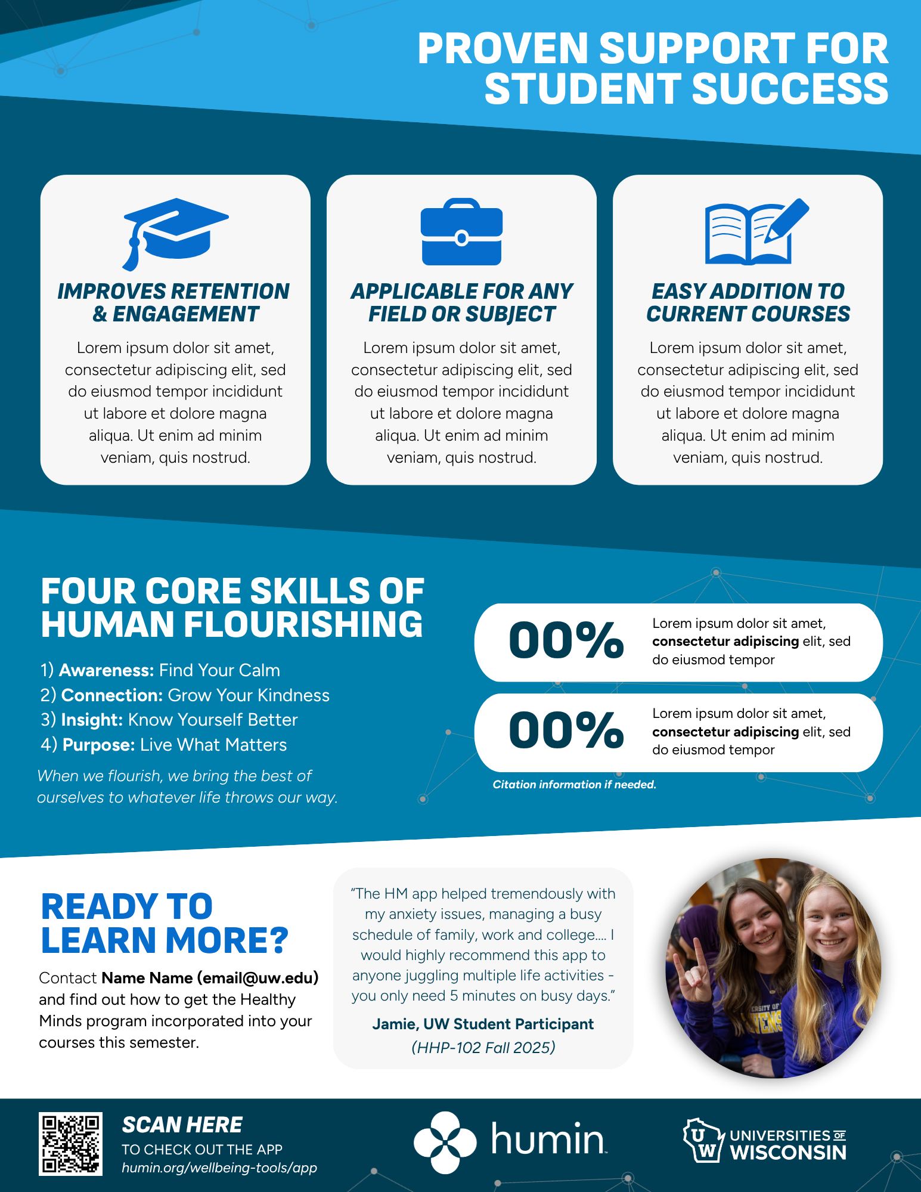

Help Us with Flier Design

Slide 16
Potential Flier Audiences
General instructors
Skeptical instructors (include more research evidence)
Co-curricular staff
Who else are we missing?
Many thanks to Lindsey Lecus for her excellent and speedy graphic design skills!

Slide 17
Next Steps
Marketing:
Finalize set of one-pagers
Website for deeper dive (research, examples, how-to, etc.)
Video of testimonials from instructors and students
Gather and share faculty and student testimonials (in process)
Training/professional development opportunities
Canvas integration through Humin (budget dependent)
Explore possible research opportunities
Recruiting and ongoing integration on as many campuses as possible

Slide 18
Questions?

Slide 19
Addressing Service Gaps​

Slide 20
Sub-committee Charge
Strategic identification of mental health service needs and gaps for students.​
Notes:
Jen

Slide 21
Committee Members
Name​ | Title​ | University​
Andrew Ives​ | Director of the Disability Resource Center​ | UW-La Crosse​
Byron Adams​ | Executive Director, Center for Student Success & Belonging​ | UW-Oshkosh​
Greg Tremelling​ | Non-Traditional and Veteran Student Coordinator​ | UW-Platteville​
Helen Luce​ | Director Student Health Service​ | UW-Stevens Point​
Jennifer Bird​ | Associate Dean of Students​ | UW-Superior​
Rebecca Freer​ | Assoc. Dean of Students​ | UW-Milwaukee​
Riley McGrath​ | Director of Counseling Services ​ | UW-Eau Claire​
Ryan Callahan​ | Assistant Chancellor and Director of Athletics ​ | UW-Whitewater​
Kaeden Conway​ | Student Rep, Psychology Major​ | UW-Stout​
Notes:
Jen

Slide 22
Timeline of Meetings
September 9, 2025​
October 21, 2025​
November 10, 2025​
December 9, 2025​
January 9, 2026 – Full President's Advisory Committee meeting​
February 13, 2026​
March 13, 2026​
April 20, 2026​
Notes:
Jen

Slide 23
Our proposal: Healthy Minds Surveys​
The HMS would not replace the NCHA survey but would be offered on rotating years. ​
Using validated measures, HMN’s survey research provides a detailed look at the prevalence of mental health outcomes, knowledge and attitudes about mental health and service utilization. HMS emphasizes understanding help-seeking behavior, examining stigma, knowledge, and other potential barriers to mental health service utilization.​
The goal is for HMS data to be used to inform policy and practice at our institutions. HM data can be used to:
Assess need for programs and services
Advocate for mental health services and programs on campus​
Evaluate existing programs
Raise awareness of mental health and campus resources​
Strengthen grant applications
Make comparisons with peer institutions​
Notes:
Riley

Slide 24
Our proposal: Healthy Minds Surveys​
Survey Structure​
The Healthy Minds Study consists of three core modules, which are included in all survey administrations:​
Demographics​
Mental Health Status​
Mental Health Survey Utilization/Help-Seeking​
HMS has available a wide variety of elective modules as well. The availability of these modules will depend on the size of school and cohort participation. Elective modules include.​
Campuses may add up to 10 custom questions to the survey.
Data deliverables are designed to facilitate the translation of mental health research into practice. In order to make the research as useful as possible, the HMN team provides participating institutions with numerous ways to examine their data (initial report, clean data set, customized reports, etc.)
Notes:
Riley

Slide 25
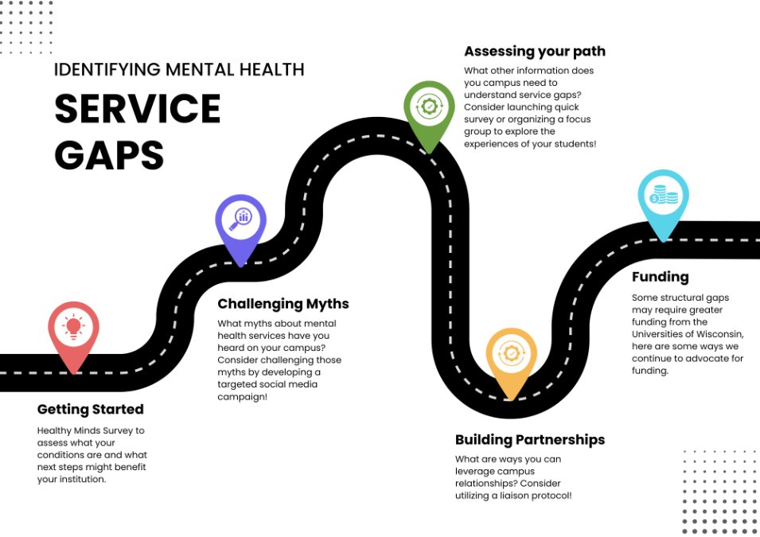
Our proposal:
Service Gaps Road Map
Notes:
Jen

Slide 26
Our proposal: Tools and Resources
Focus Group Tool​
This is a tool to use as a starting point. It could be used by various offices to help gather information they are seeking. The examples listed below are flexible and can be modified to meet your needs.​
Redirection of Funding Tips ​
This tool provides ideas and tips for considering redirection of funding to increase support for professional mental health services available to students at the institutional level ​
FAQ Sheets ​
One regarding make-up of counseling center staff and one regarding make-up of students served by the center​
Uses: These can be modified to fit your campus needs. Use them as a way to collect and present information an easily readable format to be shared with key stakeholders as well as counseling center staff. ​
Quick Polls​
This is a tool to assist you in gathering information. There are different ways in which this could be utilized. Consider what will work best for your campus. This is not intended to replace other more robust tools such as the NCHA assessment. ​
Notes:
Kaeden/Jen

Slide 27
Next Steps
Pending budget approval, develop plan for disseminating Healthy Minds Survey​
If not approved, continue plan to disseminate tools and means to identify gaps in mental health services​
Collaborate to develop resource library so tools can be accessed by any UW employee​
Feedback on any of the tools or any needed resources can be emailed to Jen Bird jbird2@uwsuper.edu or Andrew Ives ​aives@uwlax.edu
Notes:
Jen

Slide 28
Questions?

Slide 29
Lunch Break
12:30-1:15 PM
Notes:
Val

Slide 30
Faculty/Staff Training & Resources: Preparation to Support Student Mental Health
Subcommittee Update
May 8, 2026
Notes:
Val

Slide 31
Committee Charge
Develop, deploy, and incentivize the use of a systemwide repository of resources for faculty and staff to support student mental health.​
​Create pathway for intentional, ongoing engagement among faculty/staff across Universities of WI.
Leverage existing resources, training, and expertise.
Goal: Increase faculty and staff preparation and capacity to respond to and support student mental health.
Notes:
Val

Slide 32
Sub-Committee Members​
Name | Title | University
AJ Walker​ | Police Lieutenant​ | UW-Green Bay​
Anna Kopitzke​ | UW MH Shared Projects Coordinator​ | UW-Madison​
Caitlin Henriksen​ | Deputy Title IX Coordinator​ | UW-Green Bay​
Kelly Wenig​ | Director, Advisement Center​ | UW-Stout​
Lori Bokowy​ | Population Health Manager/Emotional Health Promotion Coordinator​ | UW-Milwaukee​
Lori Develice Collins​ | Director of Residence Life & Dining​ | UW-Oshkosh​
Teresa Miller​ | Acting Director, University Counseling Services​ | UW-Platteville​
Val Donovan​ | Assistant Director, Suicide Prevention and Mental Health Promotion​ | UW-Madison​
Kristen Jasperson​ | Project Manager for Student Success Initiatives​ | UW Administration​
Notes:
Val to Anna handoff

Slide 33
Initial Step: Information Gathering
Learn how campuses prepare, train, and support faculty and staff to support student mental health.
Better understand what is working well on campuses, where there are gaps, and how we can improve.​
Share findings, identify themes, and brainstorm opportunities.
Notes:
Anna

Slide 34
Approach and Timeline
Fall 2025 – Over several meetings we developed our strategy for gathering information – identify key stakeholders and questions to ask campuses (SWOT analysis informed)
January 9 – Advisory Committee Meeting
January 15 – Worksheet shared to campus stakeholders​
February 9 - Information gathering completed​
February 24 – Subcommittee reviewed responses, identified themes, developed budget request related to most urgent priorities
February 27 – Budget request submitted
Notes:
Anna

Slide 35
Key Takeaways from Campuses
Goal: Increase faculty and staff preparation and capacity to respond to and support student mental health.
Notes:
Anna

Slide 36
Takeaways overview
UW | # of Respondents
Eau Claire | 5
Green Bay | 3
La Crosse | 5
Madison | 6
Milwaukee | 7
Oshkosh | 2
Parkside | 5
Platteville | 3
River Falls | 2
Stevens Point | 3
Stout | 3
Superior | 5
Whitewater | 4
Total | 53
We received responses from all 13 Universities of Wisconsin.
Notes:
Anna

Slide 37
Takeaways overview
The following responses are not a comprehensive list, nor should they be considered fully representative of a particular UW.
Responses were reviewed, and themes were identified.
Notes:
Anna

Slide 38
Strengths are mainly related to training and communication.​
Training offerings - (100% of campuses)​
Top mentions: online RRR (>75%), employee workshops, MHFA
Referral pathways & consultation (>50%)
Cross-Unit collaboration (>50%)​
Communication channels (>50%)​
Onboarding and orientation (>50%)
Name one item you agree with and one addition to the list.
Notes:
Anna
With a partner, quickly scan the list: name one item you strongly agree with and one addition you think belongs on the slide. Be ready to share one point of agreement or one suggested addition with the larger group.

Slide 39
Challenges & barriers are mainly related to inconsistent or lack of time/resources and lack of training integration.​
Time limitations (100% of campuses)​
Lack of resources for specific populations
Workload + insufficient staffing
Training is not mandatory (>50%)​
Unawareness of resources
Lack of role clarity/Stigma
Name one item you agree with and one addition to the list.
Notes:
Anna
With a partner, quickly scan the list: name one item you strongly agree with and one addition you think belongs on the slide. Be ready to share one point of agreement or one suggested addition with the larger group.

Slide 40
Opportunities include training integration and incentivization, leadership support, and stable staffing.
Make training mandatory (>50%)​
More support from campus leadership & UWSA
Dedicated staff positions
Name one item you agree with and one addition to the list.
Notes:
Anna
With a partner, quickly scan the list: name one item you strongly agree with and one addition you think belongs on the slide. Be ready to share one point of agreement or one suggested addition with the larger group.

Slide 41
What did we learn?
Campuses feel supported by training options – RRR in particular.
Lack of time and heavy workload are barriers to fac/staff accessing resources.​
Lack of funding, insufficient staffing, and training being optional are barriers to broader institutional commitment
Mandating training, support from system/leadership, and are opportunities for improvement.
Notes:
Anna
What rose to the top overall

Slide 42
In response to these findings, the subcommittee recommends:
Confirming funding to sustain, support, and enhance RRR training programs.
Advocacy for training mandates for employees, including auditing roles to determine what level and dose of training are appropriate.
Notes:
Val

Slide 43
Budget Request
Minimum: Annual support for sustainability of RRR on campuses (60% FTE)
+ Additional support for RRR enhancements and other behavioral health initiatives (Healthy Minds app, Healthy Minds Survey, etc.) (100% FTE)
Technical support
Individual campus consultation
Customer service support
Marketing and communications materials
Coordination with UW-Madison
Evaluation plan
Convening stakeholders
In-person training and supplemental resources
Notes:
Val
$98K/year =
7,500 / campus
$0.60 / student
$2.28 / employee

Slide 44
Why?
Infrastructure and support helps campuses overcome some commonly identified barriers to delivering effective prevention training on campuses.
Stability for campus programming and initiatives. Given the success that we have seen expressed by campuses after having 1 year of a dedicated support role, our subcommittee is eager to build on that momentum.
Equitable access to support resources for campuses. Not all campuses have equal needs or similar resources available to effectively deploy training on their campuses.
Facilitate ongoing connection, consultation, and alignment across campuses. This role would create infrastructure to allow for all 13 campuses to communicate and collaborate.
Notes:
Val

Slide 45
Recognize, Respond, Refer Overview
Notes:
Val

Slide 46

Recognize, Respond, Refer (RRR)
Suite of prevention trainings and resources that provide education and guidance about how to intervene with and support students experiencing mental health distress or thoughts of suicide. ​
RRR training programs were developed by the University Health Services Prevention team at the University of Wisconsin-Madison.
Notes:
Val
Live and available on every campus

Slide 47
Recognize, Respond, Refer (RRR)
Customize and deploy RRR trainings across all 13 UWs
Convene representatives from all UWs to collect feedback, consult, and share updates and data.
Develop resources for campus RRR administrators, including training materials, marketing toolkits, evaluation data, and technical resources.​
Support transition of faculty/staff training from Canvas to Workday Learning.
Track enrollment, completions, and evaluation data.
Notes:
Val

Slide 48
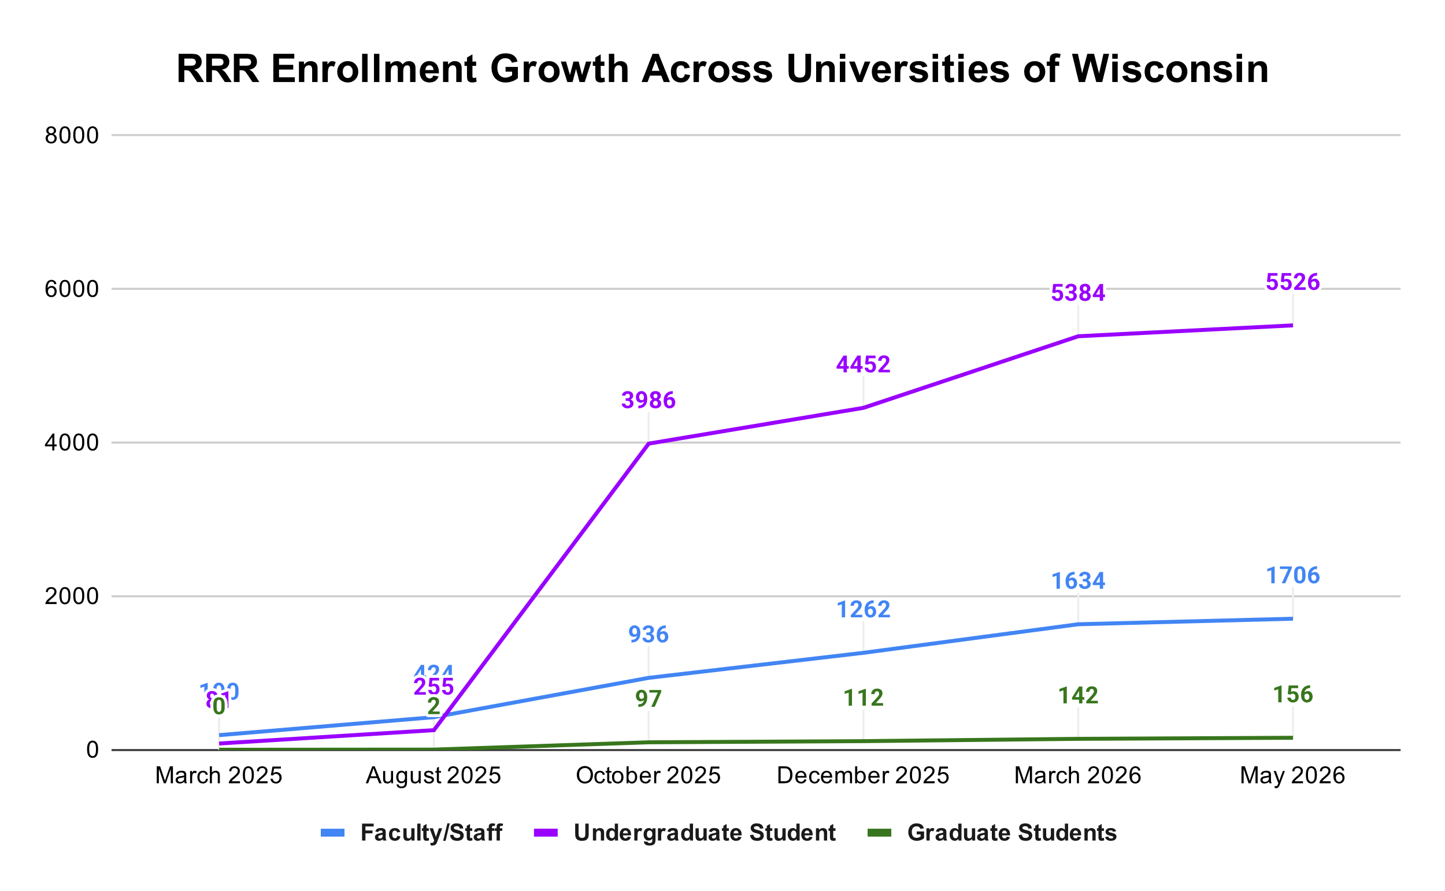
RRR Enrollment Growth Across Universities of Wisconsin
Notes:
Highlights and successes from campuses?
UW Green Bay – first year seminar
UW LaCrosse – first year seminar

Slide 49
RRR Fac/Staff Evaluation Data​
I can name at least 3 suicide warning signs.​
47% increase in agreement for faculty/staff (68% pre / 99% post)​
I am prepared to ask someone directly about their thoughts of suicide.​
54% increase in agreement for faculty/staff (61% pre / 95% post)
I know what mental health and suicide prevention resources are available to students on our campus.
29% increase in agreement for faculty/staff (77% pre / 99% post)
98% would recommend this training to their colleagues.

Slide 50





What can you do to support RRR on your campus?
Take the training yourself!
Onboarding integration / checklists
Annual training and refreshers
Professional development opportunities
Share with faculty/staff and students

Slide 51
Questions?

