Slide 1
E-Reimbursement Per Diem Changes

Slide 2
Lodging
In-State – Maximum rate based on GSA rate for the location (city/county)
Out-of-State – 125% of the GSA rate for the location
International – Federal rates by location established by the Dept. of State/Defense (includes Alaska, Hawaii, US Territories)

Slide 3
Mileage
Only the following three mileage types will be available:
Standard rate - $0.54/mile
Turndown rate - $0.352/mile
Motorcycle rate - $0.51/mile

Slide 4
Meals and Incidentals
Day Trip Meal Allowance - $15.00
Meals and Incidental Per Diem – Use the Federal Per Diem rates by location
75% for first and last days of travel
20% deduction if Breakfast is provided
30% deduction if Lunch is provided
50% deduction if Dinner is provided

Slide 5
Per Diem Meal Notes
You can only claim $15.00 for Day Trip or nothing if any meal was provided.
You cannot claim more than the Per Diem meal rate for the location.
An approver will get an alert bubble if the traveler did not choose the first or last day deduction.
Incidental amount is included in the Per Diem Meal rate

Slide 6
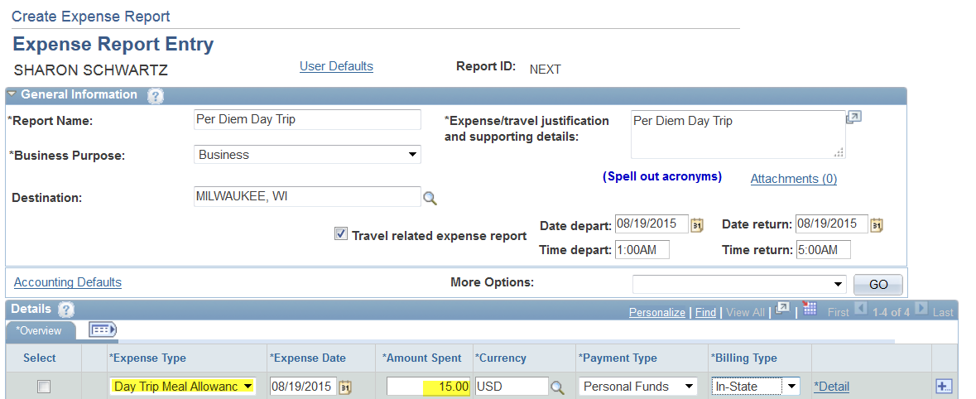
Per Diem Day Trip

Slide 7
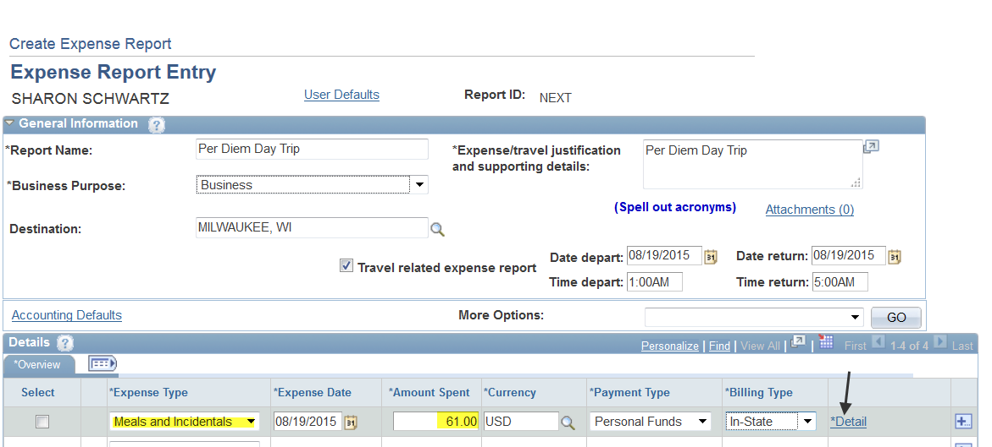
Per Diem Meals
Once you choose Meals and Incidentals Expense type go into the details link for the Per Diem Deductions

Slide 8
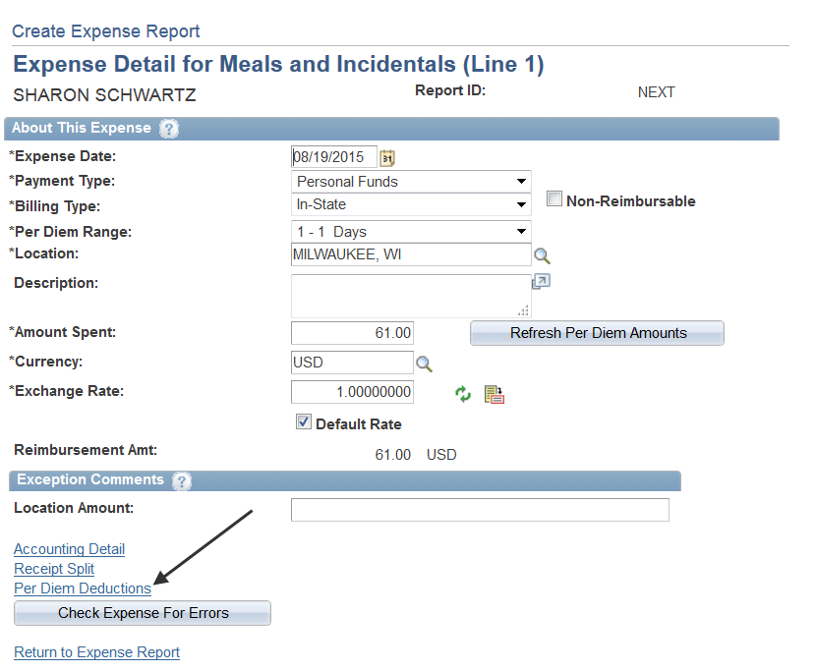
Per Diem Meals Cont.
Choose the Per Diem Deductions link

Slide 9
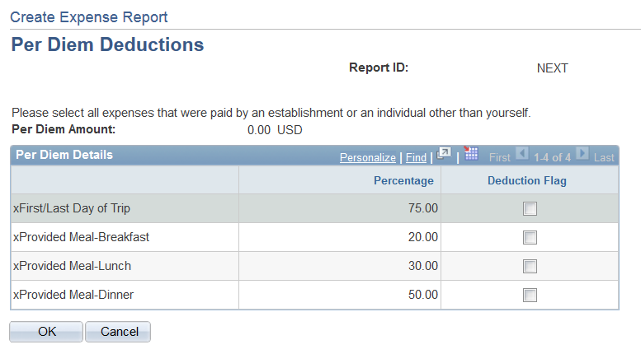
Per Diem Meals Cont.
Choose the appropriate deduction for first/last day or meals provided

Slide 10
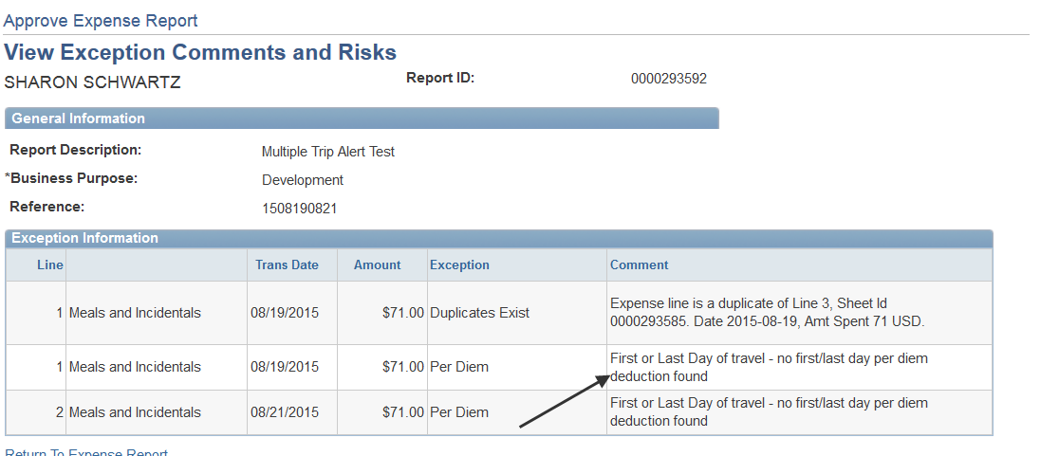
Approver Alert for First/Last Day

Slide 11
Corporate Card/Travel Card
We will still load the US Bank Corporate Card Meal charges
The line in your wallet will be greyed out so it cannot be imported into the Expense Report for only Meal charges since the amount will not be the appropriate Per Diem allowable amount.
There is also the option to not use their Corporate Card/Travel Card for meal expenses

Slide 12
Miscellaneous Items
Travel Authorizations do not have a Per Diem Deduction tab
If the location is not listed, choose the County rate for that State and Location
Travel Authorizations pulled into an Expense Report may need to have the “Refresh Per Diem Amounts” button clicked to get the most recent Per Diem Amounts. You should click the Refresh button for United States travel and the Travel Authorization was created before October 1st for travel after October 1st and for Foreign travel if created the prior month for travel the following month. United States rates could change annually on October 1st and Foreign rates could change monthly.

Slide 13
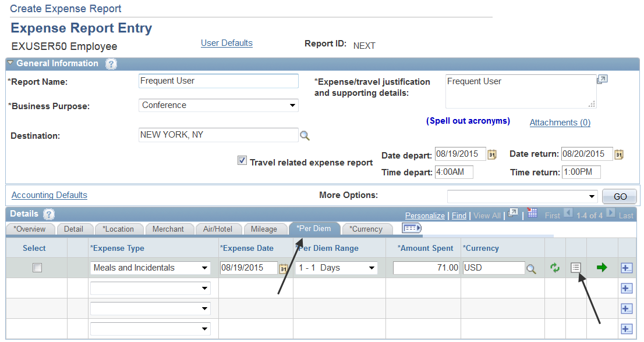
Frequent Traveler View

