Slide 1
University Personnel System (UPS) Overview

Slide 2
Today’s Agenda
What is UPS? How did it come to be?
Why do we need a new personnel system?
What might be different at UWSA vs. other UW institutions once UPS is effective?
Who will be affected by changes under UPS?
What is not going to change under UPS?
Who makes decisions about UPS, and how can we as employees provide our input?
Other questions you have!

Slide 3
What is UPS?
A personnel system effective July 1, 2015
Authorized by Wis. Stat. §36.115
A combination of all UW employment governed by the Board of Regents
A historic opportunity to enhance and improve the way we manage our human resources matters

Slide 4
Legislative Intent of § 36.115, Wisconsin Statutes
Office of State Employment Relations
University of Wisconsin
State Agency Employees (DOA, DNR, DOT, etc.)
12,300 UW
Classified
Employees
State Agency Employees (DOA, DNR, DOT, etc.)
12,300 UW
Classified
Employees
40,000 UW Employees
UW-Madison
Balance of the UW System
28,000 Unclassified Employees
Titles
Compensation
Labor Relations
Titles
Compensation
Labor Relations
Titles
Compensation

Slide 5
How Did UPS Evolve?
Development started August 2011
UPS and HR Design (only for UW-Madison)
Current state assessments & workgroups formed to recommend and review changes
Stakeholder feedback at all institutions
December 2012: Board of Regents approved three Regent Policy Documents
Paused July 1, 2013: WI 2013-15 Biennial Budget
April 23, 2014: Joint Committee on Employment Relations (JCOER) approved the implementation of UPS and HRD (UW-Madison)

Slide 6
How Did UPS Evolve?

Slide 7
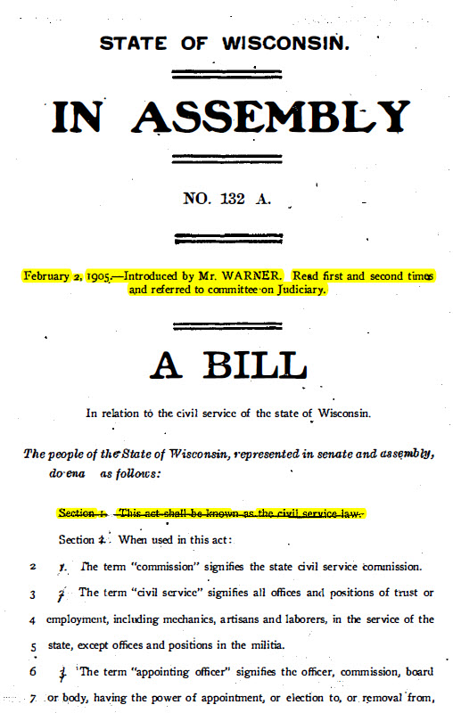
Meritocracy in civil service has a 100+ year history in our state
Wisconsin was the 3rd state to establish a civil service system based on the principle of merit for public employees (NY & MA earlier)

Slide 8
Why Do We Need UPS?
Currently: two systems of employment at UW
Classified and Unclassified (faculty, academic staff, limited appointees)
Difficult to manage personnel with some of the rules we did not make and do not control
Flexibilities sought for years, well before Wis. Stat. § 36.115

Slide 9
Why Do We Need UPS?
Imagine that you own a business, United Widgets Incorporated (UW Inc.).
For most of your employees, you control their employment as normal – you decide how to recruit and hire, how much to pay people and when to give raises, and what to do when they’re not meeting their goals.
For a small group of your employees, another company, Office of Super Employable Folks (OSEF), controls their employment. They get to make a lot of choices about your employees. These are your UW Inc. employees – you provide pay and benefits to them, and you provide workspace and equipment so they can do their jobs.
Nevertheless, OSEF gets to make a lot of decisions about how your employees work for you. They determine how you find and interview potential employees, the job titles your employees get, how much pay they earn, when/whether the employees get a raise, what you do if your employees are having performance problems, and more.

Slide 10
Why Do We Need UPS?
Now imagine that:
You need to hire another widget maker. You’ve been having trouble finding quality candidates for your job, and you think that raising the starting wage may help. If UW Inc. controls the widget-maker job, you can go ahead and offer more money. BUT if the widget-maker jobs are controlled by OSEF, you do not have any flexibility to offer more money to help your recruitment efforts.
What can you do?

Slide 11
Why Do We Need UPS?
Now imagine that:
During a time of transition in the department, duties need to be reassigned temporarily. An employee steps up to perform these additional duties. You would like to provide the employee additional compensation for performing these temporary duties. Since she’s an employee controlled by OSEF, you are not able to adjust her pay.
What will happen?

Slide 12
What UPS is NOT
UPS is NOT:
An end to civil service employment at UW
A source of money
A new computer system
Part of proposed budget (cuts) for UW system
Part of the proposed public authority change
Completed as of July 1, 2015

Slide 13
Who is Affected by UPS?
Faculty, Academic Staff, Limited : little effect
Board of Regents already has the authority
Classified Staff: most affected
Shift away from OSER (compensation plan, titles & classification series, benefits, etc.)
All stakeholders in HR processes – supervisors who recruit & manage, job applicants, employees who seek a new job or pay

Slide 14
What Will Change Under UPS?
Employee Categories
Classified staff will become ‘university staff’ and include all FLSA non-exempt positions. Transition over time.
Classified FLSA exempt staff in permanent status on July 1 will have option to remain university staff or be voluntarily reassigned to academic staff
Progression series remain (e.g, IS Tech Services Professional)
FLSA non-exempt = eligible for overtime ($ or comp time)
FLSA exempt = not eligible for overtime; salaried for ‘total job effort’

Slide 15
Employee Categories
TODAY
UNDER UPS
(AS OF JULY 1, 2015)

Slide 16
What Will Change Under UPS?
Recruitment
Merit selection principles, part of a civil service system
No longer subject to OSER requirements
Grievance Procedure
University staff in permanent status on 6/30/15 will keep right to WERC appeal
Terminations will have Board of Regents as last appeal
Workplace Expectations
Institutions will develop specific policies from broad parameters

Slide 17
What Will Change Under UPS?
Compensation
OSER will not administer UW System compensation plan
Merit-based pay plan with pay flexibility for all employees
Layoff
University Staff layoff decisions by operational area, not entire employing unit
Seniority an important consideration, but not the only one
Paid Leave
Recommending that university staff use vacation from 1st day of employment
- Recommending that catastrophic leave covers all employees in one program

Slide 18
What Will Change Under UPS?
University staff governance and job security
Regent policy has established university staff governance at all UW institutions
University staff ‘permanent’ positions now known as appointments ‘with expectation of continued employment’
A university staff member who does not pass probation may return to previous job but at employer’s discretion
University Staff Temporary Employees (formerly LTEs and Projects)
No longer need to be WI resident
Recommending university staff project employees keep leave banks upon accepting an appointment with an expectation of continued employment

Slide 19
What Will Change at UWSA vs. Other UW Institutions?
Coherent umbrella Operational Policies (OPs) that each institution can adjust to its needs
As a UW institution, UWSA can implement its own policies in some areas
Layoff policy, for example
UW-Madison has HR Design, balance of UW System has UPS

Slide 20
What Will Not Change Under UPS?
Hiring based on merits of the applicant - a civil service system
Adhere to inclusive and equal access to fair, merit-based recruitment and assessment processes based on job-related criteria
UW employees will remain state employees
State group health insurance
WRS & ETF participation

Slide 21
What About Jobs at State Agencies?
Wis. Stat §36.115(6) provides reinstatement privileges for staff holding classified positions on June 30, 2015
Retain privilege of permissive reinstatement as defined in Wis. Stat. § 230.31(1)
For those in permanent status as of June 30, 2015, retain the privilege of having permissive reinstatement to classified positions at state agencies for a period of five years (until July 1, 2020)
For those on probation as of June 30, 2015, will retain the same privilege of having permissive reinstatement to classified positions at state agencies for a period of five years (until July 1, 2020) if they successfully complete the probationary period in the position held on June 30, 2015

Slide 22
What About Accepting a Job at State Agencies?
Accumulated WRS creditable service not affected – credits remain in your account
Accumulated sick leave balances transfer to the new sick leave eligible position with no break in employment
Current vacation earned will transfer to the new vacation eligible position with no break in service

Slide 23
What About Accepting a Job at State Agencies?
Vacation carryover and/or banked leave -new agency will determine if vacation carryover and/or banked leave will be transferred
Continuous service – time worked in a leave-eligible position counts toward continuous service date when moving to a state agency

Slide 24
Who Makes Decisions About UPS?
Project team and topical workgroups
HR staff from around UW system
Propose and review changes and OPs
After July 1, 2015
“Op on Ops” GEN 27
New policies suggested
Feedback solicited from governance and other stakeholder groups
UPS Operational Review Team

Slide 25
Who Makes Decisions About UPS?
Shared Governance groups at all institutions
Best way for all employees to get involved
Change in university staff probation period
UWSA Classified Staff Committee
[name] [email]
[name] [email]
UWSA Academic Staff Committee
[name] [email]

Slide 26
What Doesn’t Need UPS?
Current State Assessment identified things that don’t require UPS
Enhance performance evaluation process
Enhance new employee programs – onboarding
Enhance supervisor education programs
Enhance workplace environment

Slide 27
What Do I Need To Do?
Learn more about UPS policies and changes
Remember: July 1 is just a start for all of us
If you’re classified exempt currently, think about whether Voluntary Reassignment is right for you
It is your choice – you will not be forced to switch
Eventually all classified exempt jobs will become academic staff positions
Consider effects on leave benefits

Slide 28
How Can I Learn More?
UPS website www.wisconsin.edu/personnelsystems
Send an email to [insert email here]
Future information sessions by topic
Recruitment
Compensation
Benefits Changes
Others
Voluntary Reassignment 1-on-1 counseling

Slide 29
Questions?
Email address here

